Slide 1
Open Archiving
@
Virginia Tech
DLRL
Hussein Suleman
http://www.dlib.vt.edu

Slide 2
Why are we involved ?
Networked Digital Library of Theses and Dissertations (NDLTD)
MARIAN Information Retrieval System
Computer Science Teaching Center (CSTC)
PetaPlex
Web Characterization Repository
VT-Imagebase, CDDC, etc.

Slide 3
Alpha Test Collection
VT ETD Collection
  Based at university library
  Accessible through remote OAI interface
  Approximately 3000 records
  Dynamic
NDLTD
  Distributed digital library
  Willingness of participants ?
http://smp2.cc.vt.edu/cgi-bin/hussein/vtetd/OAI1.0

Slide 4
Issues in OAI-Compliancy
Cleaning of data
Rights management and ownership
USMARC, rfc1807 and DC
Resumption tokens
Existing protocols and layering
http://smp2.cc.vt.edu/cgi-bin/hussein/vtetd/OAI1.0

Slide 5
Technical Requirements
Implemented in Perl for flexibility and platform-independence
Original implementation took 3 hours, after a first reading of protocol !
http://smp2.cc.vt.edu/cgi-bin/hussein/vtetd/OAI1.0

Slide 6
Repository Explorer
Need consistency for NDLTD
Online vs Offline
Protocol and XSD testing
Interactive browsing
Automatic test suite
List of demonstration archives
http://purl.org/net/oai_explorer

Slide 7
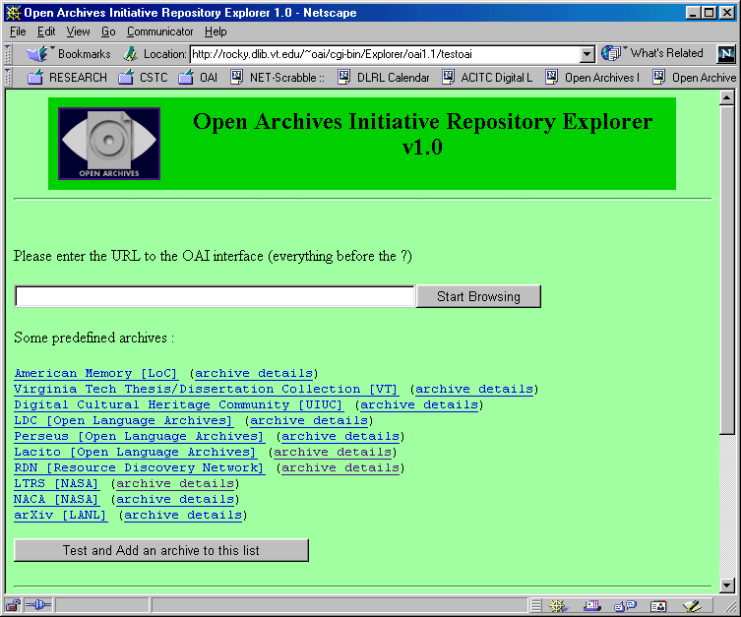
http://purl.org/net/oai_explorer

Slide 8
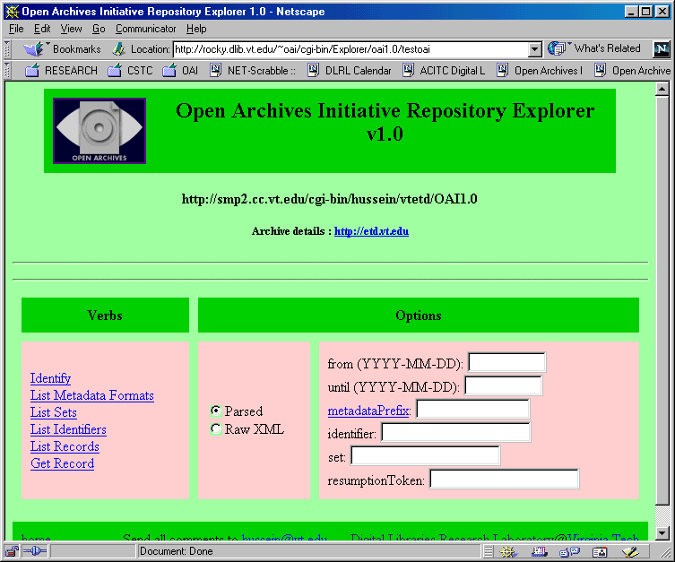
http://purl.org/net/oai_explorer

Slide 9
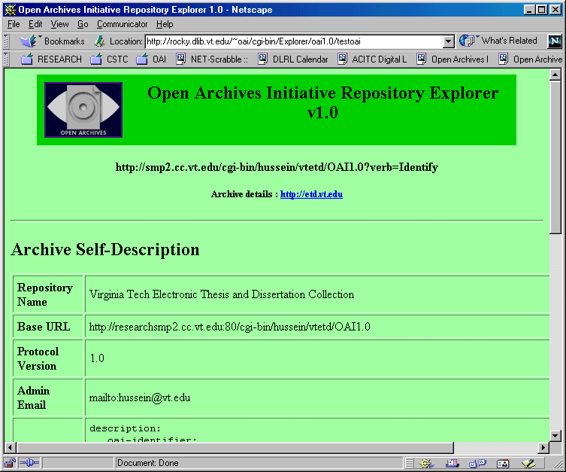
http://purl.org/net/oai_explorer

Slide 10
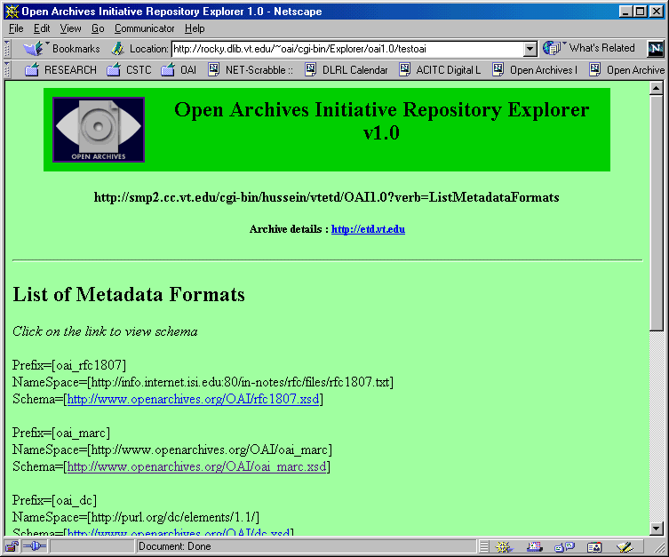
http://purl.org/net/oai_explorer

Slide 11
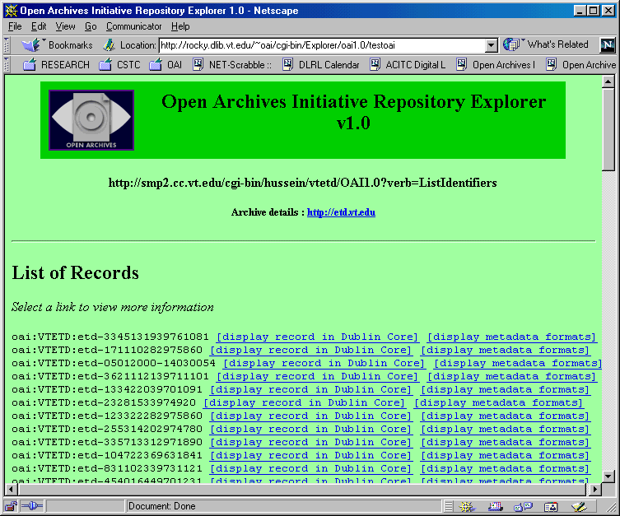
http://purl.org/net/oai_explorer

Slide 12
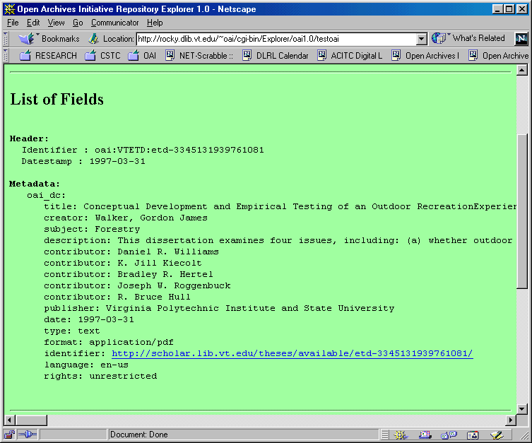
http://purl.org/net/oai_explorer

Slide 13
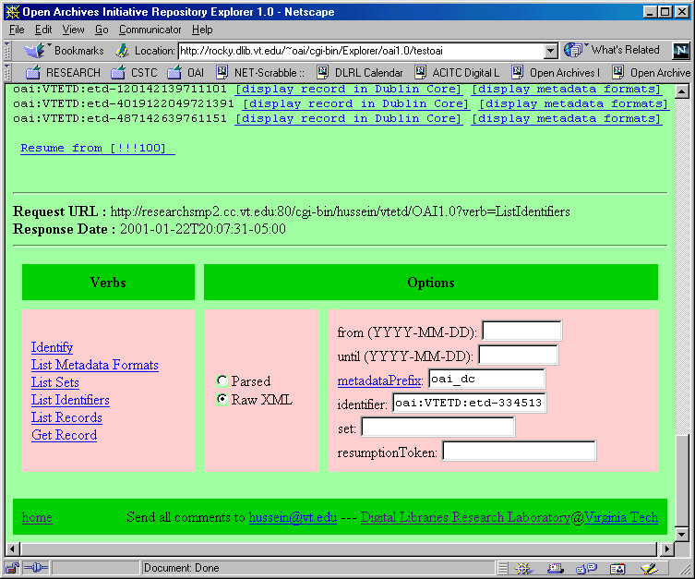
http://purl.org/net/oai_explorer

Slide 14
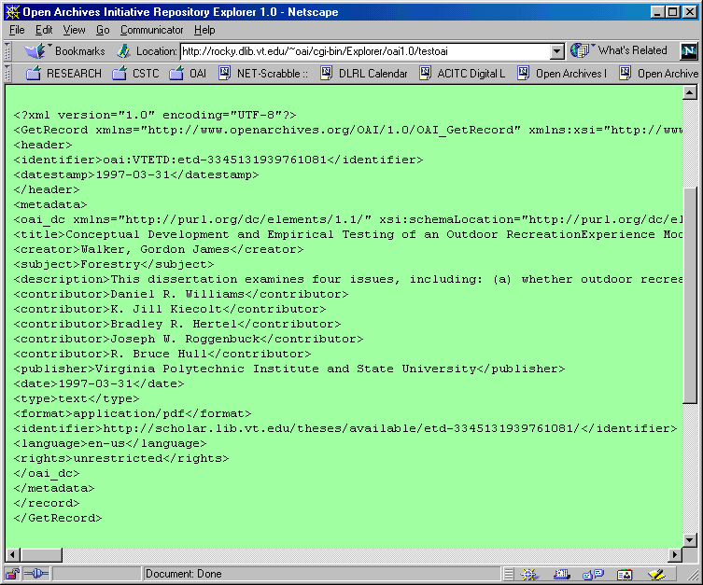
http://purl.org/net/oai_explorer

Slide 15
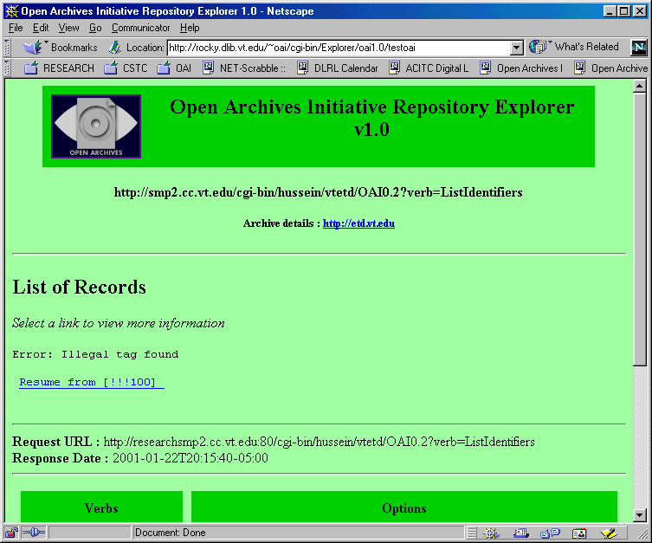
http://purl.org/net/oai_explorer

Slide 16
Ongoing Projects
MARIAN OAI input/output filters
oai_marc definition, encoding and conversion
Perl, JAVA codebase
NDLTD Union Collection
  VTLS
  PhysDis

Slide 17
Ongoing Projects 2
VT Digital Library
  Central digital document archive
CSTC and iLumina
  Distributed DL for educational material

Slide 18
Vision
Lots and lots of little archives all over the world
OAI
International ETD Archive
International Teaching Resources Archive
Etc …

Slide 19
That’s all Folks !
Questions ? Comments ?

