Slide 1
Open Language Archives
Steven Bird, University of Pennsylvania
Gary Simons, SIL International

Slide 2
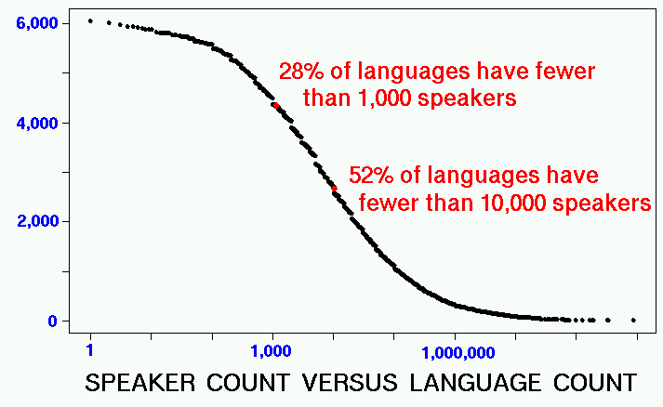
The World’s Languages

Slide 3
Countries with >150 languages
New Guinea: 823
Indonesia: 726
Nigeria: 505
India: 387
Mexico: 288
Cameroon: 279
Australia: 235
Congo (DRC): 218
China (PRC): 201
Brazil: 192
USA: 176
Philippines: 169

Slide 4
Major Language Archives
American Philosophical Society
    Wordlists, texts, manuscripts, audio; 200 languages
National Anthropological Archives
    manuscripts, field-notes, photographs, maps, video
    1,300 recordings of myths, legends, stories, songs
Perseus Project
    >70 million words of Greek, Latin, English, Italian, German
Aboriginal Studies Electronic Data Archive
    texts, dictionaries, grammars and teaching materials
    300 Australian languages

Slide 5
Major European Archives
Germany
  IDS: Institüt für Deutsche Sprache (Mannheim)
  BAS: Bavarian Archive of Speech (Munich)
France
  INALF: Institute National à Langue Français (Paris)
  LACITO: Langues et Cultures à Tradition Orale (Paris)
United Kingdom
  OTA: Oxford Text Archive (Oxford)
Many others …

Slide 6
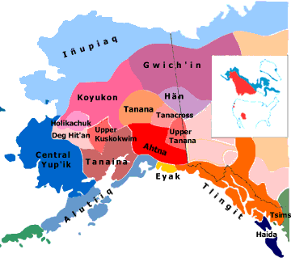
Alaska Native Language Center
Founded in 1972
20 native languages
10,000 documents
  Texts
  Ethnographies
  Place names
  Lexicons
3,000 recordings

Slide 7
An ANLC Record
Title: | Gwich’in Wordlist
Author: | Zimmerman, Herbert
Date: | 1959
Language: | Gwich’in
Format: | Non-digital
Description: | MS, 75pp
Description: | 1400 items based on SIL schedule
RESOURCE TYPE?
LANGUAGE NAME?
AVAILABILITY?

Slide 8
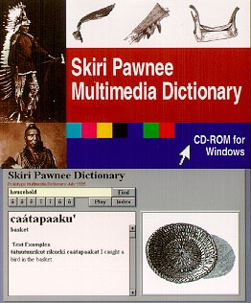
American Indian Studies Research Institute, Indiana
Interactive language lessons for American Indian languages
Multimedia dictionaries
  audio
  photographic images

Slide 9
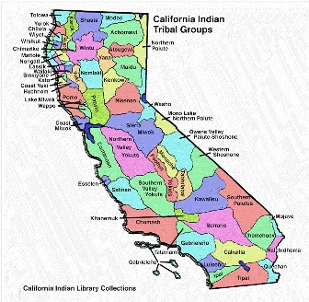
UC Berkeley Survey of Californian Languages
90 languages
Field notes
750 cassettes
Catalog is an HTML document
Typical…

Slide 10
Linguistic Data Consortium
Data for new language technologies:
  ASR, NLP, MT, IR, TREC, MUC, TDT, …
  ~200 CD-ROM publications (largest 82 CDs)
  >1 terabyte of audio data
E.g. SWITCHBOARD Corpus
  2400 transcribed telephone calls
  Distributed on 26 CDs (web is inappropriate)
  Published, ISBN, distribution mechanism

Slide 11
ACL Natural Language Software Repository
Hosted by the German Foundation for AI (DFKI)
Software metadata:
  Authors
  Functionality
  Linguistic datatype (e.g. lexicon)
  File format
  Operating system
  availability
  URL

Slide 12
Resource Types
DATA
  Sound recording
  Shoebox of hand-written index cards
  Descriptive grammar
TOOLS
  Software for creating, storing, querying and viewing language data
  Formats for storage and interchange (e.g. TEI)
ADVICE
  Mailing list archives, FAQs

Slide 13
The Community
Linguists
    >13,000 members of LINGUIST
    Ethnologue >500,000 page hits / month
Engineers
    ~1,000 organizations which buy LDC resources
Language teachers
Archivists
Software developers

Slide 14
Challenges
Endangered languages
  Preserving languages before they die
Endangered data
  Saving old recordings before they disintegrate
Best practices
  Creating new data using XML and Unicode
Finding aids
  Locating resources (mailing lists)

Slide 15
Finding Aids
Goal: “bringing like things together and differentiating among them” (Svenonius)
Traditional databases versus the web
  Metadata is coherent, but highly distributed
We need a middle ground:
  Bottom-up, distributed initiatives
  Consistent, centralized finding aids

Slide 16
Language Archives within the OAI
Specialist communities can define their own metadata format
Service providers can exploit the metadata
Philadelphia Workshop (December 2000)
    linguists, anthropologists, archivists, engineers, funding agencies, publishers
    North America, South America, Europe, Middle-East, Africa, Asia, Australia
    Commitment to implement OAI

Slide 17
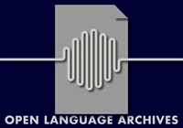
Structure of OLAC
Three groups:
  Advisory board
  Member archives
  Participating data providers
Three phases:
  Alpha test [Dec 2000]
  Pilot [Fall 2001]
  Operational [Fall 2002]

Slide 18

Primary Service Provider
Eastern Michigan Univ
& Wayne State Univ
Funded by NSF
>13,000 members
Complete union catalog

Slide 19
A Community defined by its metadata
OPEN
  Rights.openness
  Format.openness
LANGUAGE
  Encoding scheme: RFC 1766
  Subject.language
ARCHIVES
  Type.data
  Type.functionality

Slide 20
Language Identification
Existing standards (ISO 639, RFC 1766)
  incomplete: 7% coverage
  inconsistent: e.g. Quechua, Bantu (other)
  Undocumented: only gives a name
Issues to be addressed:
  Impossible to create a static inventory
  Multiple names for a language
    E.g. Fedicca, Fadicha, Fedija, Fiadidja, Fiyadikkya

Slide 21

SIL Ethnologue
The only complete language identification scheme openly available on the web
For each of 6,800 languages:
  Language name and variants, 3-letter code
  Population, location
  Linguistic classification
  Dialects, alternative names for dialects
  Notes on language use and available literature

Slide 22
LDC Prototype Service Provider
Harvests data from LDC, ELRA, DFKI
Query for “language=Bulgarian”:
oai:ldc:LDC95T5 | ECI Multilingual Text Lang: Albanian, Bulgarian, Chinese, Czech, … Applications: IR, MT, LM
oai:elra:L0030 | Bulgarian Morphological Dictionary Lang: Bulgarian 67,500 entries, 242 inflectional types, …
oai:dfki:KPML | Grammar development workbench Lang: Spanish, Russian, Japanese, Bulgarian, …

Slide 23
Our Experience with the OAI
Experience of OLAC alpha testers
  Harvesting protocol
  Dublin Core
OAI support
  Specialized metadata
  OAI representative at our meeting (Michael Nelson)
  Solves our problem with cataloging distributed, dynamic resources

Slide 24
Challenges ahead…
Large legacy catalogs
  cleansing and exporting
  hierarchical collections
Overlap with other OAI groups
  e-prints & digital museums
OAI as a springboard
  digitization of legacy data
  formats for access in perpetuity

