Slide 1
University of Illinois at Urbana-Champaign
OAI Alpha Experiences
Timothy W. Cole t-cole3@uiuc.edu
Thomas G. Habing thabing@uiuc.edu
Grainger Engineering Library Information Center
23 January 2001
http://dli.grainger.uiuc.edu/Publications/TWCole/OAIAlpha/

Slide 2
Context & Motivation
Metadata Key to Several UIUC Projects
  DLI / D-Lib Test Suite
  Digital Imaging & Multimedia Technology Initiative
  Archives & Special Collections Finding Aids (EAD)
  Kolb-Proust Archive (TEI)
Builds on Smaller Scale, Domain-Specific Work
  Large Body of Available Metadata
Compliments Local Reference Resolution Work
Increasing Reliance of Academic Libraries on Digital Resources

Slide 3
Metadata Contributed (Alpha Phase)
D-LIB Scientific / Technical Journal Articles
  Articles from AIP & APS publications (~5,500 objects)
  Metadata in XML (RDF, DC, Local Namespaces)
  Implemented Access & Authorization Features
  Added & Updated Metadata Records During Test
Digital Imaging and Media Technology Initiative
  Digital Cultural Heritage Community -- Digitized Images for Elementary Grades Curricula (~500 objects)
  Metadata in Flat Database Structure
Planned Future Additions
  Digitized Historical Aerial Photos of Illinois
  EAD Finding Aids for Manuscript Archive Collections

Slide 4
Computing Environment
MS Windows NT 4.0 Operating System
MS Internet Information Server 4.0
  Active Server Pages (VBScript & JScript)
MS SQL Server 7 and MS Access 97
  D-Lib XML Data Uploaded Using Visual Basic & MSXML Parser / DOM Implementation
Future Plans
  Windows 2000, IIS 5, SQL & Access 2000
  XML Extensions for MS SQL Server

Slide 5
Assumptions / Groundrules
Each Object Member of 1 and Only 1 Set Hierarchy
Flow-Control Exclusively Using resumptionTokens
Non-ASCII Characters May Be Included
  UTF-8 and &#x0000; hexadecimal character references
Not Investigated During Alpha Testing
  Mechanisms to Maintain Server-Side Statefulness
  Redirection Using HTTP Headers
  Status=‘Deleted’ (Attribute of recordType)
  Alternative Metadata Formats (e.g., DCQ or Formats Allowing Embedded Markup from XHTML Namespace)

Slide 6
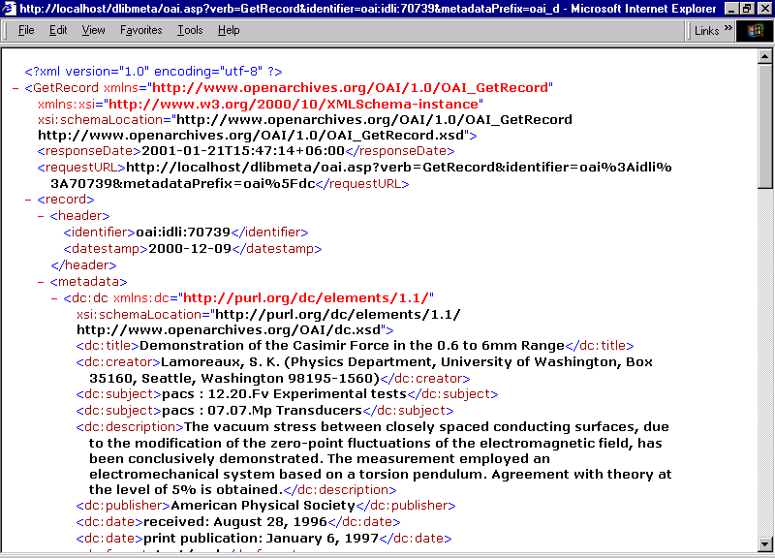

Slide 7
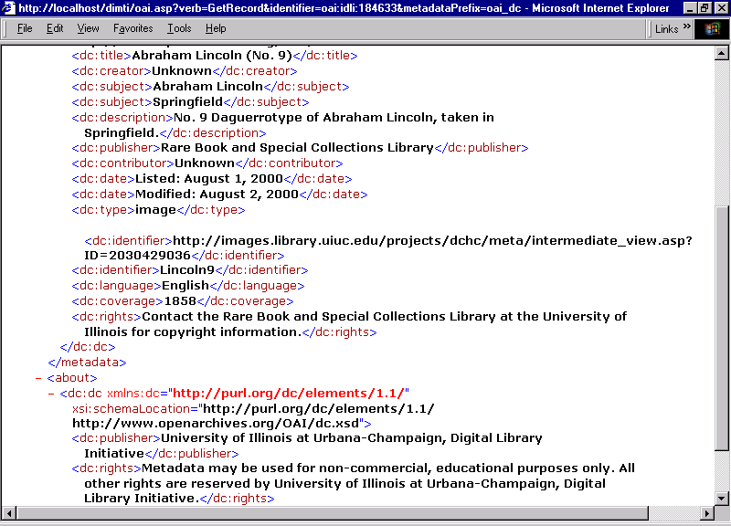

Slide 8
System Architecture
Metadata Maintained in Relational DB
  Root table & secondary tables (e.g., 1 each DC category)
  Additional tables for set descriptions & supported schemas
  Stored Procedures Map DB Fields to Schema Elements
  De-couples Database Schema from Metadata Schema(s)
OAI Responses Built Dynamically
  Use ASP To Query DB & Build Response
  Each OAI Verb becomes a Case Statement
  XML Syntax & Semantics Explicitly Coded in ASP
  HTTP Errors Constructed Using ASP Built-in Objects
  Authentication & Access Controls in global.asa
  Maintained Separate Log Files

Slide 9
Database Schema
About
object_id
date_stamp
sets
1:n
1:n
DC_Creator
object_id
creator
DC_Subject
object_id
subject
scheme
DC_Title
object_id
title

Slide 10
Evaluative Comments
Given Metadata, Minimal Effort to Implement OAI
  1 to 2 Weeks to Design DB & Upload Data
  1 to 2 Weeks to Implement OAI Provider Service
Generic, Modular Technology for Sharing Metadata
  Usable for Both Vertical & Cross-Domain Applications
  Boon to Institutions (like libraries) that Have Multiplicity of Diverse Collections
More Work to Do on Harvest Service Applications
  How Powerful is Search Against LCD Metadata Schema
  Cross-Schema Mapping Issues Still Remain
  Local Linking & Presentation Issues Remain

Slide 11
Possible Future Work
Alternative System Architectures
  E.g., Exploit MS XML Front-End to SQL Server
  Uses XML to Map HTTP-Submitted Query to SQL Query
  SQL Response is Mapped Automatically to XML
  XSL-T Used to Transform Output to OAI Schemas
  Requires ISAPI Filter to Handle Mal-Formed Queries
Turnkey OAI Provider Service Applications
  E.g., Generic ASP with Template MS Access Database
OAI Metadata Brokerage Services
  E.g., Broker Harvests Metadata From Specific Group
  Broker Provider Optimizes for Simultaneous Use
  Source Site Deals with Only Single Harvester

