Slide 1
Technical Exploration Team 3
Members: Tim Cole, Tim DiLauro, Leigh Dodds, Tony Hammond, Ray Plante, Rob Tansley
Focused on sample data models and serializations (primarily serializations) of ReMs

Slide 2
Spectrum of Interoperability
Some of the serializations were quite complex
Less sophisticated/short-staffed organizations need easier mechanisms/tools or some kind of shorthand
Ability to describe even simple relationships could be helpful to value added service providers (Google links, e.g.)
Supporting a range of encoding complexities would allow more collections play.

Slide 3
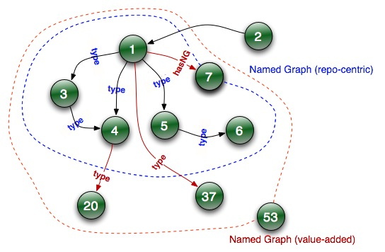
Overlapping Named Graphs
The web graph
Repository-centric
Value-added services …

