Slide 1
OAI-PMH harvester for agricultural knowledge gathering
(Development, testing and implementation)
Francesco Castellani and Stefka Kaloyanova
4 February 2009
Notes:
Open Archive Initiative- Protocol for Metadata Harvesting

Slide 2
Overview
Introduction
The main requirements for OAI-PMH harvester
Selection and rational
Requirements for Data Providers
OAI framework workflow and the six verbs
AGRIS Network and OAI-PMH
Setup of a harvester
Installation
Technical details
Main functions
Management and trouble shooting
Results, summary and conclusions
Next steps
Notes:
Main functions and characteristics of the harvester

Slide 3
Introduction
Main role of a harvester:
To set up a mechanism for automatic gathering of metadata and saving it in a common place (central repository) as a file system or database
Notes:
New tool for organisation of AGRIS harvesting
It is not an user interface but a scheduler. Its success depend on the OAI-PMH plug-in exported data quality.

Slide 4
The main requirements for OAI-PMH harvester
To retrieve and define remote OAI data providers for harvesting ,
To collect data from them according to the rules and requirements of OAI-PMH protocol (usually it is done automatically)
To ensure saving of this data at the central file system or database repository for further indexing and search at the service provider (portal)

Slide 5
Many harvesters available as OSS
Selection (Pro and cons)
  PKP harvester
  OCLC harvester
Evaluation and testing
  PKP harvester
  OCLC harvester
Selection of OCLC harvester and its adaptation to the existing AGRIS flow
Notes:
PKP Additional schemas to be developed as plug-ins
Searchable index of the metadata from Open Archives Initiative (OAI)-compliant archives, such as sites using Open Journal Systems (OJS) or Open Conference Systems (OCS)

Slide 6
The requirements for OAI-PMH Data providers
Exposing data over Internet according to the 6 verbs of OAI-PMH
To allow selective harvesting by date/set
Use of Resumption Tokens for flow control
To ensure a response compression, validation and normalization of the data.

Slide 7
OAI framework
Service provider
Data provider
REPOSITORIES
HARVESTER
OAI-PMH request for selective harvesting:Datestamp,Set
OAI-PMH XML records
SP – operates harvester as means of collecting metadata and provides extended services using harvested metadata
DP – ensures that the Internet accessible institutional repositories expose metadata for their digital objects to harvesters following OAI-PMH rules
The quality of the service is proportional to the quality of the data harvested.

Slide 8
Workflow: database - OAI-PMH-harvester
Service provider
Data provider
Script interaction to database
OAI request
Harvester
ISISOAI
(OAI plug-in/
Java layer)
WWWISIS
or
wxis
CDS/ISIS database
XML response
XML response
Request: http://www4.fao.org:8080/oaiagris/OAIHandler?verb=GetRecord&metadataPrefix=oai_dc&identifier=oai%3Aagris.uruguay%3AUY2006005761
Script: http://www4.fao.org/cgi-bin/oaiagris.exe?database=agris&search_type=query&query=ID=UY2006005761&table=mont&lang=oai&format_name=oaidc
Notes:
In response to a request from a harvester, well-formed XML instance records are returned

Slide 9
OAI-PMH: the six verbs
Verb | Function
Identify | Describes the repository
ListMetadataFormats | Gives all metadata formats supported by this repository
ListSets | Describes the possible subsets defined by repository (semantic or type of doc.)
ListIdentifiers | Lists record identifiers for given set/date-range/metadata format from this repository
ListRecords | Gives all records for given set/date-range/metadata format from this repository
GetRecord | Get a single record by identifier

Slide 10
AGRIS network
Service provider
Service provider OAISter
Data Harvester
Data Harvester
AGRIS Service provider
OAI -DC
AGRIS services
File system
XML repository
OAI DC
OAIcat
OAI AGRIS AP
Data Harvester
FAOBIB
Accessible on Internet
OAI - AGRIS AP
OAIagris
OAIagris
OAIagris
Data agregator hosting metadata (KAINet)
Not on Internet
Local database
Data provider
Repository
KAINet Service provider
Local database
Local database
Data provider
Harvester
Service provider
Notes:
An implementation of OAI harvesting in the AGRIS network

Slide 11
Technical details
Customized Java application on the top of OCLC Harvester2 that provides an OAI-PMH harvester framework
Open Source Software (OSS) ready to be included in the CVS repository
Framework used in this project:
  Hibernate (Object Relation Mapping (ORM) for RDBMS independency), persistence layer
  Quartz (for the scheduling framework)
  Prototype framework AJAX for the Web user interface (mainly used for AGRIS centers information)
  RDBMS (MySQL) database to keep statistics
Notes:
GPL ver 3, license for use

Slide 12
Setup of a harvester
Installation
Register data providers to be harvested
(parameters)
Establish schedule procedure (parameters)
Define output files and where to be saved

Slide 13
Installation:
Installation of Tomcat
Installation of Java
Installation of MySQL
Installation of harvester

Slide 14
Functionalities:
Scheduler
Data Provider
  Add new
  List/ Modify/ Delete
Statistics
  List Data Providers
  Trace Log

Slide 15
Define parameters for each Data Provider
  Activate or Deactivate data provider
  Title *
  Description
  URL *
  Data Provider's Name
  Administrator's E-mail
  Metadata Format *
  Set Specification
  Start Date / YYYY / MM DD
Notes:
URL and getting parameter automatically

Slide 16
Define data providers (DP)
Requires Title and URL to identify DP
Dynamic recognition of the data provider’s parameters using OAI-PMH verb (Identify, Listset, metadataPrefix)
Additional information taken from the AGRIS data providers (mdb file)
  center code (CC), name and acronym
  description of the participating center
  search in AGRIS portal etc.

Slide 17
Parameters for metadata format and subset selection
Available subsets as defined in ListSets OAI-PMH and selection of the one suitable for AGRIS (if not selected the whole database will be harvested)
Available formats for storage from ListMetadataFormats:
  AGRIS AP
  DC
  others

Slide 18
Defining schedule for each data provider
Continuous (runs every N minutes)
Daily (runs every day at a given time)
Weekly (runs every week at a given day and time)
Monthly (runs every month at a given day and time)
Notes:
Schedule when the automatic harvesting procedure should run:

Slide 19
Data storage parameters *
Identify format/type of storage *
File prefix for the data provider *

Slide 20
List of defined data providers
List/Delete or Modify the parameters for a data provider
Trace log for each data provider

Slide 21
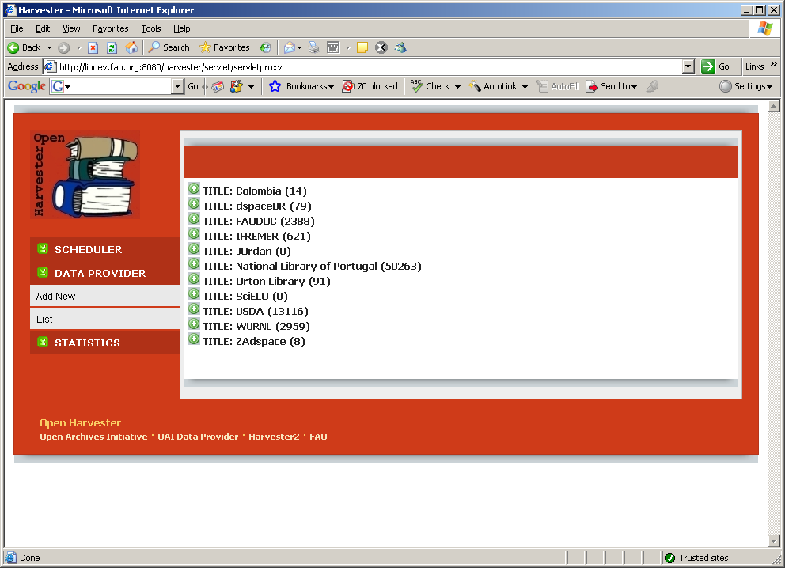
List of Data providers defined for harvesting

Slide 22
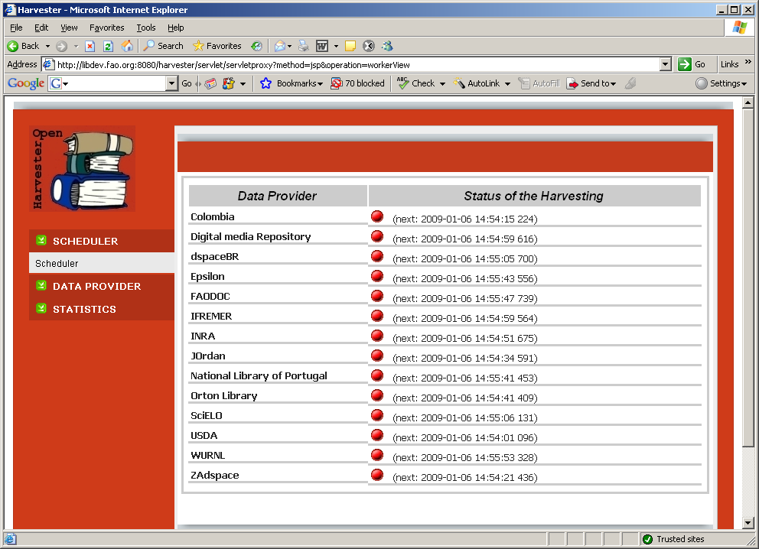

Scheduler /status of the harvesting
As for topic Two

Slide 23
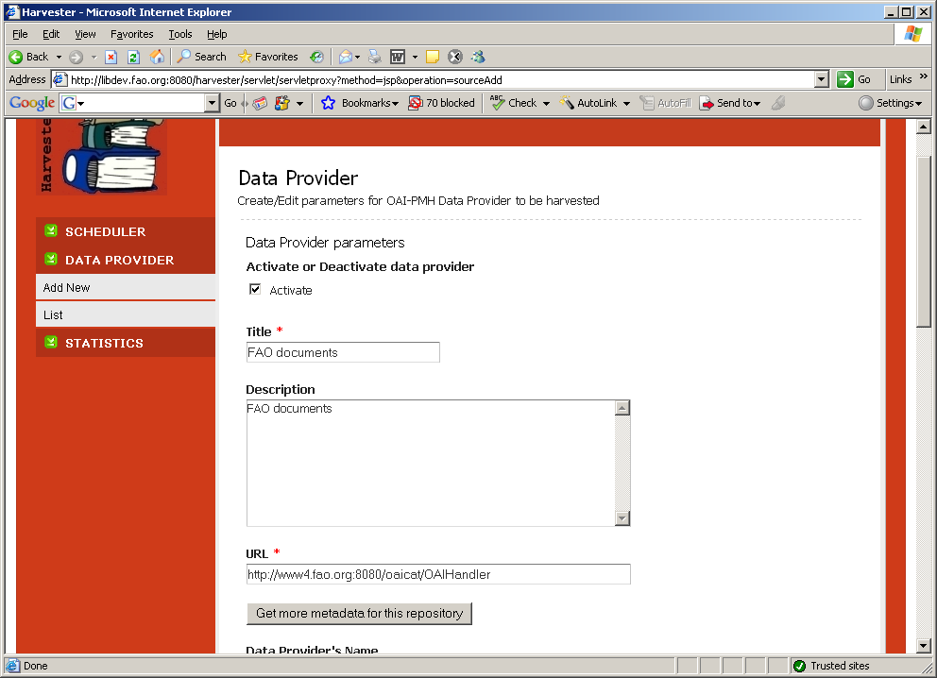
Define a Data Provider for harvesting

Slide 24
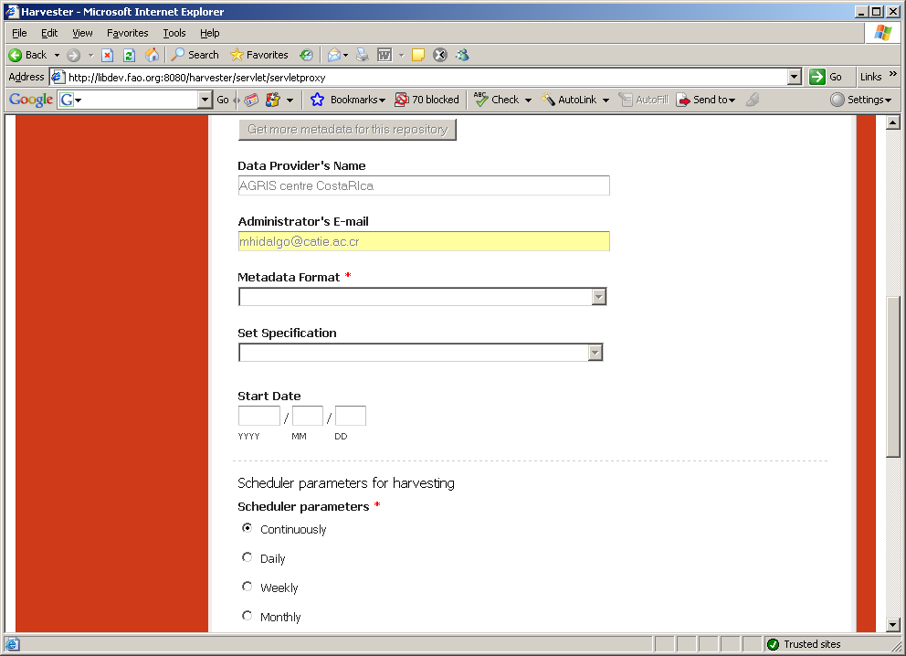
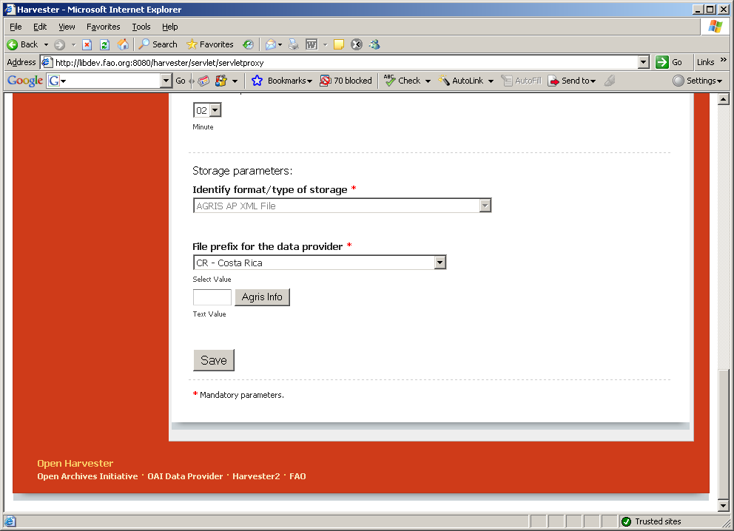

Slide 25
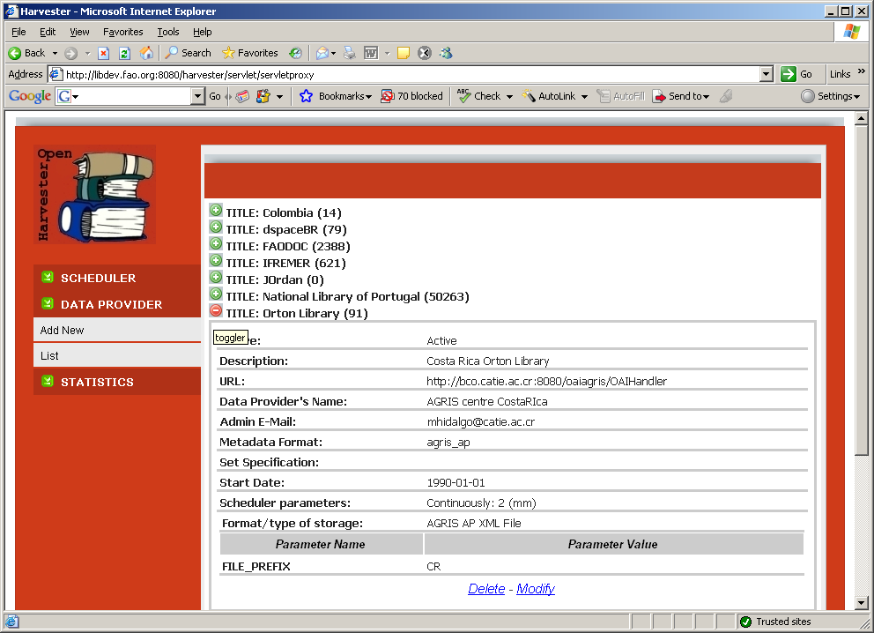
List of Data providers expanded for delete or modify

Slide 26
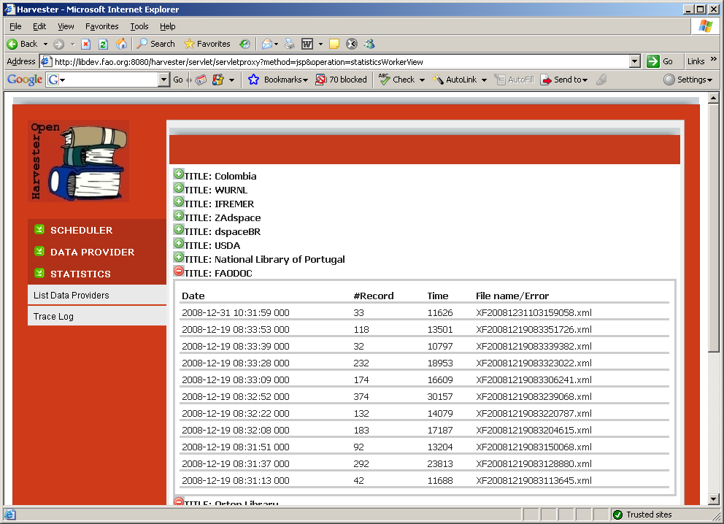
Statistics:Trace log

Slide 27
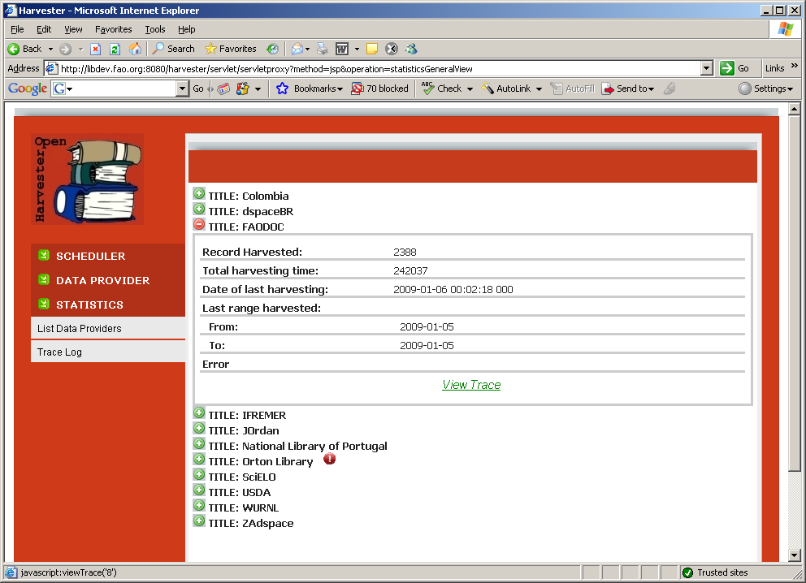
Statistics: Trace log

Slide 28
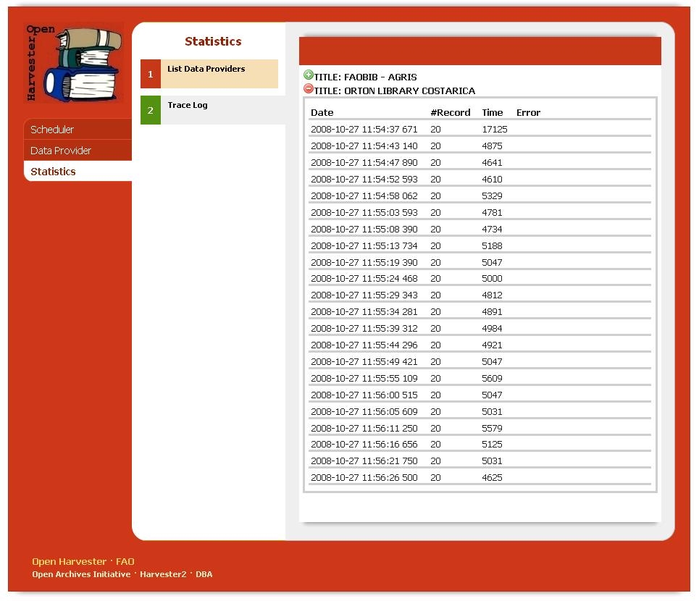
Results from the harvesting/Trace logs

Slide 29
Structure of the result XML files
Ordered by Data provider
  by format
  by subset

Slide 30
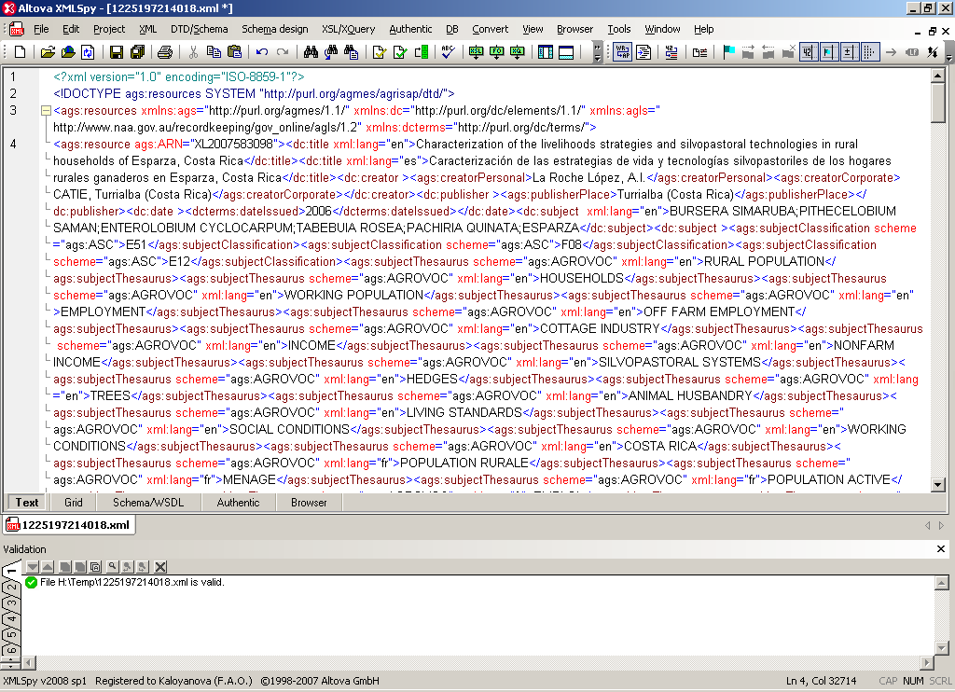
Result file from FAOBIB harvesting

Slide 31
Management of the harvesting
Status (active/not active)
Management of errors
Statistics kept in the MySQL database including:
  the last range harvested;
  the date of last harvesting done for starting the next harvesting
  number of records harvested;
  name of the XML files generated
Administration

Slide 32
What was done until now:
Harvester developed (shown to the group)
Testing with more than 15 different repositories (SciELO, Orton Library, FAOBIB, BIBSYS, National Library of Portugal, hosted WEBAGRIS databases (Uruguay, Peru)
Fixing of bugs and a lot of new FAO requirements (or changes)
Full documentation and installation package available

Slide 33
List of additional works done:
Error handling: in case of bad AGRIS AP xml the process should stop after 3rd trial that produces empty xml
adding “monthly” as period for harvesting in the scheduler as possible parameter
Changing RDBMS keeping statistics to MySQL
Introducing login and password
Enable changing of the path for the XML files
Adding number of records harvested on the initial display of DP
Additional modifications of the menus
Adding of additional parameters (CC, Name, acronym etc.) for data provider taken from mdb for AGRIS data providers
Changing the naming of the produced output files and including the center code
Cleaning of OAI part and the wrong namespaces in the XML result
Adding of activate/ deactivate function
Improvement of the statistics

Slide 34
Testing and implementation
Testing. Installation in FAO (under common accessible server GILS09) for further testing
Creation of distribution package and documentation
Presenting to the management and other colleagues in FAO
Installation to another server or just redirecting of the output to the existing directory for AGRIS production
Mechanism for including in the AGRIS production cycle
Trouble shooting for OAI-PMH repositories

Slide 35
Summary / Conclusions
The goal of the harvester
Benefits for AGRIS
Possibility to use it with other FAO OA project
Future implementation and use in house and by our partners

Slide 36
What next
Help AGRIS centres to install OAI-PMH plug-in and expose outside firewall.
Facilitating host services for some Data Providers
Installing harvester to other aggregators
from AGRIS harvesting to AGRIS portal
Follow up actions

Slide 37
Close
New way of organization of AGRIS harvesting
It is not an user interface but a scheduler.
Not a search interface
Its success depend on the OAI-PMH plug-in exported data quality.

Slide 38
Thank you

