Slide 1
Programming Decentralized Application
Dr. Bambang Purnomosidi D. P.
VP Curriculum at Refactory
Faculty at STMIK AKAKOM
Road to DevSummit - STMIK AKAKOM - 28 Oktober 2017

Slide 2
Agenda
What is Blockchain?
What is Decentralized Application (DApp)?
What do I need to program a DApp?
Enter Ethereum
Ethereum Clients
Private or Public BlockChain?
Overview of Development Environment in Ethereum
Development Without Framework
Development With Framework
Deployment

Slide 3
What is BlockChain?
“We can define the blockchain as a system that allows a group of connected computers to maintain a single updated and secure ledger.” (Michele D’Aliessi, 2016).
“A blockchain is a decentralized and distributed digital ledger that is used to record transactions across many computers so that the record cannot be altered retroactively without the alteration of all subsequent blocks and the collusion of the network”. (Stephen Armstrong, 2018).
Preliminary research: Cryptographically secured chain of blocks (Stuart Haber dan W. Scott Stornetta, 1991), Ross J. Anderson (1996), Michael Doyle (1997), Bruce Schneier and John Kelsey (1998), Nick Szabo (1998, bit gold), Stefan Konst (2000).
Satoshi Nakamoto (2008): Bitcoin

Slide 4
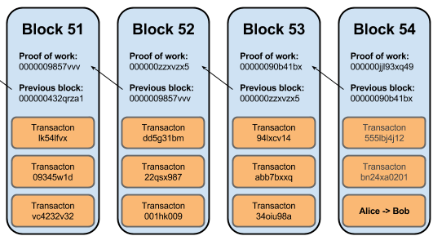
Source: http://dataconomy.com/2015/10/wtf-is-the-blockchain-a-guide-for-total-beginners/

Slide 5
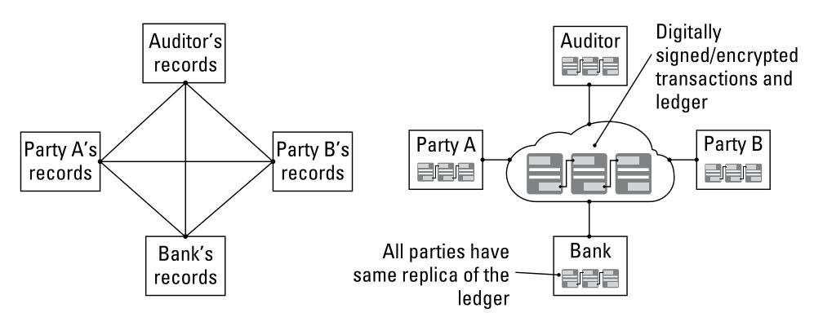
Image was taken from “Blockchain for Dummies - IBM”

Slide 6
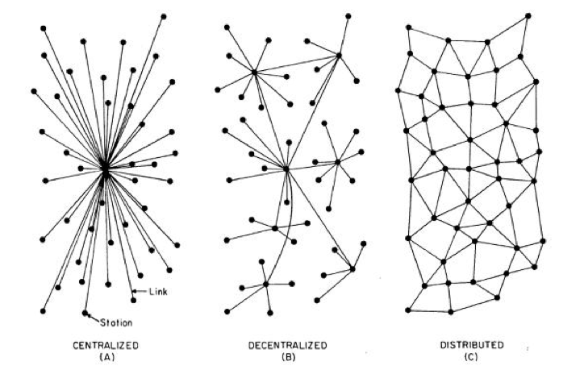
What is Decentralized Application (DApp)?

Slide 7
What Do I Need to Program A DApp?
Blockchain Platform:
Ethereum
Tezos
Corda
Exonum
Hyperledger Project
Development Tools
See https://www.stateofthedapps.com/ for inspiration.

Slide 8
Enter Ethereum
Ethereum is a decentralized platform that runs smart contracts: applications that run exactly as programmed without any possibility of downtime, censorship, fraud or third party interference.
It has ether as its cryptocurrency.
Provides smart contracts for DApp development
Provides Ethereum Virtual Machine. EVM is an environment where arbitrary code of smart contracts and other operations can be executed.
There are some high level language for DApp development:
Solidity
Serpent
LLL

Slide 9
Ethereum Clients
Ethereum client refers to any node able to parse and verify the blockchain, its smart contracts and everything related. It also allows you/provides interfaces to create transactions and mine blocks which is the key for any blockchain interaction.
Official Reference Implementation:
Go: go-ethereum (geth):: https://geth.ethereum.org/
C++: cpp-ethereum (eth): http://www.ethdocs.org/en/latest/ethereum-clients/cpp-ethereum/
Python (pyethapp): https://github.com/ethereum/pyethapp
3rd party:
Rust: parity: https://parity.io
Java: https://github.com/ethereum/ethereumj
JS: https://github.com/ethereumjs/ethereumjs-vm
Ruby: https://github.com/janx/ruby-ethereum

Slide 10
Private, Consortium, or Public BlockChain?
Private blockchains: a fully private blockchain is a blockchain where write permissions are kept centralized to one organization.
Consortium blockchains: a consortium blockchain is a blockchain where the consensus process is controlled by a pre-selected set of nodes; for example, one might imagine a consortium of 15 financial institutions, each of which operates a node and of which 10 must sign every block in order for the block to be valid.
Public blockchains: a public blockchain is a blockchain that anyone in the world can read, anyone in the world can send transactions to and expect to see them included if they are valid, and anyone in the world can participate in the consensus process.

Slide 11
Overview of Development Environment / Workflow in Ethereum
The development process of a ÐApp often entails a Whitepaper and a working prototype, a token sale, an initial coin offering (ICO), its implementation and launch.
From the workflow, developer tasks are:
Create token
Create application
Deploy application to EVM

Slide 12
Development Without Framework
Never use public blockchain for test.
What you have to learn:
Smart contract and how to use Solidity programming language. Get Solidity compiler (https://github.com/ethereum/solidity/releases). Some Linux distros provide official package (ex: Arch Linux pacman: community/solidity 0.4.18-1)
How to deploy your smart contract to EVM
Documentation for Solidity: http://solidity.readthedocs.io/en/latest/
Development environment: Atom, Emacs, Vim, Intellij, VSCode, See Awesome Solidity (https://github.com/bkrem/awesome-solidity)
Step:
Build everything in local computer. Use testrpc to mimick blockchain (https://github.com/ethereumjs/testrpc).
Test on the staging blockchain (Ether and any other resource fees are fake).: Ropsten. See https://github.com/ethereum/ropsten and https://ropsten.etherscan.io/ . Also --morden when run Ethereum clients.
Real Ethereum deployment. Mainnet - Homestead.

Slide 13
Development With Framework
Truffle Framework (http://truffleframework.com/) - A Swiss army knife for smart contract development and deployment.
DApp (https://dapp.readthedocs.io/en/latest/) - simple command line tool for smart contract development for package management, source code building, unit testing, simple contract deployments.

Slide 14
Deployment
In deployment, understanding Gas is important.
Transactions on the Ethereum network require fees in the form of gas. The amount of gas depends on the amount of computation required to complete the transaction.
Estimating transaction costs: http://ethdocs.org/en/latest/contracts-and-transactions/account-types-gas-and-transactions.html

Slide 15
The End

