Slide 1
Digital Marketing: Reinvent Marketing Strategies
Dr. Bambang Purnomosidi D. P,
Co-founder dan CEO - Wabi Teknoogi
http://kamiwabi.id

Slide 2
Agenda
Strategic Issues in Marketing
(Information) Technology and Marketing
What is Digital Marketing?
Digital Marketing Models
Digital Marketing Methods
Digital Marketing Framework
Case Studies

Slide 3
Strategic Issues in Marketing
Contemporary business environment: many, frequent and strong changes
Marketing, therefore forced to conduct changes
What’s the implication to (traditional) marketing?
Sales - promotion to creating and positioning value added for consumers.

Slide 4
(Information) Technology and Marketing
Technology: collections of techniques, skills, methods, and processes in the accomplishment of objectives
IT makes information available.
Communication is multichannel and easy.
Competitor is only one click away.
How do IT change consumer behaviour?
Customers are becoming more powerful in making their own purchasing decisions.
Customers are lazy, easy to complaint, are not loyal.
From First Moment of Truth to Zero Moment of Truth

Slide 5
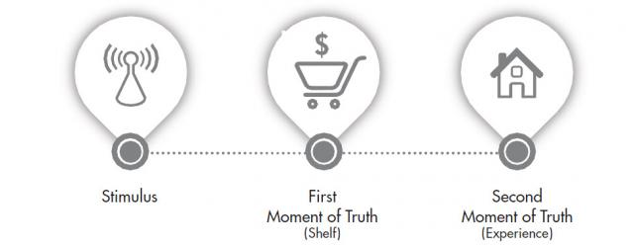
Where is Zero Moment of Truth?

Slide 6
What is Digital Marketing?
The marketing of products or services using digital channels to reach consumers. The key objective is to promote brands through various forms of digital media.

Slide 7
Digital Marketing Models
Digital Branders: focus on building and renewing brand equity and deeper consumer engagement, shifting their investment from traditional linear advertising toward more immersive digital multimedia experiences that can connect consumers to the brand in new ways.
Customer Experience Designers use customer data and insights to create a superior end-to-end brand experience for their customers by reinventing how they interact with customers.
Demand Generators: focus on driving online traffic and converting as many sales as possible across channels.
Product Innovators: use digital marketing to identify, develop, and roll out new digital products and service

Slide 8
Digital Marketing Methods
NOTE
Your product is VERY IMPORTANT. It becomes a foundation for every marketing effort - be it digital or not.
IT just a “helper” to support any marketing activities.
Marketing should become the soul of the organization and its people inside.
Keys: Unique - Original. Influencer is important

Slide 9
Website - Landing Page
Choose colour. Apply it consistently
Your product and their strengths: how product can help your customers.
Not too much contents
Responsive Web Design
Include communication channels
Link to resources - social media presence
Use HTTPS instead of HTTP.
HTTPS: Mandiri Syariah, BRI Syariah
HTTP: BCA Syariah, MayBank Syariah
Use e-mail with your domain name. Never use unofficial e-mail.

Slide 10
Mobile Phone App
Market: Android and iOS
There’s a limitation: users generally have many app that they may refuse to install new app.

Slide 11
Blog
Medium is the best.
Not recommended: Blogspot, WordPress
See https://medium.com/@kamiwabi.id for example

Slide 12
Social Media Presence
People want prompt reply and continous contents
Originality and uniqueness

Slide 13
SEO (Search Engine Optimization)
Visibility in organic search engine results.
On page optimization: HEAD - Title - Contents
Off page o\ptimization: backlinks
Blackhat SEO:
Keyword stuffing
Link farms: fake backlinks

Slide 14
Search Engine Marketing
Paid advertising from search engine results.
PPC (Pay per click) or CPC (Cost Per Click)

Slide 15
Display Advertising
Use any website which has many visitors. Advertiser advertise in a specific spot inside the website.
Give values to potential targets! How? Give them free book, free gift, whatever.

Slide 16
Marketing Automation and E-mail Marketing
Getting e-mail contacts (by any means) and target the e-mail for advertisement.
I personally do not recommend this method.

Slide 17
Social Network Platform
Most people engage in:
Facebook
Twitter
Instagram
LinkedIn

Slide 18
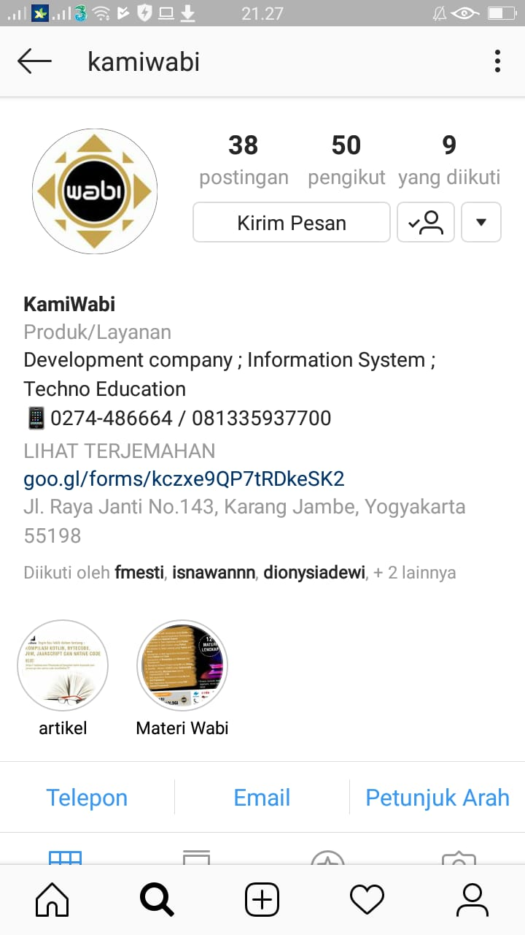
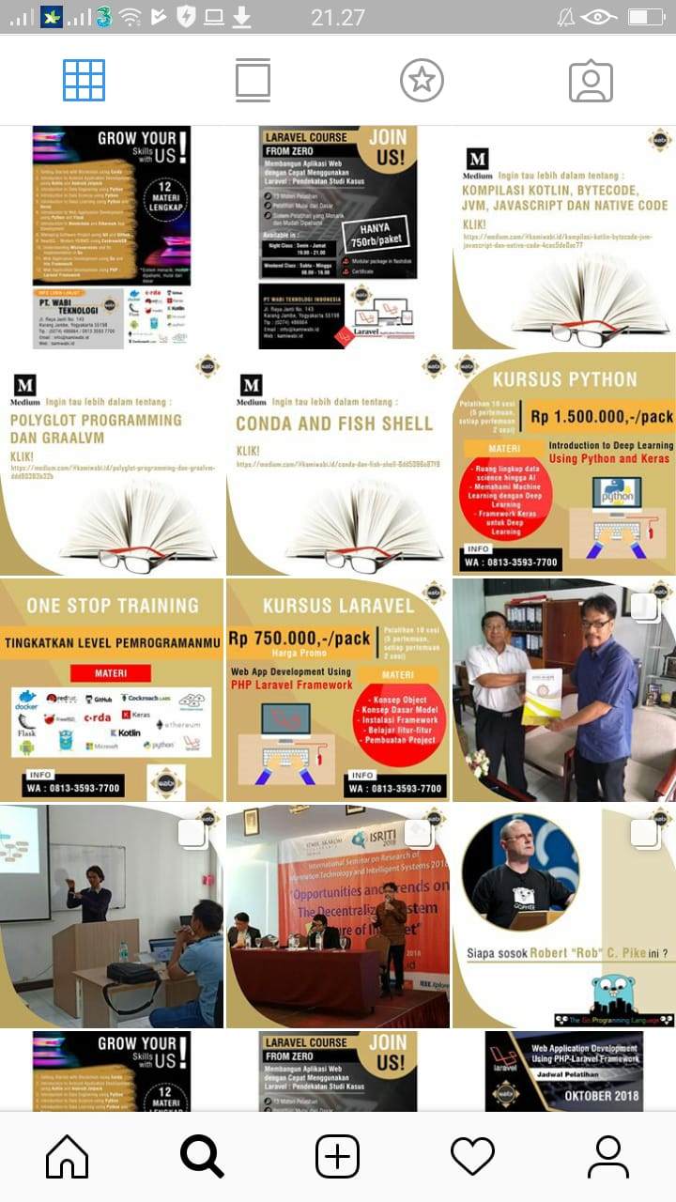

Slide 19

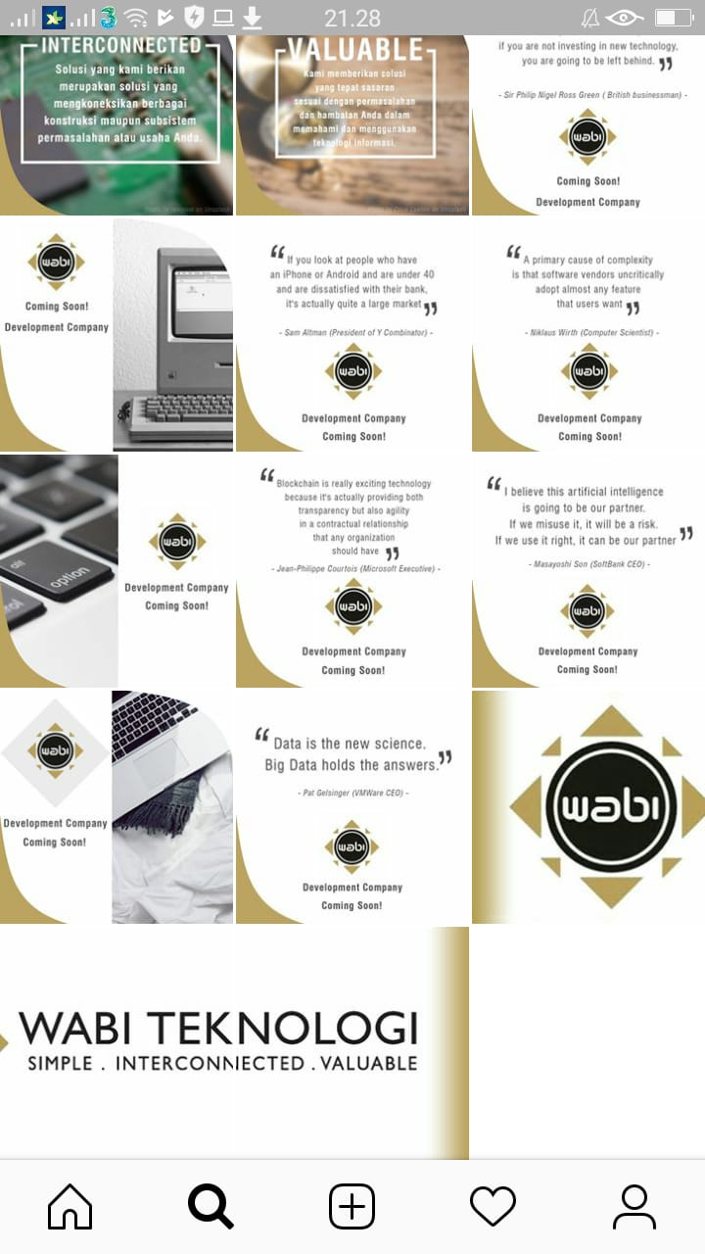

Slide 20
Video Marketing
Youtube - of course!
Other platform: Vimeo
Deliver value, minimze advertisement!

Slide 21
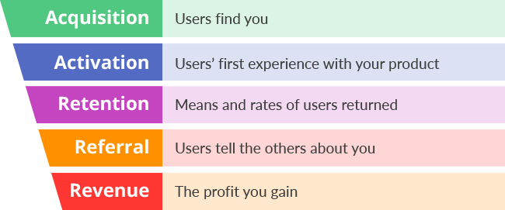
Digital Marketing Framework

Slide 22
