Slide 1
Direction-Aware Gate
Adaptive Test-Time Optimizer Triggering
Weekly Report | 2026-03-02
Core Question: For any test-time optimizer T, can we learn WHEN to use it?
Status: Phase 0-4 Complete | Phase 5 Ready to Launch
1/22

Slide 2
SECTION 01
Full Experiment Data Overview
6 Environments × 10 Methods × 3 Seeds × 200 Episodes
3/22

Slide 3
Environment Overview & Optimizer Design
HotpotQA
Main Exp
APPS (Intro)
2nd Effective
WebShop
3rd Effective
Model: Qwen3-4B
Actions: K≤5 (search/lookup/finish)
Optimizer T: Per-action evaluation
Model: Qwen3-4B
Actions: Single (code gen)
Optimizer T: K-variant gen (K=5)
Model: Qwen3-4B
Actions: Medium (search/click/buy)
Optimizer T: LLM-Propose-K (K=5,H=3)
ALFWorld
NO-GO
HumanEval
Ceiling
MBPP
Ceiling
Model: Qwen3-8B
Actions: Medium discrete
Optimizer T: LLM-as-Sim / Batch Score
Model: Qwen3-4B
Actions: Single (code gen)
Optimizer T: K-variant generation
Model: Qwen3-4B
Actions: Single (code gen)
Optimizer T: K-variant generation
4/22

Slide 4
Base vs Always-Trigger: Does the Optimizer Help?
Environment
Base SR
Always SR
Δ (lift)
Verdict
HotpotQA
49.0%
97.0%
+48.0pp
GO
APPS
57.8%
64.8%
+7.0pp
GO
WebShop
7.2%
43.0%
+35.8pp
GO
ALFWorld v3
30.0%
20.0%
−10.0pp
NO-GO
HumanEval
92.1%
92.3%
+0.2pp
Ceiling
MBPP
92.7%
92.7%
+0.0pp
Ceiling
Key: 3 effective environments (GO) + 1 boundary result (NO-GO) + 2 ceiling environments
5/22

Slide 5
HotpotQA: Main Experiment (10 Methods × 3 Seeds)
MAIN EXPERIMENT
Method
SR (mean±std)
RR (%)
CS (%)
TES
base_only
49.0±1.9%
0.0%
100.0%
0.000
always_trigger
97.0±0.4%
100.0%
0.0%
0.000
random_50
89.0±0.8%
51.4%
48.6%
0.614
entropy_threshold
67.2±3.3%
21.5%
78.5%
0.509
best_sigma_wrong
58.2±2.5%
49.9%
50.1%
0.277
scg_prompt
95.7±0.5%
82.1%
17.9%
—
scg_mlp
96.7±0.6%
63.7%
36.3%
—
scg_finetune
96.7±0.6%
55.9%
44.1%
0.609
oracle
97.0±0.4%
33.0%
67.0%
0.802
SCG-LR Pareto-dominates random: SR 96.7% >> 89.0%, comparable CS
Wrong-direction SR crashes to 58.2% (−38.8pp vs correct)
6/22

Slide 6
APPS & WebShop: Supporting Environments
2nd ENV
WebShop
APPS
3rd ENV
base_only SR 57.8% RR 0%
always_trigger SR 64.8% RR 100%
sigma_wrong SR 58.5% RR 0%
scg_finetune_lr SR 65.0% RR 40.2%
oracle SR 66.8% RR 100%
base_only SR 7.2% RR 0%
always_trigger SR 43.0% RR 100%
sigma_wrong SR 7.2% RR 37.1%
scg_finetune_lr SR 43.7% RR 16.9%
scg_lora SR 42.8% RR 17.7%
oracle SR 43.3% RR 13.1%
Wrong-dir: RR=0% — passive abandonment mode
SR ≈ oracle (43.7% vs 43.3%), precision 75.1%
6× compute efficiency (RR=16.9%) — best case!
ALFWorld (NO-GO): Always-trigger SR 20% < Base 30%. Failure: confirmation bias, LLM hallucination scoring
7/22

Slide 7
SECTION 02-03
Core Empirical Findings
Direction Reversal + Signal Replacement → Zero prior papers report this
9/22

Slide 8
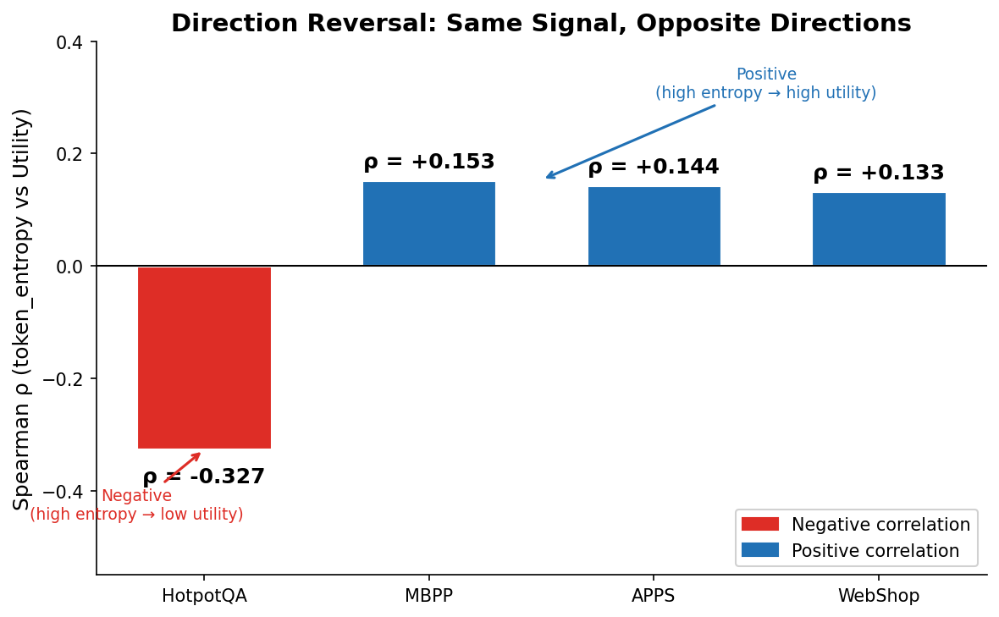
Finding 1: Signal-Utility Direction is NOT Fixed
NOVEL FINDING
token_entropy × Optimizer Utility
HotpotQA
ρ = −0.327 ↘
High entropy = confused → optimizer useless
MBPP
ρ = +0.153 ↗
High entropy = diverse solutions → optimizer helps
APPS
ρ = +0.144 ↗
Same direction as MBPP
WebShop
ρ = +0.133 ↗
Same direction as MBPP
Implication:
Methods assuming fixed direction (CoRefine, SEAG,
Think Just Enough) WILL fail on HotpotQA
10/22

Slide 9
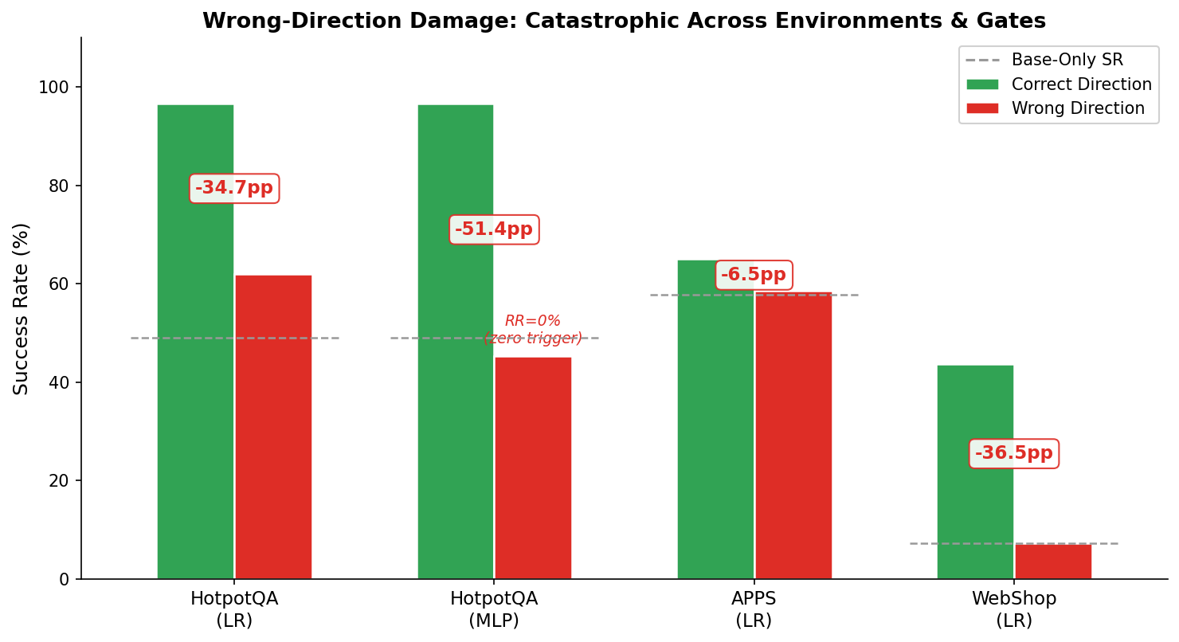
11/22

Slide 10
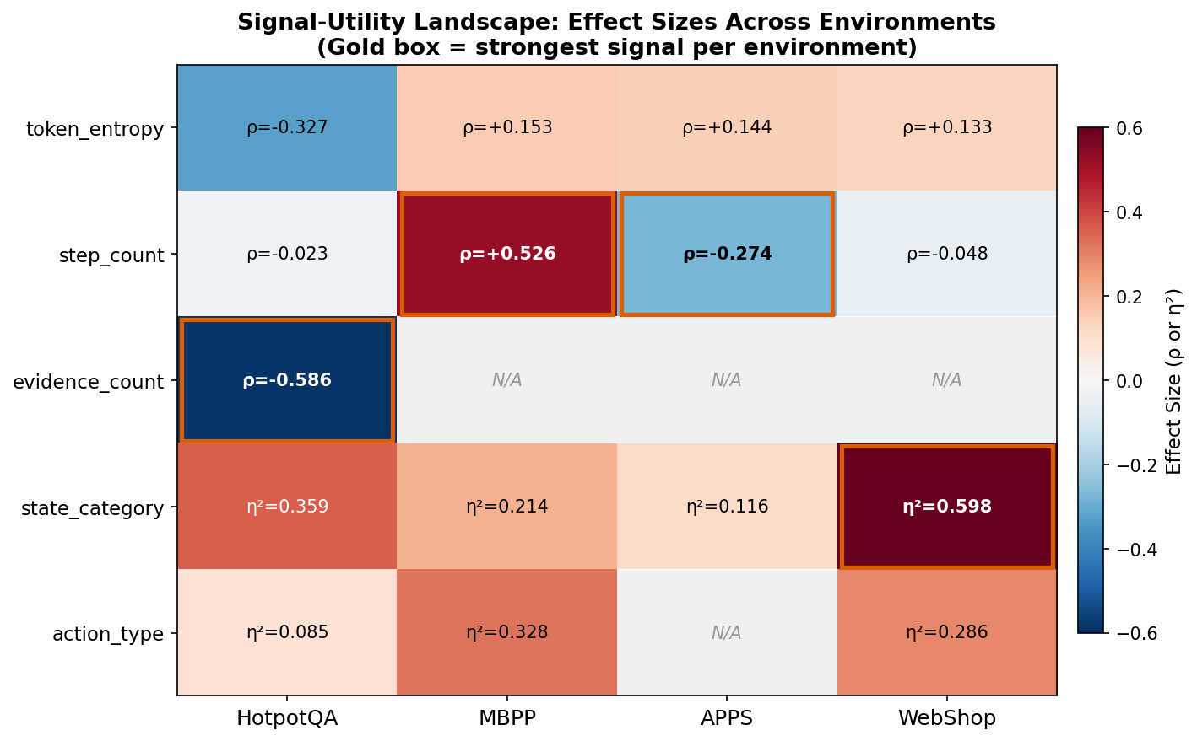
Finding 2: Strongest Signal Differs Per Environment
NOVEL FINDING
1. Direction not fixed
token_entropy: HotpotQA negative, MBPP/APPS/WebShop positive
2. Strongest signal not fixed
QA→evidence_count, Code→step_count, Web→state_category
3. Signal TYPE not fixed
HotpotQA/APPS: continuous; WebShop: categorical
4. step_count direction also reverses!
MBPP ρ=+0.526 vs APPS ρ=−0.274
Pre-selecting a fixed signal + fixed direction (11+ concurrent methods) is SYSTEMATICALLY FRAGILE
12/22

Slide 11
SECTION 05
Paper Storyline & Contributions
NOT 'we propose a new gate' → 'we discovered a phenomenon + phenomenon drives method'
19/22

Slide 12
Paper Narrative: Three-Act Structure
Act 1
Act 2
Act 3
Problem Setting
Empirical Finding
Method + Validation (Next Phase)
Background: Test-time optimizers widely used but costly (5-15×)
Status quo: 11+ concurrent works study 'when to trigger'
Hidden assumption: All methods share UNVERIFIED assumption
— signal-utility direction is fixed
— signal is fixed（pre-define）
Finding 1: Direction reversal across environments
token_entropy: HotpotQA ρ=−0.327 vs MBPP ρ=+0.153
Finding 2: Signal replacement (identity differs per env)
QA: evidence_count, APPS: step_count, WebShop: state_category
Findings derive two requirements:
(1) Auto-discover environment-specific features
(2) Probe signal-utility direction
Validation: 3 envs + 1 boundary + wrong-dir ablation
CORE FIRE
Act 2 is the CORE contribution — novel empirical finding that no prior paper reports
20/22

Slide 13
Phase 5
An automatic feature discovery framework that replaces hand-crafted signal engineering with learned representations. The framework extracts features from the agent‘s state automatically, then trains a lightweight direction-aware gate on these features using calibration data.
Proposer Hidden State
Extract the LLM‘s last-layer hidden state (d=2560) during inference; train an MLP or fine tune LLM to predict VOC (Value of Computation)
Text embedding
Encode state_text with a lightweight sentence-transformer (d=384/768); train an MLP to predict VOC
LLM-Guided Discovery
Use LLM to analyze "optimizer-helpful" vs. "optimizer-unhelpful" trajectory samples from a calibration set, directly generate a pure Python function should_trigger() that jointly performs feature extraction and triggering decisions, then iteratively refine it over 2–3 rounds of error feedback, ultimately producing an environment-adaptive gate with zero deployment overhead and no hand-crafted features.

