Slide 1
Direction-Aware Gate
Adaptive Test-Time Optimizer Triggering
Weekly Report | 2026-03-09
Core Question: For any test-time optimizer T, can we learn WHEN to use it?

Slide 2
AGENDA
01
Updated Storyline (v4.0)
Three-layer narrative with token cost quantification
02
Token Cost Analysis
SR vs Cost Pareto frontier across 3 environments
03
CATTS Failure & Adaptive Behavior
Why vote-based gating fails; emergent RR adaptation
04
Environment Expansion
3 new GO + 1 negative example + 11 NO-GO
05
Limitations Revealed
What the rejections tell us about method boundaries
06
Next Week Plan
Complete experiments, cost analysis, begin paper writing
2/18

Slide 3
SECTION 01
Updated Storyline
From 'direction reversal' to 'direction reversal + token cost damage'
3/18

Slide 4
Paper Narrative: Three-Act Structure
Act 1: The Hidden Assumption
Act 2: The Empirical Finding
Act 3: Method + Cost Analysis
Test-time optimizers cost 4-36x more tokens per step
Finding 1: Direction reverses across environments
SCG-LR: LR on 5 features, <1s training, zero GPU
11+ concurrent methods address 'when to trigger'
Finding 2: Best signal identity also changes
NEW: Pareto-dominates ALL competitors on SR-Cost
ALL assume signal-utility direction is fixed
Wrong-direction: LR -34.5pp, MLP -51.2pp (RR=0%)
38-77% cheaper than always_trigger
v4.0 KEY CHANGE: Token cost quantification elevates 'why not always trigger?' from intuition to proven Pareto dominance
4/18

Slide 5
Storyline Evolution:
Aspect
Last Week
This Week
Primary hook
Direction reversal finding
Direction reversal + token cost damage
'Why not always?'
Acknowledged but not quantified
Fully quantified: 4-36x cost, Pareto analysis
Method justification
Near-oracle SR
Near-oracle SR at fraction of cost
Competitor comparison
SR-only comparisons
SR vs Token Cost Pareto frontier (Table 2)
Environment coverage
3 validated + 1 NO-GO
6 GO + 1 negative + 11 NO-GO (17 total)
Adaptive behavior
Mentioned briefly
Elevated to Layer B -- emergent, not programmed
5/18

Slide 6
SECTION 02
Token Cost Analysis
Answering: 'always_trigger has high SR, why not use it every step?'
6/18

Slide 7
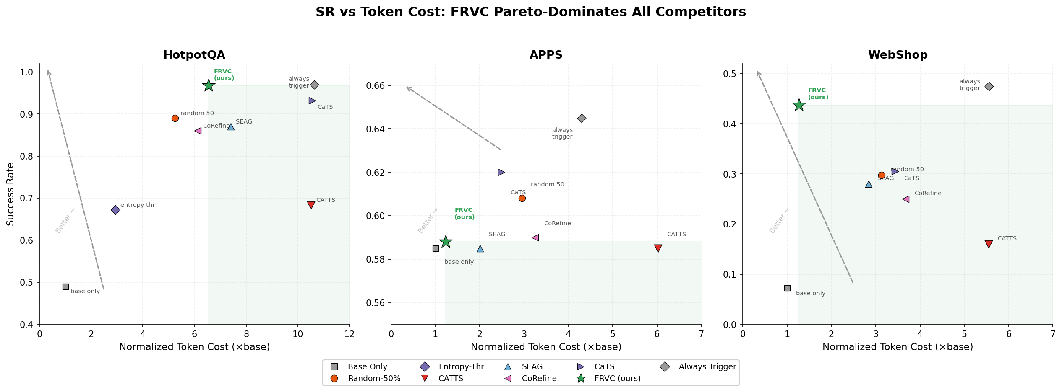
SR vs Token Cost: FRVC Pareto-Dominates All Competitors
KEY RESULT
FRVC achieves near-oracle SR at fraction of cost: 6.55x (HotpotQA), 1.23x (APPS), 1.27x (WebShop)
Upper-left = better (high SR, low cost). Green star = FRVC consistently in ideal region.
7/18

Slide 8
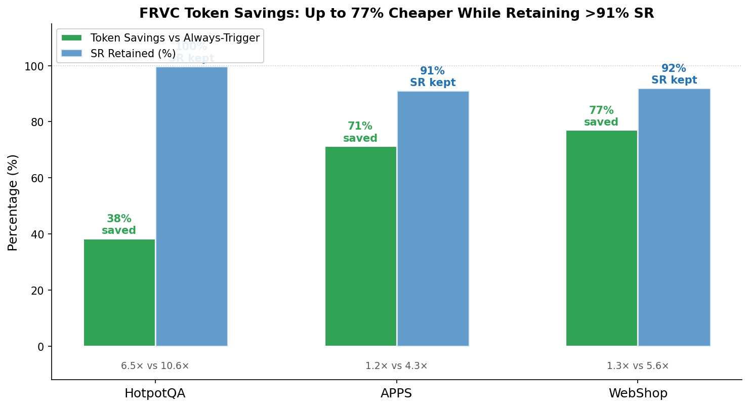
Token Savings: Up to 77% Cheaper While Retaining >91% SR
HotpotQA
Saved: 38% tokens | SR Retained: 100%
FRVC 6.55x vs Always 10.64x
APPS
Saved: 71% tokens | SR Retained: 91%
FRVC 1.23x vs Always 4.30x
WebShop
Saved: 77% tokens | SR Retained: 92%
FRVC 1.27x vs Always 5.56x
8/18

Slide 9
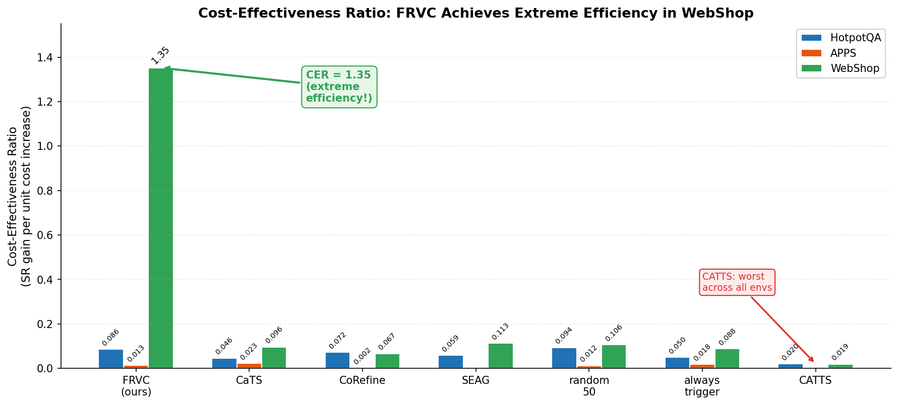
Cost-Effectiveness & CATTS Failure Analysis
CATTS: Uniformly Worst
HotpotQA
SR=0.683 | Cost=10.5x | Low SR + high cost
APPS
C_vote > C_rollout!
SR=0.585 | Cost=6.02x | ZERO SR gain!
WebShop
SR=0.160 | Cost=5.55x | Near-baseline SR
Root cause: K=5 voting every step
regardless of rollout trigger decision
10/18

Slide 10
SECTION 03
Environment Expansion
17 environments evaluated: 6 GO, 1 negative example, 11 NO-GO
12/18

Slide 11
3 Newly Accepted Environments (Phase 5 GO)
BabyAI
TextWorldExpress
TextWorld
Grid-world navigation
GoTo-v0, 7 discrete actions
Base SR: 2.0%
Always SR: 11.3%
Delta: +9.3pp
SCG-LR SR: 8.8%
Status: 18/18 DONE
CoinCollector (text)
Medium difficulty, max 50 steps
Base SR: 64%
Always SR: 98%
Delta: +34pp
SCG-LR SR: ~97%
Status: 11/18 done
Text adventure
5 rooms, 8 objects, quest=8
Base SR: 58%
Always SR: 68%
Delta: +10pp
SCG-LR SR: TBD
Status: 3/6 shards
TextWorldExpress has LARGEST headroom of all environments (+34pp) -- strongest validation of adaptive gating
13/18

Slide 12
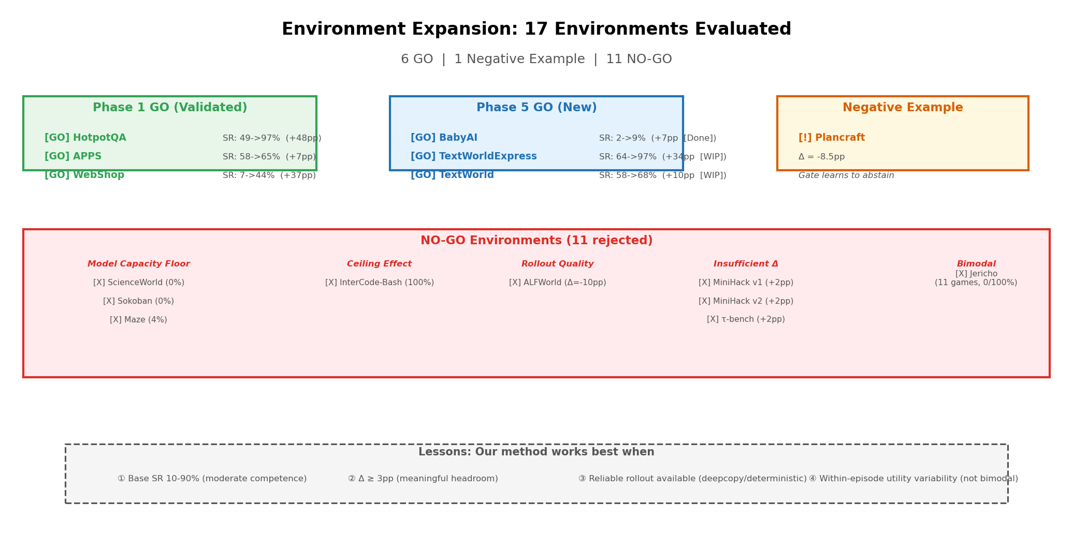
Negative Example & Rejected Environments
14/18

Slide 13
Limitations Revealed by Rejected Environments
HONEST ANALYSIS
1. Model Capacity Floor
Requirement: Base agent needs SR > 10%
ScienceWorld (0%), Sokoban (0%), Maze (4%): Qwen3-4B fundamentally cannot perform the task. No amount of gating or rollout helps.
-> Inherent to all test-time optimization, not specific to our method
2. Meaningful Rollout Headroom
Requirement: Need Delta >= 3pp from optimizer
MiniHack (+2pp), tau-bench (+2pp): When the optimizer barely helps, there's nothing for the gate to optimize.
-> Our method is most valuable in 'high-value, high-cost' regime
3. Reliable Rollout Mechanism
Requirement: Need deepcopy or deterministic eval
ALFWorld: LLM-as-Simulator hallucinates, Batch Scoring has confirmation bias (2.9/10 vs 6.6/10).
-> Rollout quality hierarchy: env.deepcopy > deterministic eval > LLM simulation
4. Within-Episode Variability
Requirement: Not bimodal performance distribution
Jericho 11 games: Either 0% or 100% SR per game. No 'sweet spot' for per-step gating.
These are reasonable prerequisites for any adaptive compute method. Plancraft shows gate is ROBUST (learns to abstain).
-> Per-step gating assumes variability; per-instance estimation is different
15/18

Slide 14
Complete Environment Summary: 6 GO Environments
Environment
Base SR
Always SR
Delta
SCG-LR SR
Cost
Best Signal
Status
HotpotQA
49.0%
97.0%
+48pp
96.8%
6.55x
evidence_count
Complete
APPS
57.8%
64.5%
+6.7pp
58.8%
1.23x
step_count
Complete
WebShop
7.2%
47.5%
+40pp
43.7%
1.27x
state_category
Complete
BabyAI
2.0%
11.3%
+9.3pp
8.8%
TBD
TBD
18/18 Done
TWExpress
64%
98%
+34pp
~97%
TBD
step_count
11/18
TextWorld
58%
68%
+10pp
TBD
TBD
TBD
3/6 shards
Plancraft
29.8%
21.3%
-8.5pp
Abstain
Weak (has_output 0.16)
Negative Example
Green = Phase 1 validated | Blue = Phase 5 new | Gold = Negative example | 9 adapters built
Each env uses different best signal -- reinforcing the core finding of signal-utility environment dependence
16/18

Slide 15
Phase 5
An automatic feature discovery framework that replaces hand-crafted signal engineering with learned representations. The framework extracts features from the agent‘s state automatically, then trains a lightweight direction-aware gate on these features using calibration data.
Proposer Hidden State
Extract the LLM‘s last-layer hidden state (d=2560) during inference; train an MLP or fine tune LLM to predict VOC (Value of Computation)
Text embedding
Encode state_text with a lightweight sentence-transformer (d=384/768); train an MLP to predict VOC
LLM-Guided Discovery
Use LLM to analyze "optimizer-helpful" vs. "optimizer-unhelpful" trajectory samples from a calibration set, directly generate a pure Python function should_trigger() that jointly performs feature extraction and triggering decisions, then iteratively refine it over 2–3 rounds of error feedback, ultimately producing an environment-adaptive gate with zero deployment overhead and no hand-crafted features.

Slide 16
SECTION 04
Next Week Plan
Complete experiments -> Cost analysis -> Begin paper writing
17/18

Slide 17
Next Week Plan & Key Milestones
Priority P0
Priority P1
Priority P2
Complete TextWorldExpress Step 2 (7 remaining jobs)
Run full cost analysis on new environments (BabyAI, TWExpress, TW)
Begin paper writing: Section 2 (Empirical Finding) + Section 4 (Experiments)
Complete TextWorld Step 1 (3 shards) -> Step 2
Merge all results into unified Table 1 (SR) and Table 2 (Cost)
Generate Pareto frontier plots for 6 environments
Run Plancraft K=3 rerun (negative example validation)
Key Milestones
Risk Items
Tue 03-10
All Phase 5 environment experiments complete
TextWorld shards may fail again (fallback: 3/6)
Thu 03-12
Unified cost analysis across 6 environments
TWExpress oracle jobs timeout (partial OK)
Sat 03-14
Paper Section 2 + Section 4 first draft
Plancraft K=3: either outcome is informative
18/18

