Slide 2




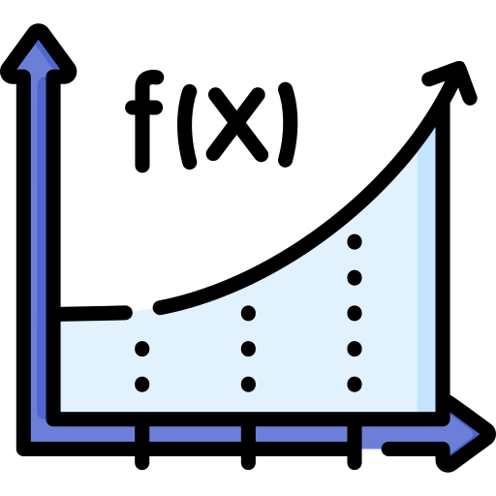

















(a) Explore: Signal-Agnostic Data Collection
$$action_{T}$$
Webshop example
Optimizer $T$
[state_text: Results Page (Page 1/5) [B07XYZ1] Nike Running Shoes Red Mesh.$85.00. Size 9 ... $72.00. (45 more), action:[Next] [Prev] [Back to Search]”, 0.68]
agent
Base Policy $π$
$$action_{B}$$
$$D=\{(state text,R\left(a_{T}\right)−R\left(a_{B}\right))$$
environment
(b) Reason: Feature Extraction & Merging
Universal Feature
[entropy=0.043, step=3, action_ent=2.31, state_len=412, num_avail_actions=12, -0.44], [entropy=0.012, step=5, action_ent=0.69, state_len=198, num_avail_actions=2, 0.68]
entropy, state text length, …
$$⨁$$
LLM Reasoning Feature
state text
action type, action length, …
$$D=\{(f_{1}, …,f_{n}, R\left(a_{T}\right)−R\left(a_{B}\right))$$
Features’ value
(c) Learn: Feature Selection & Direction Discovery
$$w$$
Type D($w_{i}$ > 0)
$$θ$$
feature
Decision-Difficult
Deployed Gate
$$−θ$$
Type I($w_{i}$ < 0)
Information-Poor
$$g\left(s\right)=1[σ(w^{T}φ\left(s\right)+b)>τ]$$
feature regularized
feature selection

Slide 3

















a
Explore: Signal-Agnostic Data Collection
$$action_{T}$$
Webshop example
Optimizer $T$
[state_text: Results Page (Page 1/5) [B07XYZ1] Nike Running Shoes Red Mesh.$85.00. Size 9 ... $72.00. (45 more), action:[Next] [Prev] [Back to Search]”, 0.68]
agent
Base Policy $π$
environment
$$action_{B}$$
$$D=\{(state text,R\left(a_{T}\right)−R\left(a_{B}\right))$$
b
Reason: Feature Extraction & Merging
[entropy=0.043, step=3, action_ent=2.31, state_len=412, num_avail_actions=12, -0.44], [entropy=0.012, step=5, action_ent=0.69, state_len=198, num_avail_actions=2, 0.68]
Universal Feature
entropy, state text length, …
$$⨁$$
state text
LLM Reasoning Feature
$$D=\{(f_{1}, …,f_{n}, R\left(a_{T}\right)−R\left(a_{B}\right))$$
action type, action length, …
Features’ value
c
Learn: Feature Selection & Direction Discovery
$$w$$
Type D($w_{i}$ > 0)
feature
$$θ$$
Decision-Difficult
$$−θ$$
Deployed Gate
Type I($w_{i}$ < 0)
feature
regularized
feature
selection
Information-Poor
$$g\left(s\right)=1[σ(w^{T}φ\left(s\right)+b)>τ]$$

Slide 4


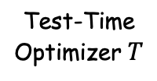

















a
Explore: Signal-Agnostic Utility Collection
b
Reason: Build State Signals
c
Learn: Feature Selection & Direction Discovery
Test-Time
Optimizer $T$
$$action_{T}$$
Universal Features
$$w$$
entropy, state text length, …
feature
agent
$$θ$$
$$⨁$$
$$−θ$$
state
text
LLM Reasoning Feature
feature
regularized
feature
selection
Base Policy $π$
environment
$$action_{B}$$
action type, action length, …
Webshop example
Feature example
$$state_text$$
Results Page (Page 1/5)…
$entropy$=0.043
$step$=3
Type D($w_{i}$ > 0)
Type I($w_{i}$ < 0)
$$action_{T}$$
[Next]
Decision-Difficult
Information-Poor
$state_len$=412
$action_ent$=2.31
$$action_{B}$$
[Back to Search]
$$D=\{(f_{1}, …,f_{n}, R\left(a_{T}\right)−R\left(a_{B}\right))$$
Deployed Gate
$$D=\{(state text,R\left(a_{T}\right)−R\left(a_{B}\right))$$
Features’ value
$$g\left(s\right)=1[σ(w^{T}φ\left(s\right)+b)>τ]$$

Slide 5

















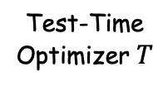










a
Explore: Signal-Agnostic Data Collection
b
Reason: Feature Extraction & Merging
c
Learn: Feature Selection & Direction Discovery
Signal-agnostic exploration
Bernoulli-$ε$ rollouts
State text from $D_{a}$
$$w$$
(state text, history …)
feature
$$action_{T}$$
$$θ$$
Test-Time
Optimizer $T$
$$−θ$$
Candidate feature pool $φ_{cand}(s_{t})$
agent
Compare returns
feature
regularized
feature
selection
state $s_{t}$
Universal Feature
$$R\left(a_{T}\right)−R\left(a_{B}\right)$$
entropy, state text length, …
environment
Base Policy $π$
LLM Reasoning Feature
Type D($w_{i}$ > 0)
Type I($w_{i}$ < 0)
$$action_{B}$$
action type, action length, …
Use optimizer $T$
Use base policy $π$
Webshop example
$$U_{t}$$
$$U_{t}$$
1
1
$$state_text$$
Results Page (Page 1/5)…
Feature vector
$$φ(s_{t})∈R^{d}$$
$$action_{T}$$
[Next]
0
low
high
0
low
high
$$action_{B}$$
[Back to Search]
Feature example
$entropy$=0.043
$step$=3
Deployed Gate
$$D_{a}=\{(state text,R\left(a_{T}\right)−R\left(a_{B}\right))$$
$state_len$=412
$action_ent$=2.31
$$g\left(s\right)=1[σ(w^{T}φ\left(s\right)+b)>τ]$$
Action metadata
(step, action type…)
$$⨁$$
$$D=\{(f_{1}, …,f_{n}, R\left(a_{T}\right)−R\left(a_{B}\right))$$
Features’ value

Slide 6





a
Explore: Signal-Agnostic Data Collection
b
Reason: Feature Extraction & Merging
c
Learn: Feature Selection & Direction Discovery
Signal-agnostic exploration
Bernoulli-$ε$ rollouts
Raw state $s_{t}$
Action metadata
$$w$$
+
feature
(state text, history …)
(step, action type…)
$$action_{T}$$
$$θ$$
Test-Time
Optimizer $T$
$$−θ$$
Candidate feature pool $φ_{cand}(s_{t})$
agent
Compare returns
feature
regularized
feature
selection
state $s_{t}$
Universal Feature
$$R\left(a_{T}\right)−R\left(a_{B}\right)$$
entropy, state text length, …
environment
Base Policy $π$
LLM Reasoning Feature
Type D($w_{i}$ > 0)
Type I($w_{i}$ < 0)
$$action_{B}$$
action type, action length, …
Use optimizer $T$
Use base policy $π$
$$U_{t}$$
$$U_{t}$$
$$D=\{(state text,R\left(a_{T}\right)−R\left(a_{B}\right))$$
1
1
Webshop example
Feature vector
$$φ(s_{t})∈R^{d}$$
0
low
high
0
$$state_text$$
Results Page (Page 1/5)…
low
high
Feature example
$$action_{T}$$
[Next]
$entropy$=0.043
$step$=3
Deployed Gate
$$action_{B}$$
[Back to Search]
$state_len$=412
$action_ent$=2.31
$$g\left(s\right)=1[σ(w^{T}φ\left(s\right)+b)>τ]$$
$$⨁$$
$$D=\{(f_{1}, …,f_{n}, R\left(a_{T}\right)−R\left(a_{B}\right))$$
Features’ value

Slide 7









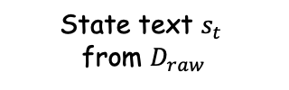

a
Explore: Signal-Agnostic Data Collection
b
Reason: Feature Extraction & Merging
c
Learn: Feature Selection & Direction Discovery
Signal-agnostic exploration
Bernoulli-$ε$ rollouts
State text $s_{t}$ from $D_{raw}$
$$w$$
feature
$$action_{T}$$
$$θ$$
Test-Time
Optimizer $T$
Candidate feature pool $φ_{cand}(s_{t})$
$$−θ$$
agent
Compare returns
Universal Feature Value
feature
regularized
feature
selection
state $s_{t}$
token entropy, state text length, …
$$R\left(a_{T}\right)−R\left(a_{B}\right)$$
Base Policy $π$
LLM Reasoning Feature Value
Type D($w_{i}$ > 0)
Type I($w_{i}$ < 0)
environment
$$action_{B}$$
action type, action length, …
High$→$ Optimizer $T$
High $→$base policy $π$
$$U_{t}$$
$$U_{t}$$
$$D_{raw}=\{\left(state text,R\left(a_{T}\right)−R\left(a_{B}\right)\right)\}$$
$$D=\{(v_{1}, …,v_{n}, R\left(a_{T}\right)−R\left(a_{B}\right))$$
1
1
Webshop example
Feature vector
0
0
low
high
low
high
$$state_text$$
Results Page (Page 1/5)…
Feature example
$$action_{T}$$
[Next]
$entropy$=0.043
$step$=3
Deployed Gate
$$action_{B}$$
[Back to Search]
$state_len$=412
evidence_cnt=2
$$g\left(s\right)=1[σ(w^{T}φ\left(s\right)+b)>τ]$$
$$⨁$$
$$D_{b}=\{(state text,R\left(a_{T}\right)−R\left(a_{B}\right))$$
$$D=\{(f_{1}, …,f_{n}, R\left(a_{T}\right)−R\left(a_{B}\right))$$

Slide 8











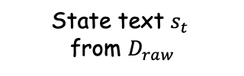


a
Explore: Signal-Agnostic Data Collection
b
Reason: Feature Extraction & Merging
c
Learn: Feature Selection & Direction Discovery
Signal-agnostic exploration
Bernoulli-$ε$ rollouts
State text $s_{t}$ from $D_{raw}$
$$w$$
feature
$$action_{T}$$
$$θ$$
Test-Time
Optimizer $T$
Candidate feature pool $φ_{cand}(s_{t})$
$$−θ$$
agent
Compare returns
Universal Feature Value
feature
regularized
feature
selection
state $s_{t}$
token entropy, state text length, …
$$R\left(a_{T}\right)−R\left(a_{B}\right)$$
Base Policy $π$
LLM Reasoning Feature Value
environment
$$action_{B}$$
action type, action length, …
Type D($w_{i}$ > 0)
Type I($w_{i}$ < 0)
High$→$ Optimizer $T$
High $→$base policy $π$
$$U_{t}$$
$$U_{t}$$
$$D_{raw}=\{\left(state text,R\left(a_{T}\right)−R\left(a_{B}\right)\right)\}$$
$$D=\{(v_{1}, …,v_{n}, R\left(a_{T}\right)−R\left(a_{B}\right))$$
1
1
Webshop example
Feature vector
0
0
Results Page (Page 1/5)…
Feature example
low
high
low
high
$$state_text$$
$$action_{T}$$
[Next]
$entropy$=0.043
$step$=3
Deployed Gate
$$action_{B}$$
[Back to Search]
$state_len$=412
evidence_cnt=2
$$g\left(s\right)=1[σ(w^{T}φ\left(s\right)+b)>τ]$$
$$⨁$$
$$D_{b}=\{(state text,R\left(a_{T}\right)−R\left(a_{B}\right))$$
$$D=\{(f_{1}, …,f_{n}, R\left(a_{T}\right)−R\left(a_{B}\right))$$

