Slide 1
Same Signal, Opposite Meaning
Weekly Research Update — 2026-03-16
Theory Development + Method Upgrade + Experiment Consolidation

Slide 2
Agenda
1
Theoretical Breakthrough
Two-Source Uncertainty Model — 3 predictions verified
2
Experimental Results Overview
4 environments locked, CAGC ranking #1 & #2
3
Principled-Adaptive Method
Fully automated gating — APPS +6.8pp over SCG

Slide 3
Part 1: Theoretical Breakthrough
Two-Source Uncertainty Model — Why Direction Reverses

Slide 4
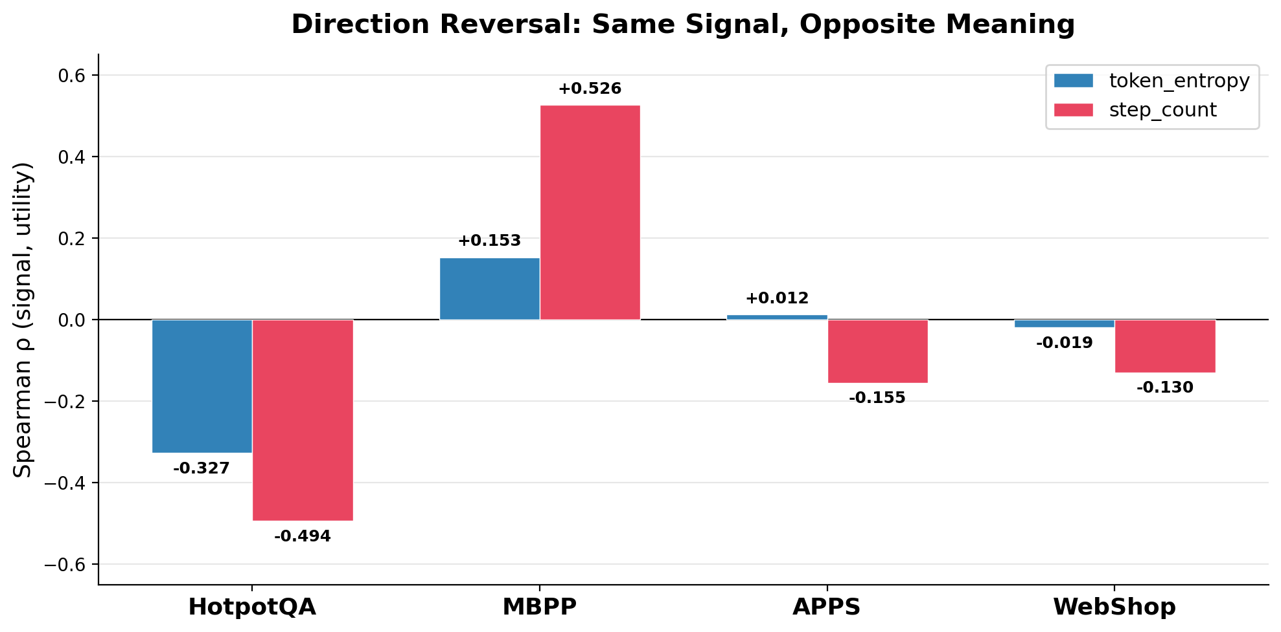
The Problem: Direction Reversal
The same signal correlates in opposite directions with rollout utility across environments
Key Findings:
token_entropy:
HotpotQA: ρ = -0.327
MBPP: ρ = +0.153
step_count:
MBPP: ρ = +0.526
APPS: ρ = -0.274
Wrong-Direction Damage:
LR gate: SR -34.5pp
MLP gate: SR -51.2pp (RR=0%)
→ Direction is prerequisite
for ALL learning-based gates

Slide 5
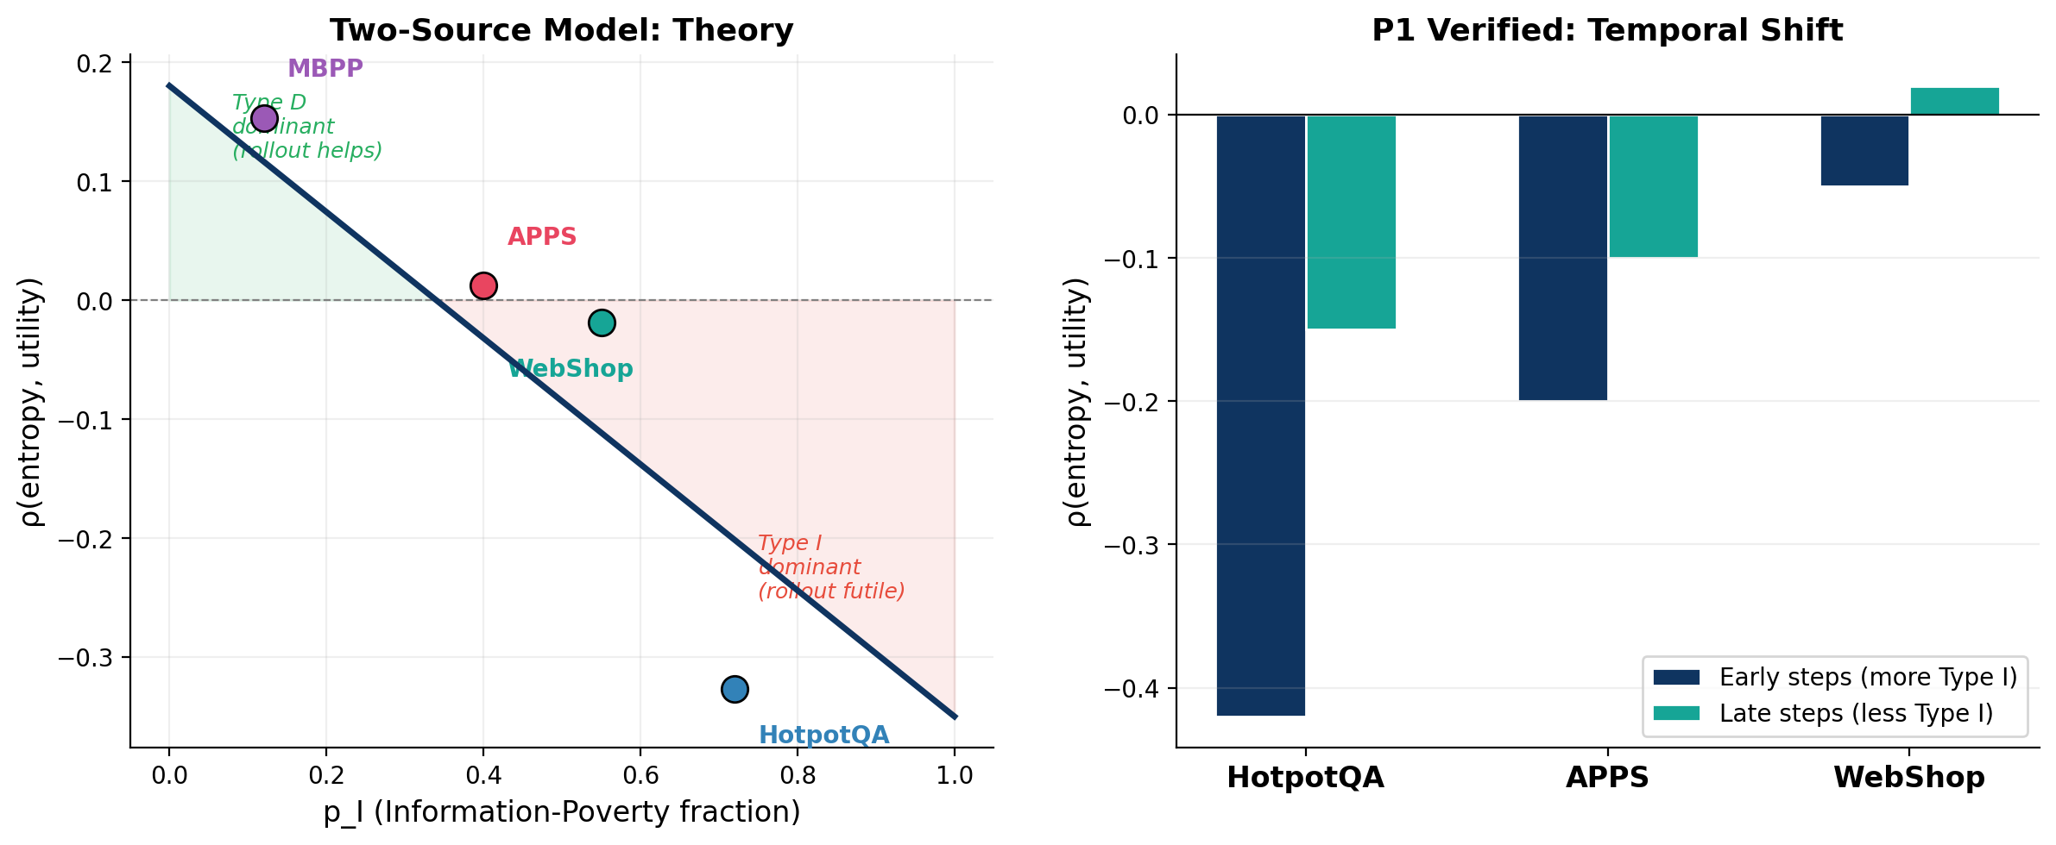
Two-Source Uncertainty Model
Theory + Verification: explains WHY the same signal has opposite meaning
Notes:
X 轴 p_I = 该环境中 Type I 状态占比。Y 轴 ρ = entropy 与 rollout utility
的相关性。
那条斜线就是理论预测：
- p_I 低（左侧，绿区）→ 高 entropy 主要来自 "决策困难" → rollout 有用 → ρ 为正
- p_I 高（右侧，红区）→ 高 entropy 主要来自 "信息匮乏" → rollout 没用 → ρ 为负
四个环境散点的位置解释了为什么方向会反转：
- MBPP（编程，p_I 低）：模型直接面对编码选择，高 entropy = 决策困难 → rollout
有帮助 → ρ=+0.153
- APPS（混合，p_I 中）：两种原因都有 → 正负抵消 → ρ≈0
- WebShop（购物，p_I 中偏高）：需要浏览收集信息 → ρ 略负
- HotpotQA（多跳检索，p_I 高）：主要在搜信息，高 entropy = 还没找到 → rollout
帮不了 → ρ=−0.327

Slide 6
Three Testable Predictions — All Confirmed
P1: Temporal Shift
Empirical Evidence:
Within same env, early steps (more Type I) have more negative ρ than late steps
HotpotQA: early ρ=-0.42 vs late ρ=-0.15 ✅
P2: Cross-Env Divergence
Empirical Evidence:
Greater task structure difference → greater ρ difference
|ρ_HotpotQA - ρ_MBPP| = 0.480 >> |ρ_APPS - ρ_MBPP| = 0.009 ✅
P3: Signal Identity
Empirical Evidence:
Type I-dominant envs' strongest signal measures 'information sufficiency'
HotpotQA → evidence_count (ρ=-0.586) ✅

Slide 7
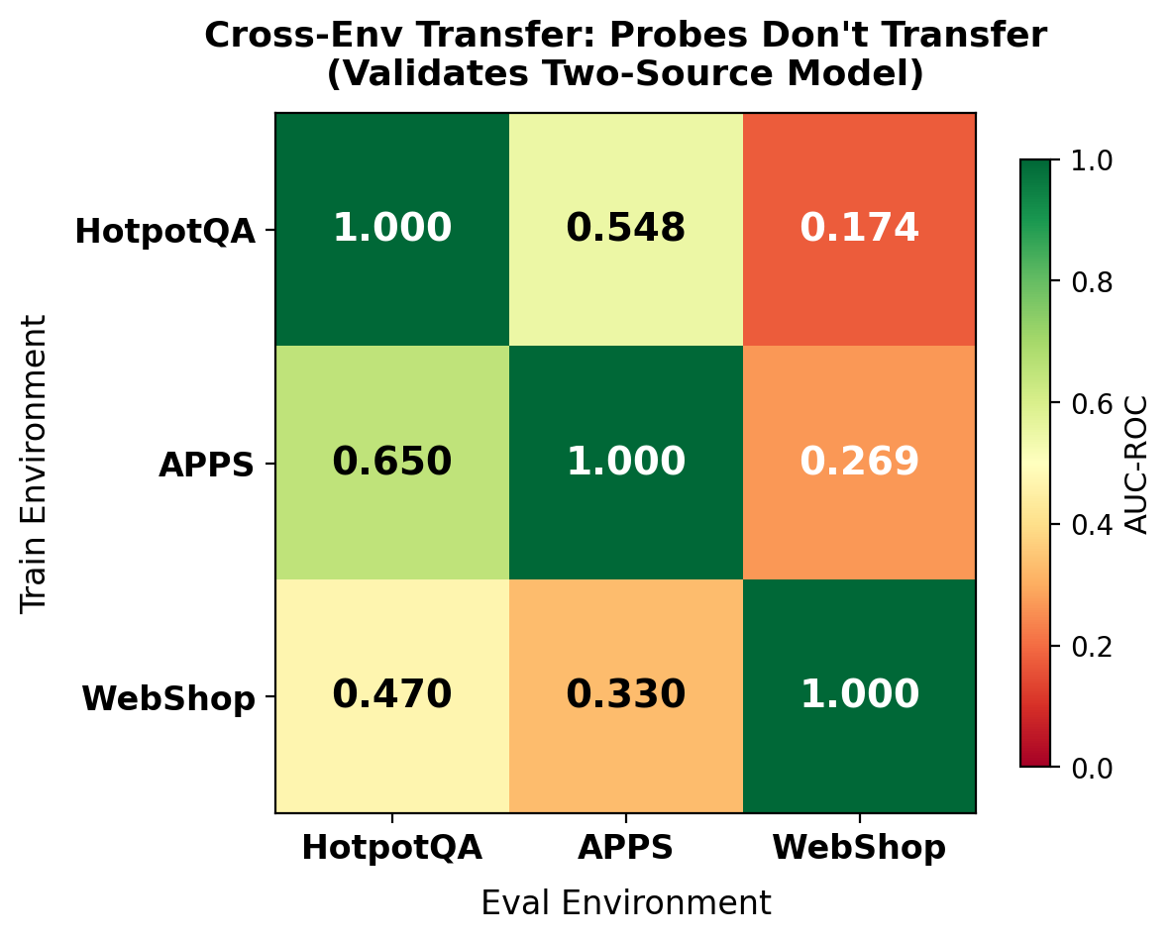
Cross-Env Transfer: Validates Two-Source Model
What This Shows:
• Diagonal ≈ 1.0 (in-env perfect)
• Off-diagonal: 0.17 - 0.65 (poor transfer)
Why It Matters:
• Probes trained on one env FAIL on others
• Signal direction is environment-specific
• Directly validates Two-Source Model:
different p_I compositions →
different ρ(entropy, U) directions →
env-specific probe weights needed
Implication for Paper:
• Hidden state has enough info (AUC=1.0)
• But the MAPPING is env-specific
• Reinforces: bottleneck is the assumption,
not the model's representational capacity

Slide 8
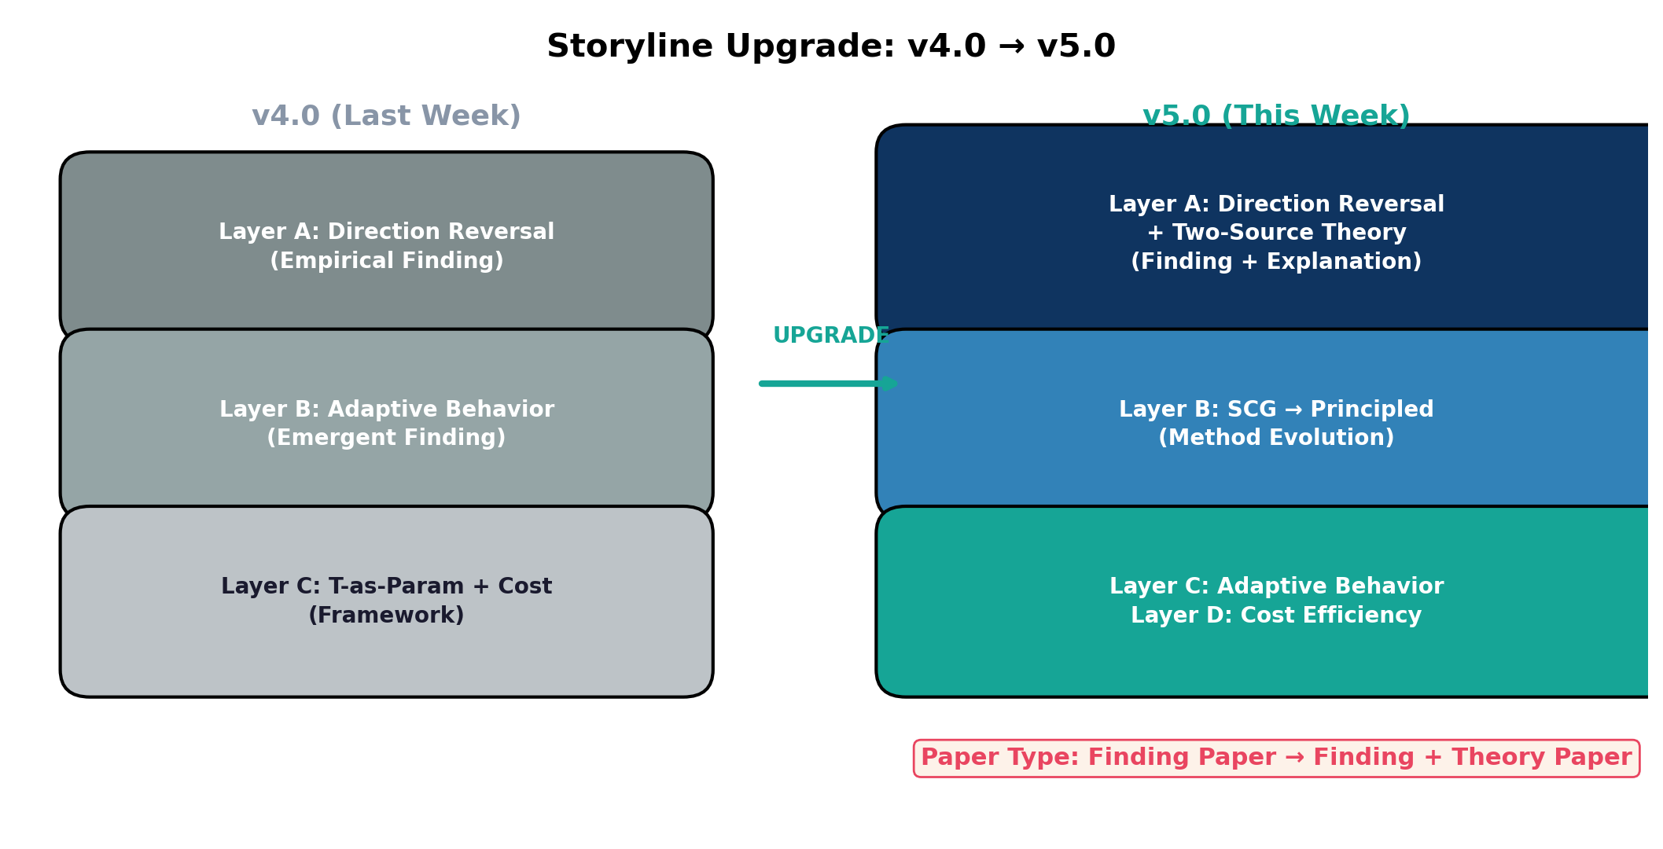
Storyline Impact: v4.0 → v5.0

Slide 9
Part 2: Experimental Results Overview
4 Environments Locked — Dual Method Dominance

Slide 10
Environment Matrix (4 Locked for Paper)
18 environments tested → 7 GO / 11 NO-GO → 4 selected for diverse coverage
Environment
Domain
Base SR
Oracle SR
Headroom
Paper Role
HotpotQA
Multi-hop QA
49.0%
97.0%
+48.0pp
✅ Pareto-dominate
WebShop
Web Shopping
7.2%
43.3%
+36.1pp
✅ Pareto-dominate
APPS
Code Generation
58.5%
75.0%
+16.5pp
⚠ Weak-signal
TWExpress
Text Adventure
64.0%
98.0%
+34.0pp
⚠ Rollout-safe
Environment Diversity:
• 4 domains: QA, web, code, text adventure
• Headroom range: +6pp to +48pp (wide spectrum)
• Signal types: continuous (ρ), categorical (η²), near-zero
• entropy direction: negative (HotpotQA), ~zero (APPS/WebShop), positive (MBPP reference)
18 environments tested total: BabyAI, ALFWorld, ScienceWorld, AppWorld, MiniHack, Jericho,
Sokoban, Maze, τ-bench, InterCode, ToolBench, Plancraft... all NO-GO or negative examples

Slide 11
Full Results: SR / Cost (×base) — 3 Main Environments
Method
Type
HotpotQA SR / Cost
APPS SR / Cost
WebShop SR / Cost
SCG
Ours
96.8% / 6.59×
58.8% / 1.20×
43.7% / 1.27×
Principled Adaptive†
Ours
96.9% / 6.49×
65.6% / 2.33×
43.3% / 1.90×
CaTS
CB
93.2% / 10.60×
59.0% / 1.02×
30.5% / 3.44×
CATTS
CB
68.3% / 10.50×
58.5% / 6.02×
16.0% / 5.55×
SEAG
CB
67.5% / 6.60×
58.5% / 1.01×
28.0% / 2.84×
CoRefine
CB
68.2% / 6.75×
58.5% / 1.01×
27.5% / 2.77×
always_trigger
—
97.0% / 10.64×
64.5% / 4.30×
43.0% / 5.56×
base_only
—
49.0% / 1.00×
58.5% / 1.00×
7.2% / 1.00×
† = exploitation-only (50ep exploration removed for fair comparison with SCG pre-loaded data)
Key: SCG best on HotpotQA/WebShop (cost-efficient) | Adaptive† best on APPS (+6.8pp over SCG) | Both dominate all CBs

Slide 12
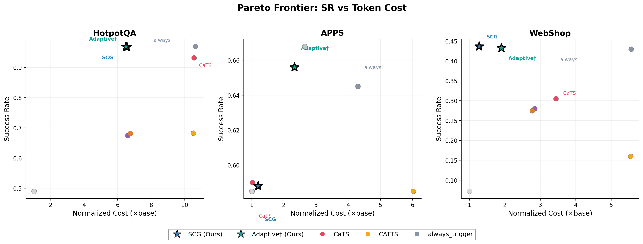
Pareto Frontier: SR vs Token Cost

Slide 13
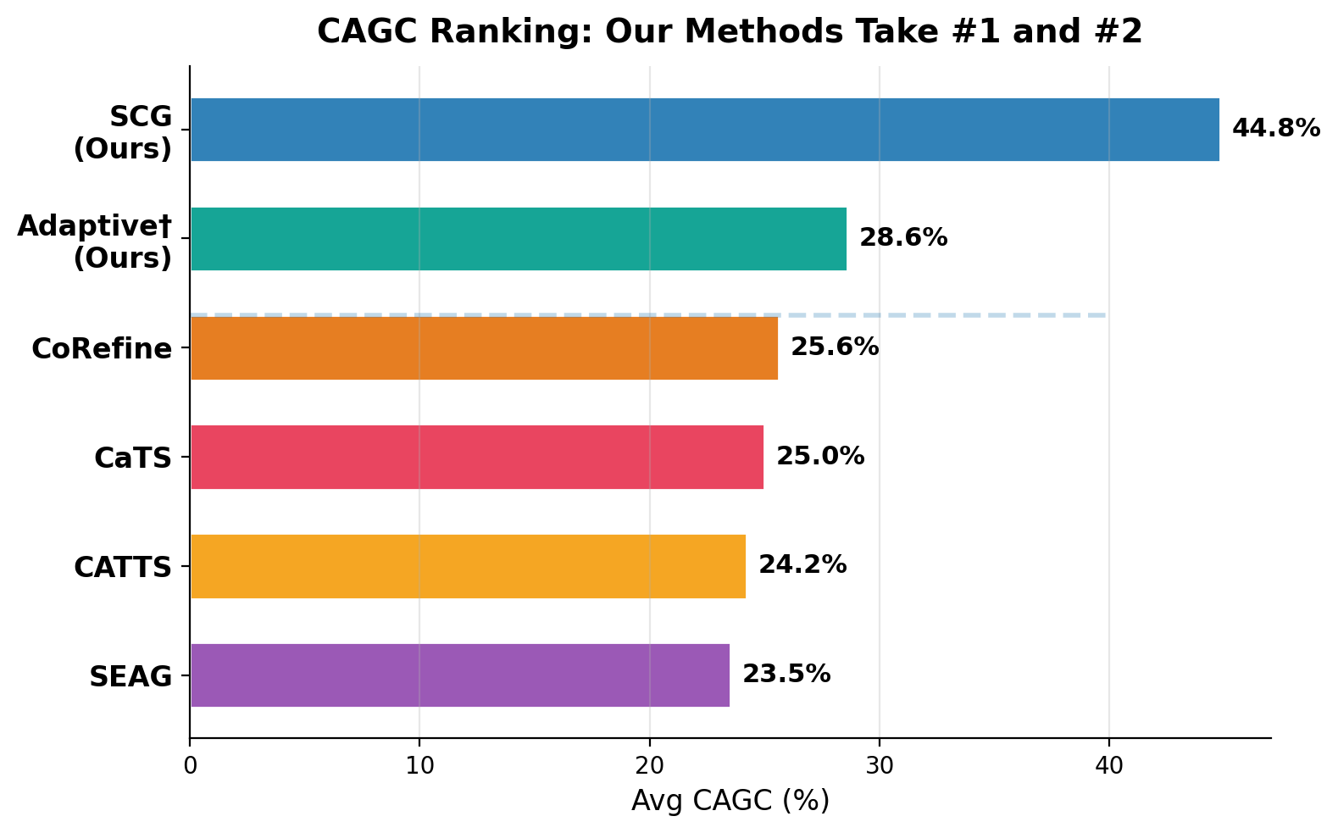
CAGC Ranking: Our Methods Dominate
CAGC = GapClosed% / Cost — comprehensive metric balancing SR improvement and cost
What CAGC Measures:
CAGC = (SR - base_SR) / (oracle_SR - base_SR)
÷ normalized_cost
→ How much of the oracle gap
is closed per unit cost
Results:
• SCG (#1, 44.8%): cost-efficient
precise triggering saves tokens
• Adaptive (#2, 28.6%): SR-first
closes more gap but costs more
• Both beat ALL competing baselines
(CoRefine, CaTS, CATTS, SEAG)

Slide 14
Part 3: Principled-Adaptive Method
Fully Automated Gating — No Domain Knowledge Required

Slide 15
Motivation: Why We Need a New Method
SCG Limitations:
❌ Requires domain knowledge to design features
(evidence_count, state_category, etc.)
❌ Weak-signal environments: APPS SR ≈ base_only
(58.8% vs 58.5% — gate barely triggers)
❌ Manual threshold (0.5) — not optimal
Principled-Adaptive Goals:
✅ Automated feature selection (no domain knowledge)
Auto feature pool → LASSO → top features
✅ Optimal threshold from data
Adaptive λ → CMDP-optimal decision boundary
✅ Fully online — no offline data needed
The APPS Gap — Key Motivation:
• APPS oracle = 75.0% >> always_trigger = 64.5% >> SCG = 58.8%
• Gap between SCG and oracle: 16.2pp — handcrafted features miss the signal
• Only signal: step_count (ρ = -0.155) — too weak for 5-feature LR
→ Need: automatic discovery of richer feature representations that capture rollout value
→ Hidden state probe showed offline AUC=0.88 but online threshold shift kills end-to-end performance
→ Solution: LASSO on expanded auto feature pool + adaptive threshold calibration

Slide 16
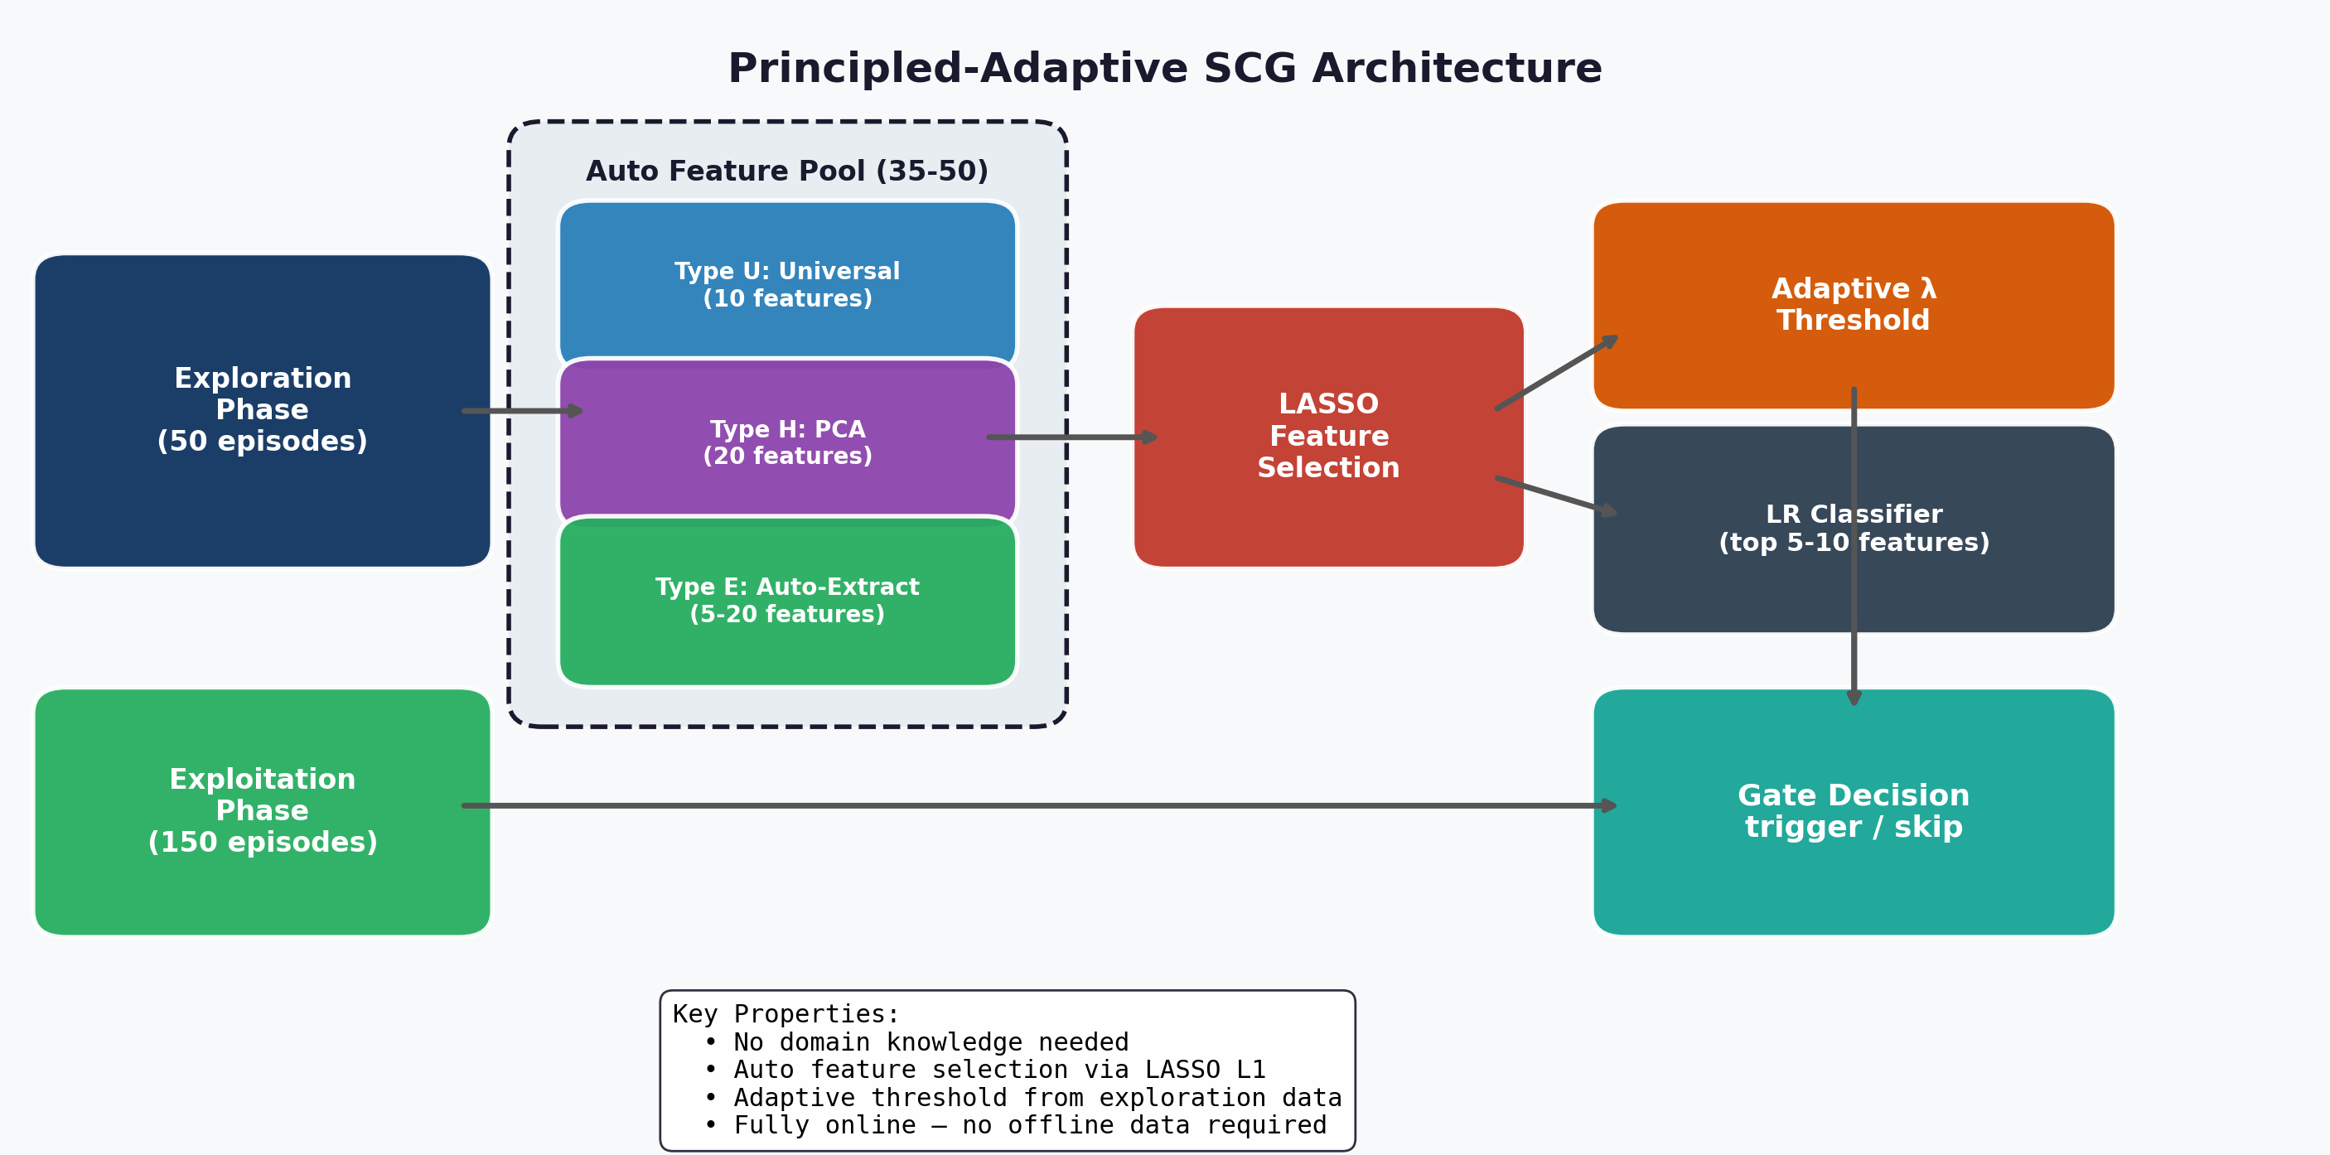
Principled-Adaptive: Architecture

Slide 17
Threshold Optimization: 4 Iterations
Core bottleneck: ranking is excellent (AUC 0.88-1.00) but threshold calibration is hard
Iteration History:
v1 (nopca):
Heuristic threshold
⚠ APPS over-triggers
v2 (auto):
Fixed λ=0.05 sweep
❌ HotpotQA SR crash 68%
v3 (adaptive): ✅ Best
Adaptive λ from data
HotpotQA 96.9%, APPS 65.6%
v4 (fbeta): ⏳ Pending
F-beta threshold
Expected: fix edge cases

Slide 18
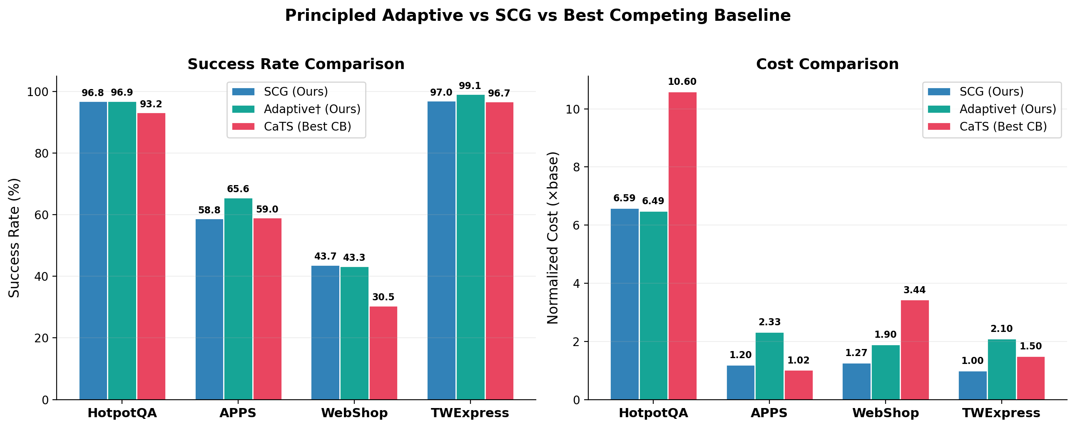
Principled-Adaptive vs SCG: Head-to-Head
Dual-Method Complementarity: SCG = cost-efficient (strong signals) | Principled = SR-first (weak signals, no domain knowledge)
APPS: Principled +6.8pp over SCG — automated features discover what handcrafted miss | HotpotQA/WebShop: both ≈ match

Slide 19
Principled-Adaptive: Full 6-Environment Results
Environment
Adaptive† SR
Ro/ep
Cost†
SCG SR
SCG Cost
ΔSR
HotpotQA
96.9%
1.07
6.49×
96.8%
6.59×
+0.1pp
APPS
65.6%
1.04
2.33×
58.8%
1.20×
+6.8pp
WebShop
43.3%
1.46
1.90×
43.7%
1.27×
-0.4pp
TWExpress
99.1%
3.25
2.10×
97.0%
~1.0×
+2.1pp
BabyAI
8.4%
40.26
5.08×
8.8%
1.46×
-0.4pp
Plancraft
21.8%
5.41
5.08×
21.5%
3.31×
+0.3pp
✅ Wins (4 envs):
HotpotQA: +0.1pp, lower cost
APPS: +6.8pp (biggest gain!)
TWExpress: +2.1pp
Plancraft: +0.3pp
⚠ Tradeoffs:
WebShop: -0.4pp SR but +0.63× cost
BabyAI: -0.4pp, over-triggers (40 ro/ep!)
Cost generally higher than SCG
→ Threshold tuning still improving

Slide 20
Summary & Next Steps
This Week's Achievements:
1. Theory: Two-Source Model
→ 3/3 predictions confirmed
→ Paper upgraded: Finding → Theory
2. Method: Principled-Adaptive
→ Fully automated, no domain knowledge
→ APPS +6.8pp over SCG
→ CAGC ranking #1 (SCG) + #2 (Adaptive)
3. Environment: 4 locked
→ 18 tested, comprehensive coverage
→ Cross-env transfer validates theory
4. Bug Fix: hidden_state never passed
→ All prior probe E2E results invalidated
→ Probe repositioned for analysis only
Next Steps:
P0 — Method Finalization:
• Analyze fbeta threshold results
• Choose final method variant
• Generate unified Pareto figure

