Slide 1


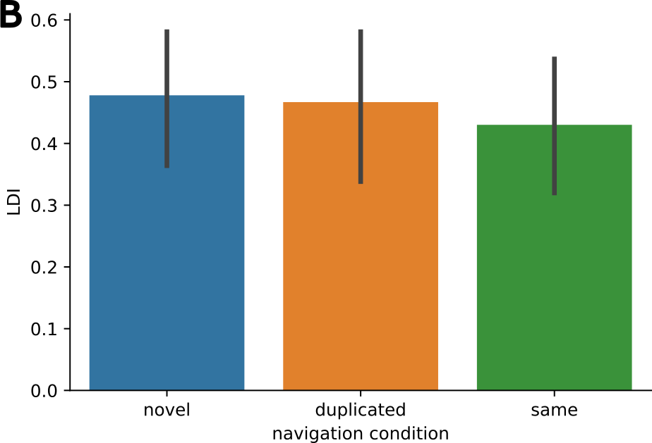
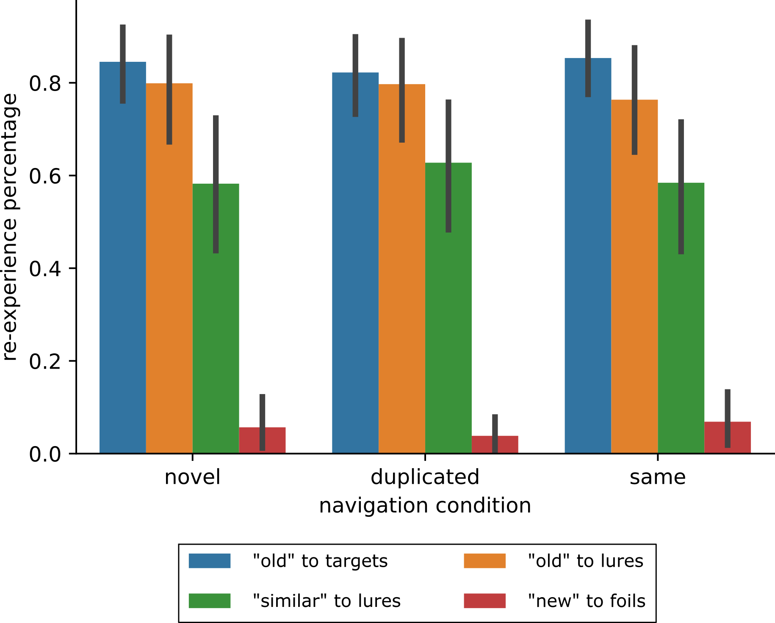
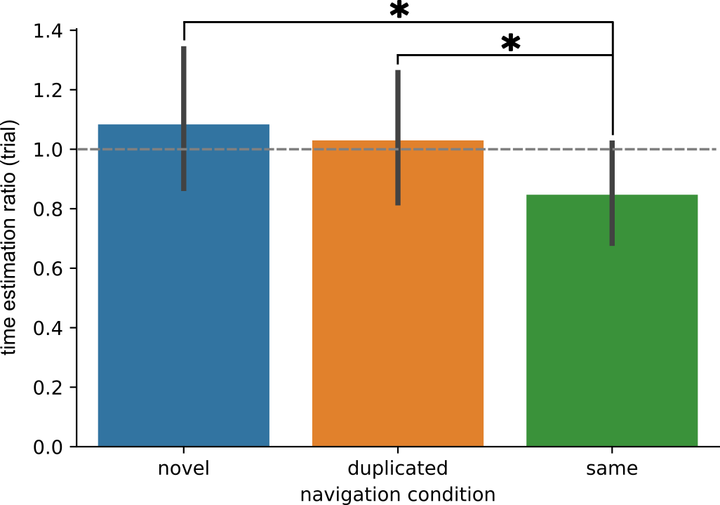
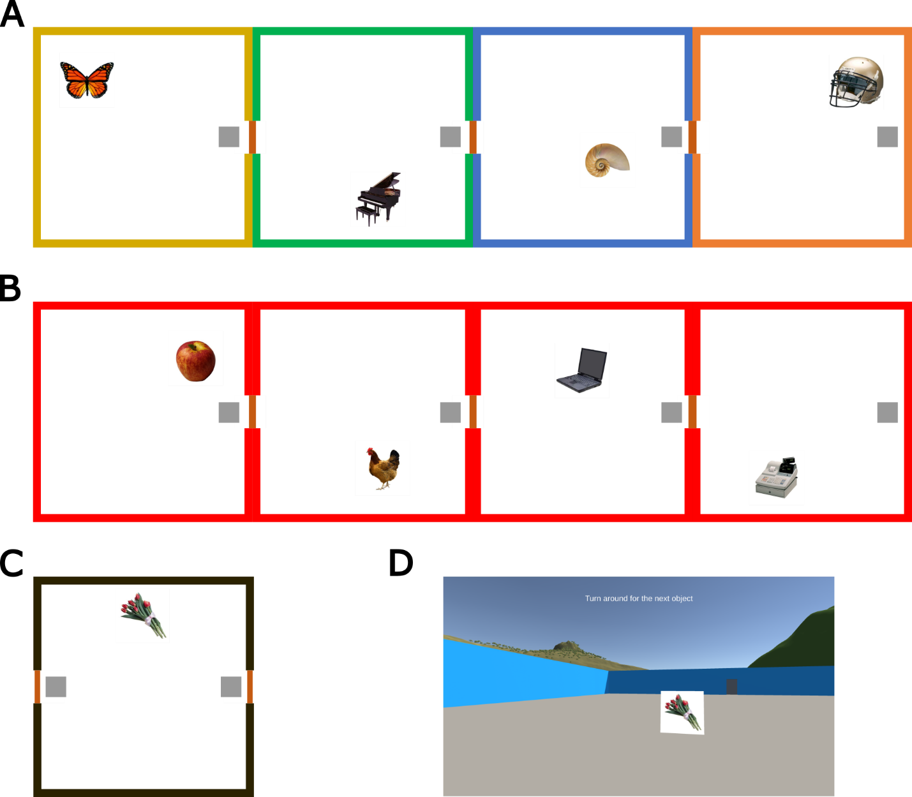
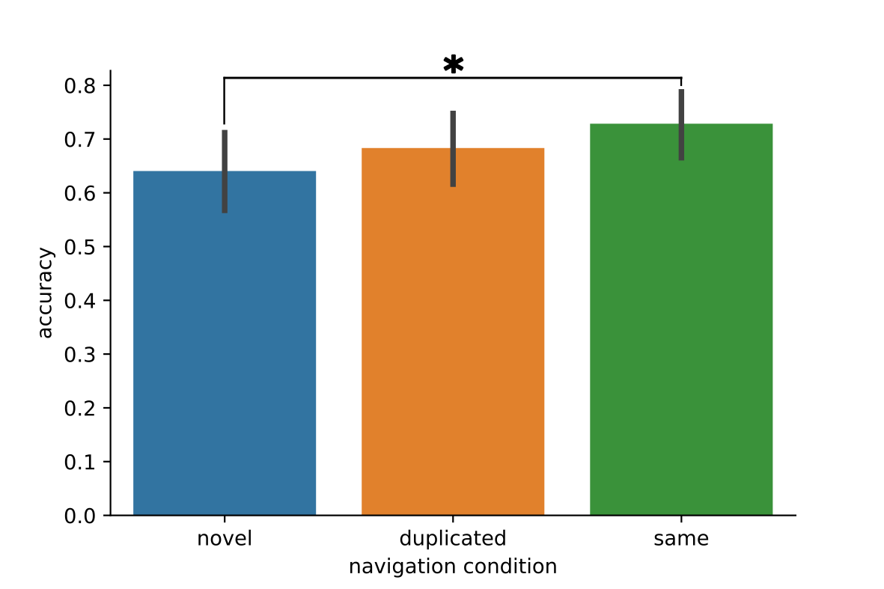
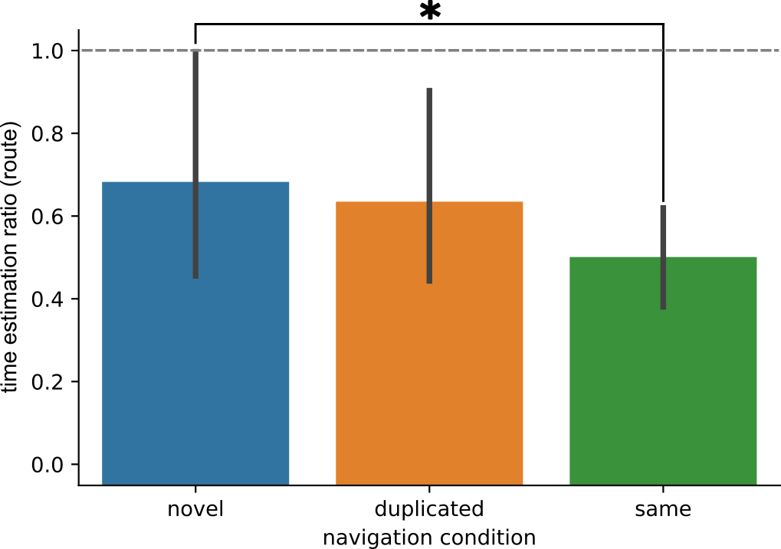

Spatial Boundaries Disrupt Temporal Order and Elongate Subjective Time
Ziming Cheng^{1,2}, Nicole Brzozowski¹, Morris Moscovitch^{1,2}
¹Department of Psychology, University of Toronto, Toronto, Canada; ²Rotman Research Institute, Baycrest Health Sciences, Toronto, Canada
Introduction
Event segmentation can structure the continuous external world into organized internal representations with clear boundaries. ¹
By which criteria do people segment events?
Prediction error or unpredictability: when people cannot predict the information to follow. ²
Contextual instability: when there is a disruption of the continuous context. ³
Unpredictability and changes in context often come together.
Does unpredictability or contextual instability
contribute to the creation of spatial boundaries?
Item-level Memory Tasks
We tested participants’ memory immediately after each round of navigation, including these and all following tasks.
Spatial boundaries did not significantly affect item-level memory regardless of how boundaries were cued
Time Estimation Tasks
Due to the active nature of our navigation task, there were considerable individual differences in the objective time passed between items. Results are displayed as the ratio between subjective time over objective time
Ratio < 1: participants underestimated time
Ratio > 1: participants overestimated time
Between-item Time Estimation Task
Participants saw two items they encountered adjacently and estimated the amount of time between them in seconds.
When estimating time between items, spatial boundaries were effectively cued when there was contextual instability, even when the context to come was completely predictable
Participants underestimated time in the same-room condition in which there was a lack of spatial boundaries
Mnemonic Similarity Tasks with targets, lures, and foils
Remember/Know Tasks for both old and new items
Compared to old/new tests, MST tests memory with higher fidelity and specificity
Spatial Boundaries to Pull Them Apart
34 young adult participants actively found and picked up items in a series of virtual reality rooms. ⁴
Three conditions, within-subject:
Different rooms: unpredictability + instability
Duplicated rooms: unpredictability + instability
Same room: unpredictability + instability
Order Discrimination Task
Participants saw two items they encountered adjacently and decided which one they saw earlier during navigation
Spatial boundaries were only effectively cued with unpredictability and instability combined
Spatial boundaries disrupted the associative strength between items flanking a boundary, possibly due to each item being associated to a different context
Route Time Estimation Task
Participants estimated the time to navigate the entire route in seconds.
When estimating time for the whole route, spatial boundaries were only effectively cued with unpredictability and instability combined.
Participants underestimated time in the same-room condition in which there was a lack of spatial boundaries.
* After collecting each object, participants needed to go to the gray square at the other end of the room (thus matching the distance traveled in all conditions), after which a new target would appear. Each route consisted of eight different objects. All participants did two routes of each condition, with the order counter-balanced.
Take-Home Messages
Spatial boundaries did not affect item-level memory even when the test required high specificity.
Associative strength between items was stronger when there were no spatial boundaries than when there were.
Subjective time between items and over the entire route was shorter when there were no spatial boundaries.
Contextual instability and unpredictability typically work together to account for the effects of spatial boundaries on memory
Participants’ view of the virtual reality room. VR is powered by SilicoLabs.
References
Griffiths, B. J., & Fuentemilla, L. (2020). Hippocampus, 30(2), 162–171.
Zacks, J. M. et al., (2007). Psychological Bulletin, 133(2), 273–293.
Clewett, D., & Davachi, L. (2017). Current Opinion in Behavioral Sciences, 17, 186–193.
Heusser, A. C., Ezzyat, Y., Shiff, I., & Davachi, L. (2018). Journal of Experimental Psychology: Learning, Memory, and Cognition, 44(7), 1075–1090.

