Slide 1
Exploration of Integrating Computation into the Curriculum
Todd Zimmerman
University of Wisconsin – Stout
Kelly Roos
Bradley University
Please go to gopicup.org and click register (upper right corner of screen)
Partnership for the Integration of Computation into Undergraduate Physics
Gopicup.org

Slide 3
Outline for Today
Introduction to PICUP --10 minutes
Work Through Computational Activity -- 45 minutes
Overview of PICUP Website and Framework -- 15 minutes
Strategies for Integrating Computational Activities -- 20 minutes

Slide 4
Partnership for the Integration of Computation into Undergraduate Physics
T
Theoretical
Skills
Mission
Create a vibrant community of educators, a forum for open discussion, a collection of educational resources, and a set of strategies and tactics that support the development and improvement of undergraduate physics education through integration of computation across its curriculum.
E
C
Computational
Skills
Experimental
Skills
W
Writing / Technical
Communication
Skills
M.E. Johnston, “Implementing Curricular Change,”
Computing in Science and Engineering, Vol. 8, No. 5, p. 32 (2006).
Notes:
How to help you get computer activities into your courses

Slide 5
Benefits:
Students develop skills that are necessary in private sector jobs and in graduate school¹.
Computational homework and projects that are more closely connected to how professional physicists engage with their own work, excite students, and might help retain physics majors by providing enjoyable experiences².
Enhance content coverage with little or no loss.
Enhance conceptual understanding by allowing students to play around in "parameter space" and to visualize system behavior.
1. AIP Statistical Research Center, “Report on Physics Bachelors,” Focus On, June 2015.
2. Caballero, M.D. & Pollock, S.J. Am. J. Phys. 82 (3), March 2014.
3. Dancy, M. & Henderson, C. Barriers and Promises in STEM Reform, Commissioned Paper for National Academies of Science Workshop on Linking Evidence and Promising Practices in STEM Undergraduate Education, Washington, DC, Oct 13-14, 2008.

Slide 6
Question:
Why are you at this workshop?
Why do you want to add computation to your courses?

Slide 7
Choice of Activity
Introduction to Glowscript and Vpython (Glowscript/Vpython)
or
Lunar Lander (Glowscript/Vpython)
or
Falling Sphere with Air Resistance Proportional to v² (Excel)
Notes:
Let participants choose
45 minutes for activity
Show them finished product
What do students have access to:
Overview and Exercise only
Overview: Elevator talk version
Learning objectives: look at others for examples if you aren’t sure
Instructor’s guide: Help on how to implement in their classroom. Include issues you encountered when trying this
Theory: What do you assume the instructor has covered in class for students to understand the activity
Exercise: This is what the student sees
Code: Templates for instructors to share as well as solutions
Solutions: What students should get – include graphs/screenshots
References: Textbook chapter where you can find the relevant material
Show them web edit view

Slide 8
Computation Implementation Space (CIS)
Midterm or
Final project
Exams
Laboratory
Homework
Lecture
Modifying minimally working programs.
Producing
Pseudocode.
Using available simulations.
Modifying working programs.
Writing code from scratch.
Notes:
Emphasize PICUP’s two main ideas are (1) platform agnosticism and (2) lowering barriers

Slide 9
Go to:
https://www.compadre.org/PICUP/exercises/
Notes:
Show them finished product
What do students have access to:
Overview and Exercise only
Overview: Elevator talk version
Learning objectives: look at others for examples if you aren’t sure
Instructor’s guide: Help on how to implement in their classroom. Include issues you encountered when trying this
Theory: What do you assume the instructor has covered in class for students to understand the activity
Exercise: This is what the student sees
Code: Templates for instructors to share as well as solutions
Solutions: What students should get – include graphs/screenshots
References: Textbook chapter where you can find the relevant material
Show them web edit view

Slide 10
Question:
What issues do you think you might have adding computation to your curriculum?
How can you overcome these issues?

Slide 11
Possible issues:
Dancy and Henderson¹ have listed the most salient barriers to changes in Physics instruction. We offer suggestions for overcoming these barriers in the context of integrating computation into an undergraduate Physics course in the “Notes” .
#1 Expectations of content coverage.
#2 Lack of instructor time.
#3 Departmental norms.
#4 Student resistance.
#5 Class size and room layout.
1. Dancy, M. & Henderson, C. Barriers and Promises in STEM Reform, Commissioned Paper for National Academies of Science Workshop on Linking Evidence and Promising Practices in STEM Undergraduate Education, Washington, DC, Oct 13-14, 2008.

Slide 12

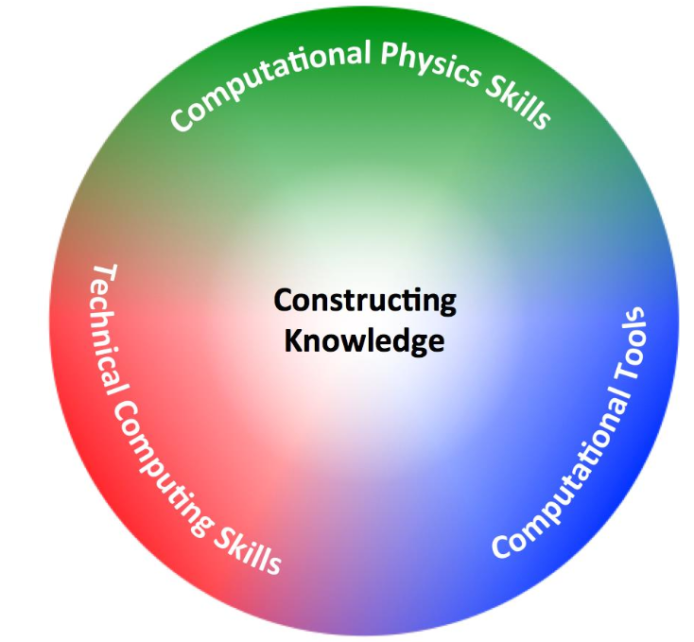
Where to go next:
J-TUPP report: Phys21: Preparing Physics Students for 21st Century Careers
http://www.compadre.org/jtupp/
AAPT Recommendations for Computational Physics in the Undergraduate Physics Curriculum
http://www.aapt.org/Resources/upload/AAPT_UCTF_CompPhysReport_final_B.pdf

Slide 13
Support:
Listserve: gopicup@googlegroups.com
Online community: gopicup.slack.com
Contact a member of the PICUP leadership team:
Danny Caballero, Department of Physics and Astronomy, Michigan State University, caballero@pa.msu.edu
Marie Lopez del Puerto, Department of Physics, University of St. Thomas, mlpuerto@stthomas.edu
Larry Engelhardt, Department of Physics, Francis Marion University lengelhardt@fmarion.edu
Kelly Roos, Engineering Physics, Bradley University, rooster@Bradley.edu
Robert Hilborn, American Association of Physics Teachers, rhilborn@aapt.org
Norman Chonacky, Yale University, norman.chonacky@yale.edu
Attend a PICUP workshop! http://www.compadre.org/PICUP/events/

