Slide 1
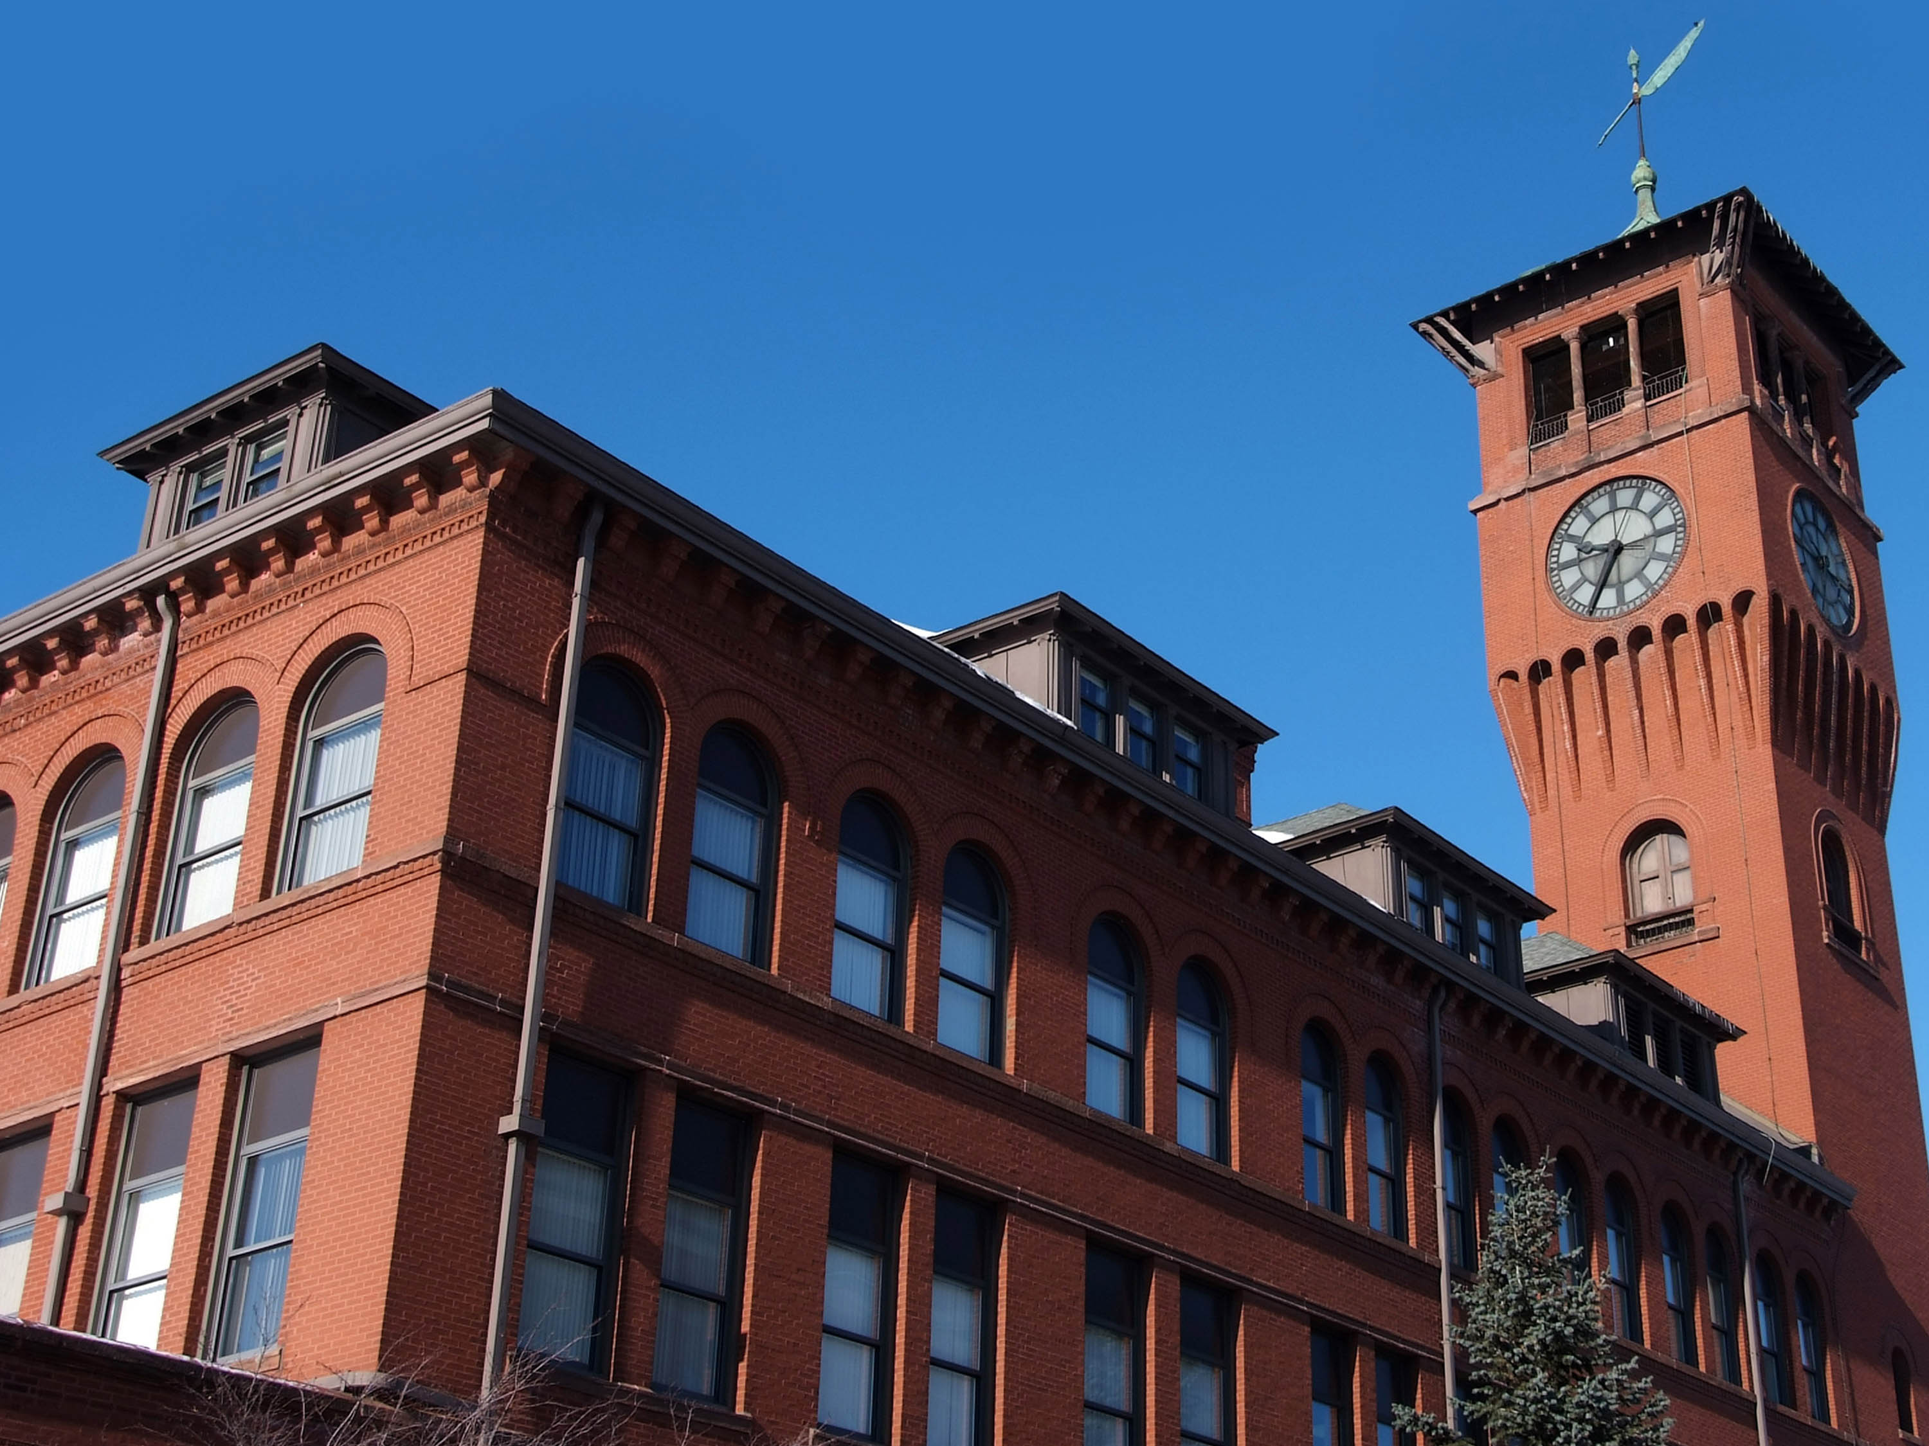

Projectile Motion Experiment and Computational Model
AAPT Winter Meeting
Jan 8, 2018
Todd Zimmerman
University of Wisconsin – Stout
Menomonie, Wisconsin
Inspiring Innovation. Learn more at www.uwstout.edu

Slide 2
Computation and Experiment
The 3-legged stool
Theory
Experiment
Computation
Notes:
Computation can be a bridge between theory and experiment
Virtual experiments

Slide 3
University Physics I
23 students per section
All students have laptops
3 hours of lecture
2 hour labs
2 hour discussions
Notes:
No TA’s and lecturer handles labs as well
Two sections per year
Primarily Applied Science and Computer Science students
Typically do an introduction to Vpython – bouncing ball and constant acceleration

Slide 4
SageMathCloud CoCalc
VPython
Jupyter Notebooks running at CoCalc.com
Also used Glowscript.org
Notes:
Not installing due to fact that I always have differing error message

Slide 5
Activity
Projectile Motion
Computer Model
Look at horizontal distance traveled and total time in the air
Horizontal launch
Vertical launch
Experiment
Determine launch velocity
Model launch for arbitrary angle and do experiment
Notes:
2nd Python activity – know how to do constant velocity and constant force

Slide 6
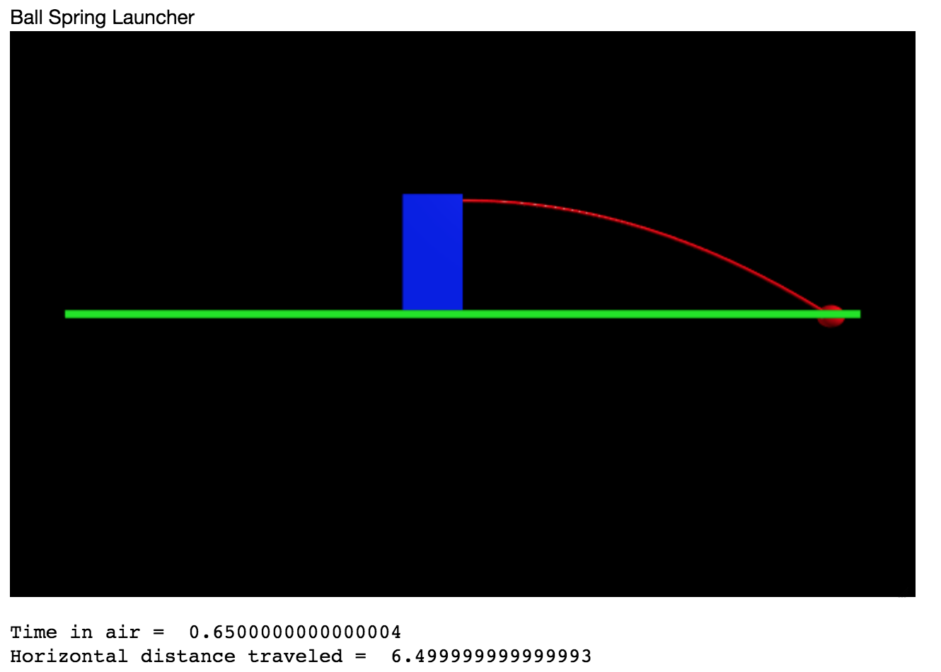
Jupyter Notebook
Notes:
Show code

Slide 7
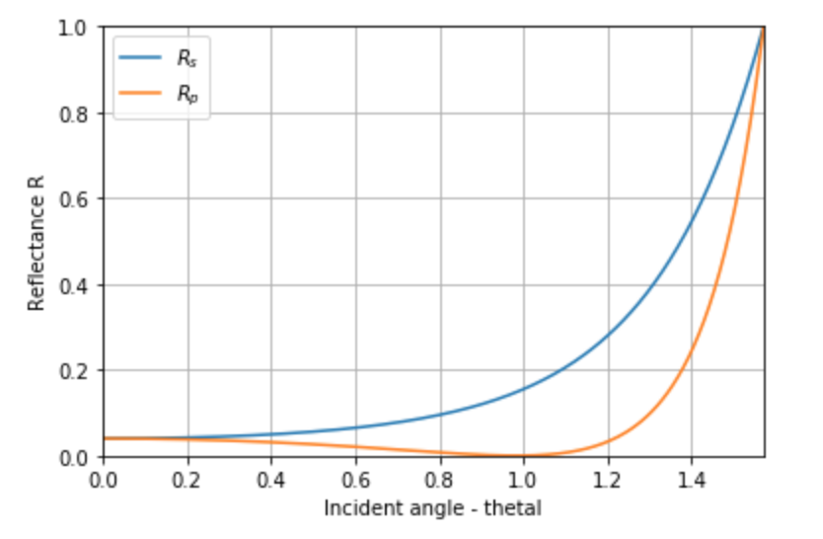
Fresnel’s Equations
Use Snell’s law to plot angles
Plot reflectance at air-to-glass surface
Use graph to predict results
View reflected light w/ polarizer and glass slide
Observe Brewster’s angle
Notes:
Not a full-fledged lab – brief hands-on activity
Junior level optics course with 6 students

Slide 8
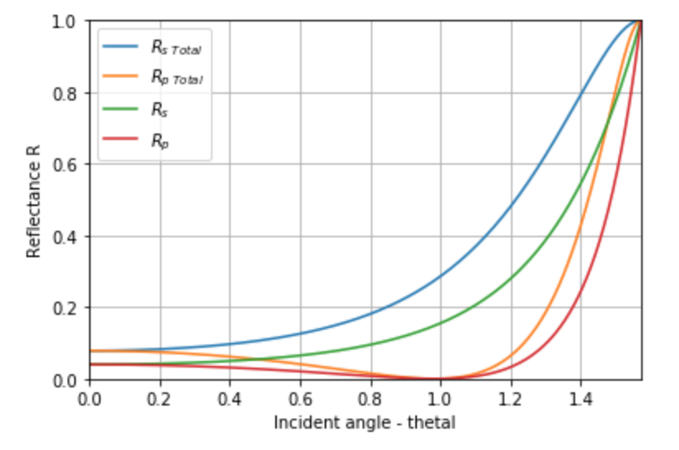
Additional Activity
Account for reflection from back surface

Slide 9
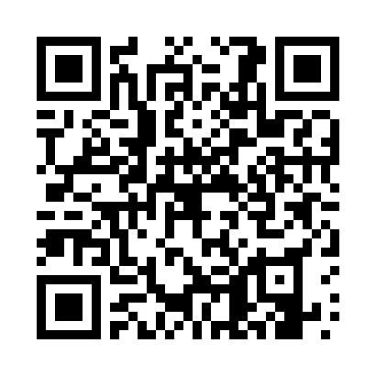
Thank You
Thanks to the UW-Stout Office of Research and Sponsored Programs and to the Nakatani Teaching and Learning Center for financial support
Slides are available at:
https://github.com/zimmermant/talks/

