Slide 1
Implementing Computation Across the Curriculum

Slide 2
Talk Outline
Three-legged stool

Slide 3
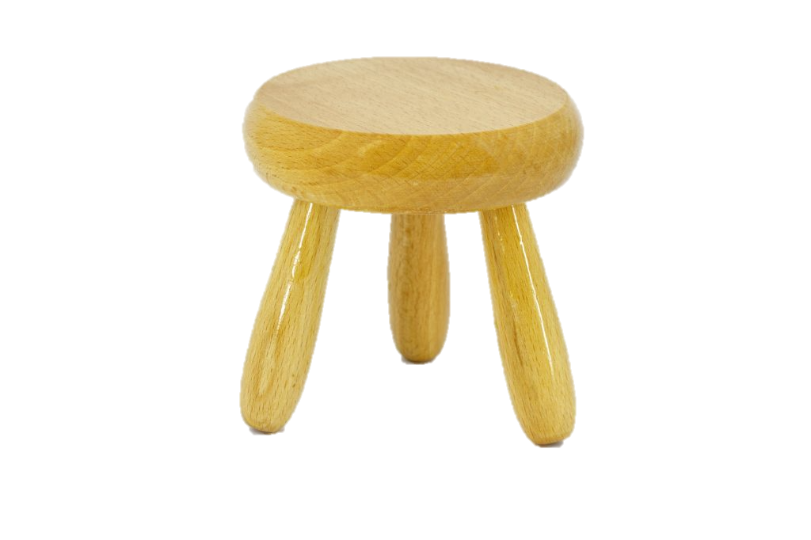
Three-Legged Stool
Physics
Theory
Experiment
Computation
[Three-legged stool]. (n.d.). Retrieved July 23, 2018, from https://marketvolt.com/2017/05/marketing-is-a-three-legged-stool/

Slide 4
Inert Gas Condensation

