Slide 1
CORNERSTONE
TESTING
Created: Aiman Hazim 13/04/2026
Updated: 22/06/2026

Slide 2
To provide overview of the testing work performed in CORNERSTONE
To list out the setups available and to be built for measurement activities
To outline on the progress for the measurement work

Slide 3
Contents
Testing Overview
Test Setups – Available
Test Setups – Future
Wafer-Scale Tester
Testing Service
Measurement Request Tracker
Post-processing activities
PDK-Monitor upload

Slide 4
Testing - Overview
Chip level
  Optical
    Insertion Loss
    Propagation Loss
    Fibre arms (Grating Couplers)
    Fibre arrays
    Edge Coupling (future plan)
    C-band
    O-band
    Mid-IR
  Electrical
    MZI Heater performance
    Heater Resistance
    On-chip Photodetectors
Wafer level
  Optical
    Insertion Loss
    Propagation Loss
    Grating couplers only
  Electrical
    MZI Heater performance (work in progress)

Slide 5
Testing
Chip Level
Wafer Level
Optical
Electrical
Optical
Electrical
Insertion Loss
Propagation Loss
Fibre Arrays
Edge Coupling
C-band, O-band, Mid-IR
MZI Heater Performance
Heater Resistance
Photodetectors
Insertion Loss
Propagation Loss

Slide 6
Testing
Chip Level
Wafer Level
Optical
Electrical
Optical
Electrical
Insertion Loss
Propagation Loss
Fibre Arrays
Edge Coupling
C-band, O-band, Mid-IR
MZI Heater Performance
Heater Resistance
Photodetectors
Insertion Loss
Propagation Loss
MZI Heater Performance (work in progress)

Slide 7
Measurement Setup

Slide 8
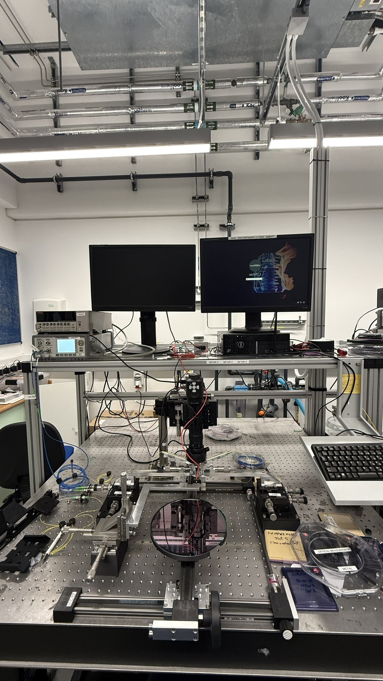
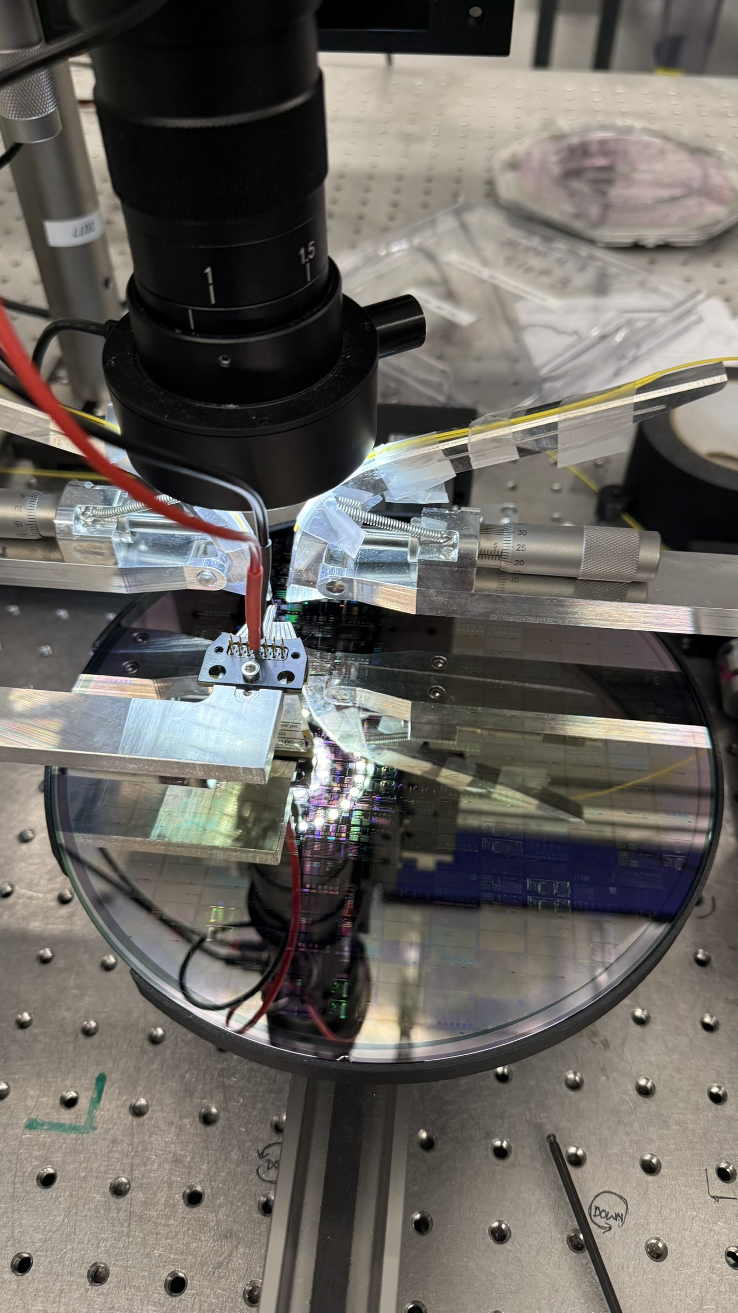
Chip-Level Optical Testing - Setup
SETUP (Picture)
Equipment:
  Tunable Laser Source
  Powermeter
  Fibre arms
  Optical fibre
  3-axes stage
  Camera module

Slide 9
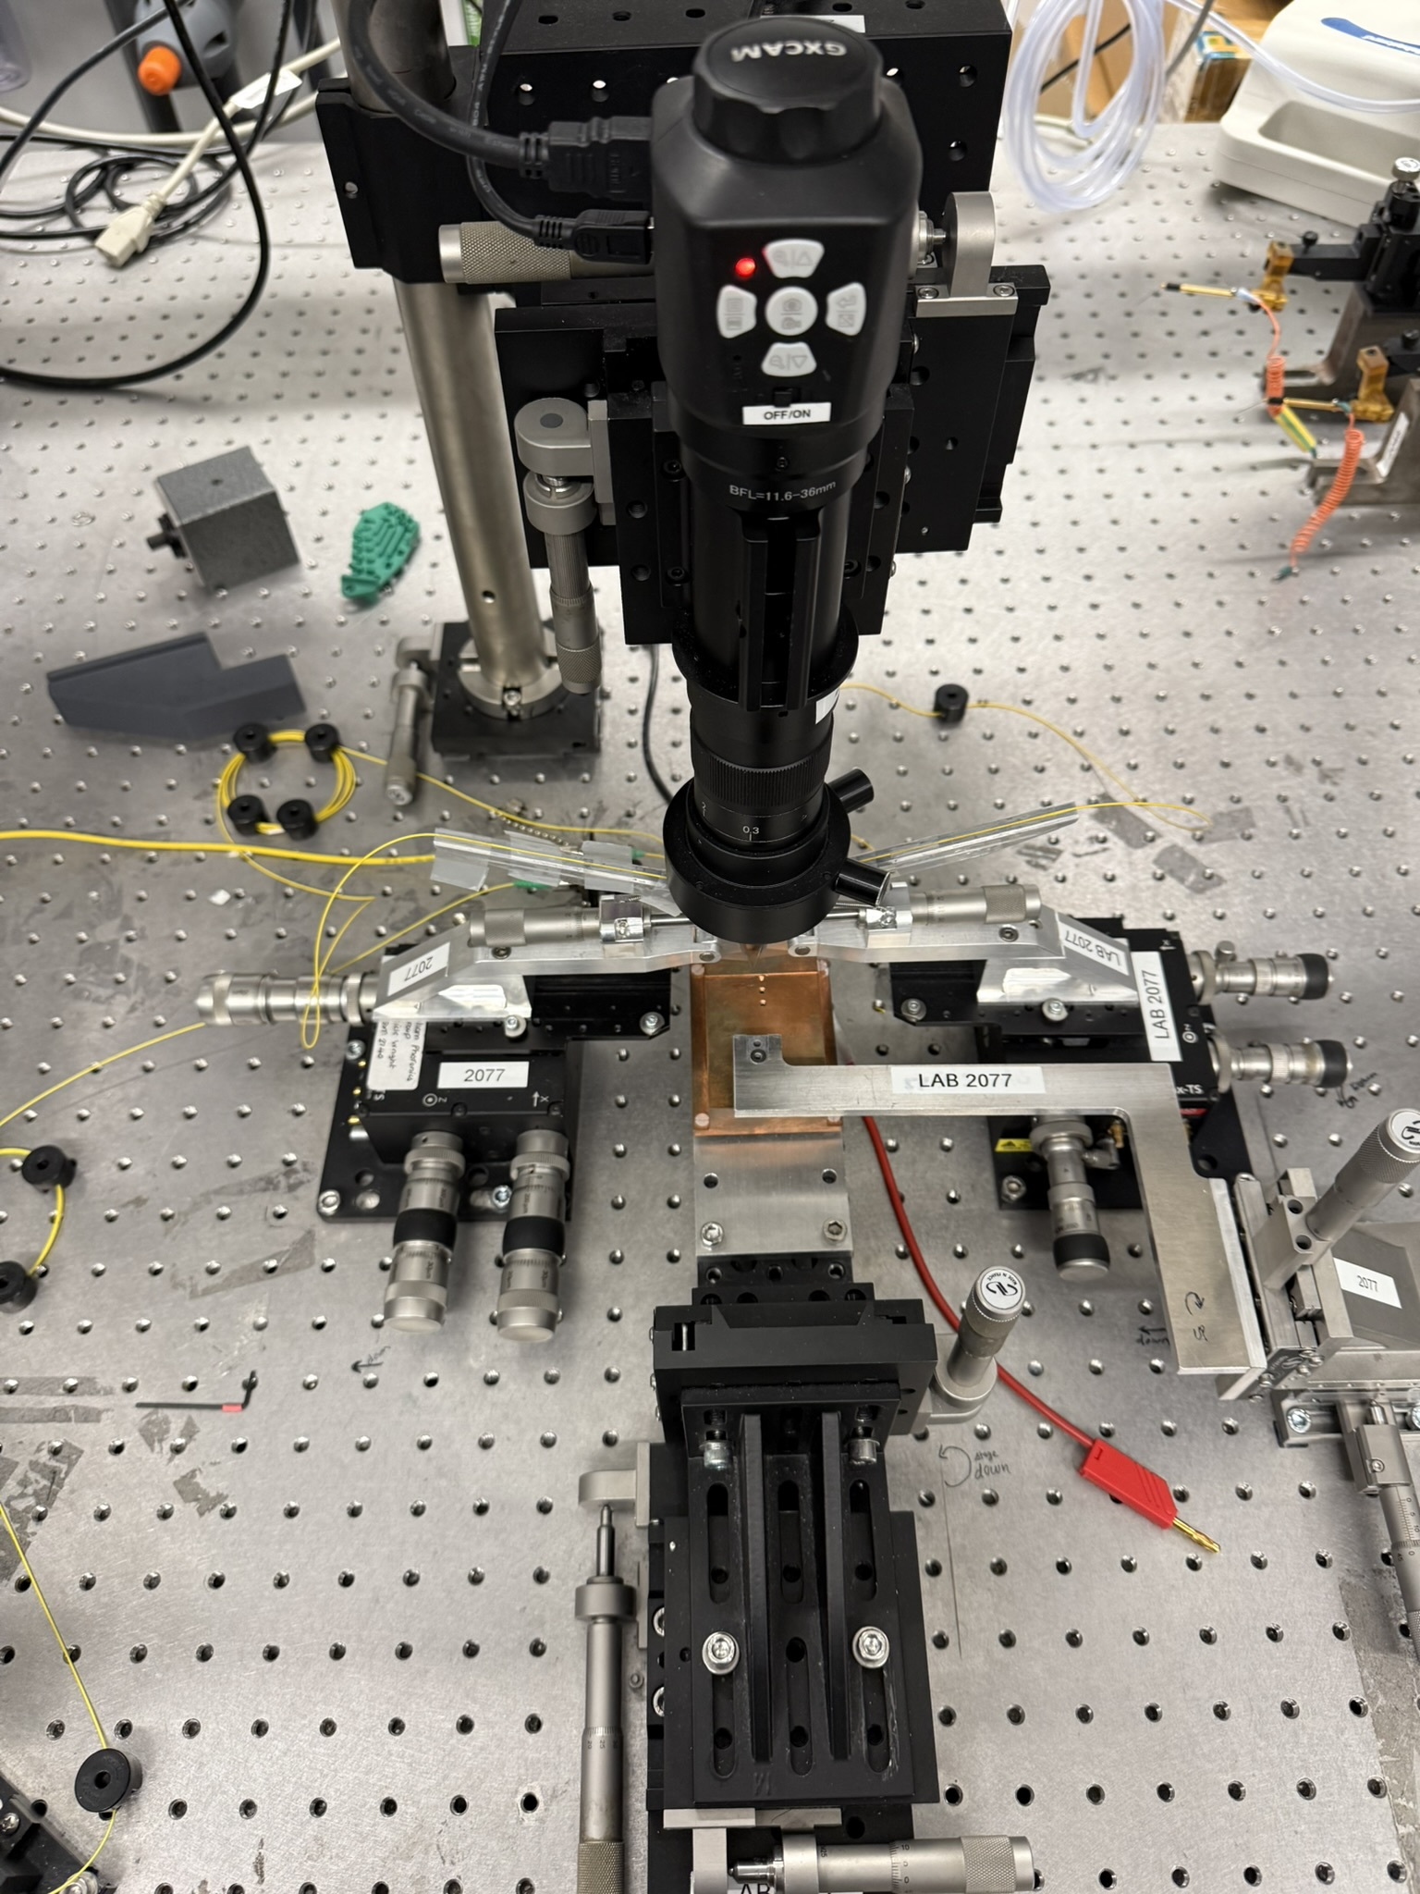
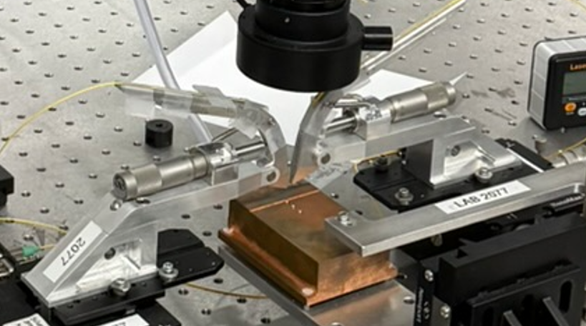
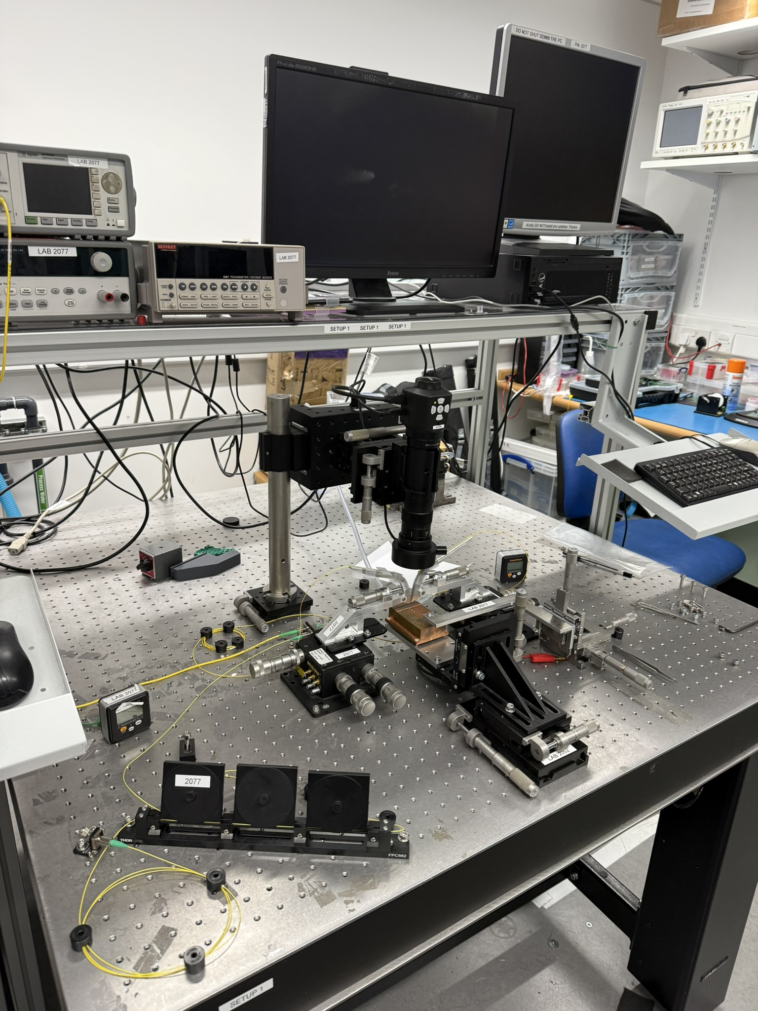
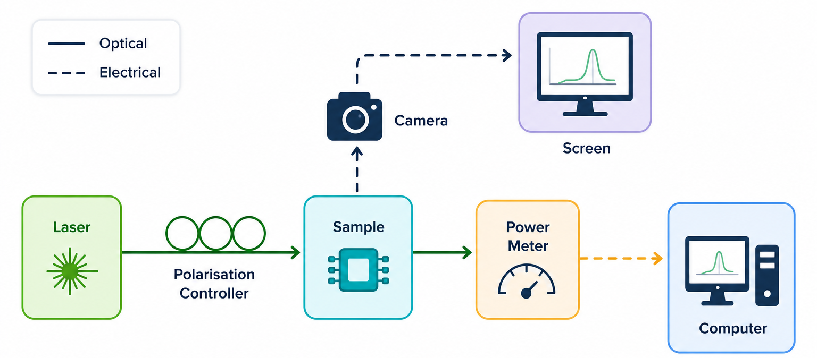
Chip-Level Optical Testing - Setup
Equipment:
  Tunable Laser Source
    81940A Compact Tunable Laser Source with Continuous Sweep Mode, 1520nm to 1630nm [Obsolete] | Keysight
  Optical Powermeter
    81634B Low Polarization Dependence Optical Power Sensor [Discontinued] | Keysight
  Polarisation Controller
    Thorlabs · Manual Fiber Polarization Controllers
    3-Paddle Polarization Controllers, Ø56 mm Loop
  Camera module
    USB and Display Cameras
  Fibre arms
    Bespoke design (University of Southampton)
  Optical fibre
    Thorlabs · Optical Fiber & Fiber Patch Cables
    Thorlabs · P3-SMF28Y-FC-5 Single Mode Patch Cable, 1260-1625 nm, FC/APC, Ø900 µm Jacket, 5 m Long
    Thorlabs · P3-1550PM-FC-5 PM Patch Cable, PANDA, 1550 nm, Ø3 mm Jacket, FC/APC, 5 m Long
  3-axes stage
    Thorlabs · 3-Axis NanoMax™ Flexure Stages
  Chip holder

Slide 10
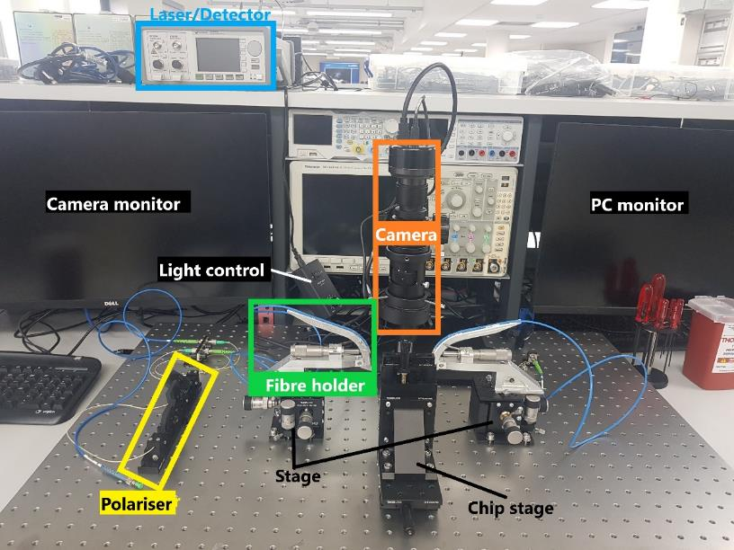
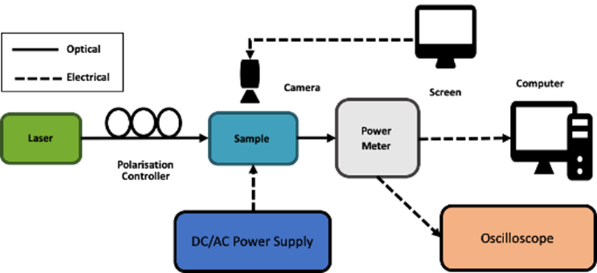
Chip-Level : Optical Testing Setup
A typical optical bench includes:
Tunable Laser Source
Polarisation Controller
Photodetector
Camera (for alignment)
Fibre holders/arms
Chip stage
Light is coupled into the waveguide, interacts with the device, and is measured at the output.

Slide 11
Chip-Level Electrical Testing

Slide 12
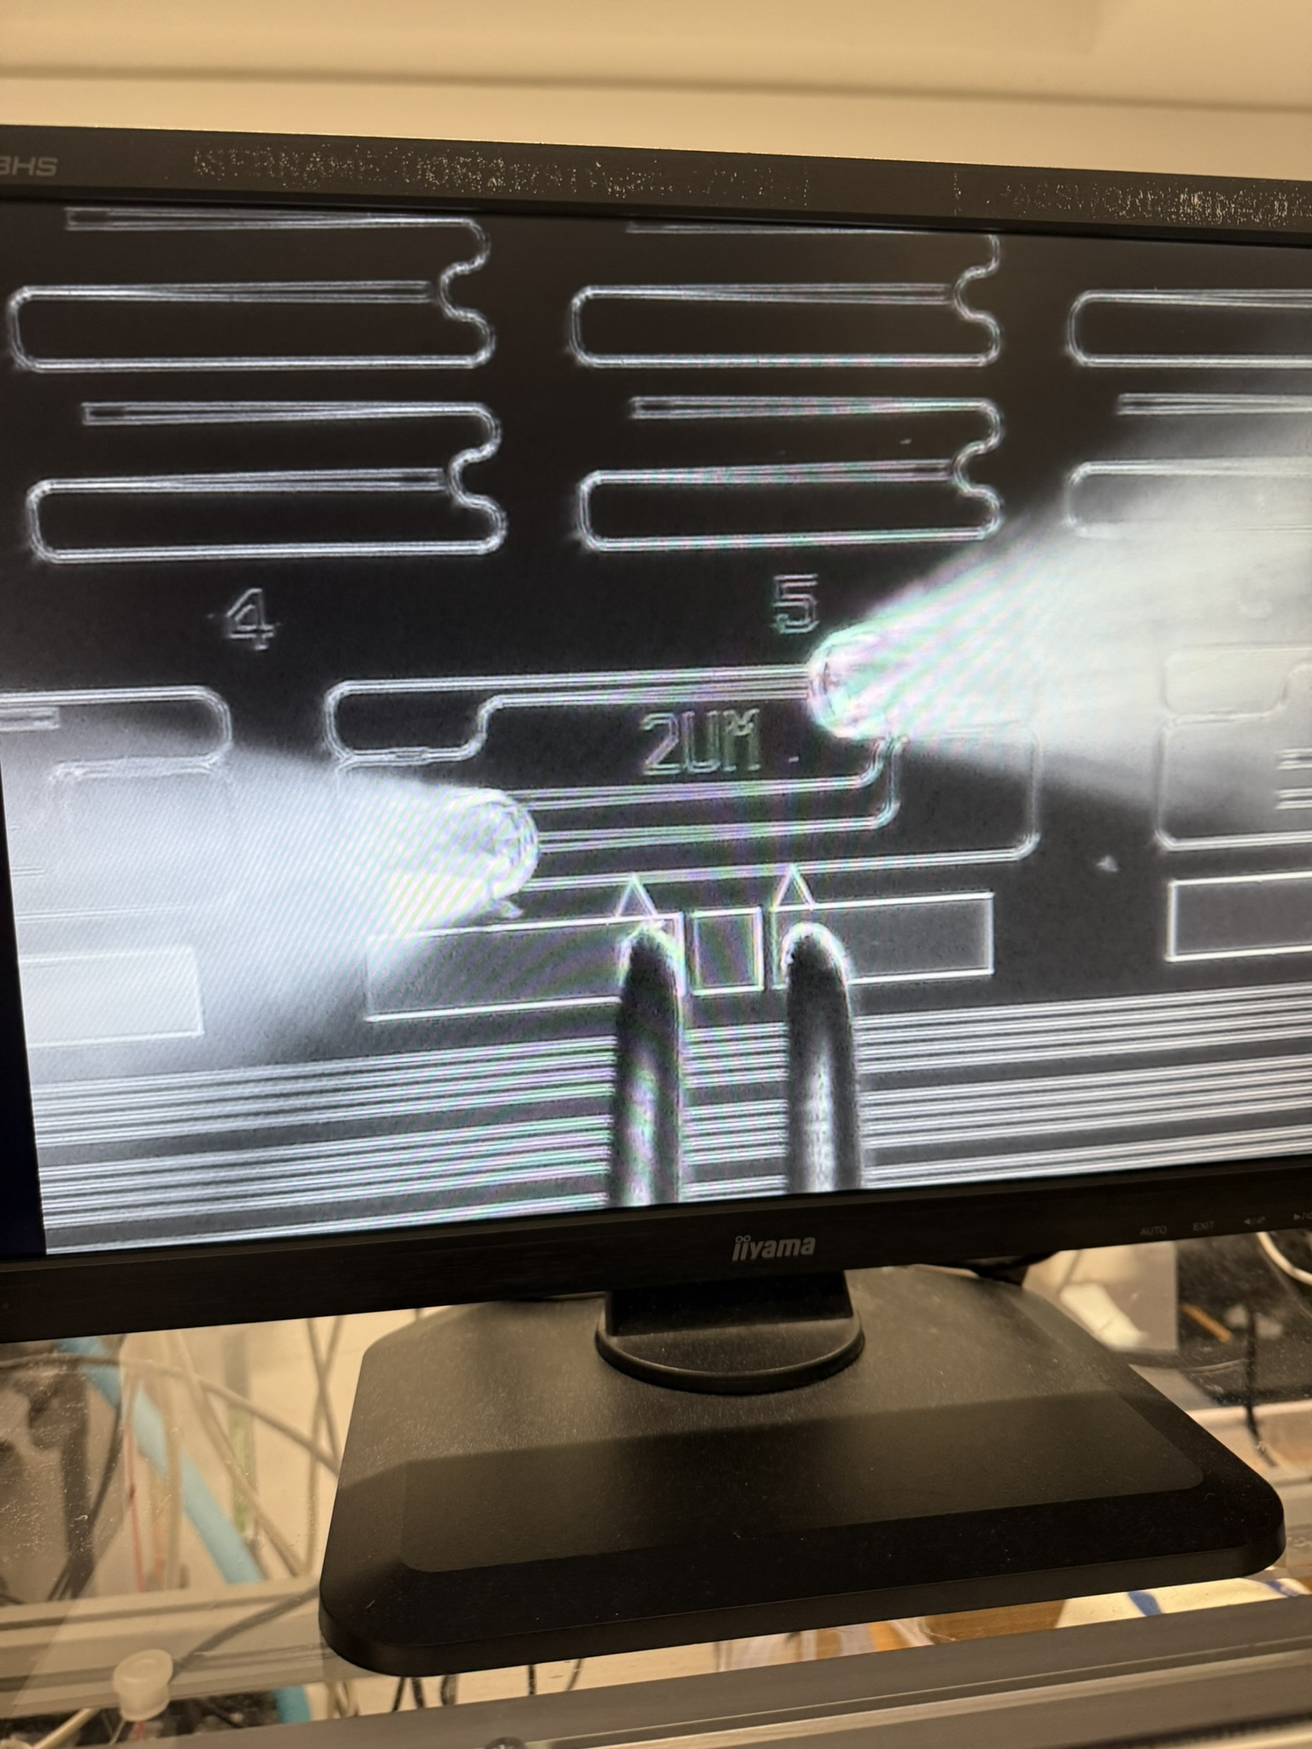
Chip-Level Electrical Testing - Setup
SETUP (Picture)

Slide 13
Optical Characterisation

Slide 14
Insertion Loss
SETUP (Picture)

Slide 15
Propagation Loss
SETUP (Picture)

Slide 16
Coupling Loss (Gratings)
SETUP (Picture)

Slide 17
MZI – Heater Efficiency
SETUP (Picture)
Thermo-optic phase shifter

Slide 18
TE/TM mode
SETUP (Picture)

Slide 19
Fibre angle Variation
SETUP (Picture)

Slide 20
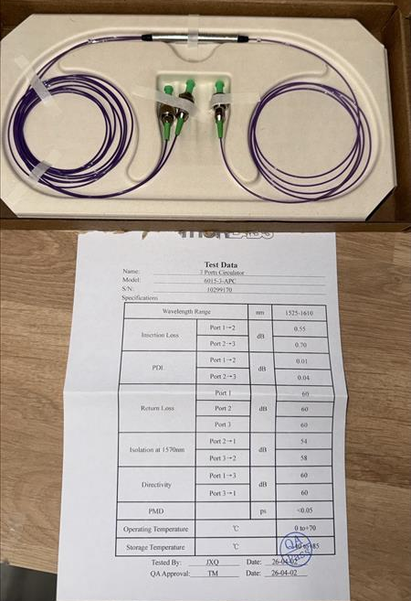
Tunable RR based optical reflector
SETUP (Picture)
Use 3 ports circulator
Add setup flow figure

Slide 21
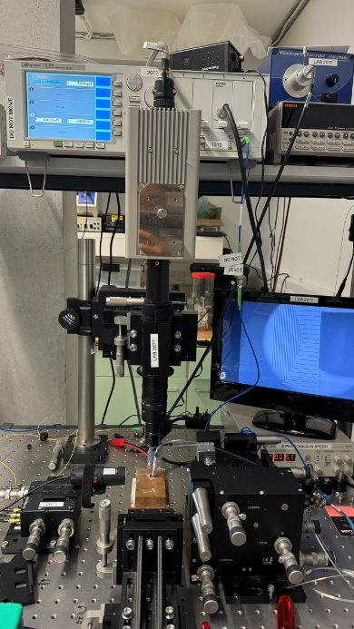
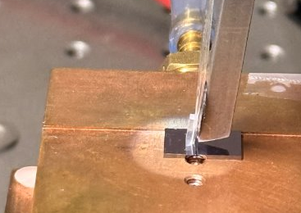
Chip-Level – Fibre Array
SETUP (Picture)

Slide 22
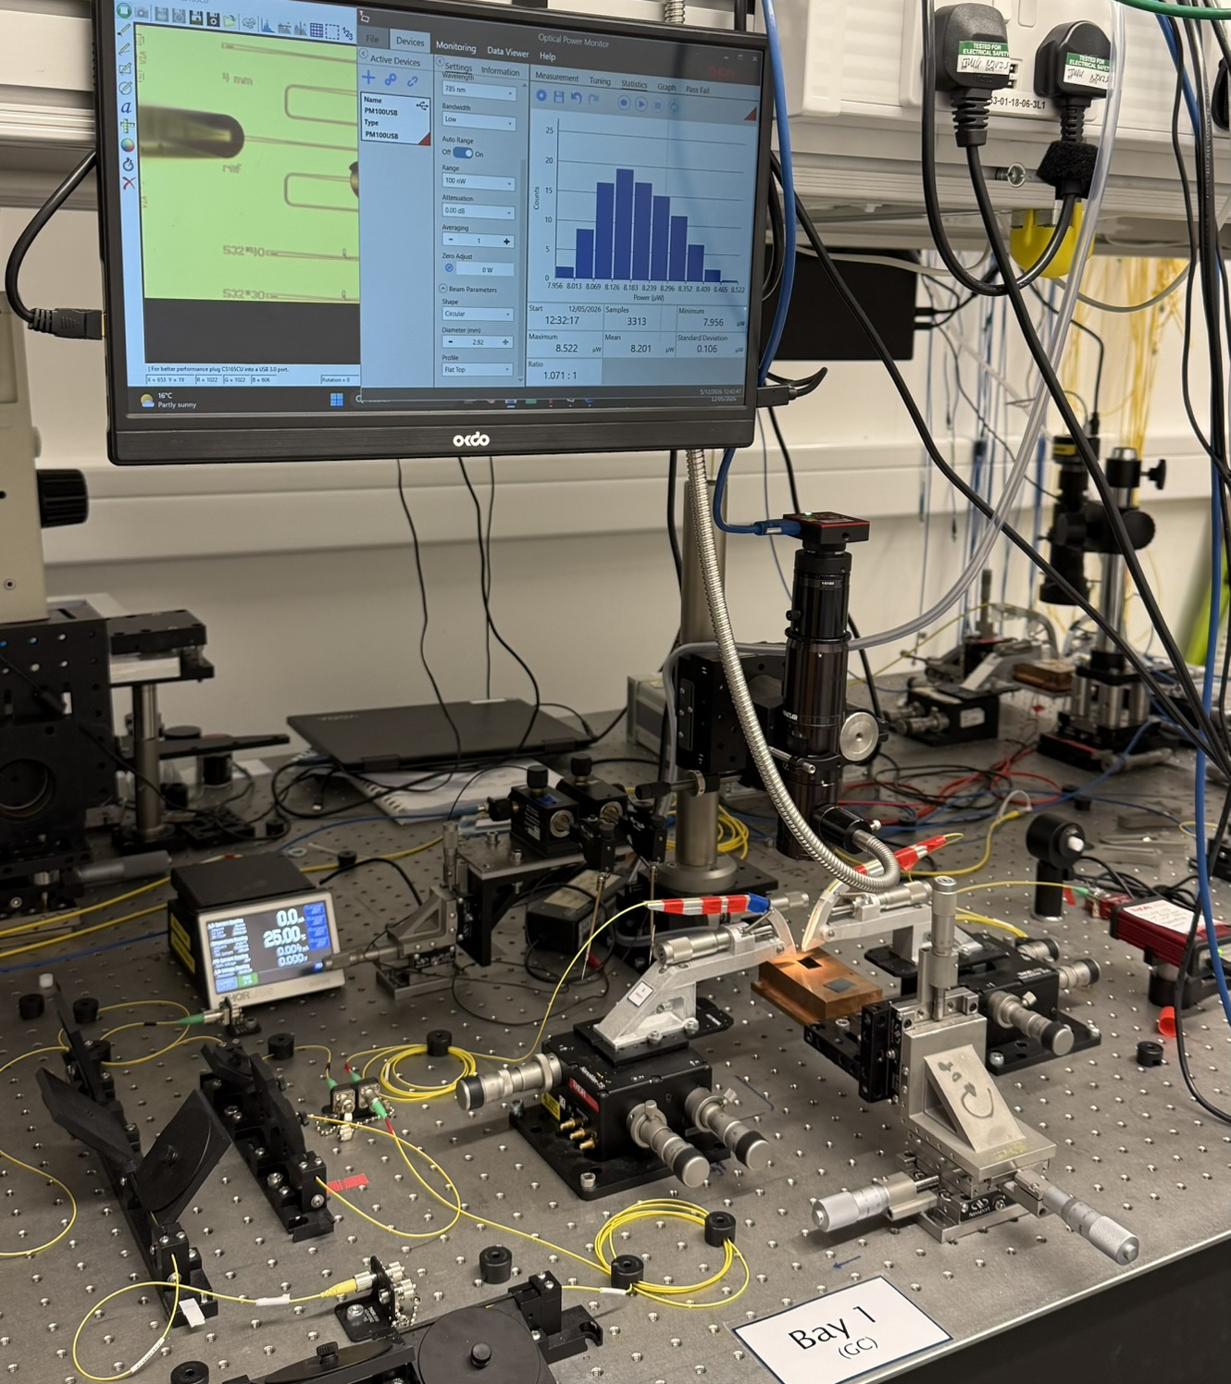
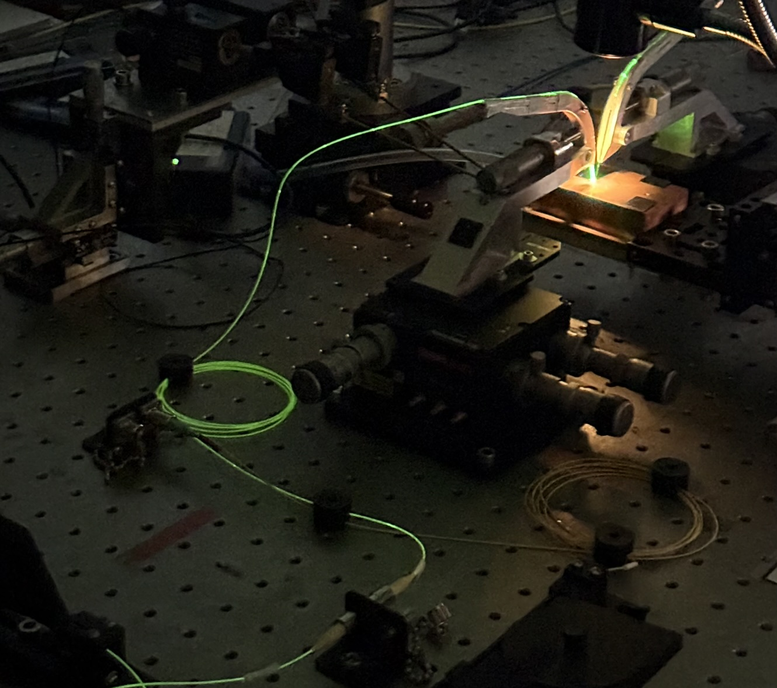
Chip-Level – Visible
SETUP (Picture)

Slide 23
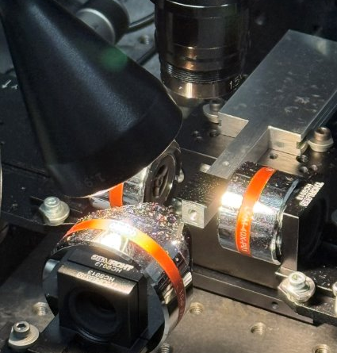
Chip-Level – Mid-IR
SETUP (Picture)

Slide 24
Chip-Level – Edge coupling
SETUP (Picture)
To build the setup
List out the components (Thorlabs) need to be purchased for the setup
  Thorlabs · HFV002 Tapered V-Groove Fiber Holder for Multi-Axis Stages
  Thorlabs · P3-SMF28Y-FC-5 Single Mode Patch Cable, 1260-1625 nm, FC/APC, Ø900 µm Jacket, 5 m Long
  Chip holder/stage (like the one in Mid-IR lab)

Slide 25
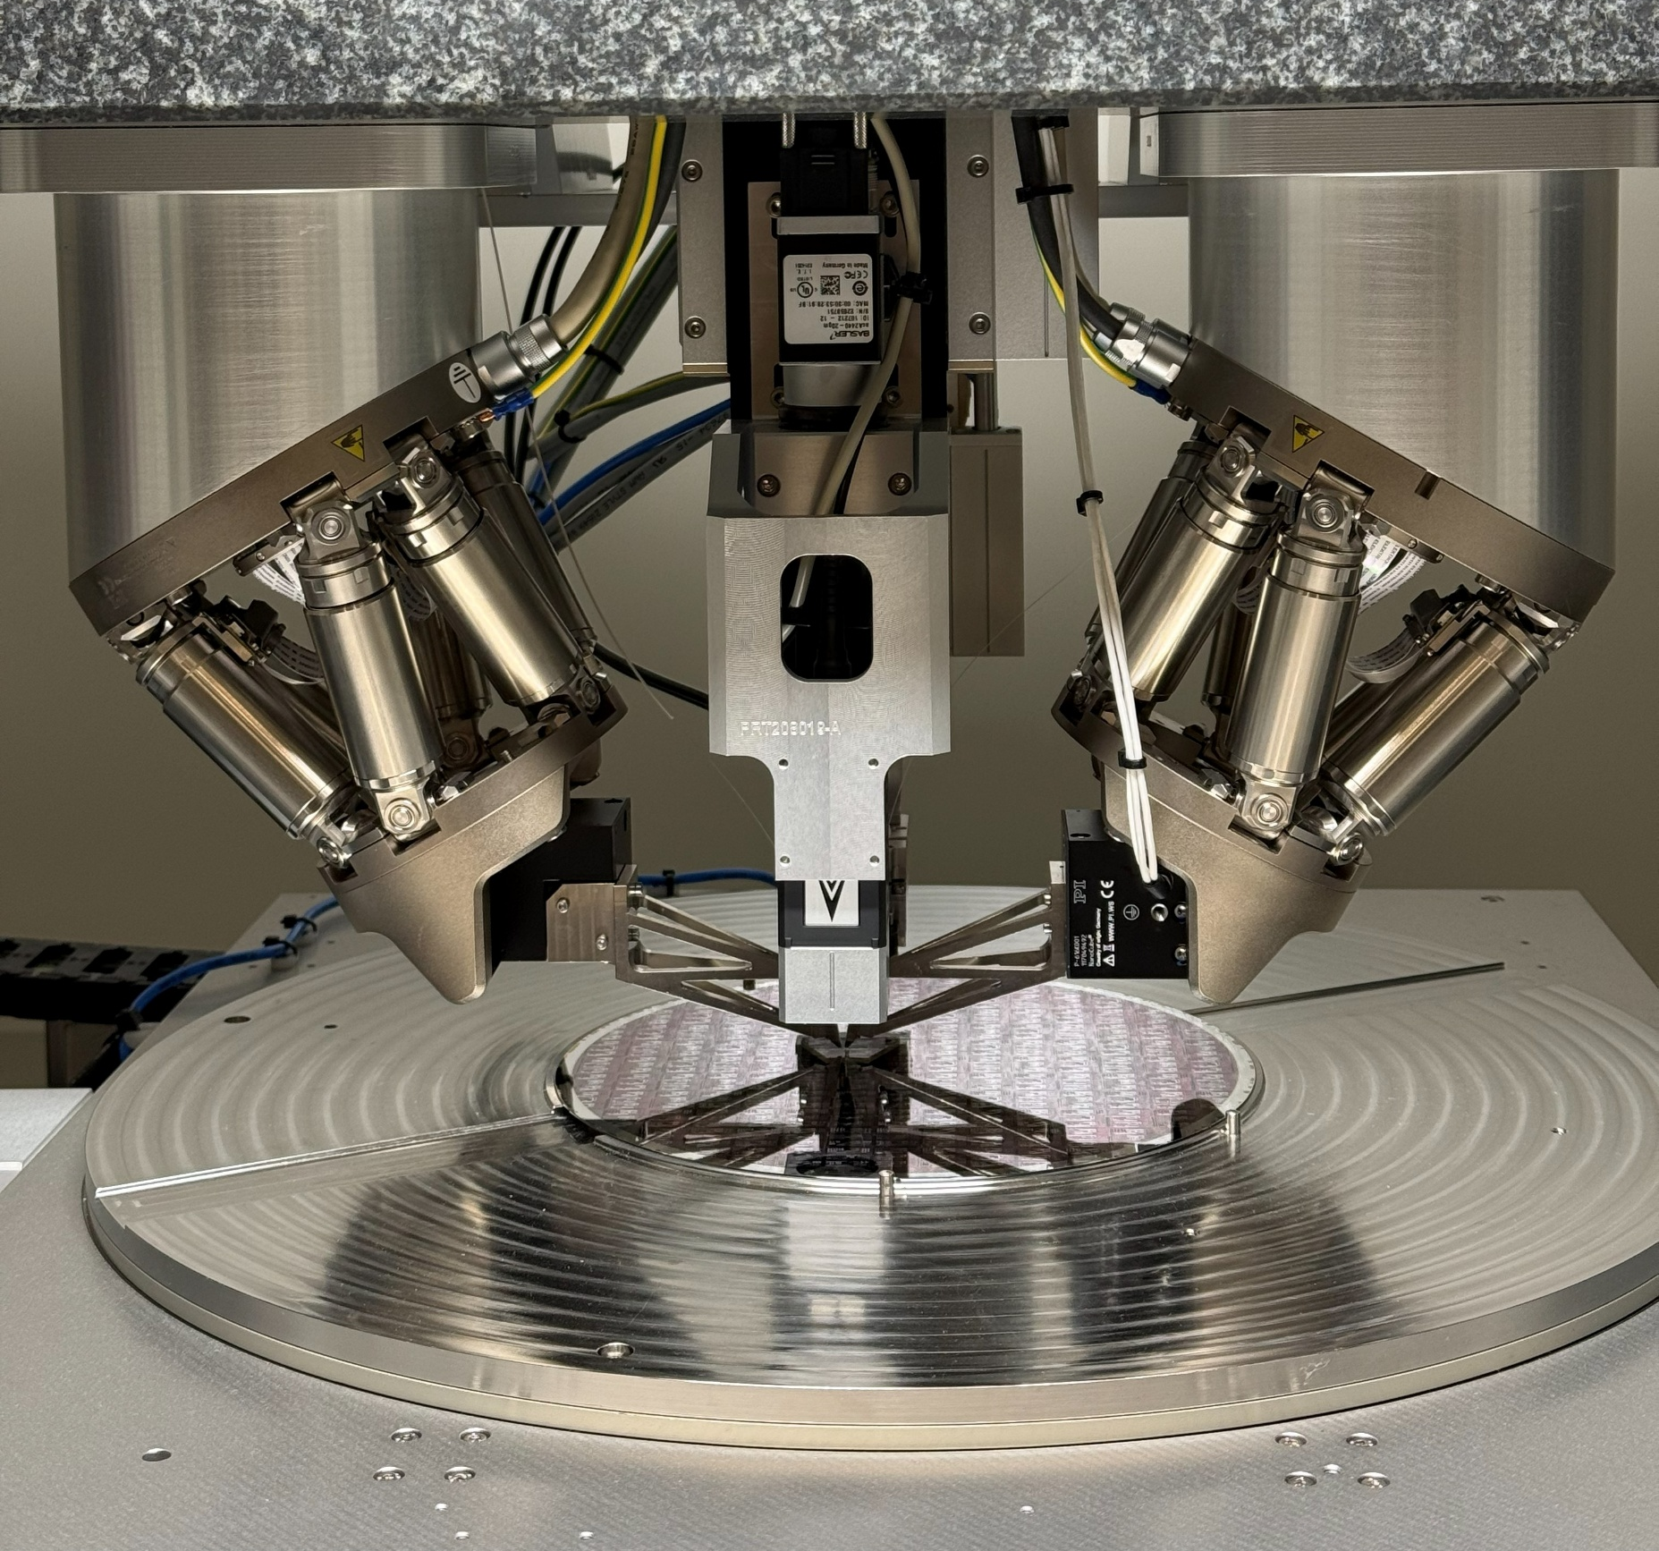
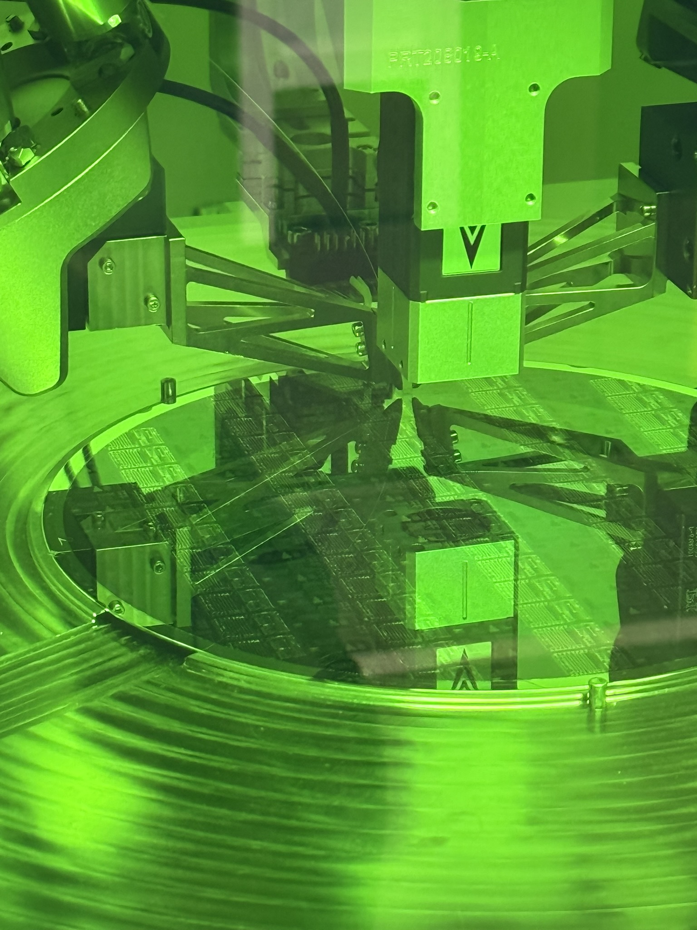
Wafer-Level
SETUP (Picture)

Slide 26
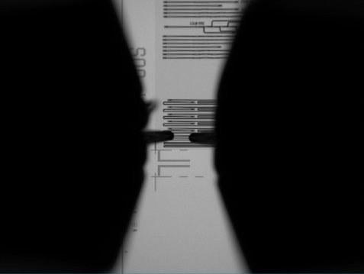
Wafer-Level Optical Testing
SETUP (Picture)

Slide 27
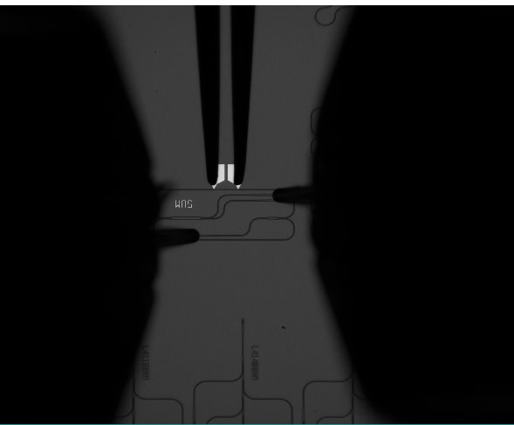
Wafer-Level Electrical Testing
SETUP (Picture)

Slide 28
Measurement Examples
Transmission spectrum
Phase shift vs power
MATLAB

Slide 29
Equipment Summary
Optical
  Tunable laser sources
  Powermeters

Slide 30
Future capabilities
Edge coupling
Database integration
Mid-IR

Slide 31
Test Setup
- Upgrades
Created: Aiman Hazim (13/04/2026)

Slide 32
Measurement labs
Lab 2077 - Optical measurement lab
Lab 2074 – Wafer-scale tester lab

Slide 33
Current Setup
Lab 2077

Slide 34
List of Equipment (interest)
Lensed fibre array – PHIX
  Lensed fiber array Archives - Fiber Array Webshop
Thorlabs · Cerna® Mini Microscopes

Slide 35
Plan for New Setup
To build our own optical test setup
  A setup dedicated for CORNERSTONE’s MPW/Bespoke/Development chips and wafers
  As a backup for the WST
  Minimise disruption eg booking of measurement setups in lab 2077 (busy week with PHD students)
  The setup would be in Lab2074
Laser source
Detector
Fibre arms
Wafer stage

Slide 36
Estimated cost for the setup

Slide 37
Wafer-scale tester (Upgrade/ alternative)

Slide 38
WST – Ficontec
Plan upgrades:
  Electrical measurement – tested to be worked but the process hasn’t fully developed yet
  Chip-scale measurement – to measure chips on chips tray
  Fibre array measurement – to align and measure fibre array structures on wafers (eg two fibres are placed on a fibre array holder (with certain pitch) to one hexapod)
  1310nm O-band measurements

Slide 39
EXFO – wafer/chip tester
Alternative
Cost

Slide 40
CORNERSTONE Testing Service

Slide 41
Plan
Preparing Test Design Kit documentation
  Max allowable gap/spacing between gratings
  Number of waveguides to be measured
Testing Service in CORNERSTONE website

