Slide 1

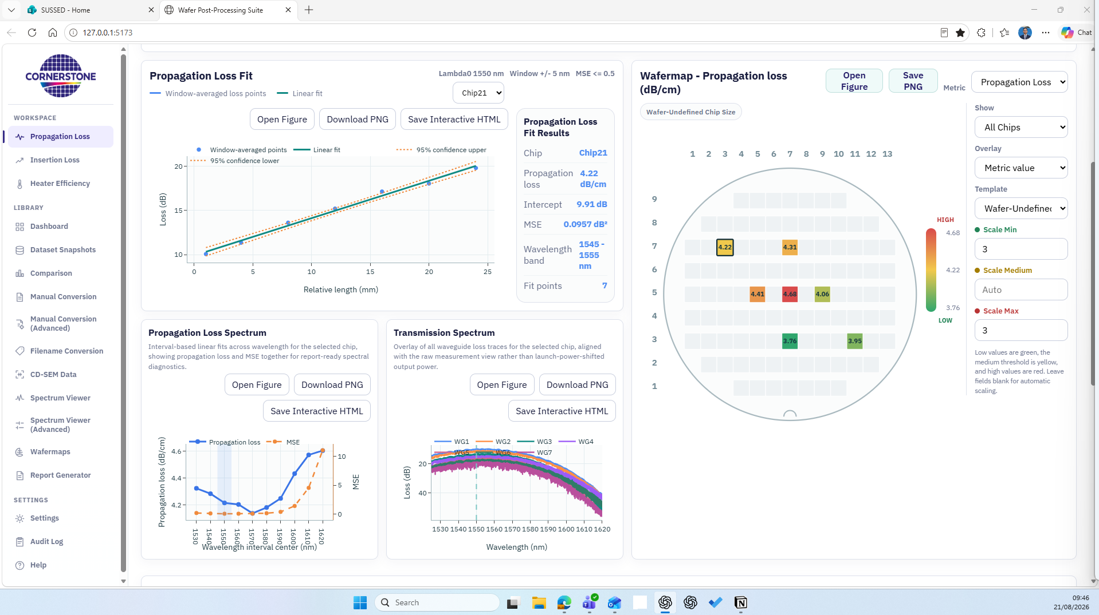
Wafer Post-Processing
Suite
Unified processing and analysis for silicon photonics wafer measurements
Created by Aiman Hazim Shafizam · Research Technician Testing and Characterisation · CORNERSTONE · v0.5.0 · 27 August 2026
Notes:
Introduce v0.5.0 as the release candidate that adds AI Diagnostics without replacing engineering judgement. Explain that screening evidence is calculated locally and Gemini interpretation is optional.
[Sources]
- docs/AI_DIAGNOSTICS.md
- docs/releases/v0.5.0/FEATURES.md
- docs/releases/v0.5.0/CHANGELOG.md
- https://ai.google.dev/gemini-api/docs/models
- https://ai.google.dev/gemini-api/docs/pricing
- https://ai.google.dev/gemini-api/docs/api-key

Slide 2
WAFER POST-PROCESSING SUITE
Wafer measurements become more useful when the workflow is shared
Today’s opportunity
Reduce manual translation between tester and spreadsheet workflows
Optical and electrical measurements arrive in different formats, are reviewed through different tools, and can be difficult to compare later. The suite creates one visible path from source files to wafer-level evidence.
Make processing status and fit quality visible to the reviewer
Keep chip, wafer, and dataset context together
Create repeatable outputs for technical review and reporting
CORNERSTONE | Wafer Post-Processing Suite
02
Notes:
Frame the suite as a shared, auditable engineering workspace. v0.5.0 adds optional AI-assisted triage while keeping compact evidence and the normal analysis workflow at its core.
[Sources]
- docs/AI_DIAGNOSTICS.md
- docs/releases/v0.5.0/FEATURES.md
- docs/releases/v0.5.0/CHANGELOG.md
- https://ai.google.dev/gemini-api/docs/models
- https://ai.google.dev/gemini-api/docs/pricing
- https://ai.google.dev/gemini-api/docs/api-key

Slide 3
WAFER POST-PROCESSING SUITE
One workflow connects raw files, local screening, wafer context, and reports
1 INGEST
2 NORMALISE
3 SCREEN + ANALYSE
4 COMPARE
5 REPORT
TXT, CSV, XLSX and bundled GitHub datasets
Shared internal schema and controlled filenames
Metrics, spectra and local anomaly evidence
Chip selection, wafermaps and cross-dataset views
Figures, interactive HTML and presentation outputs
The same dataset remains traceable as the user moves from loading to local screening, chip-level review and export.
CORNERSTONE | Wafer Post-Processing Suite
03
Notes:
Use this slide to separate deterministic local screening from optional model interpretation. The assistant receives compact metrics and flagged evidence rather than a complete raw spectrum.
[Sources]
- docs/AI_DIAGNOSTICS.md
- docs/releases/v0.5.0/FEATURES.md
- docs/releases/v0.5.0/CHANGELOG.md
- https://ai.google.dev/gemini-api/docs/models
- https://ai.google.dev/gemini-api/docs/pricing
- https://ai.google.dev/gemini-api/docs/api-key

Slide 4
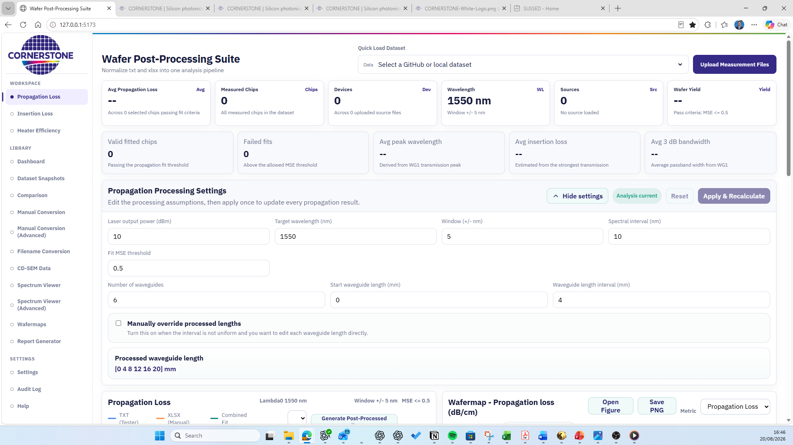
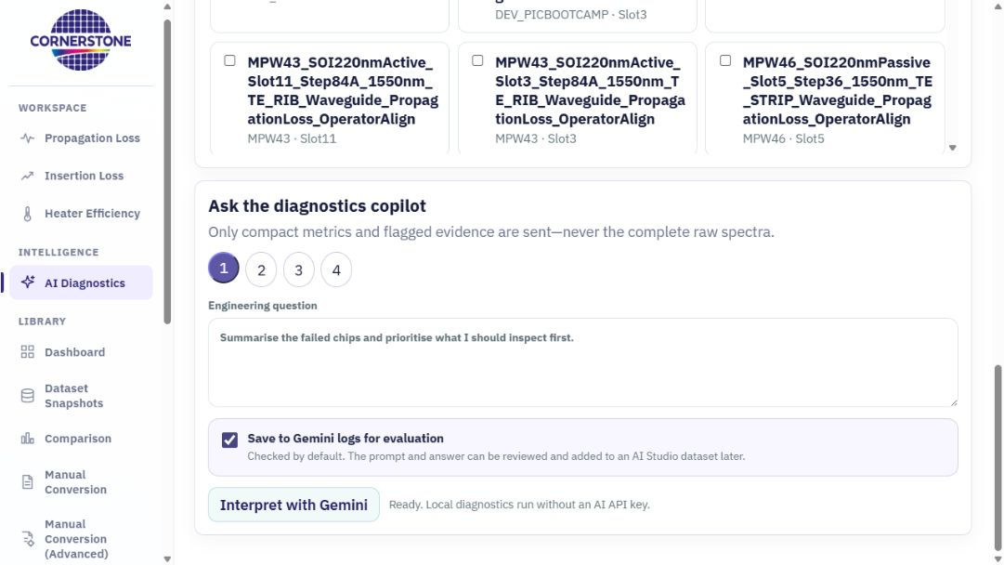
WAFER POST-PROCESSING SUITE
The interface evolved from a long dashboard into a comparison workspace
Earlier layout
Approved v0.4.0 layout
Fit, spectra and wafermap stay visible together at a standard desktop view.
CORNERSTONE | Wafer Post-Processing Suite
04
Notes:
Use this before-and-after to explain the design objective. The approved layout is not only cosmetic: it supports a real comparison task—selecting a die on the wafermap and immediately reviewing fit and spectral behaviour without losing context.
[Sources]
- Screenshot - App Development/01-initial-interface-2026-08-20.png
- Screenshot - App Development/05-compact-analysis-workspace-2026-08-21.png

Slide 5
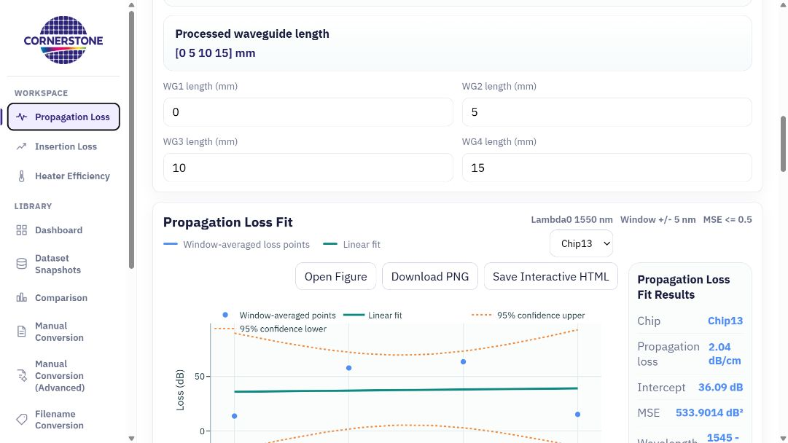
WAFER POST-PROCESSING SUITE
Propagation analysis now separates wafer health from individual fit detail
What changed
Measured Chips counts every measured die
Avg Propagation Loss is the filtered wafer average
MSE is the stated fit-quality measure
Fit, spectra and map remain linked by chip selection
CORNERSTONE | Wafer Post-Processing Suite
05
Notes:
Clarify the distinction between counts and filters. Measured Chips describes dataset coverage; Valid Fitted Chips and wafer yield describe the quality gate. The wafer average is based on selected chips passing the fit criterion, while detailed MSE remains visible for individual fits.
[Sources]
- Screenshot - App Development/11-propagation-analysis-current-v0.4.0.png
- docs/releases/v0.4.0/FEATURES.md
- docs/releases/v0.4.0/CHANGELOG.md

Slide 6
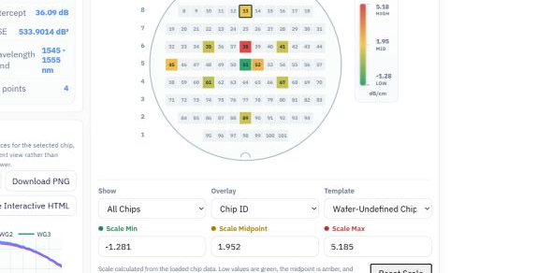
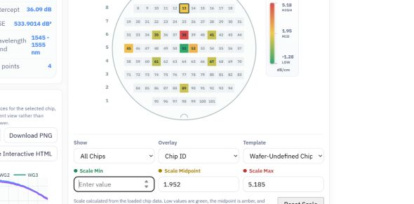
WAFER POST-PROCESSING SUITE
Wafer colour scaling starts from the data and remains under user control
Dataset-derived defaults
Keyboard-friendly override
Minimum, midpoint and maximum display the active chip values instead of an ambiguous “Auto” label.
A value can be cleared and replaced directly; Reset Scale restores the data-derived thresholds.
CORNERSTONE | Wafer Post-Processing Suite
06
Notes:
Explain the user interaction as a safety feature. Defaults are anchored to measured data, but the reviewer can set controlled thresholds for comparison. Temporarily clearing a field no longer forces the spinner arrows or interrupts the map; Reset Scale provides a clear return path.
[Sources]
- Screenshot - App Development/07-wafer-scale-redesign-2026-08-21.png
- Screenshot - App Development/08-wafer-scale-editable-input-2026-08-21.png
- docs/releases/v0.4.0/CHANGELOG.md

Slide 7
WAFER POST-PROCESSING SUITE
Three analysis workspaces remain the analytical foundation
Propagation Loss
Insertion Loss
Heater Efficiency
Waveguide attenuation
Building-block transmission
Electrical-to-optical response
Linear fit versus waveguide length, MSE quality, wavelength-resolved loss, wafer yield and die selection.
Peak wavelength, insertion at peak and target wavelength, 3 dB bandwidth, flatness and wafer variation.
MZI heater response, phase-shift interpretation and wafer-level electrical/optical comparison.
Shared navigation and data handling make the three routes feel like one suite rather than separate scripts.
CORNERSTONE | Wafer Post-Processing Suite
07
Notes:
The original measurement workspaces remain the analytical foundation for the v0.5.0 release. AI Diagnostics complements them; it does not replace the underlying calculations.
[Sources]
- docs/AI_DIAGNOSTICS.md
- docs/releases/v0.5.0/FEATURES.md
- docs/releases/v0.5.0/CHANGELOG.md
- https://ai.google.dev/gemini-api/docs/models
- https://ai.google.dev/gemini-api/docs/pricing
- https://ai.google.dev/gemini-api/docs/api-key

Slide 8
WAFER POST-PROCESSING SUITE
The Library keeps measurement data reusable beyond a single analysis session
Discover and compare
Prepare and standardise
Dashboard and published dataset coverage
Manual Conversion and Advanced conversion
Dataset Snapshots and cross-dataset Comparison
Filename Conversion with controlled naming
Wafermaps and CD-SEM overlap review
Standard and Advanced Spectrum Viewers
Result: datasets can be revisited, compared across MPWs, and handed between teams with more context and less rework.
CORNERSTONE | Wafer Post-Processing Suite
08
Notes:
Explain that analysts should inspect the underlying visual evidence before accepting an AI-proposed cause or priority.
[Sources]
- docs/AI_DIAGNOSTICS.md
- docs/releases/v0.5.0/FEATURES.md
- docs/releases/v0.5.0/CHANGELOG.md
- https://ai.google.dev/gemini-api/docs/models
- https://ai.google.dev/gemini-api/docs/pricing
- https://ai.google.dev/gemini-api/docs/api-key

Slide 9
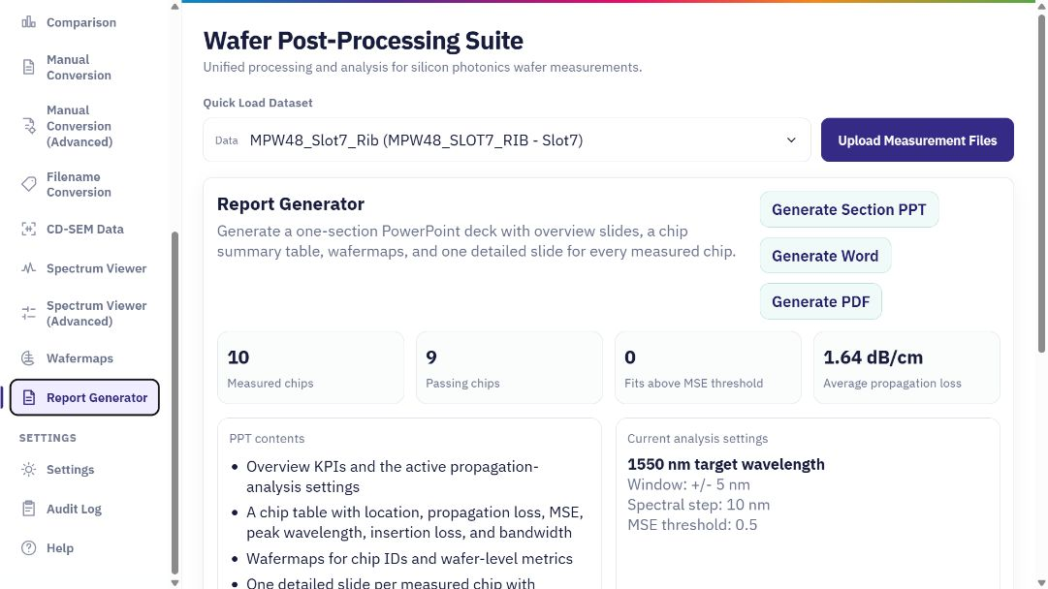
WAFER POST-PROCESSING SUITE
Reporting converts analysis state into review-ready material
Available outputs
Open and inspect figures
Download PNG evidence
Save interactive HTML where available
Generate PowerPoint, Word and PDF reports
CORNERSTONE | Wafer Post-Processing Suite
09
Notes:
Explain that report generation remains the dedicated place for consolidated outputs. Duplicate post-processing actions were removed from the propagation panel so analysis and reporting responsibilities are clearer. The goal is a repeatable review package rather than a collection of manually assembled screenshots.
[Sources]
- Screenshot - App Development/10-report-generator-current-v0.4.0.png
- README.md
- docs/releases/v0.4.0/CHANGELOG.md

Slide 10
TEAM VALUE
For the test team, v0.5.0 adds governed, AI-assisted triage to faster interpretation
Before
With v0.5.0
Processing delays could look like an unresponsive page, and chip-level comparison required more scrolling and manual context switching.
Local screening before optional AI interpretation
Wafer and chip metrics sent as compact evidence
Explicit model selection and logging control
Repeatable figures, reports and triage summaries
Outcome: less time preparing the view, more time deciding which evidence and follow-up checks matter next.
CORNERSTONE | Wafer Post-Processing Suite
10
Notes:
The additional capability is designed for hypothesis generation and prioritisation. It is not a pass/fail authority and must be reviewed against the underlying measurement evidence.
[Sources]
- docs/AI_DIAGNOSTICS.md
- docs/releases/v0.5.0/FEATURES.md
- docs/releases/v0.5.0/CHANGELOG.md
- https://ai.google.dev/gemini-api/docs/models
- https://ai.google.dev/gemini-api/docs/pricing
- https://ai.google.dev/gemini-api/docs/api-key

Slide 11
TEAM VALUE
For the PDK team, AI-assisted triage must remain traceable and reviewable
Compact evidence
Explicit model choice
Human-reviewed conclusions
Local metrics and flagged features are prepared before any optional model request.
Provider and model can be recorded with the diagnostic request when logging is enabled.
The assistant can propose causes and priorities; it cannot make a wafer-release decision.
This shortens the path from measured performance to a documented engineering review without hiding the underlying evidence.
CORNERSTONE | Wafer Post-Processing Suite
11
Notes:
Make the boundary clear: the application logs the selected provider/model when diagnostic logging is enabled, but people remain accountable for conclusions.
[Sources]
- docs/AI_DIAGNOSTICS.md
- docs/releases/v0.5.0/FEATURES.md
- docs/releases/v0.5.0/CHANGELOG.md
- https://ai.google.dev/gemini-api/docs/models
- https://ai.google.dev/gemini-api/docs/pricing
- https://ai.google.dev/gemini-api/docs/api-key

Slide 12
TEAM VALUE
For the cleanroom team, AI-assisted hypotheses can be reviewed beside optical performance
CD-SEM coordinate import
Joint review questions
Coordinate-based cleanroom measurements can be reviewed beside the local metrics and optional AI hypotheses for the same wafer template.
Do CD changes align with optical-loss variation?
Are edge, centre or row/column patterns visible?
Which wafers or die should receive deeper review?
The tool supports correlation and prioritisation; any suggested process cause still requires engineering review and appropriate sample size.
CORNERSTONE | Wafer Post-Processing Suite
12
Notes:
Invite reviewers to challenge the proposed interpretation with the trace, wafer position and process context. A useful model response is one that makes the next engineering check clearer.
[Sources]
- docs/AI_DIAGNOSTICS.md
- docs/releases/v0.5.0/FEATURES.md
- docs/releases/v0.5.0/CHANGELOG.md
- https://ai.google.dev/gemini-api/docs/models
- https://ai.google.dev/gemini-api/docs/pricing
- https://ai.google.dev/gemini-api/docs/api-key

Slide 13
WAFER POST-PROCESSING SUITE
AI Diagnostics: screen locally, interpret optionally
Local evidence
AI Diagnostics v0.5.0
Outcome: compact metrics and flagged evidence are sent—not complete raw spectra; every proposed cause still requires verification.
CORNERSTONE | Wafer Post-Processing Suite
04
Notes:
Show the real v0.5.0 AI Diagnostics workspace. The app performs deterministic screening locally, limits supplied evidence, and makes the model choice visible to the user.
[Sources]
- docs/AI_DIAGNOSTICS.md
- docs/releases/v0.5.0/FEATURES.md
- docs/releases/v0.5.0/CHANGELOG.md
- https://ai.google.dev/gemini-api/docs/models
- https://ai.google.dev/gemini-api/docs/pricing
- https://ai.google.dev/gemini-api/docs/api-key

Slide 14
TEAM VALUE
Choose models to match cost and review depth
Routine default
Shortest response
Escalation
Gemini 3.1 Flash-Lite Lowest implemented unit price; 900-token app ceiling.
Gemini 3.5 Flash-Lite 700-token ceiling for concise summaries.
Gemini 3.6 / 3.7 Flash Use for difficult cases; 3.7 has a 1,400-token ceiling.
Outcome: start with 3.1 Flash-Lite; compare difficult cases against verified engineering labels before changing the default.
CORNERSTONE | Wafer Post-Processing Suite
11
Notes:
Model availability, rate limits and pricing are provider-controlled and can change. The stated ceilings are application output caps, not provider quotas. Use Lite models by default; escalate only for a clear review need.
[Sources]
- docs/AI_DIAGNOSTICS.md
- docs/releases/v0.5.0/FEATURES.md
- docs/releases/v0.5.0/CHANGELOG.md
- https://ai.google.dev/gemini-api/docs/models
- https://ai.google.dev/gemini-api/docs/pricing
- https://ai.google.dev/gemini-api/docs/api-key

Slide 15
DEVELOPMENT TIMELINE
The suite moved from idea to a validated v0.5.0 candidate in nine weeks
25 JUN
06–29 JUL
19–20 AUG
Idea and repository
Library expansion
Reporting + dataset ops
Initial structure and connection test
Comparison, conversion and spectrum analysis
Analytics, deletion and report-export fixes
26–30 JUN
11–17 AUG
21–27 AUG
Core web workflow
Data and analysis depth
AI Diagnostics v0.5.0
Pages deployment, WST loading, wafermap and interactive charts
Filename fixes, CD-SEM, dashboard and advanced spectrum controls
Local screening, Gemini models, logging and secure API handling
CORNERSTONE | Wafer Post-Processing Suite
13
Notes:
This milestone includes local implementation, production build validation and documentation refresh. It is not a declaration that production deployment or data-governance approval is complete.
[Sources]
- docs/AI_DIAGNOSTICS.md
- docs/releases/v0.5.0/FEATURES.md
- docs/releases/v0.5.0/CHANGELOG.md
- https://ai.google.dev/gemini-api/docs/models
- https://ai.google.dev/gemini-api/docs/pricing
- https://ai.google.dev/gemini-api/docs/api-key

Slide 16
RELEASE READINESS
v0.5.0 is validated locally and ready for a controlled release decision
Validated locally
Release controls
Production Vite build
Key remains server-side and out of Git
AI Diagnostics UI and model selector
GitHub Pages needs a protected backend
Logging toggle and storage paths
Data-governance approval still required
Documentation, links and presentation QA
Approval required before push to main
Outcome: the release candidate is functionally ready locally; production hosting and data-governance controls remain explicit gates.
CORNERSTONE | Wafer Post-Processing Suite
14
Notes:
This is the release-control slide. Be clear that the Gemini secret is local-only in development. A static public site must use a protected server-side proxy or another backend secret store.
[Sources]
- docs/AI_DIAGNOSTICS.md
- docs/releases/v0.5.0/FEATURES.md
- docs/releases/v0.5.0/CHANGELOG.md
- https://ai.google.dev/gemini-api/docs/models
- https://ai.google.dev/gemini-api/docs/pricing
- https://ai.google.dev/gemini-api/docs/api-key

Slide 17
Proposal
Run a governed AI-assisted review pilot before wider deployment
Pilot
Participants
Decision
1–2 representative, approved wafer datasets
Test + PDK + cleanroom + data owner
Confirm model default, access controls and release priorities
Success means useful triage with traceable evidence, controlled data sharing and no loss of engineering judgement.
Notes:
Close by asking for approval of a small, governed pilot—not a broad production rollout. Define accepted datasets, reviewers, expected outcomes and the decision owner before collecting any training examples.
[Sources]
- docs/AI_DIAGNOSTICS.md
- docs/releases/v0.5.0/FEATURES.md
- docs/releases/v0.5.0/CHANGELOG.md
- https://ai.google.dev/gemini-api/docs/models
- https://ai.google.dev/gemini-api/docs/pricing
- https://ai.google.dev/gemini-api/docs/api-key

