Slide 1

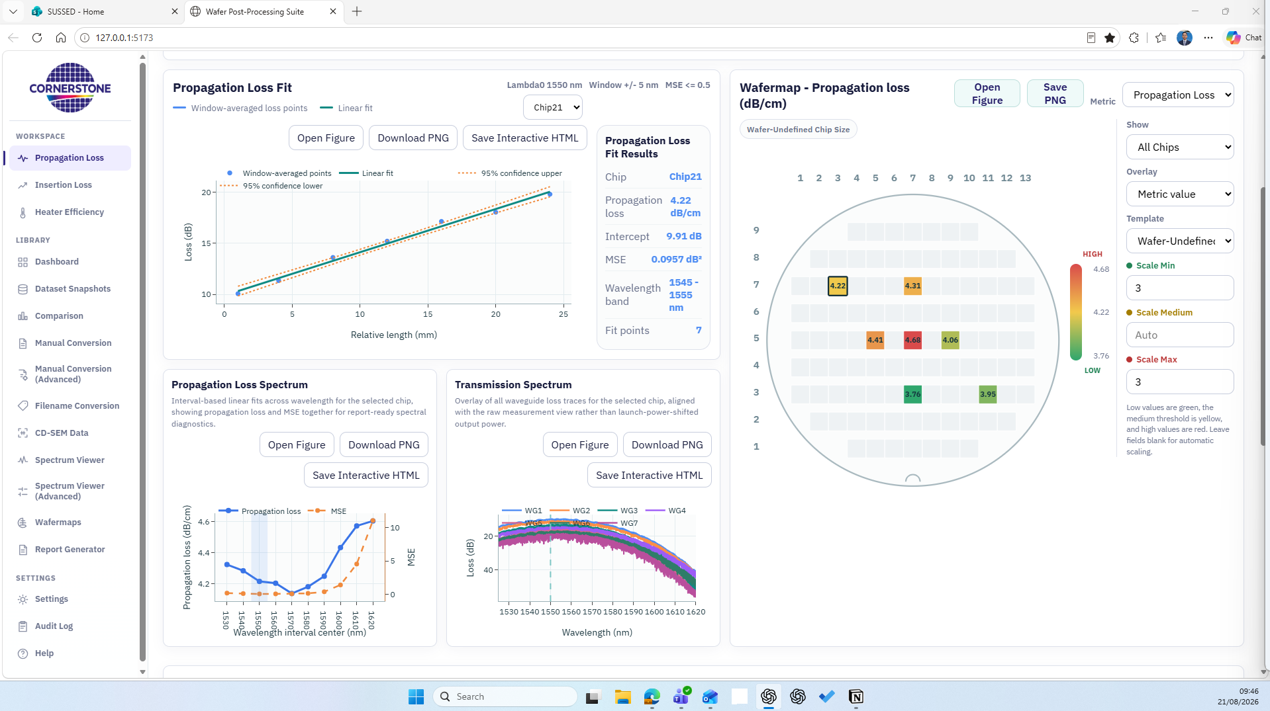
Wafer Post-Processing
Suite
Unified processing and analysis for silicon photonics wafer measurements
Created by Aiman Hazim Shafizam · Research Technician Testing and Characterisation · CORNERSTONE · v0.4.0 · 21 August 2026
Notes:
Introduce yourself as Aiman Hazim Shafizam, Research Technician in Testing and Characterisation at CORNERSTONE. Open by framing this as a shared engineering workflow, not simply a new interface. The objective is to make wafer measurements easier to process, compare, explain, and reuse across teams. Mention that this deck covers the published v0.4.0 release and the proposal for controlled team adoption.
[Sources]
- public/assets/CORNERSTONE_Logo.png
- Screenshot - App Development/05-compact-analysis-workspace-2026-08-21.png
- README.md

Slide 2
WAFER POST-PROCESSING SUITE
Wafer measurements become more useful when the workflow is shared
Today’s opportunity
Reduce manual translation between tester and spreadsheet workflows
Optical and electrical measurements arrive in different formats, are reviewed through different tools, and can be difficult to compare later. The suite creates one visible path from source files to wafer-level evidence.
Make processing status and fit quality visible to the reviewer
Keep chip, wafer, and dataset context together
Create repeatable outputs for technical review and reporting
CORNERSTONE | Wafer Post-Processing Suite
02
Notes:
Describe the current friction in neutral terms: the problem is not the measurement equipment; it is the handoff between formats, calculations, visual review, and reporting. The suite is intended to preserve engineering judgement while reducing repetitive preparation and ambiguity.
[Sources]
- README.md
- docs/releases/v0.4.0/FEATURES.md

Slide 3
WAFER POST-PROCESSING SUITE
One workflow connects raw files, analysis, wafer context, and reports
1 INGEST
2 NORMALISE
3 ANALYSE
4 COMPARE
5 REPORT
TXT, CSV, XLSX and bundled GitHub datasets
Shared internal schema and controlled filenames
Propagation, insertion and heater metrics
Chip selection, wafermaps and cross-dataset views
Figures, interactive HTML and presentation outputs
The same dataset remains traceable as the user moves from loading to chip-level review and export.
CORNERSTONE | Wafer Post-Processing Suite
03
Notes:
Walk left to right. Emphasise that normalisation is the key architectural idea: tester text files and manual spreadsheet measurements can enter the same downstream analysis. The stages remain separate enough to inspect, but the dataset context is retained throughout.
[Sources]
- README.md
- docs/releases/v0.4.0/FEATURES.md

Slide 4
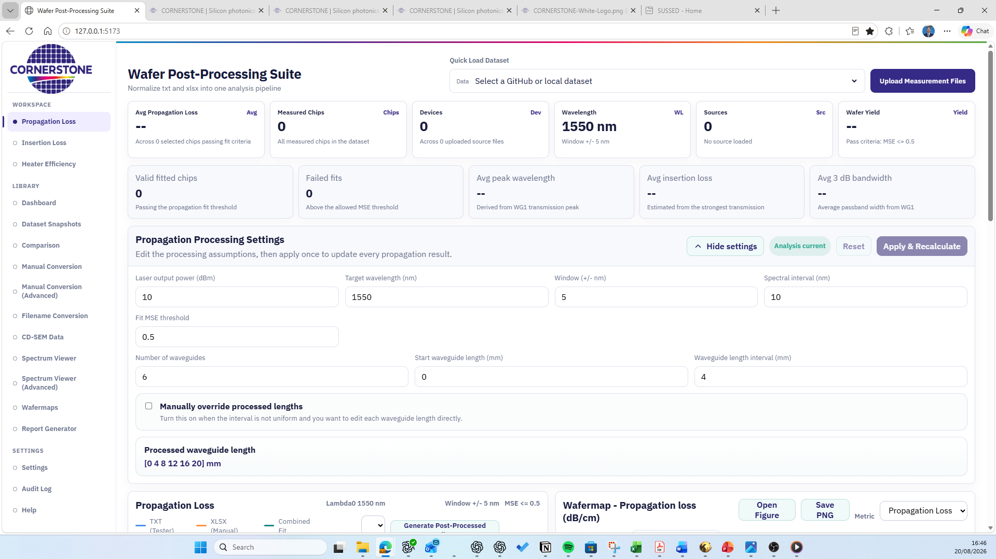
WAFER POST-PROCESSING SUITE
The interface evolved from a long dashboard into a comparison workspace
Earlier layout
Approved v0.4.0 layout
Fit, spectra and wafermap stay visible together at a standard desktop view.
CORNERSTONE | Wafer Post-Processing Suite
04
Notes:
Use this before-and-after to explain the design objective. The approved layout is not only cosmetic: it supports a real comparison task—selecting a die on the wafermap and immediately reviewing fit and spectral behaviour without losing context.
[Sources]
- Screenshot - App Development/01-initial-interface-2026-08-20.png
- Screenshot - App Development/05-compact-analysis-workspace-2026-08-21.png

Slide 5
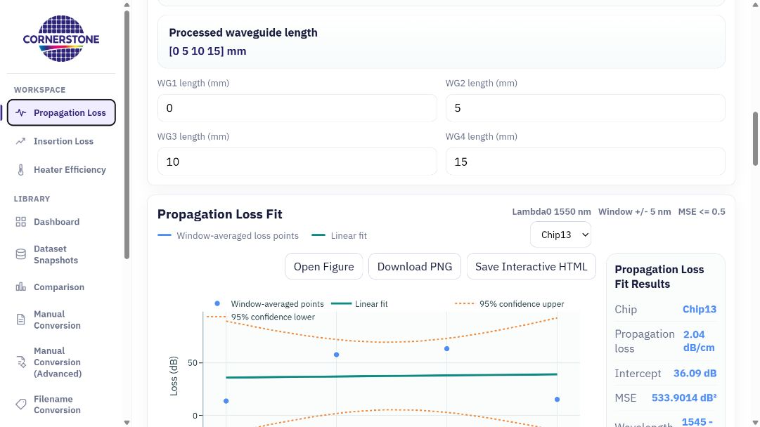
WAFER POST-PROCESSING SUITE
Propagation analysis now separates wafer health from individual fit detail
What changed
Measured Chips counts every measured die
Avg Propagation Loss is the filtered wafer average
MSE is the stated fit-quality measure
Fit, spectra and map remain linked by chip selection
CORNERSTONE | Wafer Post-Processing Suite
05
Notes:
Clarify the distinction between counts and filters. Measured Chips describes dataset coverage; Valid Fitted Chips and wafer yield describe the quality gate. The wafer average is based on selected chips passing the fit criterion, while detailed MSE remains visible for individual fits.
[Sources]
- Screenshot - App Development/11-propagation-analysis-current-v0.4.0.png
- docs/releases/v0.4.0/FEATURES.md
- docs/releases/v0.4.0/CHANGELOG.md

Slide 6
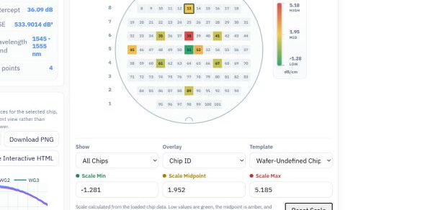
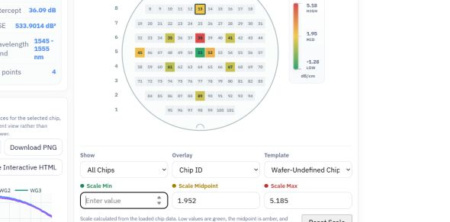
WAFER POST-PROCESSING SUITE
Wafer colour scaling starts from the data and remains under user control
Dataset-derived defaults
Keyboard-friendly override
Minimum, midpoint and maximum display the active chip values instead of an ambiguous “Auto” label.
A value can be cleared and replaced directly; Reset Scale restores the data-derived thresholds.
CORNERSTONE | Wafer Post-Processing Suite
06
Notes:
Explain the user interaction as a safety feature. Defaults are anchored to measured data, but the reviewer can set controlled thresholds for comparison. Temporarily clearing a field no longer forces the spinner arrows or interrupts the map; Reset Scale provides a clear return path.
[Sources]
- Screenshot - App Development/07-wafer-scale-redesign-2026-08-21.png
- Screenshot - App Development/08-wafer-scale-editable-input-2026-08-21.png
- docs/releases/v0.4.0/CHANGELOG.md

Slide 7
WAFER POST-PROCESSING SUITE
Three analysis workspaces cover the core measurement routes
Propagation Loss
Insertion Loss
Heater Efficiency
Waveguide attenuation
Building-block transmission
Electrical-to-optical response
Linear fit versus waveguide length, MSE quality, wavelength-resolved loss, wafer yield and die selection.
Peak wavelength, insertion at peak and target wavelength, 3 dB bandwidth, flatness and wafer variation.
MZI heater response, phase-shift interpretation and wafer-level electrical/optical comparison.
Shared navigation and data handling make the three routes feel like one suite rather than separate scripts.
CORNERSTONE | Wafer Post-Processing Suite
07
Notes:
Give one sentence to each workspace. For non-technical colleagues, describe them as three views of device performance: optical loss along waveguides, transmission through a component, and optical response to electrical heating. For technical colleagues, point to the specific metrics listed.
[Sources]
- README.md
- docs/releases/v0.4.0/FEATURES.md

Slide 8
WAFER POST-PROCESSING SUITE
The Library makes measurement data reusable beyond a single analysis session
Discover and compare
Prepare and standardise
Dashboard and published dataset coverage
Manual Conversion and Advanced conversion
Dataset Snapshots and cross-dataset Comparison
Filename Conversion with controlled naming
Wafermaps and CD-SEM overlap review
Standard and Advanced Spectrum Viewers
Result: datasets can be revisited, compared across MPWs, and handed between teams with more context and less rework.
CORNERSTONE | Wafer Post-Processing Suite
08
Notes:
Position the Library as the long-term value layer. The workspaces answer the immediate engineering question; the Library helps the team retain, standardise and compare the evidence later. Mention that GitHub-hosted datasets can support shared access when repository credentials and governance are in place.
[Sources]
- README.md
- docs/releases/v0.4.0/FEATURES.md
- docs/DATASET_FILENAME_STANDARD.md

Slide 9
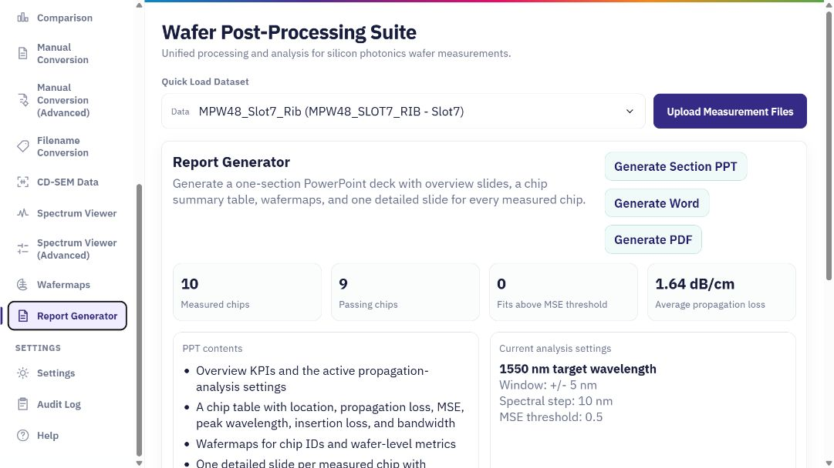
WAFER POST-PROCESSING SUITE
Reporting converts analysis state into review-ready material
Available outputs
Open and inspect figures
Download PNG evidence
Save interactive HTML where available
Generate PowerPoint, Word and PDF reports
CORNERSTONE | Wafer Post-Processing Suite
09
Notes:
Explain that report generation remains the dedicated place for consolidated outputs. Duplicate post-processing actions were removed from the propagation panel so analysis and reporting responsibilities are clearer. The goal is a repeatable review package rather than a collection of manually assembled screenshots.
[Sources]
- Screenshot - App Development/10-report-generator-current-v0.4.0.png
- README.md
- docs/releases/v0.4.0/CHANGELOG.md

Slide 10
TEAM VALUE
For the test team, the main gain is faster interpretation with fewer silent waits
Before
With v0.4.0
Processing delays could look like an unresponsive page, and chip-level comparison required more scrolling and manual context switching.
Visible startup and dataset-processing feedback
Wafer and chip metrics in one compact view
Clear MSE fit-quality language
Repeatable figures and report outputs
Outcome: less time preparing the view, more time deciding whether the data is trustworthy and what to test next.
CORNERSTONE | Wafer Post-Processing Suite
10
Notes:
Tailor this slide to test engineers and operators. The strongest benefit is clarity during the work: users know when loading is happening, can see dataset coverage separately from fit yield, and can compare selected chips without rearranging the page.
[Sources]
- docs/releases/v0.4.0/FEATURES.md
- docs/releases/v0.4.0/CHANGELOG.md

Slide 11
TEAM VALUE
For the PDK team, wafer evidence becomes easier to compare and feed back
Building-block evidence
Variation across wafers
Traceable assumptions
Propagation, insertion and heater metrics can be reviewed at die and wafer level.
Dataset comparison supports MPW, slot, platform and process-variation discussions.
Target wavelength, fit window, waveguide lengths and quality thresholds remain visible.
This shortens the path from measured performance to design-rule, model, and component-library discussions.
CORNERSTONE | Wafer Post-Processing Suite
11
Notes:
Avoid claiming that the app automatically changes the PDK. Its role is to improve the evidence feeding PDK decisions. It brings measured building-block performance, wafer variation, and processing assumptions into a form that is easier to compare and discuss.
[Sources]
- README.md
- docs/releases/v0.4.0/FEATURES.md

Slide 12
TEAM VALUE
For the cleanroom team, metrology can be reviewed beside optical performance
CD-SEM coordinate import
Joint review questions
Coordinate-based cleanroom measurements can be mapped to the same wafer template used for propagation-loss chips.
Do CD changes align with optical-loss variation?
Are edge, centre or row/column patterns visible?
Which wafers or die should receive deeper review?
The tool supports correlation and prioritisation; process conclusions still require engineering review and appropriate sample size.
CORNERSTONE | Wafer Post-Processing Suite
12
Notes:
Frame this carefully. The application can align coordinate-based CD-SEM values with optical chip positions and support simple correlation inspection. It does not prove process causation. The value is faster joint review and better prioritisation of follow-up analysis.
[Sources]
- README.md
- docs/releases/v0.4.0/FEATURES.md

Slide 13
DEVELOPMENT TIMELINE
The suite moved from idea to published v0.4.0 in eight weeks
25 JUN
06–29 JUL
19–20 AUG
Idea and repository
Library expansion
Reporting + dataset ops
Initial structure and connection test
Comparison, conversion and spectrum analysis
Analytics, deletion and report-export fixes
26–30 JUN
11–17 AUG
20–21 AUG
Core web workflow
Data and analysis depth
v0.4.0 usability
Pages deployment, WST loading, wafermap and interactive charts
Filename fixes, CD-SEM, dashboard and advanced spectrum controls
CORNERSTONE branding, feedback, compact layout and wafer scaling
CORNERSTONE | Wafer Post-Processing Suite
13
Notes:
Use the timeline to show disciplined iteration rather than a single large build. Start with the June repository and deployment foundation, then explain how real dataset loading drove the analysis features, and how user review on 20–21 August shaped the current interface.
[Sources]
- docs/PROJECT_VERSION_HISTORY.md
- git history recorded in the local repository

Slide 14
RELEASE READINESS
v0.4.0 is published to GitHub main and ready for controlled team review
Validated release
Published safely
Production Vite build
Integrated with the latest origin/main history
Local dataset load and summary metrics
Kept unrelated dataset and scratch changes out of the release
Editable scale and reset behaviour
Verified local main and origin/main at fd1ac31
No console warnings or errors in the smoke test
Published to GitHub main on 21 August 2026
The application is published and functionally ready; the next step is controlled review with the test, PDK and cleanroom teams.
CORNERSTONE | Wafer Post-Processing Suite
14
Notes:
Explain that the release gate has been completed. The v0.4.0 work was integrated onto the latest origin/main, rebuilt, browser-tested, checked for release scope and then published as commit fd1ac31. Unrelated dataset edits and the older root-level presentation were deliberately excluded. The next step is controlled review with representatives from the test, PDK and cleanroom teams.
[Sources]
- docs/releases/v0.4.0/RELEASE_CHECKLIST.md
- Git commit fd1ac311beec417e760cc58e78c38c61d73a238c

Slide 15
Proposal
Adopt the suite as a shared review workspace and run a focused pilot
Pilot scope
Participants
Decision
1–2 representative wafer datasets
Test + PDK + cleanroom reviewers
Confirm shared workflow and next release priorities
Success means the same dataset can be loaded, interpreted, discussed and reported with less manual handoff.
Notes:
Close with a concrete decision. Recommend a small pilot using representative datasets and reviewers from the three teams. Ask participants to evaluate trust in the metrics, clarity of the workflow, usefulness of the outputs, and the highest-priority gaps for the next release.
[Sources]
- README.md
- docs/releases/v0.4.0/FEATURES.md

