Slide 1

MBTI Personality Classification Based on Social Media Posts
Zimo Ma
https://youtu.be/10CQyKx4lvg

Slide 2
01
Intention &
Research Questions

Slide 3
MBTI and Workplace
Turnover behavior / Job Performance
Past Research on workplace aggression:
E Vs. I:
More ‘passive-verbal’ aggression
Less consider ‘active’ workplace behavior as aggression
N Vs. S:
More rate ‘passive indirect’ workplace behavior as aggression
P Vs. J:
More label ‘passive, indirect, physical’ workplace behavior as aggression

Slide 4
Research Question
To What Extent Can Social Media Posts Predict One’s MBTI Personality Type?

Slide 5
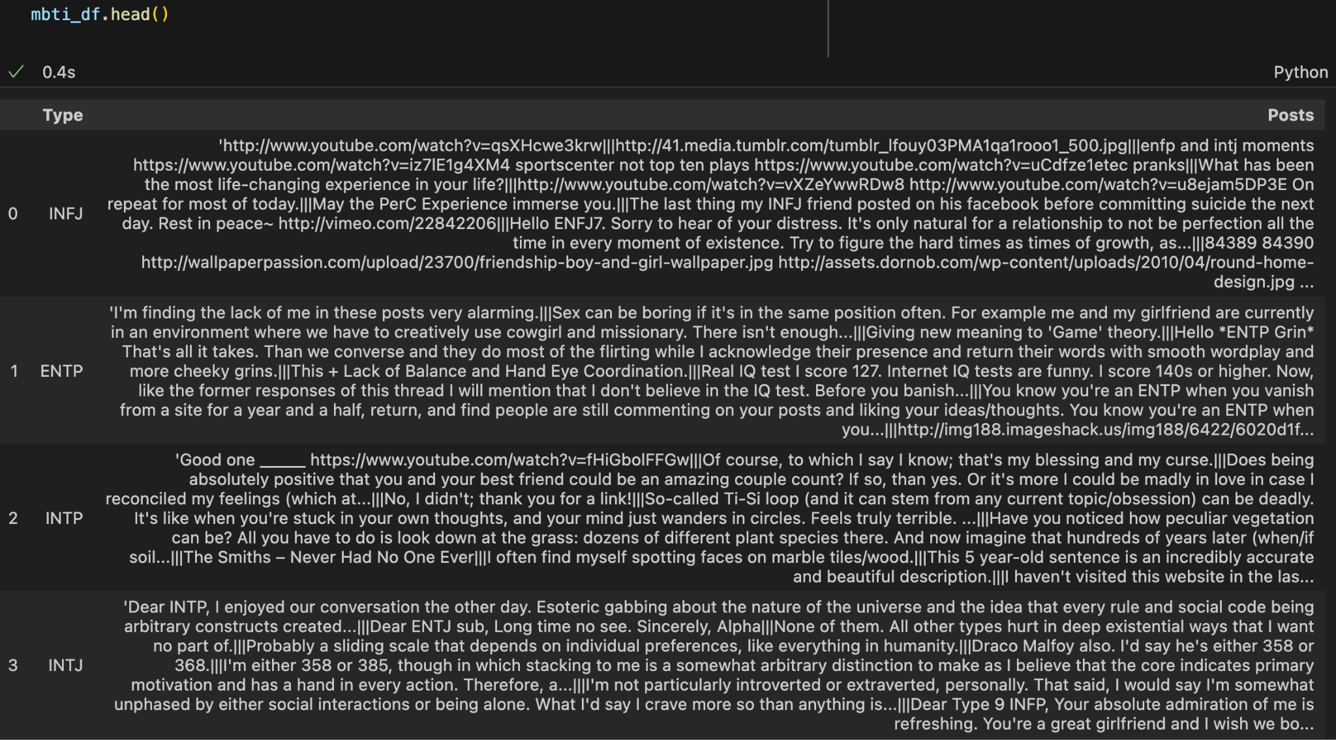
Data
Data Source: (MBTI) Myers-Briggs Personality Type Dataset
https://www.kaggle.com/datasets/datasnaek/mbti-type
8675 rows
2 features: one’s 4-letter MBTI type + most recent 50 social media posts with ‘|||’ as separation
Multi-Classification
16 MBTI personality type:
INFP, INFJ, INTP, INTJ, ENFP, ENTP, ISTP, ISFP,
ENTJ, ISTJ, ENFJ, ISFJ, ESTP, ESFP, ESFJ, ESTJ

Slide 6
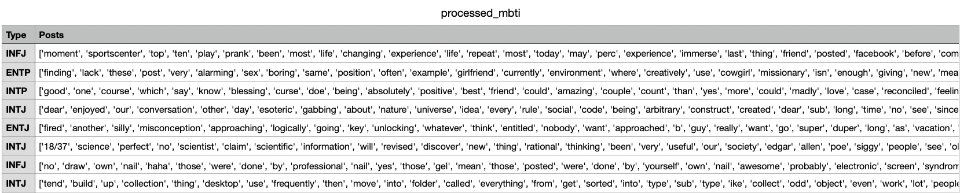
Data Preprocessing —TO CSV File
Clean text
Drop rows
- Replace links, punctuations and symbols with spaces
.,;:__@()%&$#!*^-
- Lowercase
Drop rows that are empty or have whitespace-only cells in the ‘Post’ columns
Lemmatization
Stop words
Use lexical based knowledge to get the base forms of words
Remove the stop words, including single letters, incomplete-meaningless word, pronouns, any 4-letter MBTI types
Total: 8675 w/ 2 features
Note: Vectorization was done every time after split training and testing data before applying to models

Slide 7
Tree-Based Models
Random Forest Model

Slide 8
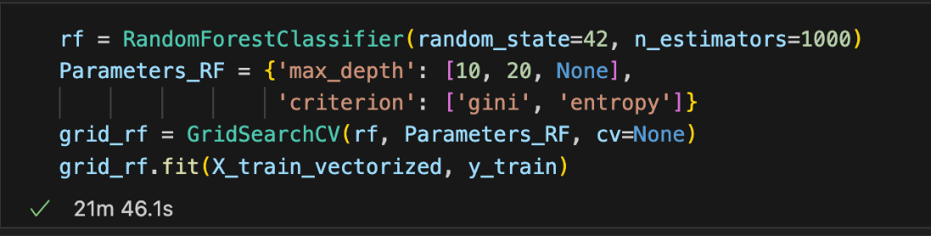
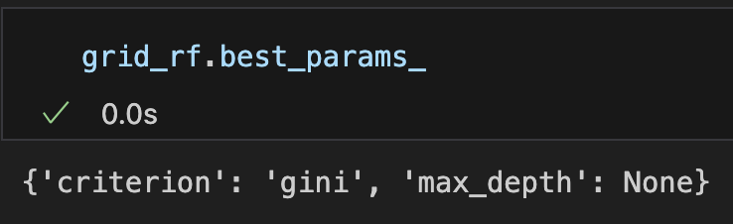
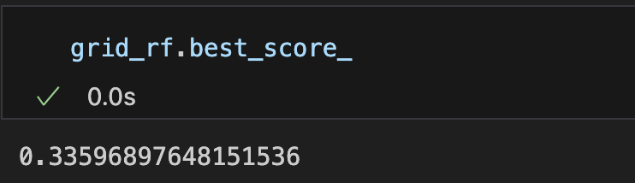
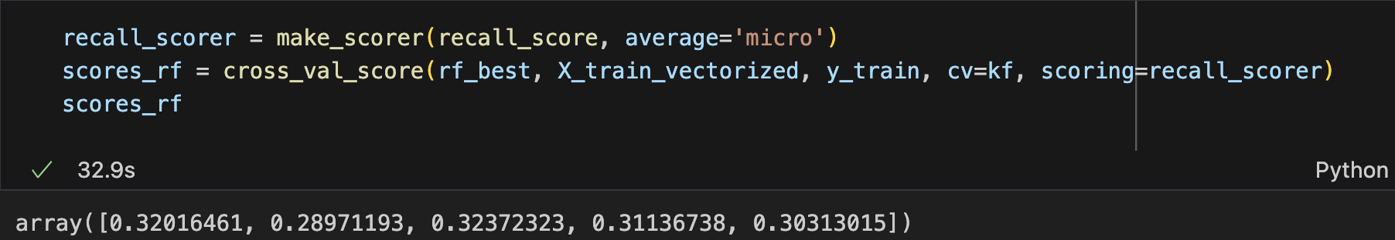
Hyper-Parameter Tuning (gridsearchcv)
KFold Cross Validation
Mean: 0.31
Range:0.29 - 0.32

Slide 9
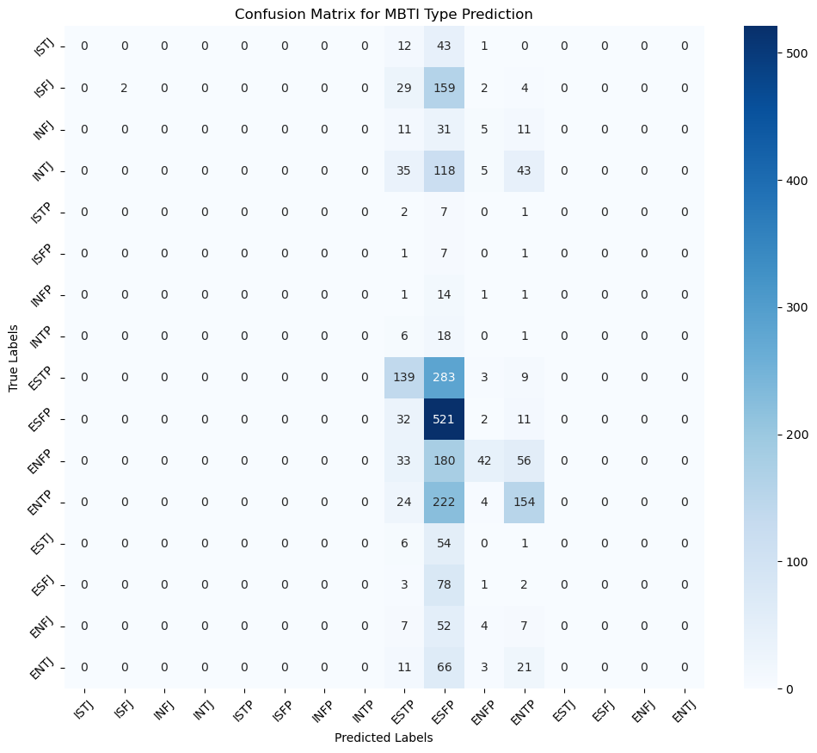
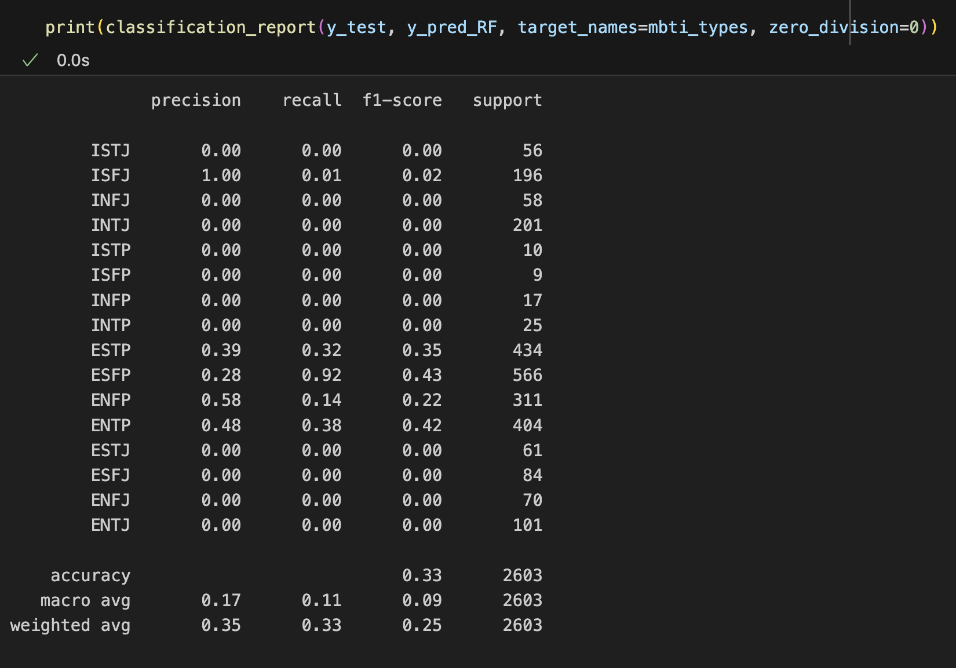
Classification Report
Confusion Matrix Heatmap
Notes:
Precision, recall and f1score for most type sare pretty low, with many types having 0.
- For RF:
- Precision: Most types have very low precision, with many types having a precision of 0.00, indicating the model did not correctly predict any instances of these types. Types like ISFJ (1.0) and ENFP (0.58) have higher precision, meaning these predictions were more often correct.
- Recall: Recall is also very low for most types, especially for types like ISTP, ISFP, INTP, and INFP, where it's 0.00, indicating the model failed to identify most of the true instances of these types. ESFP has a high recall (0.83), indicating the model was able to identify a large proportion of the actual ESFP instances.
- f1-score: The F1-scores are also low for most types, reflecting the poor performance in precision and recall. The ESFP type has the highest F1-score (0.43), indicating a relatively better balance between precision and recall for this type. However, overall, the low F1-scores indicate the model is not performing well in balancing precision and recall across most MBTI types.
- Same output can be showned in the accuracy, macro avg, and weighted avg.
- ESFP, ESTP, and ENTP all have high diagnal values. This means the model relatively effectively recognizes 'ESFP, ESTP, and ENTP' personality types from their posts. Among these three types, ESFP has the highest diagnal value, representing that the model can be mostly effectivelly predict this personality type. However, the cells corresponding to the true label 'ISFJ', 'ESTP','ENFP','ENTP' and predicted label 'ESFP' have high counts, it suggests the model often mistakes 'ESTP','ENFP','ENTP' posts for 'ESFP'. It is interesting that the model is very easy to wrongly predict other personality type to 'ESFP'.

Slide 10
Evaluation
Decistion tree classifier models: easily overfitting
Random forest classifier models: more time-consuming
Notes:
Decistion tree models are easy to overfitting. As for one of models, I did not set the max_depth (it gave me 30). As I gradually decreased max_depth to 27, the score increased from 0.302 to 0.31. Random forest classifier models are generally more time-consuming than decision tree classifier model.

Slide 11
Linear Models
Logistic Regression Model

Slide 12
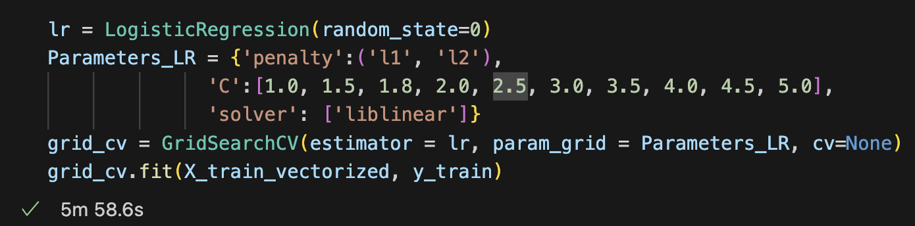
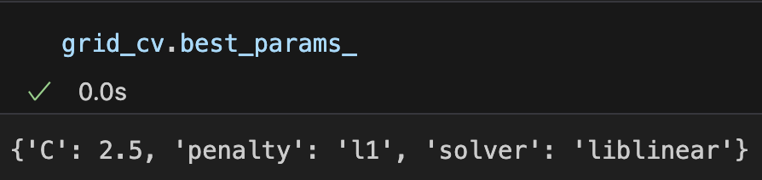
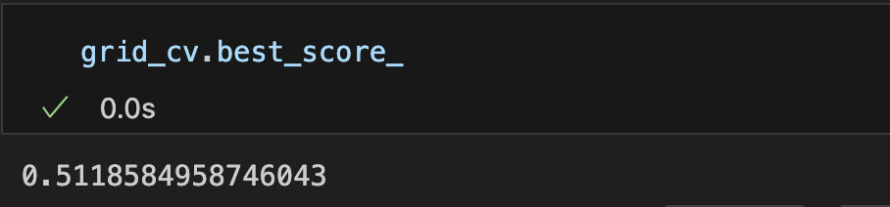
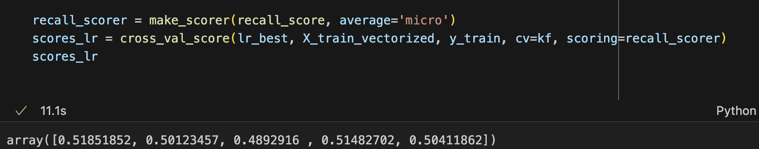
Hyper-Parameter Tuning (gridsearchcv)
KFold Cross Validation
Mean: 0.5056
Range: 0.4893 - 0.5185

Slide 13
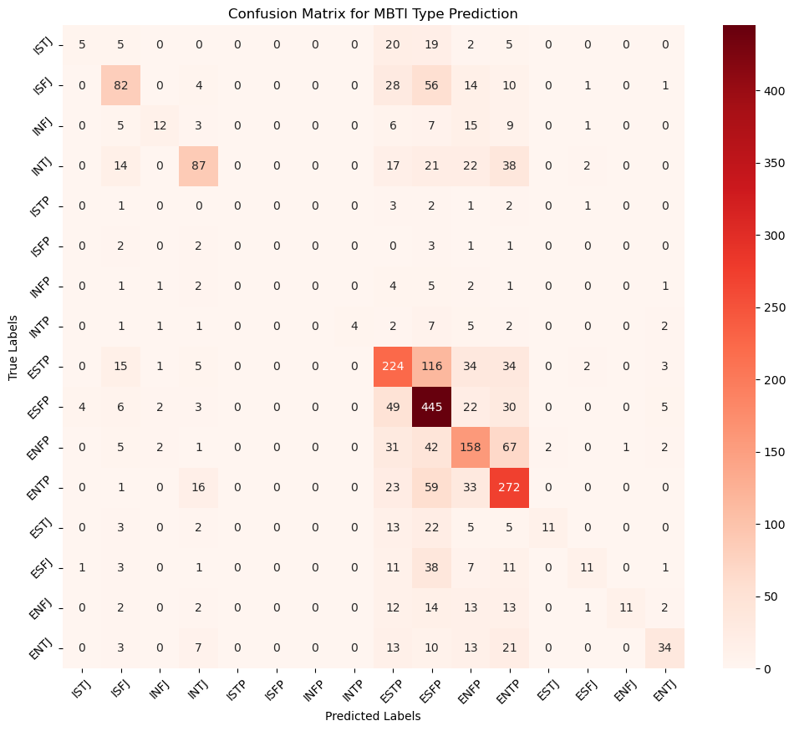
Logistic Regression Vs. Random Forest
Compare of Confusion Matrix Heatmap
Notes:
- From this heatmap, we can see that the diagonal values are more, representing the model performance is better than random forest model. Similar to the random forest model, logistic regression model also mistakes 'ESTP' as 'ESFP', but it's much less 116 Vs. 283.
- ISFJ, INFJ, ESFP, ESTP, ENFP, and ENTP all have relatively high diagnal values. This means the model relatively effectively recognizes 'ESFP, ESTP, and ENTP' personality types from their posts. ESFP still have the highest correct prediction. But, the amount of 'correct hit' decreases compare to random forest model (521 -- 445).

Slide 14
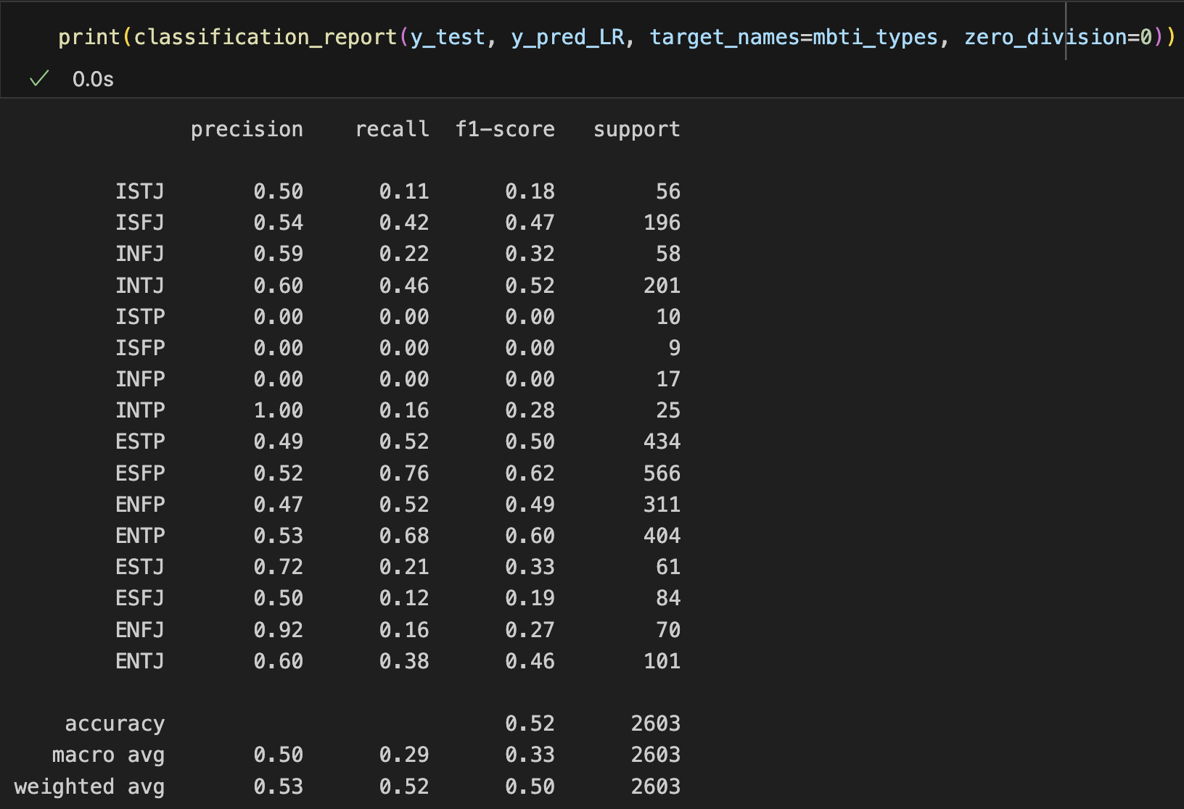
Logistic Regression Vs. Random Forest
Comparison of Classification Report
Notes:
- This model shows an improvement in precision, recall, and F1-score for many MBTI types compared to RF report. Notable improvements can be seen in classes like ISTJ, INTJ, ESTP, ESFP, ENFP, and ENTP. It also shows non-zero scores for many of these previously underperforming classes, such as ISFJ, INFJ, and ISFP. This suggests enhancements in the model's ability to correctly identify and classify these MBTI types.
- LR report still shows some classes with very low or zero scores (ISTP, ISFP, INFP), similar to RF report, indicating persistent difficulty in correctly predicting these types. However, some classes (ESFP, ENTP) now have relatively high F1-scores, showing particular strength in these areas.

Slide 15
Evaluation
Pros: Regularization to handle overfitting and feature selection (L1)
easier to interpret the models
Cons: Sensitive to imbalanced dataset

Slide 16
Error Analysis 1
Gridsearchcv: time-consuming ➡ kept changing the parameter values
combinations to balance between having
enough values and save time
Solution:
manually tested and filtered out those parameter values that I believe are not significant to combine with other parameters (20~mins)

Slide 17
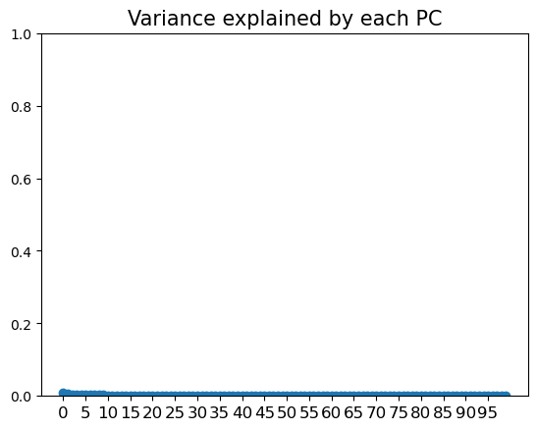
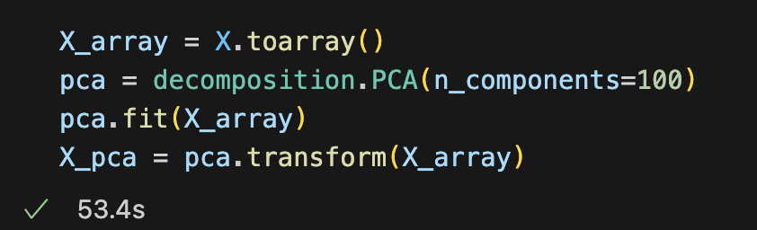
Error Analysis 2
It can barely explain any variance
PCA: not appropriate for sparse input which was resulted by Tfidf vectorization

Slide 18
Truncated SVD

Slide 19
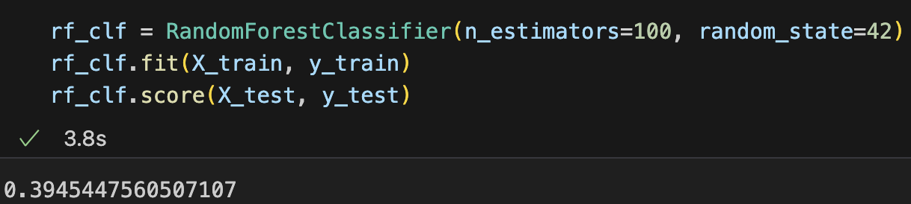
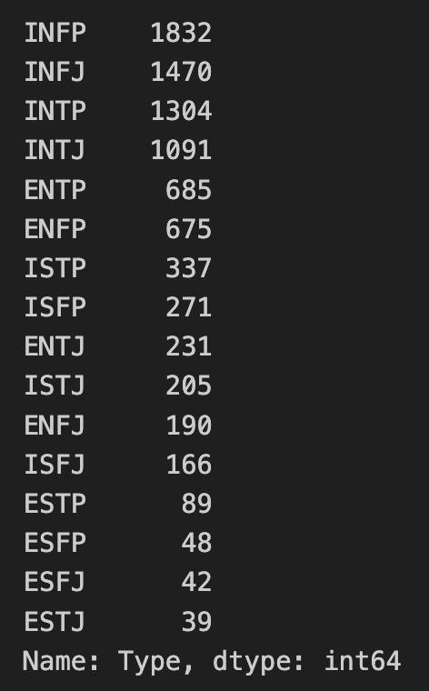
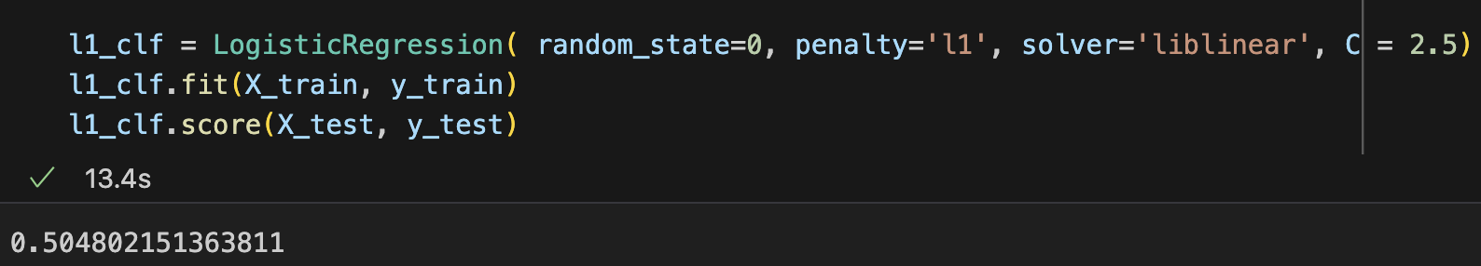
Performance
RF: 0.33➡0.39
LR: 0.52➡0.50
Probably due to
imbalance of the data/ dimensionality reduction

Slide 20
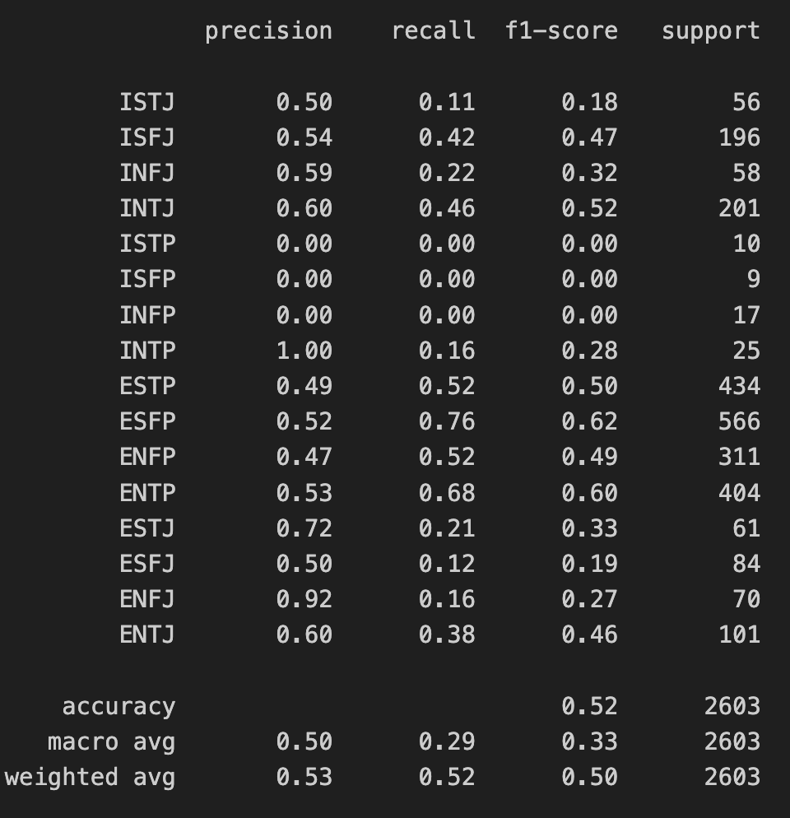
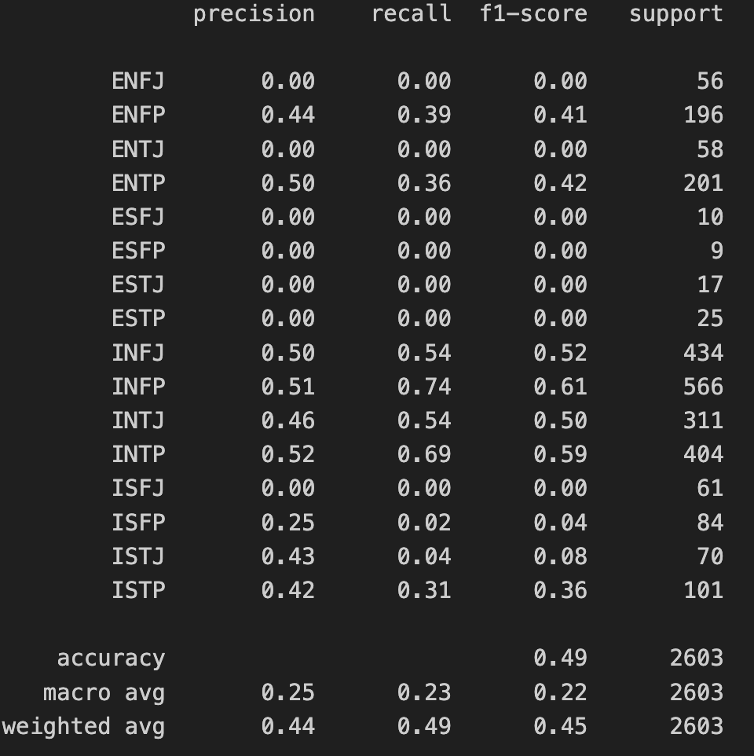
Before vs After
Notes:
reduced-dimensional space does not adequately capture the complexities of the dataset.
mislabeling or incorrect assignment of labels

Slide 21
Summary
 | Random Forest | Logistic Regression | Applying Truncated SVD
Accuracy Score | 0.33 | 0.52 | RF: 0.39 LR: 0.49
 |  | Best Performance!!!
Especially for EXXP (ENFP, ENTP, ESTP, ESFP)
Notes:
- The model achieved an accuracy of 52%, indicating that it was able to correctly predict the personality type based on social media posts more than half of the time.
-Some types (e.g., ENFP, ENTP) had higher F1-scores, suggesting better model performance for these types. In contrast, others (e.g., ISTP, ISFP) had lower scores or were not predicted at all, indicating difficulties in accurately classifying these personality types.
- The model's ability to predict different personality types varied, suggesting that some personality traits or types may be more easily identifiable from social media posts than others.

Slide 22
Thanks!

Slide 23
Resources
J. M. (2017). (MBTI) myers-briggs personality type dataset. Kaggle. https://www.kaggle.com/datasets/datasnaek/mbti-type
Cottrell, Scott A., "Personality factors linked to workplace aggression as measured by the Myers-Briggs Type Indicator (MBTI)" (1997). Theses, Dissertations and Capstones. 1589. https://mds.marshall.edu/etd/1589

