Slide 1
AIML CA1 Part A : Classification DAAA1B03 / Tan Eu Zin / P2415927

Slide 2
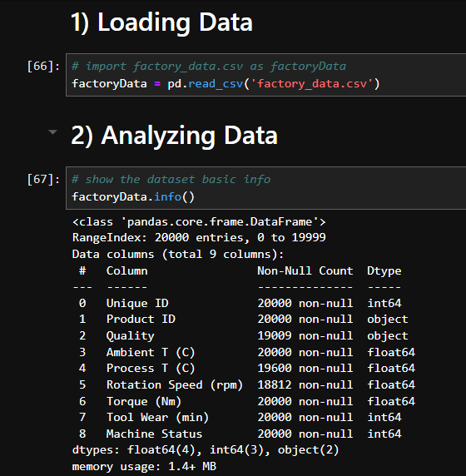
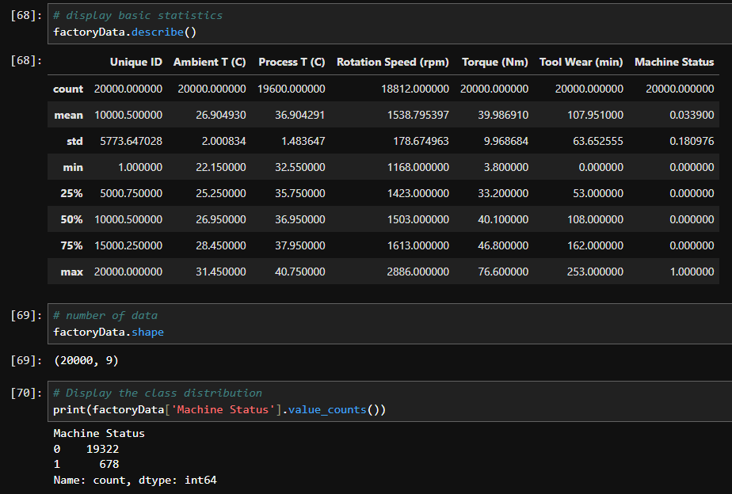
First, load data into jupyter notebook and save as factoryData, and using factoryData.info() we see the header of each column and the type of data inside. Looking at the data, Unique ID and Product ID is not in interger or float form which cannot be used to train the model
Using .describe(), we can see the statistics of the data, such as count, mean, standard deviation, min, max, 25 50 and 75 percentile for each respective column.
Using .shape, we see the dimensions of the data which is 20000 rows by 9 columns, and by printing the value_counts() in Machine Status column, we see the number of 0s and 1s in the column, and it is clear that the number of 0s far outweigh the number of 1s in the column.

Slide 3
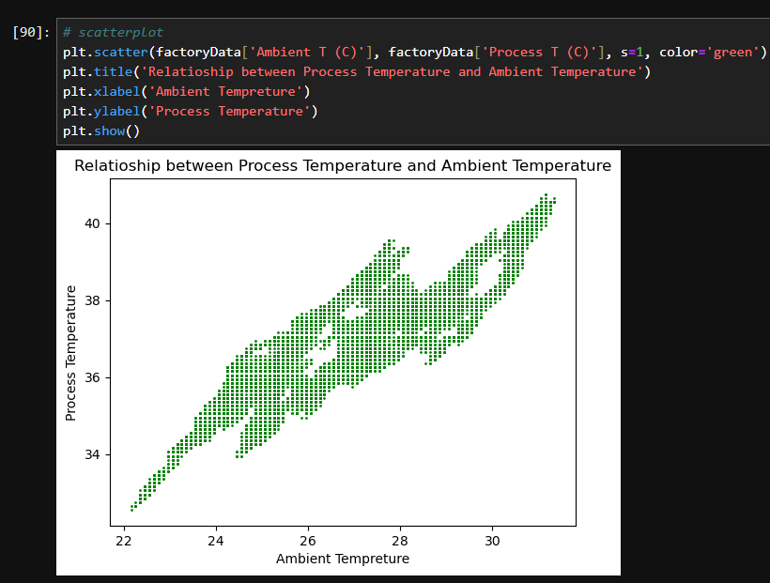
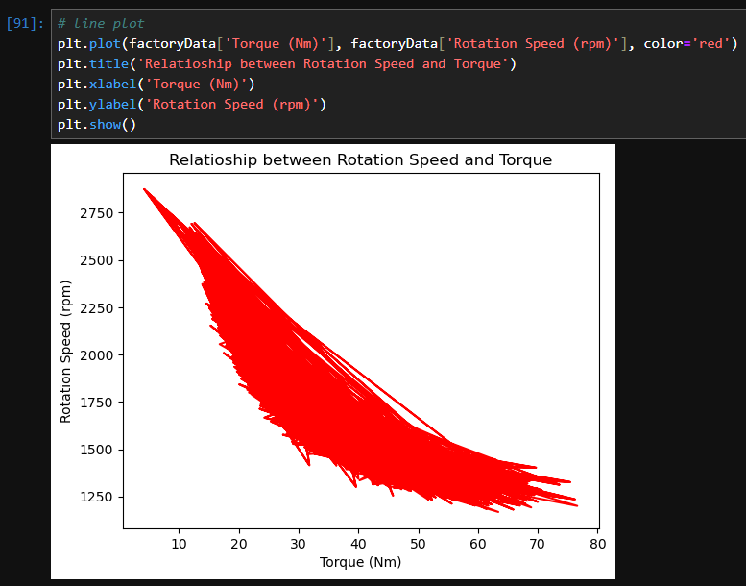
By plotting a scatter plot of the process temperature against the ambient temperature, we see that when the process temperature increases, the ambient temperature increases too and that it is directly proportional.
By plotting a line plot of rotation speed against torque, we see that when the torque increases, the rotation speed decreases, showing a linear downward trend

Slide 4
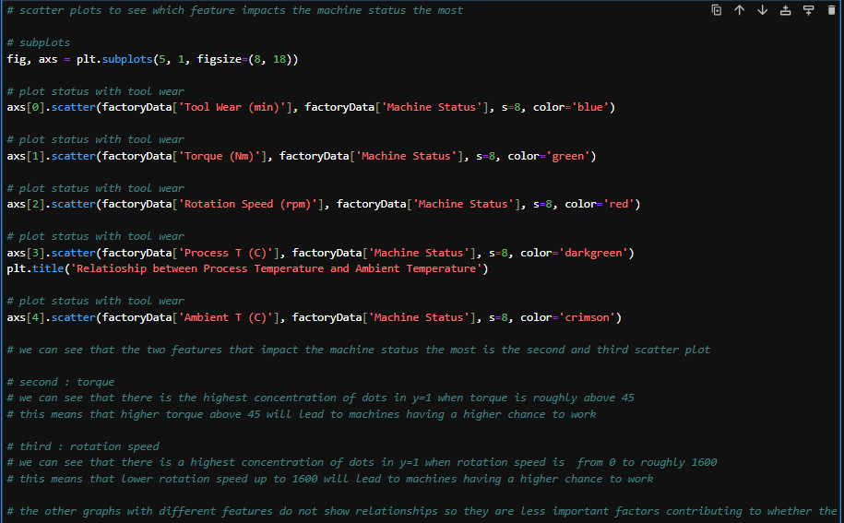
5 scatter plots with machine status against each feature is plotted to see which features are more influential of machine working.

Slide 5
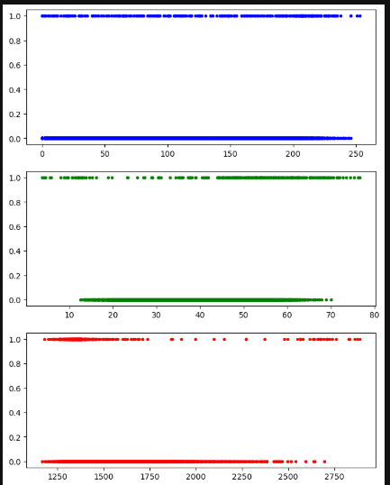
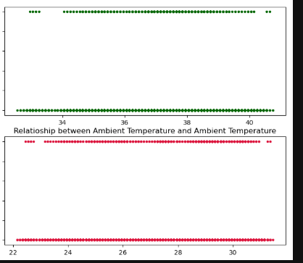



They are plotted in the order : Tool wear, Torque, Rotation Speed, Process T and Ambient T

Slide 6
As seen in the second (Torque) plot, we can see that there is the highest concentration of dots in y=1 when torque is roughly above 45 , this means that higher torque above 45 will lead to machines having a higher chance to work.
As seen in the third (Rotation Speed) plot, we can see that there is a highest concentration of dots in y=1 when rotation speed is from 0 to roughly 1600, this means that lower rotation speed up to 1600 will lead to machines having a higher chance to work.
The rest of the plots do not show any clear relationships affecting Machine Status hence these are the two most influential features affecting machine status.

Slide 7
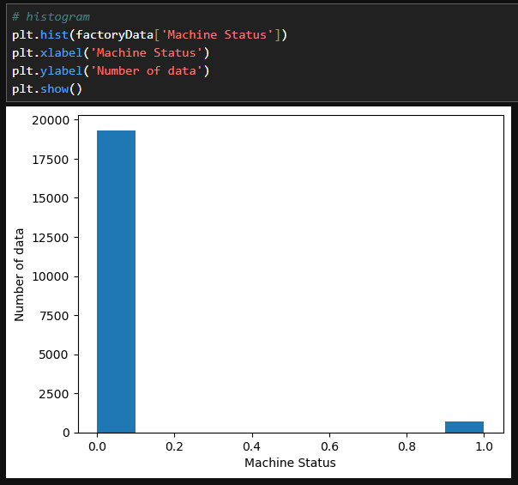
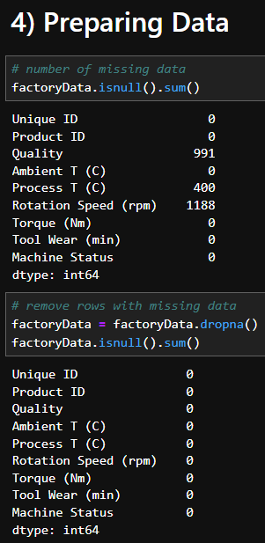
We check the number of rows with missing data and remove them using .dropna(). After that, we check if all the missing values have been removed by doing .isnull().sum() again.
Plotting a histogram for ‘Machine Status’, we can see that the number of 0s in the column is very obviously much more than the 1s in the column.

Slide 8
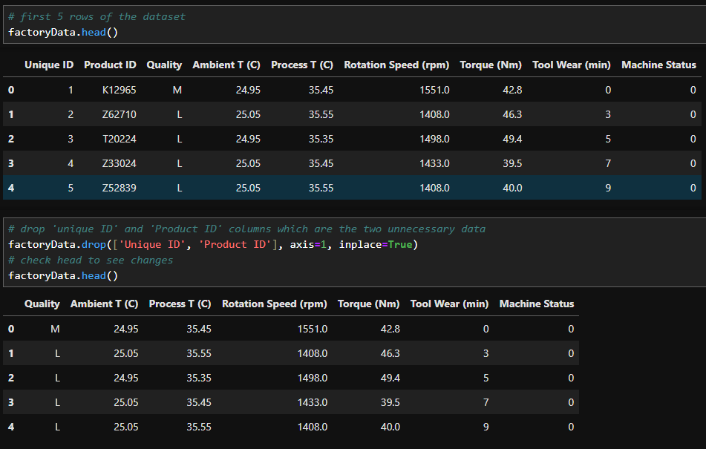
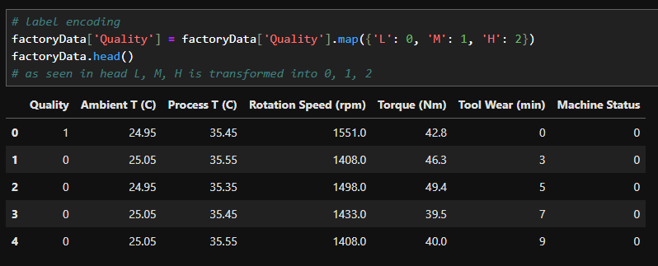

The ‘Quality’ column is not in numbers, so we need to encode it. And since the quality can be ordered : L, M, H , we use label encoding to order it : 0, 1, 2. We then check again if it has been changed.
Check the first 5 rows of data using .head(), we see columns with data that is not useful such as the column ‘Unique ID’ and ‘Product ID’ as the ID is only used to identify the machine and does not affect whether the machine is working or not, so we remove these two columns of data. We then .head() to check if it has successfully been removed.
We then separate the data and set the target which is ‘Machine Status’ as y and the rest of the data as X

Slide 9
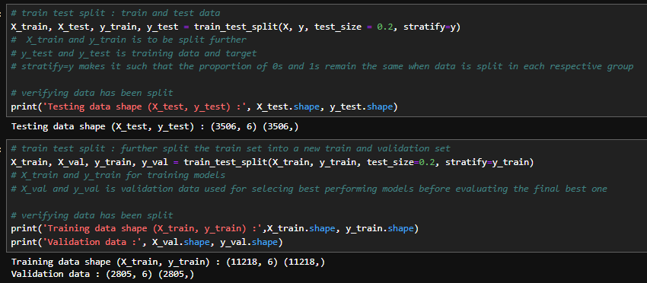
We now do the train test split for X and y, splitting 20% of the data into test data : X_test and y_test, and further splitting the data by another 20% into validation data : X_val and y_val, and the rest will be training data : X_train, y_train.

Slide 10
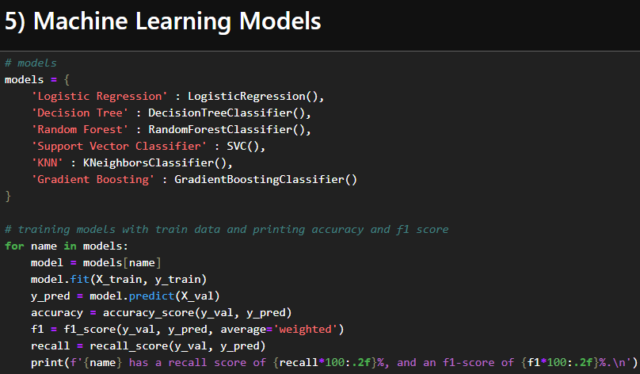
Now, we place all the models to use in a dictionary, then train each model and evaluate its f1 score and recall in a for loop. We do not use accuracy as the data is skewed towards 0s, meaning if a model guesses all to be 0s, the accuracy can be very high even if the model is not trained well. We use recall as our main measure of a model’s performance as True Positives are the most important in this context as the model is trying to predict working machines in population with mostly non-working machines. We use f1-score as a secondary measure as it is a balance of recall and precision, which can be used as a rough idea of a model’s performance in general

Slide 11
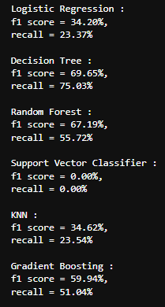
Results of each model after training and predicting
Reasons for selecting models…
Logistic Regression : Handles linearly separable data well in case the data provides a clear linear relationship.
Decision Tree : Handles non-linear relationships well in case there is no linear pattern to be found.
Random Forest : Reduces overfitting compared to individual tree and has better generalization and accuracy in non-linear datasets.
Support Vector Machine : Effective in high-dimensional spaces and for data that might not have a clear linear relationship.
KNearestNeighbors : Adapts well to patterns in data to look for patterns in identifying machine status.
Gradient Boosting : Works well with both structured and not that structured data, and that it is more accurate but more difficult to understand.
Out of all 6 models, the best one is Decision Tree as it has the highest f1 score, and the highest recall score. We choose based on recall mainly as recall is the most important measure.

Slide 12
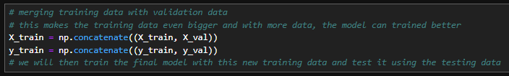
Before improving the best model the original training data is merged back with the validation data as it will give a larger dataset to train the model which can make it more well-trained.

Slide 13
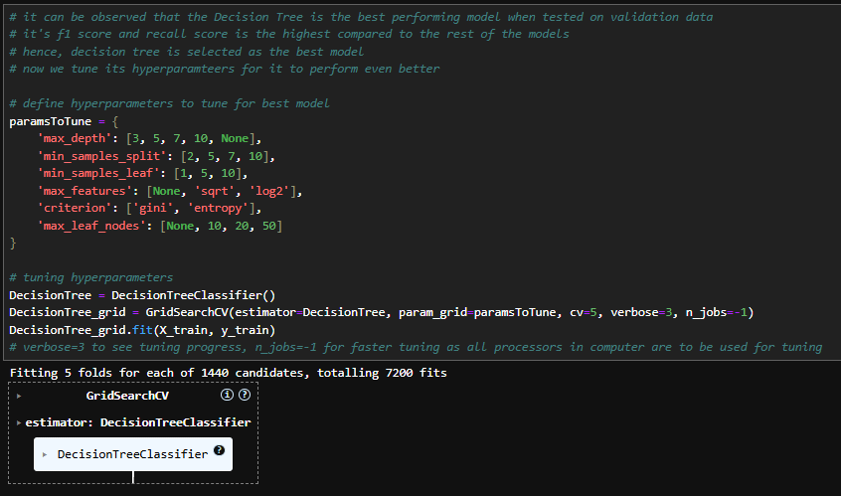
After deciding that the Decision Tree is the best model, we tune its hyperparameters. After doing so, we train the model with the best performing hyperparameters and the X_train and y_train data.

Slide 14
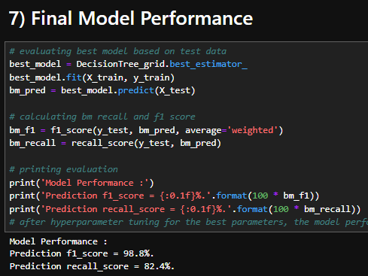
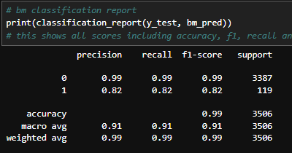
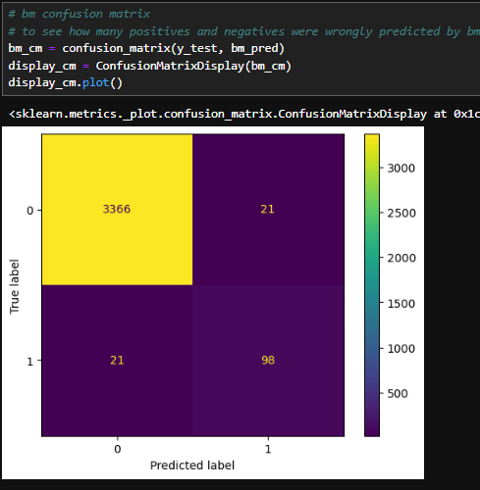
Classification report and confusion matrix shows that there are 21 false negatives and 21 false positives
After tuning hyperparameters, the models performance has increased in both recall and f1 score, which made the model perform better.

Slide 15
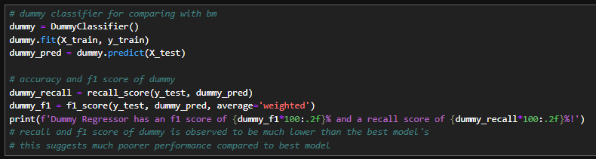
Dummy
Training dummy with same training data and predicting on same testing data.

Slide 16
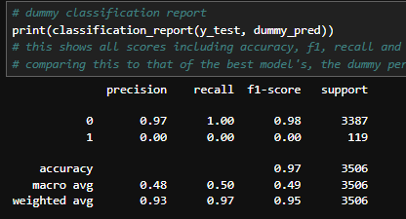
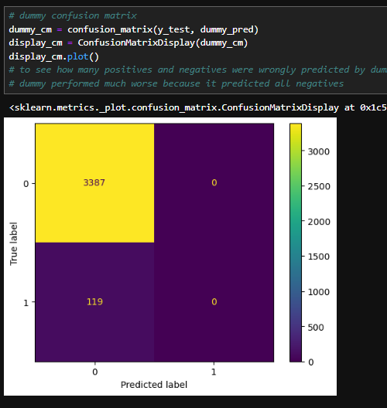
Dummy predicted all values to be 0s, resulting in 0.00% recall score as there were no positives predicted correctly. The model has a high f1 score as generally, the model performed quite well because it predicted most of its data correctly by just predicting everything as the average : 0

Slide 17
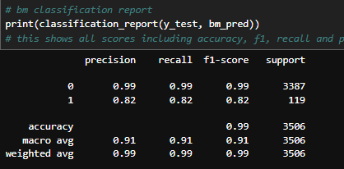
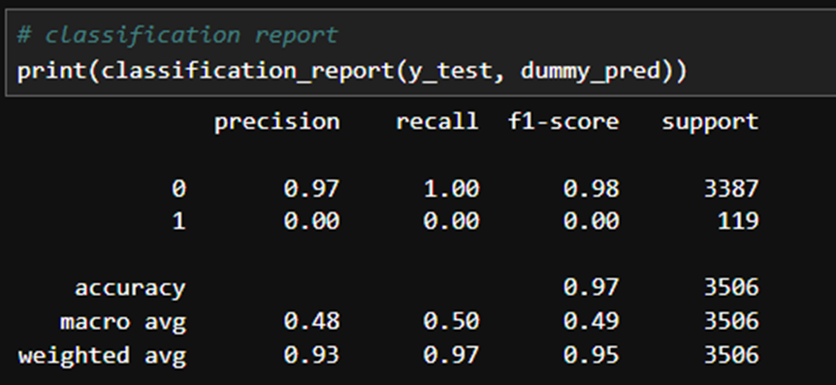
Decision Tree
Comparing classification reports, the dummy fared much worse than the Decision Tree at predicting 1s as the f1 and recall were much lower than that of Decision Tree’s. However, the dummy fared pretty well and was slightly worse than the Decision Tree at predicting 0s as dummy was only 0.01 behind Decision Tree when looking at f1 scores for 0s.
Dummy

Slide 18

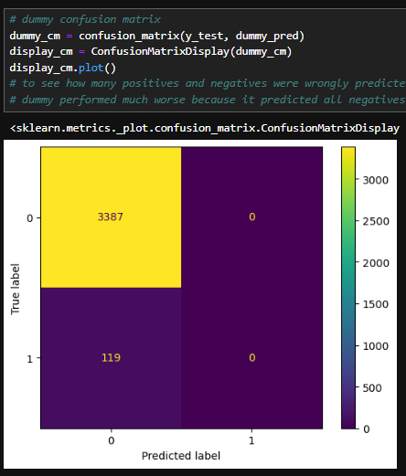
Decision Tree
dummy
By confusion matrix, Decision Tree only has a total of 42 errors (21 false negative + 21 true positive) and dummy has 119 errors (119 false negatives). Hence, it can be concluded that the dummy fared much worse.

Slide 19
The End

