Slide 1
AIML CA1 Part B : Regression DAAA1B03 / Tan Eu Zin / P2415927

Slide 2
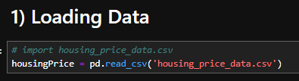
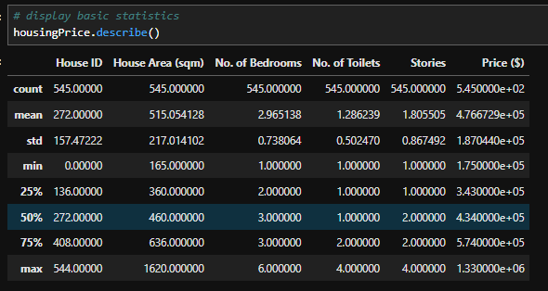
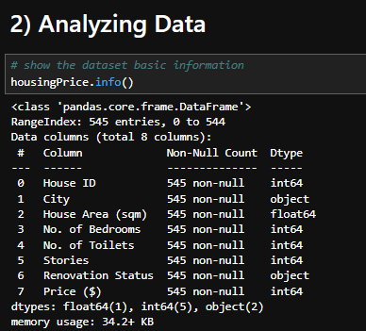

First, load the Data into housingPrice from given dataset
Using .describe(), I can see the statistics of the data, such as count, mean, standard deviation, min, max, 25 50 and 75 percentile for each respective column.
Using .shape(), I can see that we have 545 rows of data with 8 columns
Next I checked the housingPrice dataset info. We see that there are some values that are not intergers or floats so we have to change them later

Slide 3
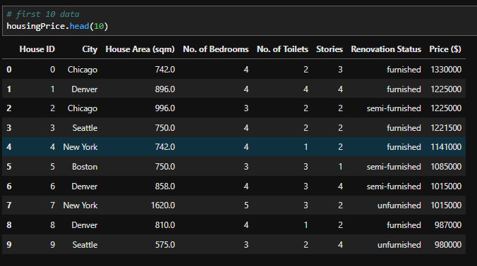
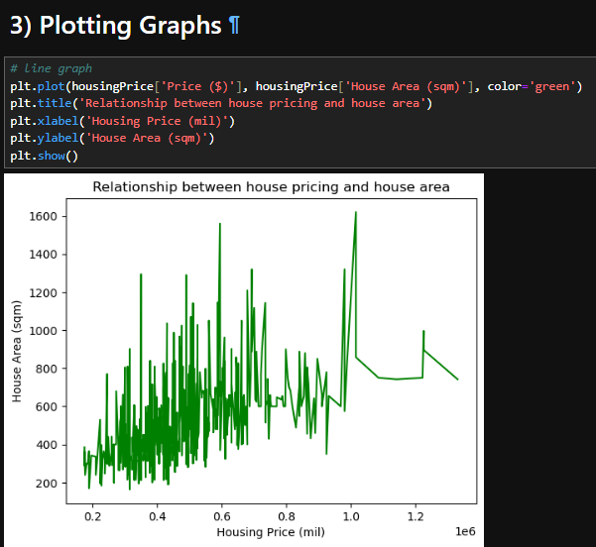
Looking at the head(10) which is first 10 rows of data, I see that there is one column which does not provide useful information : ‘House ID’ , which is only used for identifying houses. We can also see that ‘City’ and ‘Renovation Status’ are in string so we have to change them into intergers.
Plotting a line graph, I can see that there is a slight correlation between House Area and Pricing. As house area increases, house prices will as well.

Slide 4
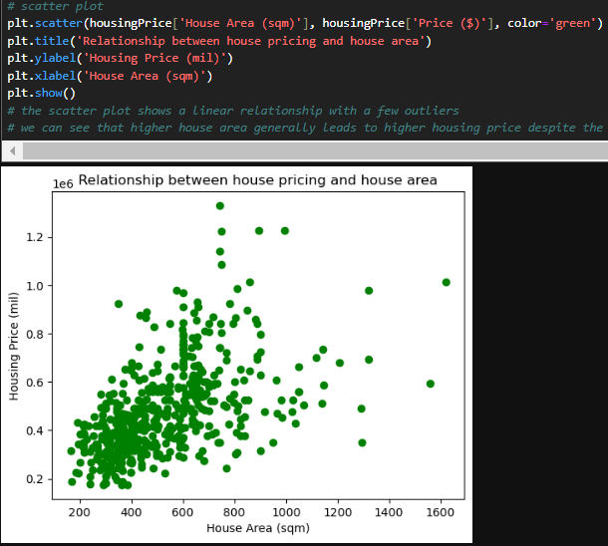
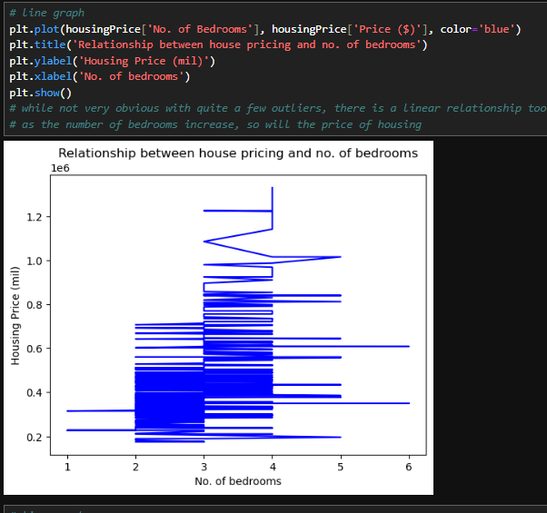
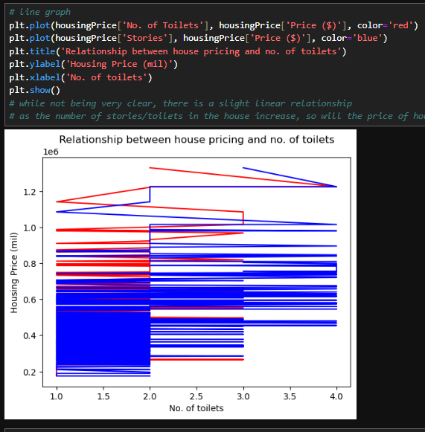
Plotting scatter and line plots for X : House Area, No. of bedrooms, Stories and No. of toilets, we can see that they all show an increasing trend, despite some not being obvious with many outliers. The higher the HouseArea/Bedrooms/Toilets/Stories, the higher the price of housing.

Slide 5
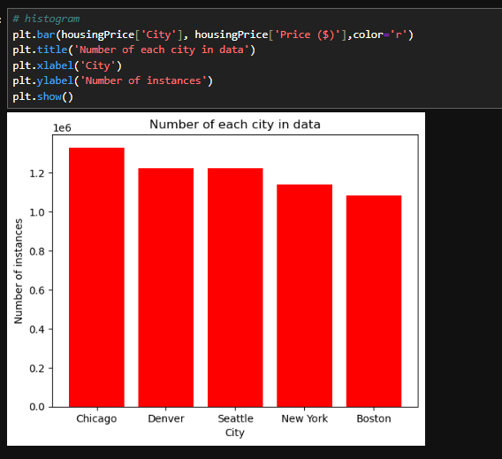
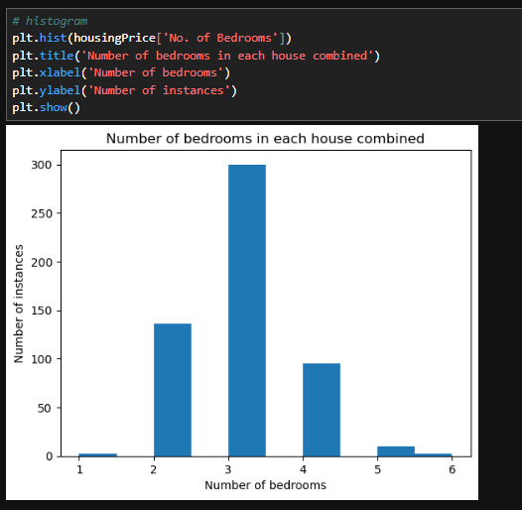
Plotting a histogram for number of bedrooms, we see that majority of the rows of data have 3 bedrooms, suggesting that the number of bedrooms is skewed towards the centre and not evenly spread out. This may lead to the model having insufficient data to learn to deal with data with more or less than 3 bedrooms.
Plotting a bar graph for City, we can see that the number of instances of each city is quite evenly spread out compared to the rest, so the model will know how each city affects house pricing equally well as there is enough data for it to learn to do so.

Slide 6
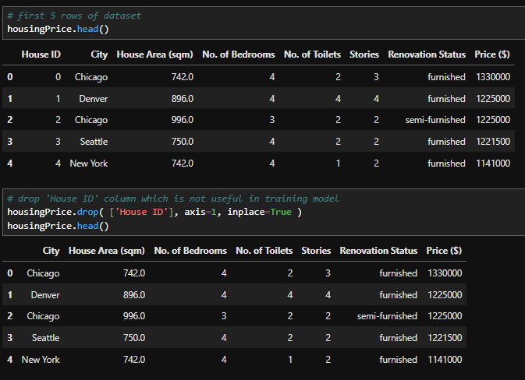
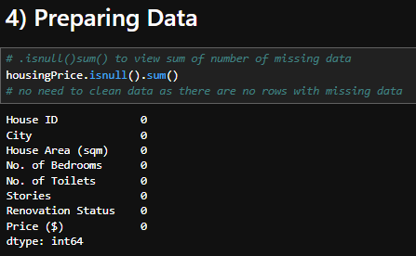
Check for missing values using .isnull().sum() and noticed that there is no missing values so there is no need to impute any data
Then, check the first five rows of the data, removed the unnecessary data ‘House ID’ and then verify we have done so again using .head() once more.

Slide 7
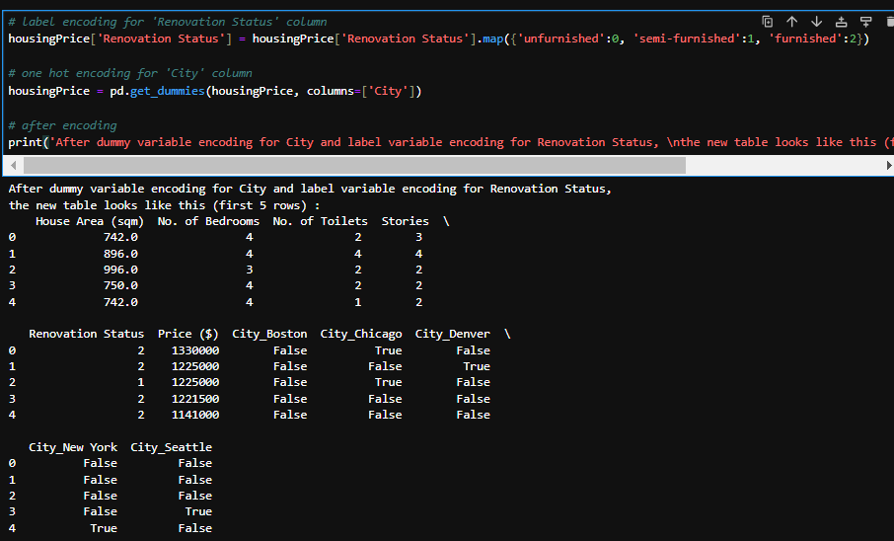
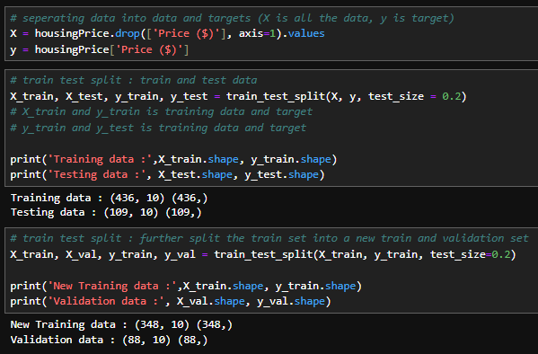
I then set the data and targets into X and y respectively, the target being the Price ($)
Next, I encoded the data in Renovation Status with label encoding as there is an order to unfurnished, semi-furnished and furnished, with unfurnished being cheaper and furnished being more expensive. I also used .get_dummies function from scikitlearn to do one hot encoding for Cities as we don’t know whether they would affect housing price and in what order.
Now, I will do the train test split for X and y, splitting 20% of the data into test data : X_test and y_test, and further splitting the data by another 20% into validation data : X_val and y_val, and the rest will be training data : X_train, y_train.

Slide 8
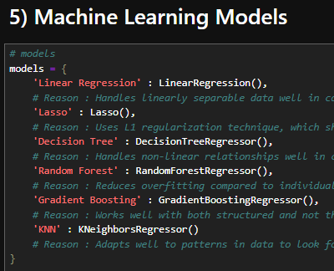
Reasons why I picked these models… Linear Regression : Handles linearly separable data well in case the data provides a clear linear relationship to suggest price of housing following a linear pattern. Lasso : Uses L1 regularization technique, which shrinks coefficients of less important features. This helps to simplify the model making it less likely to overfit, especially when there is a lot of features in the dataset like this one. Decision Tree : Handles non-linear relationships well in case there is no linear pattern to be found that helps with predicting price. Random Forest : Reduces overfitting compared to individual tree and has better generalization and accuracy in non-linear data, incase there is overfitting and incase there is non-linear relations. Gradient Boosting : Works well with both structured and not that structured data, and that it is more accurate but more difficult to understand. KNearestNeighbors : Adapts well to patterns in data to look for patterns in predicting house pricing.
These are the 6 models selected to be used in the assignment.

Slide 9
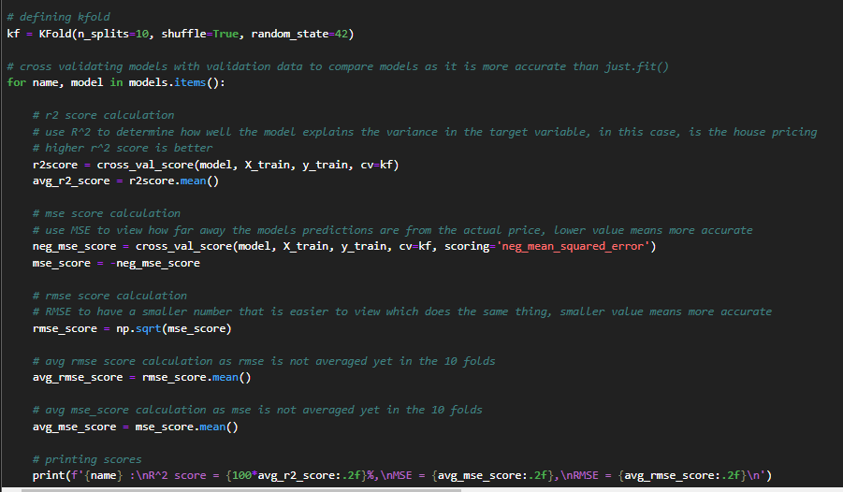
I use kfold cross validation with 10 folds to train each model and get their R^2 , MSE and RMSE to determine their performance for comparison using validation data as it is more accurate than just .fit(), especially when there is more variables to each column which makes this dataset more complex. We use MSE to view how far away the models predictions are from the actual price, and RMSE to have a smaller number that is easier to view which does the same thing as a main measure for comparison. I use R^2 to determine how well the model explains the variance in the target variable (house pricing) as a second measure for comparison.

Slide 10
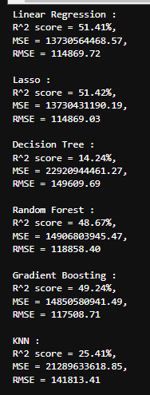
Lasso is the best performing model in here according to r^2 score and RMSE.
In most of the runs, I noticed that Lasso, Random Forest , Gradient Boosting and Linear Regression are always the top performing ones with the top 4 highest R^2 and lowest RMSEs. Since the difference between performance is only so small between all of them, I will hyperparameter tune them and compare the best one after hyperparameter tuning.

Slide 11
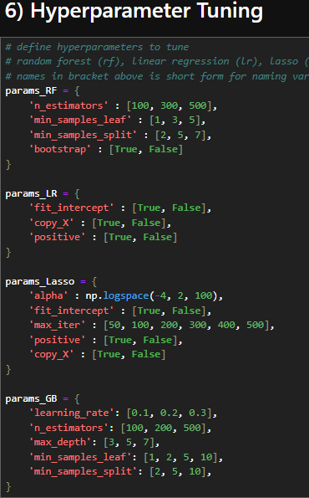
Now I will carry out hyperparameter tuning on these 4 models with these parameters and compare them by testing them on validation data.

Slide 12
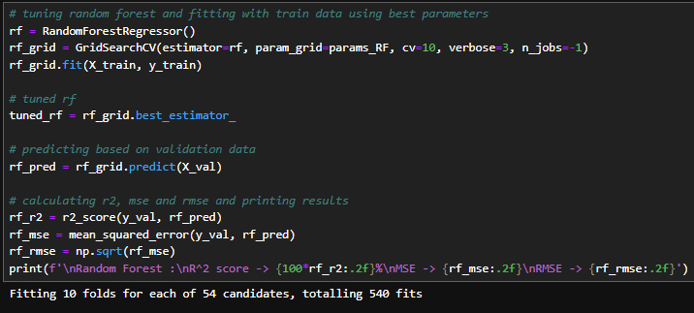
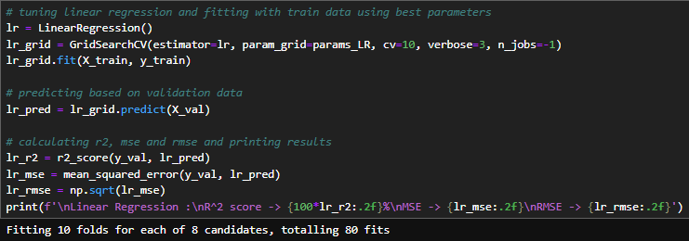
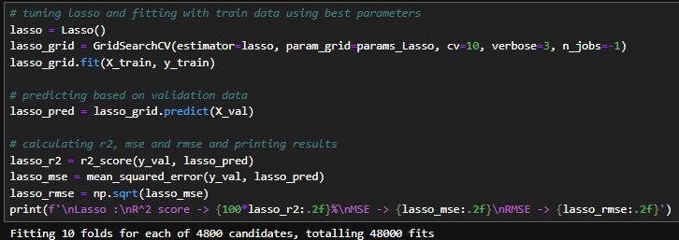
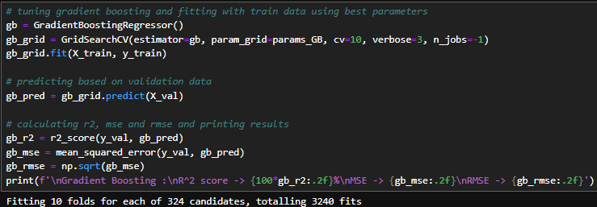

Slide 13




These are the results after hyperparameter tuning. The best performing model is Random Forest.
It has the best r^2 score and RMSE compared to the other 4 models

Slide 14
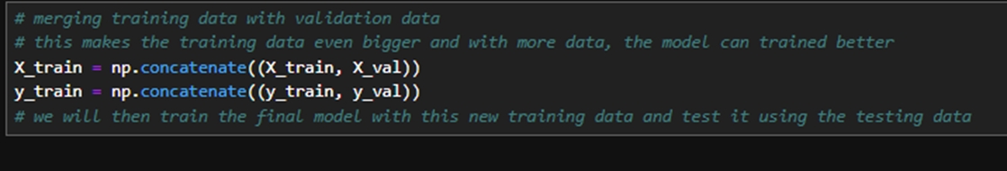
Now that we see random forest is the best model after hyper parameter tuning, we will compare it with the first best model to get the final model by using both to predict test data. The better performing one will be the final model to compare with dummy.
Before training the dummy and comparing the final 2 models, the training data is concatenated with the validation into a new training dataset. This makes the training dataset bigger and have more data to train the models which will make the models better.

Slide 15

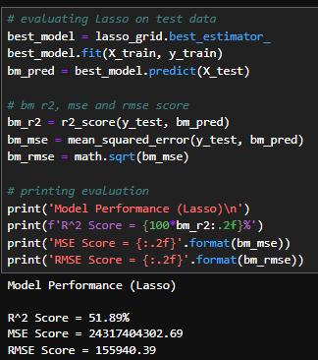
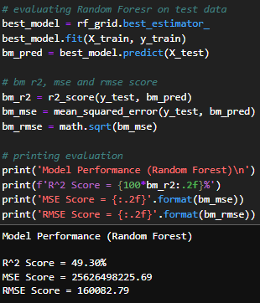
The two best models (Lasso and Random Forest) are now being evaluated on test data and here is the result :
Lasso will be chosen as the final model because Lasso has a higher R^2 value and a smaller RMSE compared to Random Forest. This model will be used to compare with a dummy baseline.

Slide 16
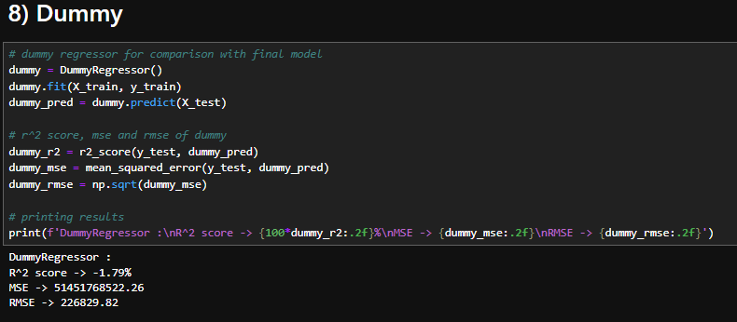
Next, the dummy is trained with train data and tested with test data. The dummy performs very badly with a negative R^2 value and high RMSE, suggesting that the dummy is either as good if not worse than the baseline (mean) and made very big errors.

Slide 17

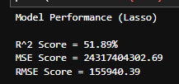
Comparing the performance of Lasso and Dummy, we see that Lasso did way better as the dummy constantly had a negative R-square score with a large RMSE, while Lasso had a much higher R^2 and much lower RMSE.
The dummy always predicts the mean of all the prices for every single row of data in y_test hence it performed very badly as there is a variety of house pricing with some being high and some being low. By only predicting the mean, the predictions end up being far from the actual value of the house pricing.

Slide 18
The End

