Slide 1
CA2 Part A : Time-Series
Tan Eu Zin
2415927
DAAA/FT/1B/03

Slide 2

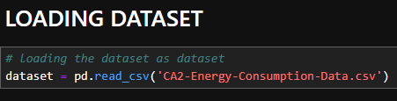

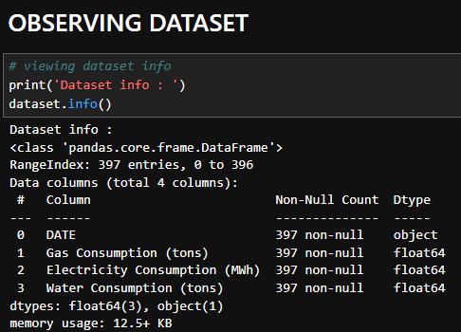
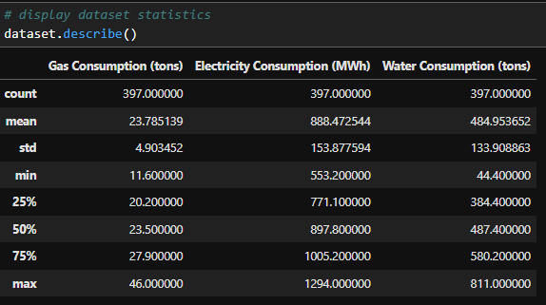
Check shape of data
First, we load the dataset
Next, observe dataset info
View basic statistics of data

Slide 3
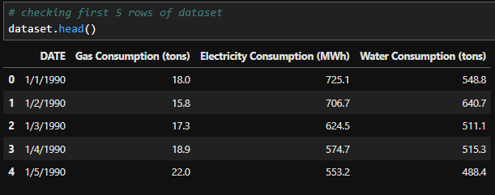
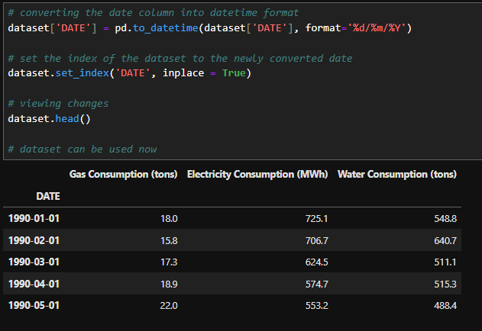
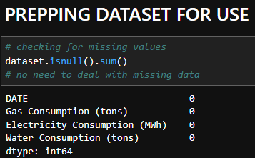
Viewing first 5 rows of data
Data prepping :
Converting date to datetime format and using it as an index
No missing values, no need to fill / drop anything.

Slide 4
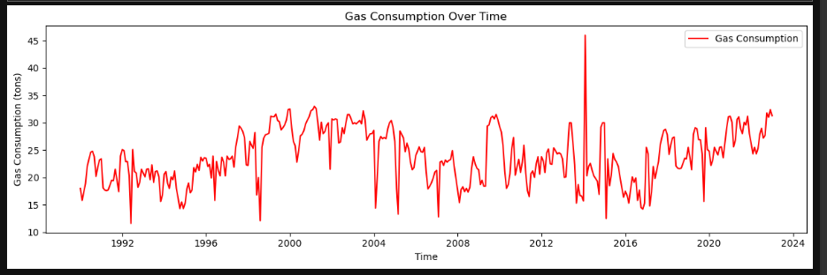
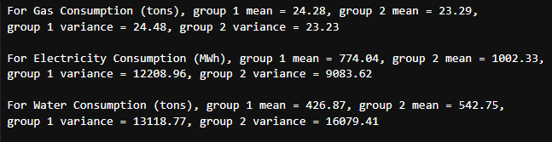
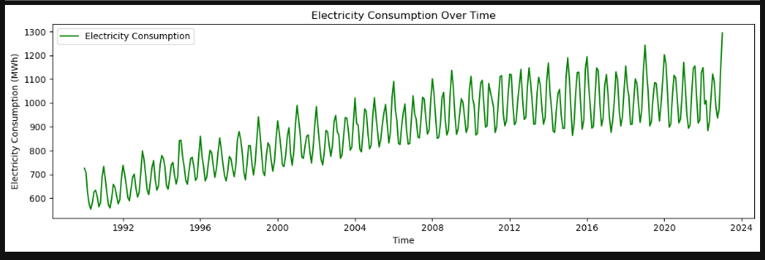
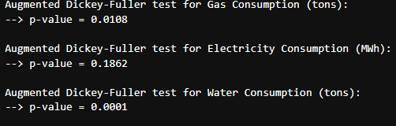
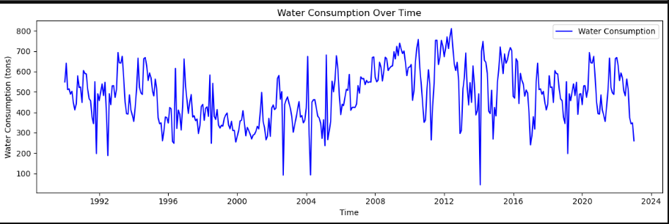
Viewed dataset before doing anything
Using both summary statistics and ADF to check for non-stationary columns, result from ADF used as summary statistics method allows more room for error. Electricity Consumption is the only column that is non-stationary.

Slide 5
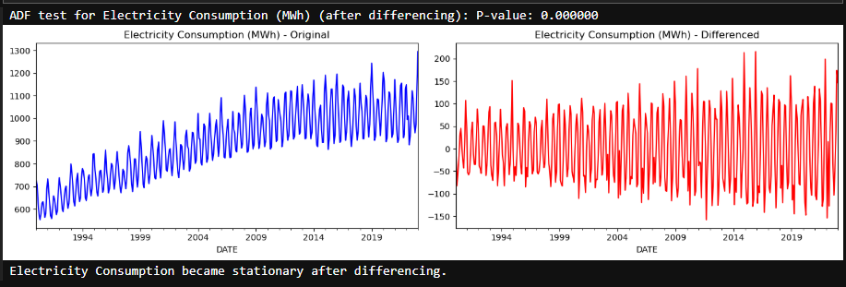
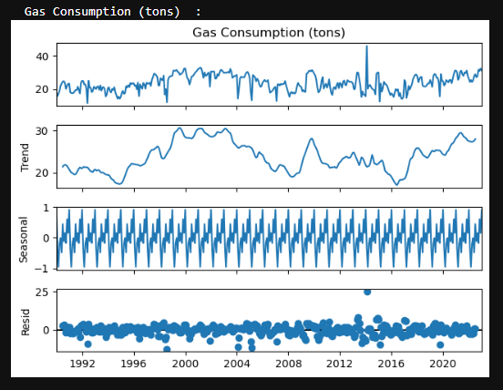
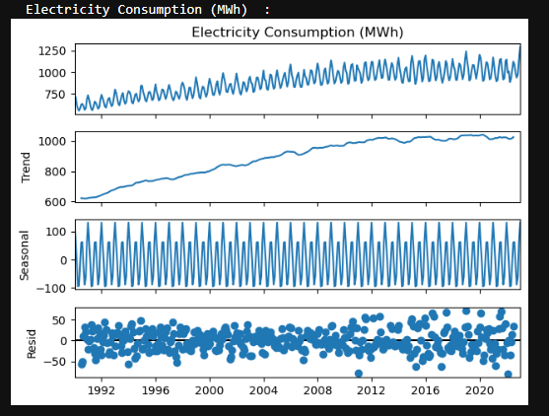
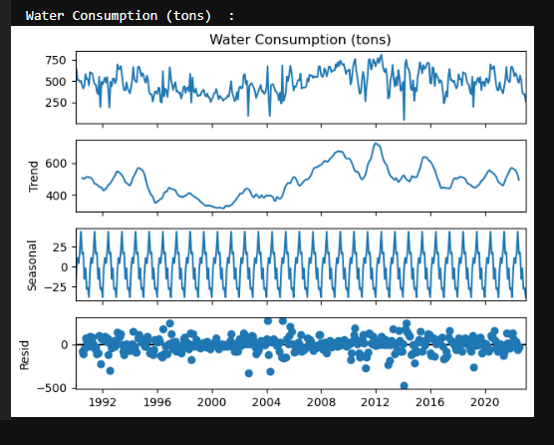
Differencing is carried out on electricity consumption to make it stationary.
Data decomposition to view mainly trend and seasonality of each column of data.

Slide 6
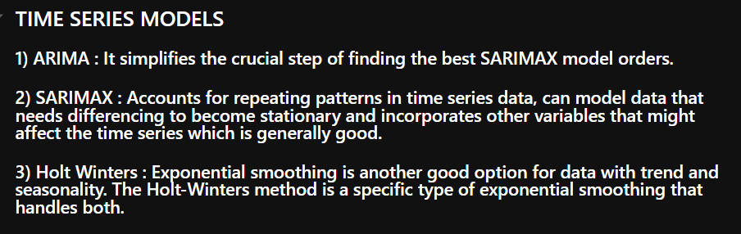
Training Models :
Models selected are :
ARIMA
SARIMAX
Holt Winters

Slide 7
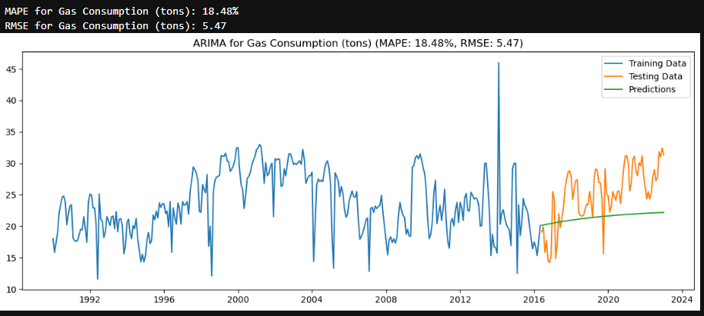
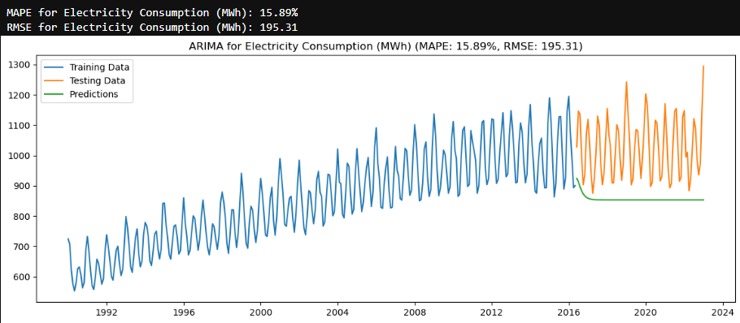
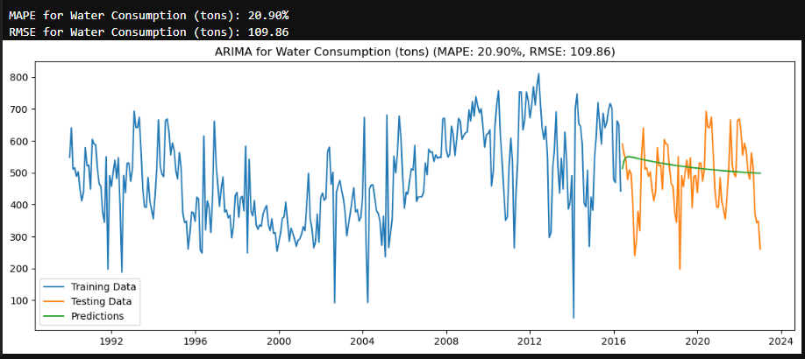
ARIMA

Slide 8
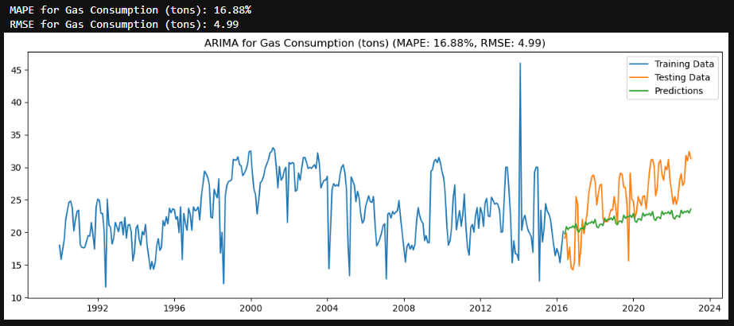
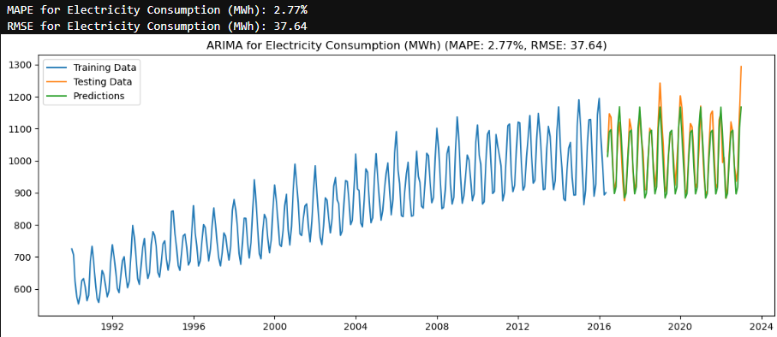
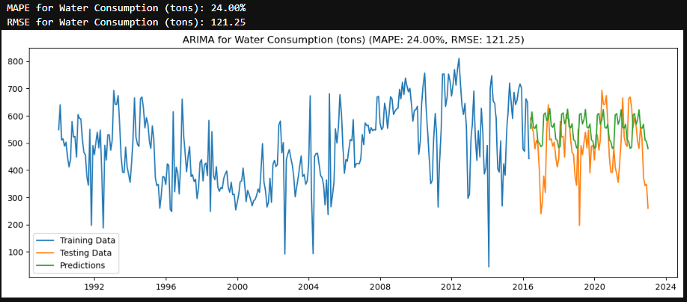
SARIMAX

Slide 9
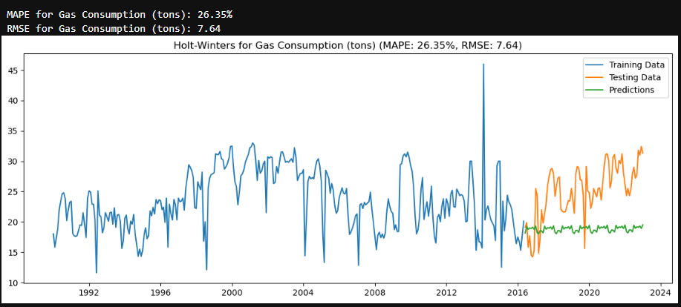
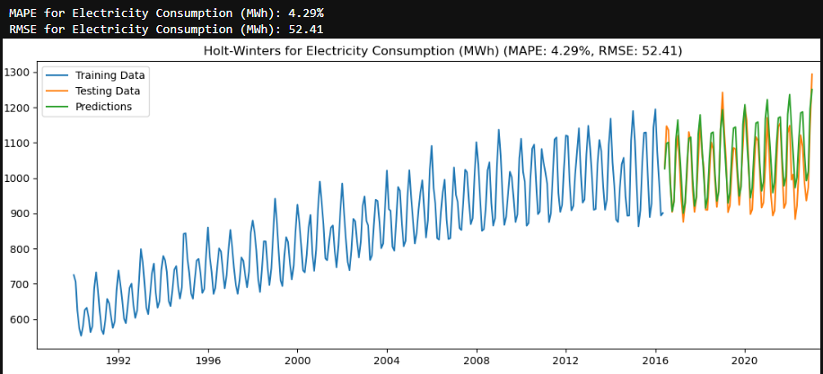
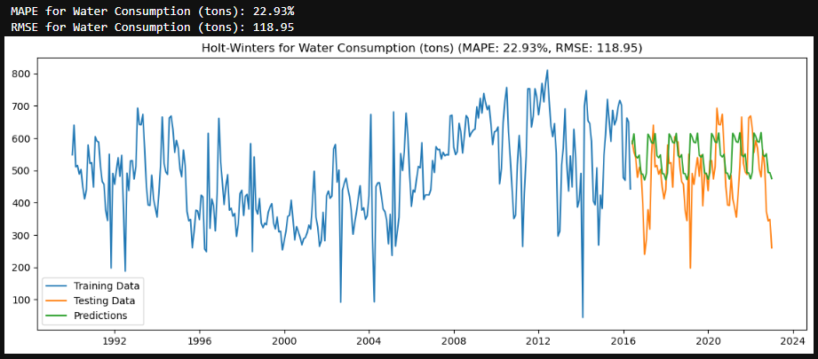
Holt Winters

Slide 10
Final Chosen Model : SARIMAX
SARIMAX has the lowest RMSE and MAPE in general compared to the other models.
However, the graph of water consumption for SARIMAX falls behind Holt Winters and ARIMA with highest MAPE and RMSE
Despite that, since 2/3 of SARIMAX’s predictions are the best among all, with lowest MAPE and RMSE (making the least error), we will take SARIMAX as the best model.
Now we will hyperparameter tune it.

Slide 11
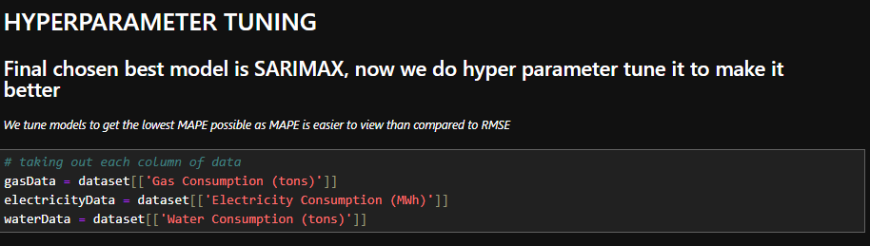


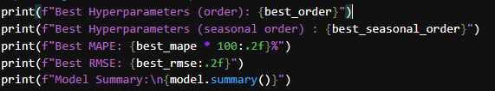
Split dataset by its columns
Here’s the parameters we are tuning SARIMAX with : order and seasonal order
We also train test split data from each column separately before tuning
We aim to get the order and seasonal orders that return the lowest possible MAPE score

Slide 12
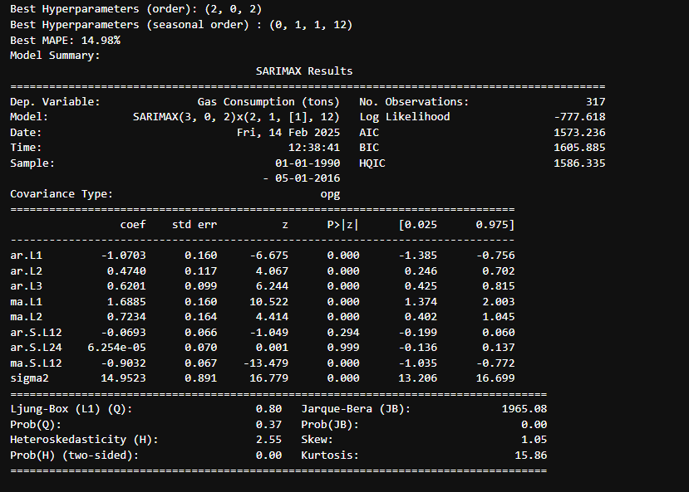
Tuning SARIMAX for gas consumption
Now that we tuned the model on gasData, we know the best parameters (order, seasonal_order) which give the lowest possible MAPE score, we can hence do the forecast with these parameters.
MAPE decreased after tuning compared to previously.

Slide 13
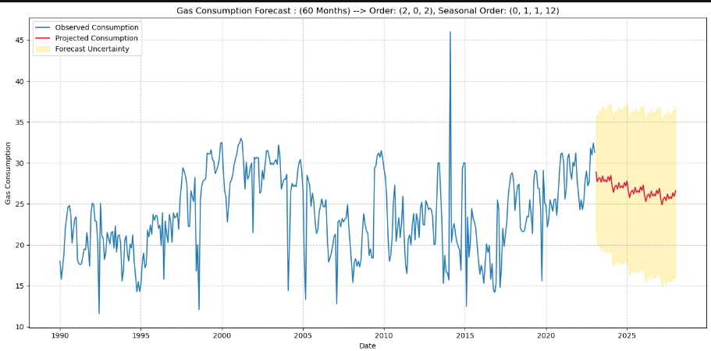
Forecast : Gas Data

Slide 14
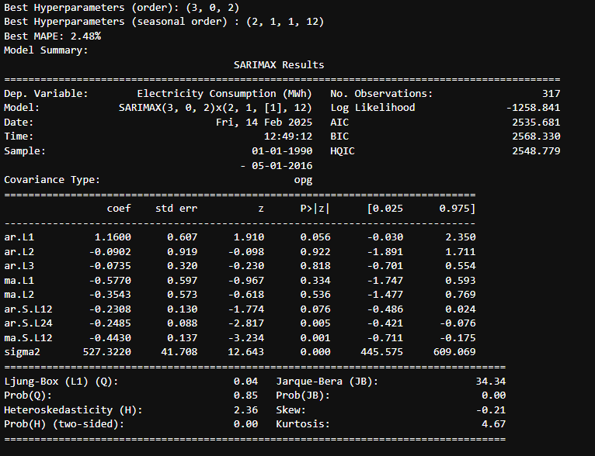
Tuning SARIMAX for electricity consumption
Now that we tuned the model on electricityData, we know the best parameters (order, seasonal_order) which give the lowest possible MAPE score, we can hence do the forecast with these parameters.
MAPE decreased after tuning compared to previously.

Slide 15
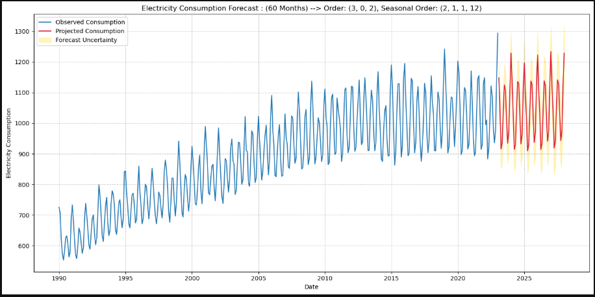
Forecast : Electricity Data

Slide 16
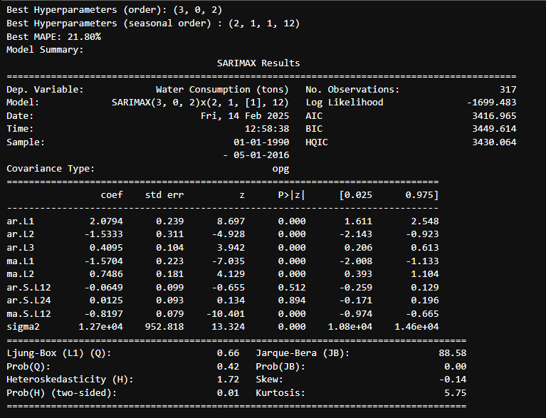
Tuning SARIMAX for water consumption
Now that we tuned the model on waterData, we know the best parameters (order, seasonal_order) which give the lowest possible MAPE score, we can hence do the forecast with these parameters.
MAPE decreased after tuning compared to previously.

Slide 17
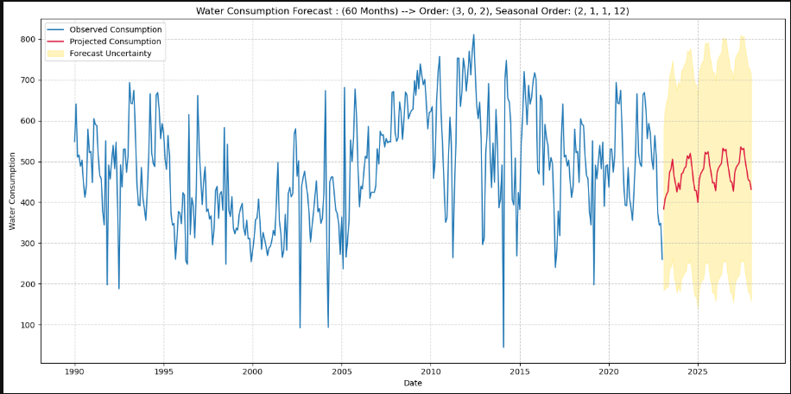
Forecast : Water Data

Slide 18
THE END

