Slide 1
AIML CA2 Part B
Tan Eu Zin
DAAA/FT/1B/03
2415927

Slide 2
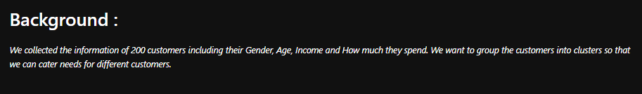
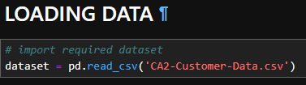
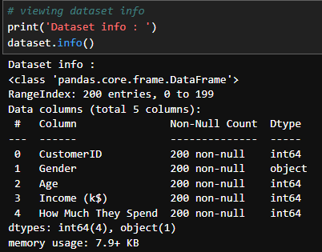

Next, view the dataset info : 5 columns with 4 int columns and one object column
First, load data
View the dataset shape : 200 rows x 5 columns

Slide 3
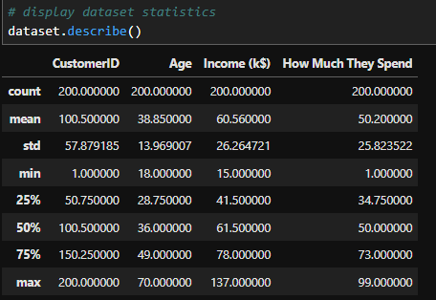
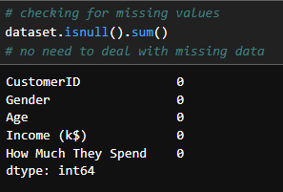
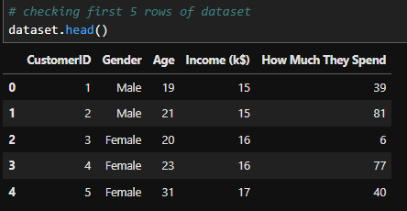
Check the dataset statistics : count, mean etc
View first 5 columns of data, CustomerID and gender seem like unimportant columns, will drop later
Checked for missing values, no missing values so no need to impute data.
Customer ID only used as a counter, gender will likely not be used since it cannot be separately viewed when doing clustering, makes no difference.

Slide 4
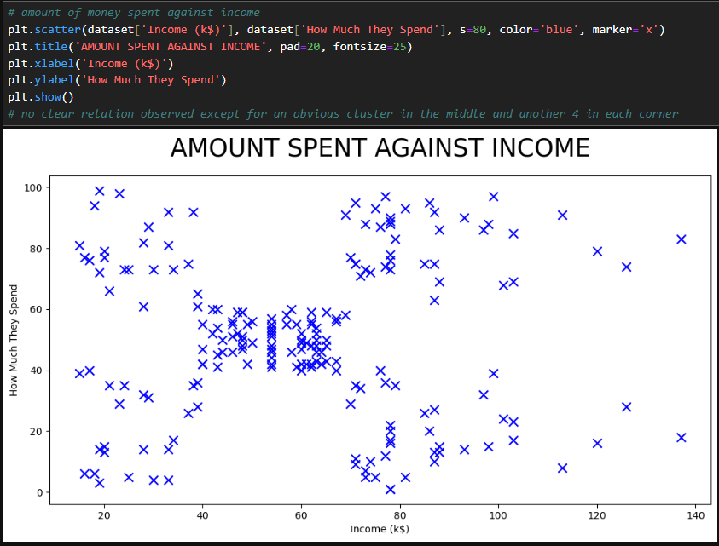
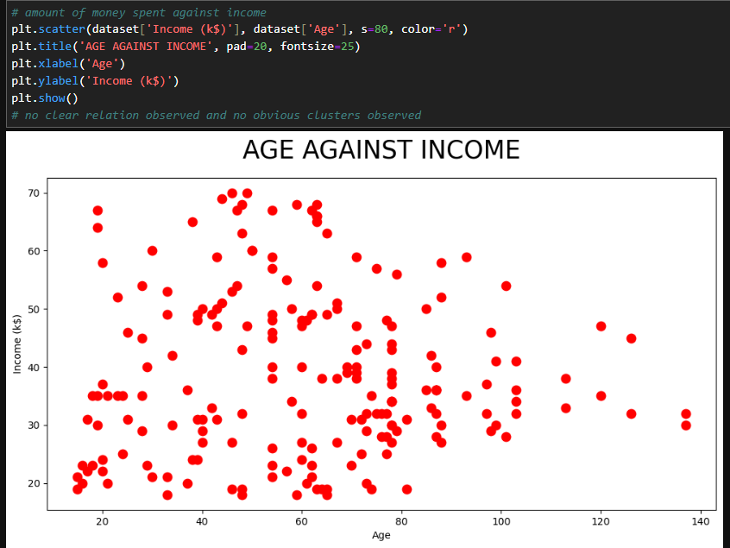
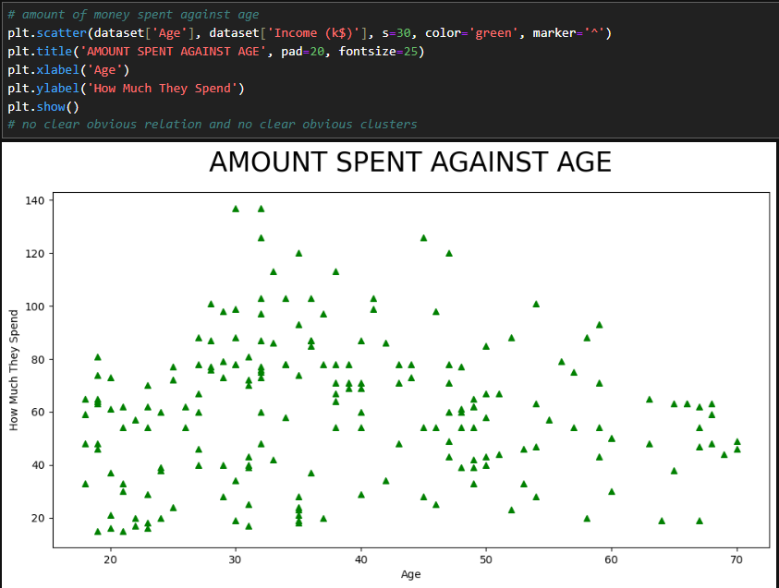
Generally quite evenly spread out, no clear clusters observed.
5 obvious clusters observed even before clustering
Also generally quite evenly spread out, no clear clusters observed either expect near the center bottom where one cluster can be seen.

Slide 5
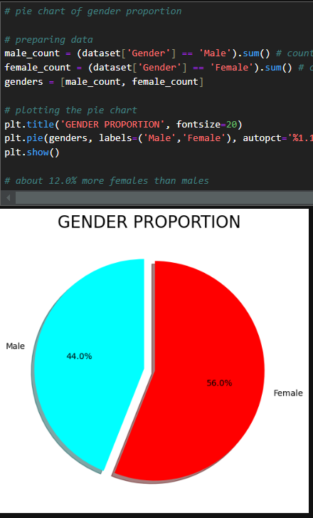
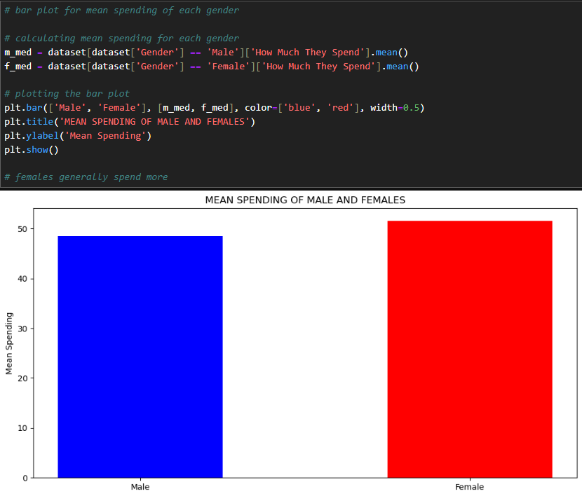
Mean spending of females customers, females generally spend more than males, by only a few dollars.
Gender proportion : 12% more females than males in the dataset, suggests more female customers.

Slide 6
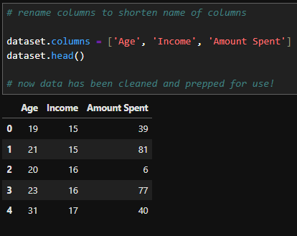
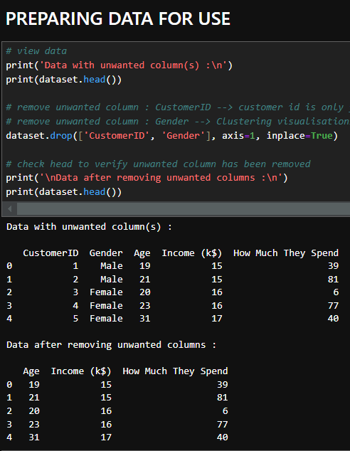
Columns are renamed such that it is shorter and easier to identify, data is prepped and first 5 rows is shown.
Columns that are not useful are dropped.

Slide 7
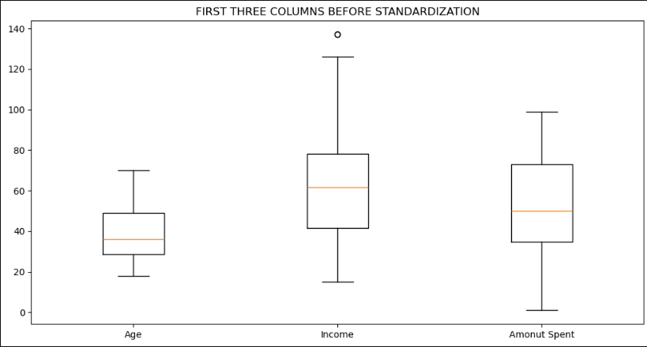
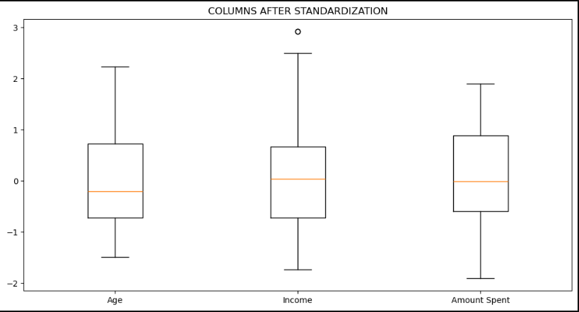
Z-score standardization
Z-score standardization was carried out for the three columns, data has been scaled such that the spread of data in all three features are more similar, mean is also more centered for all three columns.
Z-score standardization is generally preferred for clustering because it's less sensitive to outliers and doesn't distort the data as much as min-max scaling can. Clustering algorithms often rely on distance calculations, and it's important that all features are on a similar scale to avoid features with larger values dominating the distance measures.
Income feature has an outlier, so anomaly detection is required for graphs with the income feature.

Slide 8
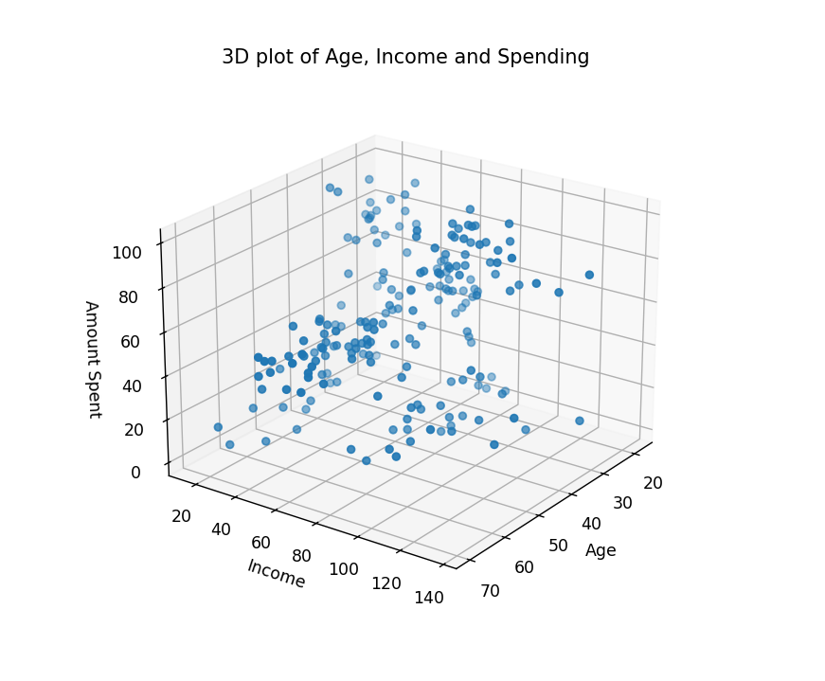
A 3d scatter is plotted before clustering to see how the data is spread out.

Slide 9
Dimensionality Reduction :
Dimensionality reduction is not needed as the dataset used only has 3 features with very little rows (200) hence there is no need for feature extraction on such low dimensional data.
Clustering Models Chosen :
K-means : Excellent starting point. Simple, efficient, and widely used. Good for finding distinct, non-overlapping clusters.
Gaussian Mixture Model : A good alternative to k-means, especially if customer segments might overlap or have different shapes/densities. More flexible than k-means.
Hierarchical clustering (Agglomerative) : Useful for exploring potential hierarchical relationships between customer segments.
Each model will be used to plot 3 scatter plots with various n clusters :
Income against age, amount spent against age, and amount spent against income.

Slide 10
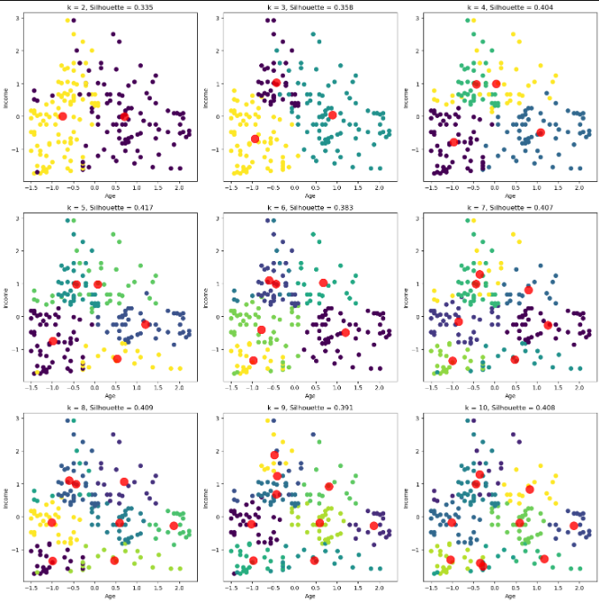
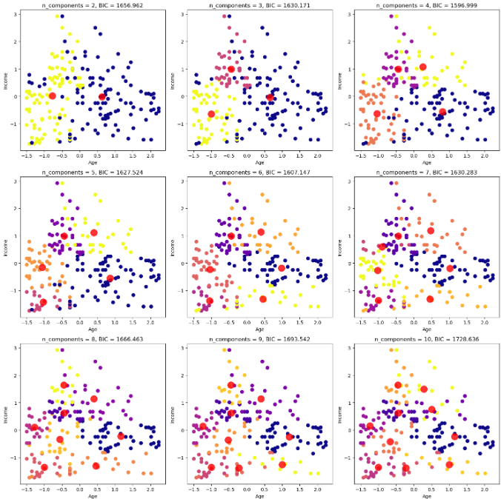
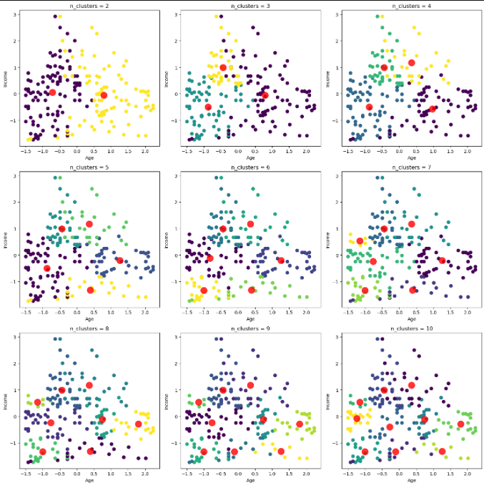
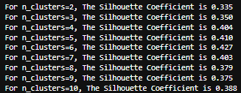
K-Means
Income against age
GMM
Agglomerative
K-means with 4 clusters is chosen as it has the clearest clusters visually with the least overlaps. Furthermore in K-means, 4 clusters has the third highest silhouette score of 0.404, suggesting points are quite tightly grouped within their clusters.

Slide 11
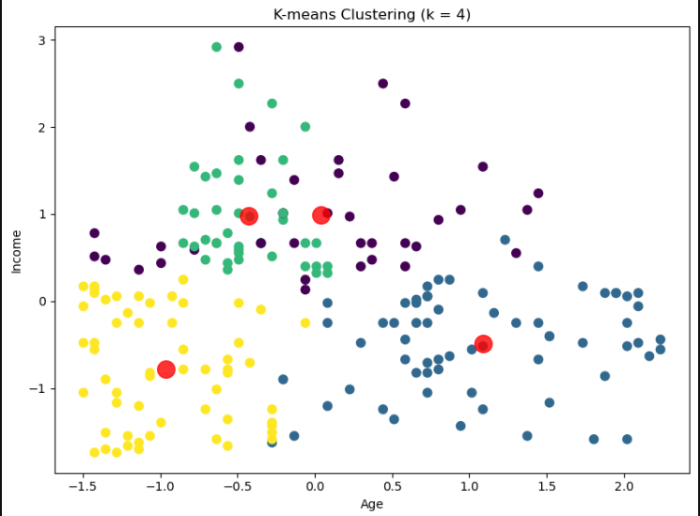
Insights :
1) Younger people below the 25th lower quartile thereabout have lowest income compared to other clusters, this cluster is mainly teenagers who are not working yet.
2) People above the 50th upper quartile, which is roughly older adults / elderly, have slightly more income than the teenagers in general.
3) For the younger people aged in the 25th to 50th quartile thereabout, which are the young working adults, they generally have the highest income and are concentrated suggesting people at this age earns the most.
4) Lastly, the last cluster shows that below the 75th quartile in age, there are people who earn slightly more in general, but it is all spread out which shows the group of people who earn slightly more than the rest who are younger than the elderly.¶

Slide 12
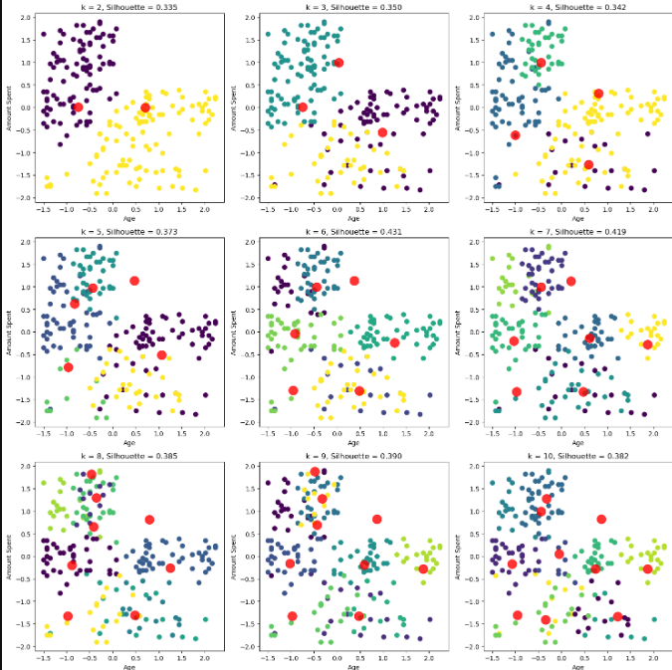
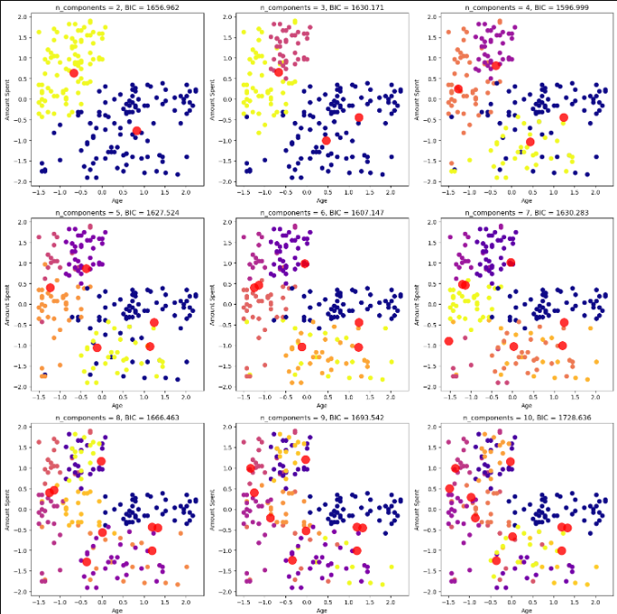
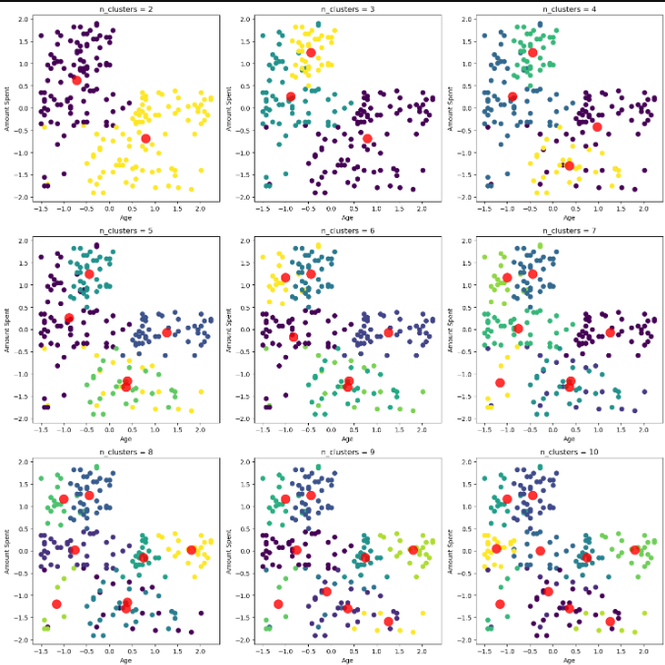
K-Means
Amount spent against age
GMM
Agglomerative
3 clusters for agglomerative is chosen, as it is visually the best and shows the most distinct clusters with minimal overlapping points compared to the rest.

Slide 13
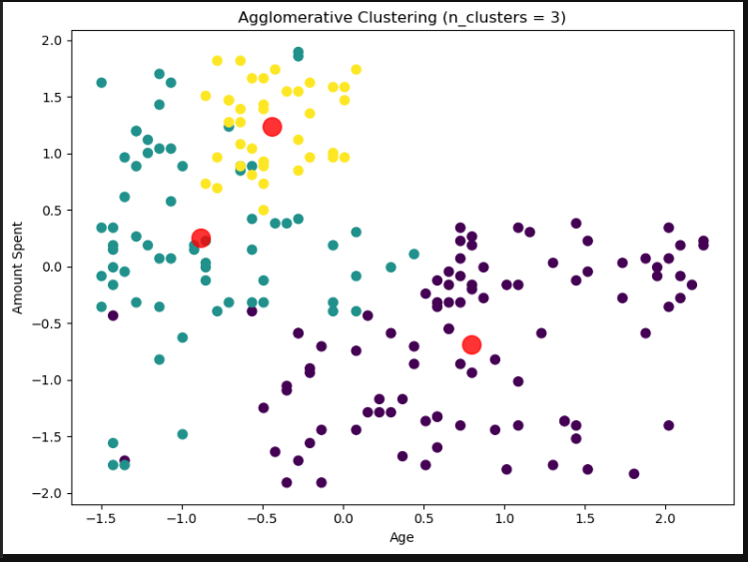
Insights :
1) The first cluster is the older people, they generally all have a trend of not spending that much compared to the younger people like adults and teenagers.
2) The second cluster is for those aged in from the 0th to 25th quartile, and they spend significantly more than the elderly/older adults, this group is mainly teenagers..
3) The third cluster shows that in the 25th to 50th quartile, which is roughly working adult, spend the most and are concentrated in a cluster, suggesting almost all of adults spend more compared to other age groups.¶

Slide 14
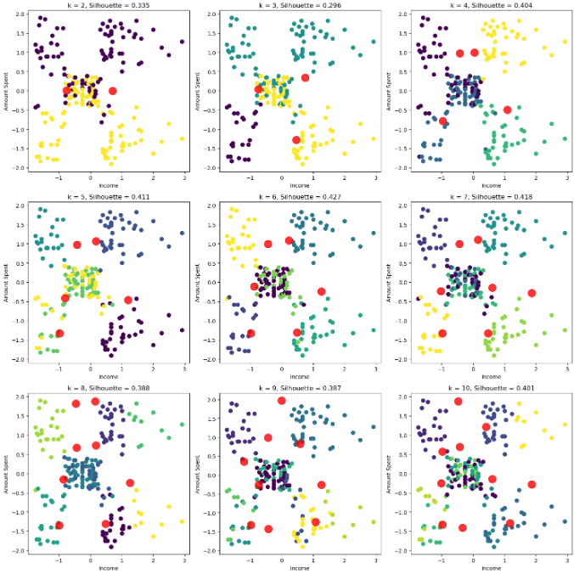
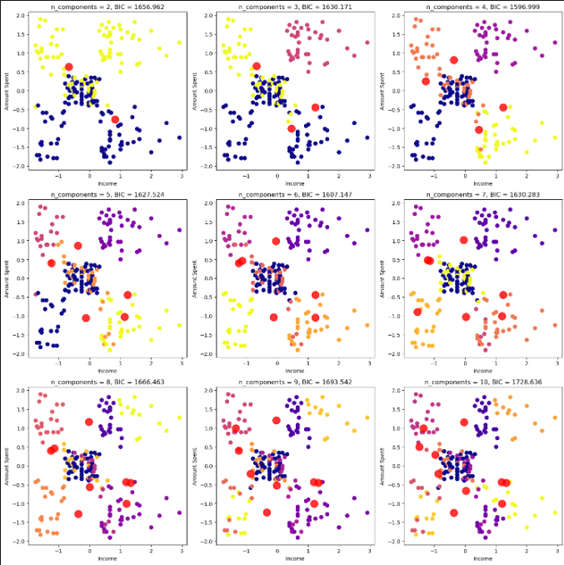
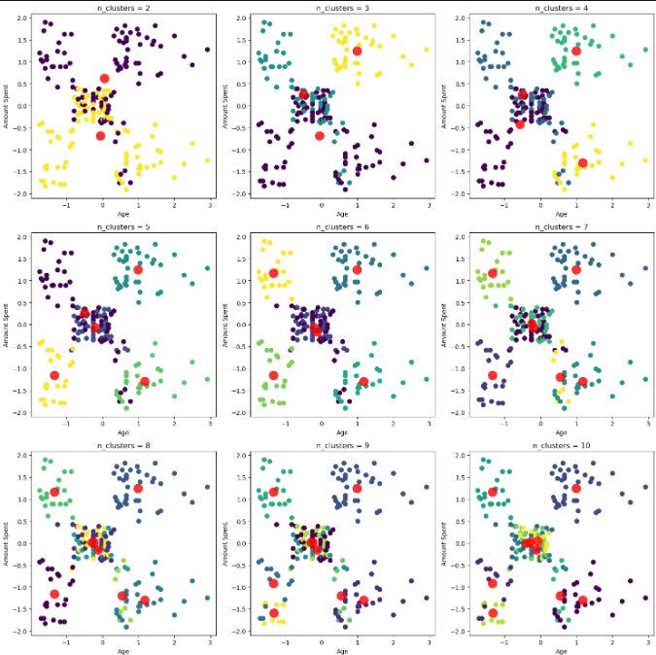
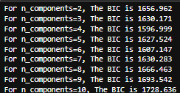
K-Means
Amount spent against income
GMM
Agglomerative
GMM with 5 clusters is chosen as visually it is the best with the clusters correctly clustering the very obvious 5 clusters to begin with from the dataset as compared to the rest, it also has one of the lowest BIC suggesting balance of good fit and complexity.

Slide 15
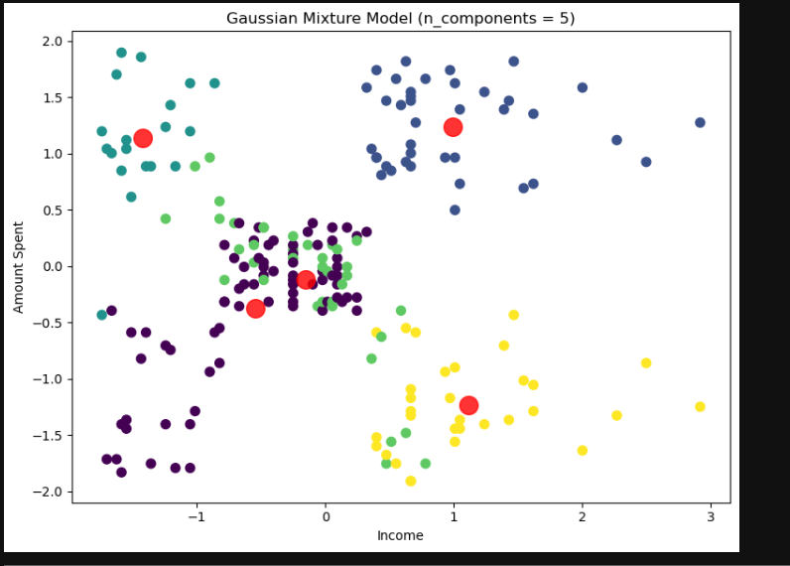
Insights :
1) First cluster is in the top left, shows cluster of people with low income yet high spending.
2) 2nd cluster is in the top right, shows people with high income and high spending.
3) 3rd cluster is roughly in the center slightly overlapping to the bottom two clusters. This cluster shows the people with medium income spending the medium amount.
4) 4th cluster is in the bottom right, it shows people with high income but low spending, suggests more well to do are saving more money.
5) Last cluster is in bottom left to overlapping with center, shows cluster of people with incomes below the 50th quartile, suggests that there are both people who save and people who spend moderately with lower income.

Slide 16
Conclusion :
Generally, there are many customers with various incomes, with medium aged working adults generally earning the most in the cluster. People aged in this cluster, also generally has the highest spending compared to clusters of teenagers and retired / older adults. However, when it comes to spending in relation to income, we can see that there are 3 very distinct spending habits. People of lower and higher income have either the habit of spending a lot or very little, whereas people of medium income spend the average amount of other clusters.

Slide 17
Linking back to the context : How to cater to different groups of customers needs?
Since there are 3 ranges of customer spending : low, medium, high, the mall should have options in each aspect such as shopping, entertainment and food with varying prices according to the customer spending. Furthermore, people that spend more are generally the middle aged people (young adults), while the younger teenagers are the slightly more than average spenders with the elders / older adults being the more budget conscious spenders as they spend less. Seeing how patterns of spending are grouped, the cheaper options in the mall should be more suited for old people, while the moderately priced options should be more suited towards teenagers, and the higher priced options should be made to be more suited towards the young adults. The mall should also include a small amount of options in each category for all ages as there are other types of spenders as well despite their income.

Slide 18
THE END

