Slide 1
Tan Eu Zin P2415927 DAAA/FT/2B/22 Data Visualisation CA1 Assignment
Title of Data Analysis :
HDB Resale Market Analysis: Uncovering Key Trends and Drivers
Notes:
Purpose: To introduce your presentation and its topic.

Slide 2
Objective : Uncovering General Market Trends
Our primary objective is to gain a clear understanding of the overall health and direction of the HDB resale market.
This involves analyzing…
Overall Price Movement : How have HDB resale prices evolved over time at a macro level?
Market Activity & Liquidity : What are the prevailing transaction volumes, and do they show any consistent patterns or shifts?
Flat Type Valuation : How do average resale prices compare across different HDB flat types?"
Notes:
Purpose: To set the context for your analysis and explain why this study is important. It should clearly articulate the challenge or question your analysis aims to address.

Slide 3
Data Source: HDB Resale Flat Prices (Given Dataset)
My analysis is built upon the comprehensive HDB Resale Flat Prices dataset, providing a robust foundation for understanding market dynamics.
Source: Data.gov.sg (HDB Resale Flat Prices from 2017 to current)
Time Period Covered: January 2017 onwards (after filtering for relevant years).
Key Information Captured in Given Dataset :
Transaction Details → month and resale_price.
Flat characteristics → town, flat_type, storey_range, floor_area_sqm, remaining_lease, lease_commence_date.
Data Cleaning : Data values across various fields in the given dataset were systematically reviewed to identify and resolve any unparseable entries, unexpected symbols, or general inconsistencies that could impede analysis.
Notes:
Purpose: To explain the origin and nature of your primary dataset, highlighting its key components and any important characteristics or preprocessing steps.

Slide 4
Data Source: HDB Resale Price Index (Additional Dataset)
To provide a deeper understanding of market momentum, our analysis incorporates the official HDB Resale Price Index data.
Source: Data.gov.sg (HDB Official Resale Price Index)
Time Period Covered: Data from Q1 2017 onwards (after filtering).
This dataset provides aggregated insights into the overall HDB resale market, specifically featuring :
Quarterly Resale Price Index → A benchmark reflecting general price movements (change in Index)
Time Period Covered → Q1 2017 onwards to Q1 2025 (Present)
Data Cleaning : The primary preprocessing step involved filtering out all rows prior to 2017, ensuring that the data aligned with the timeframe of our primary HDB resale flat prices dataset and focused on the most recent market trends.
Notes:
Purpose: To introduce the supplementary dataset used for analyzing market momentum and overall price index changes, highlighting its specific characteristics and the minimal preprocessing required.

Slide 5
Executive Summary: Key Insights from HDB Resale Market Analysis
My comprehensive analysis of the HDB resale market reveals several critical insights for prospective buyers, sellers, and policymakers :
Strong Market Growth with Maturing Pace: The HDB resale market has experienced significant price appreciation, particularly post-2020. While growth remains robust, the rate of increase may be stabilizing, suggesting a transition to a more mature growth phase.
Distinct Geographical & Flat Type Segmentation: Average resale prices vary considerably across different towns and flat types. Certain mature estates consistently command higher prices, highlighting the impact of location and amenities on value.
Quantifiable Impact of Lease Decay: The remaining lease on an HDB flat is a measurable and significant factor influencing its resale price. Our analysis demonstrates that a shorter remaining lease generally correlates with lower prices, with the rate of depreciation varying distinctly across different flat types.
Notes:
Purpose: To provide a concise summary of your most significant findings and conclusions from the entire analysis. This slide is often the most remembered.

Slide 6
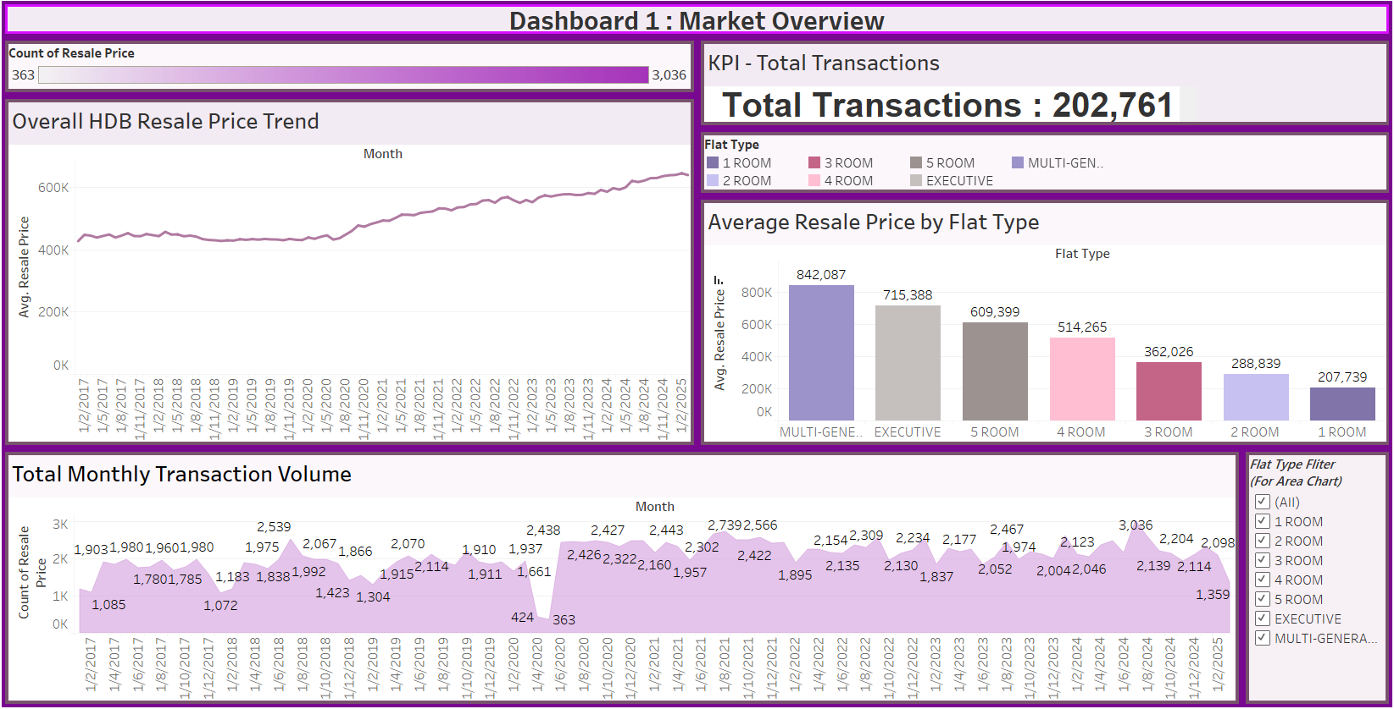
Dashboard 1 : Market Overview - The Pulse of HDB Resale
This initial dashboard provides a foundational understanding of the HDB resale market's health and general direction.
It visualizes key macro trends in overall price movements and transaction volumes.
It also offers a comparative view of average resale prices across different flat types, setting the context for deeper analysis.
Notes:
Purpose: To visually present your first Tableau dashboard and briefly explain its overall aim to the audience. This is where your actual data visualization takes center stage!

Slide 7
Key Insights: HDB Resale Market Overview
Dashboard 1 provides crucial insights into the macro trends shaping the HDB resale market :
Consistent Price Appreciation: The 'Overall HDB Resale Price Trend' (Chart 1) clearly shows a sustained upward trajectory in average HDB resale prices since 2017, with a noticeable acceleration in recent years, indicating a robust and growing market.
Dynamic Transaction Volume: The 'Total Monthly Transaction Volume' (Chart 2) highlights periods of high and low activity, often reflecting seasonal patterns or market responses to external factors. The overall 'Total Transactions' KPI underscores the significant liquidity within the market.
Flat Type Value Hierarchy: The 'Average Resale Price by Flat Type' (Chart 3) distinctly illustrates a hierarchy in pricing, with larger flat types (e.g., Executive, 5-Room) consistently commanding higher average resale prices compared to smaller units, reflecting demand for space and differing market segments.
Notes:
Purpose: To detail the key findings and observations from your "Dashboard 1: Market Overview," referring to the specific charts and the KPI.

Slide 8
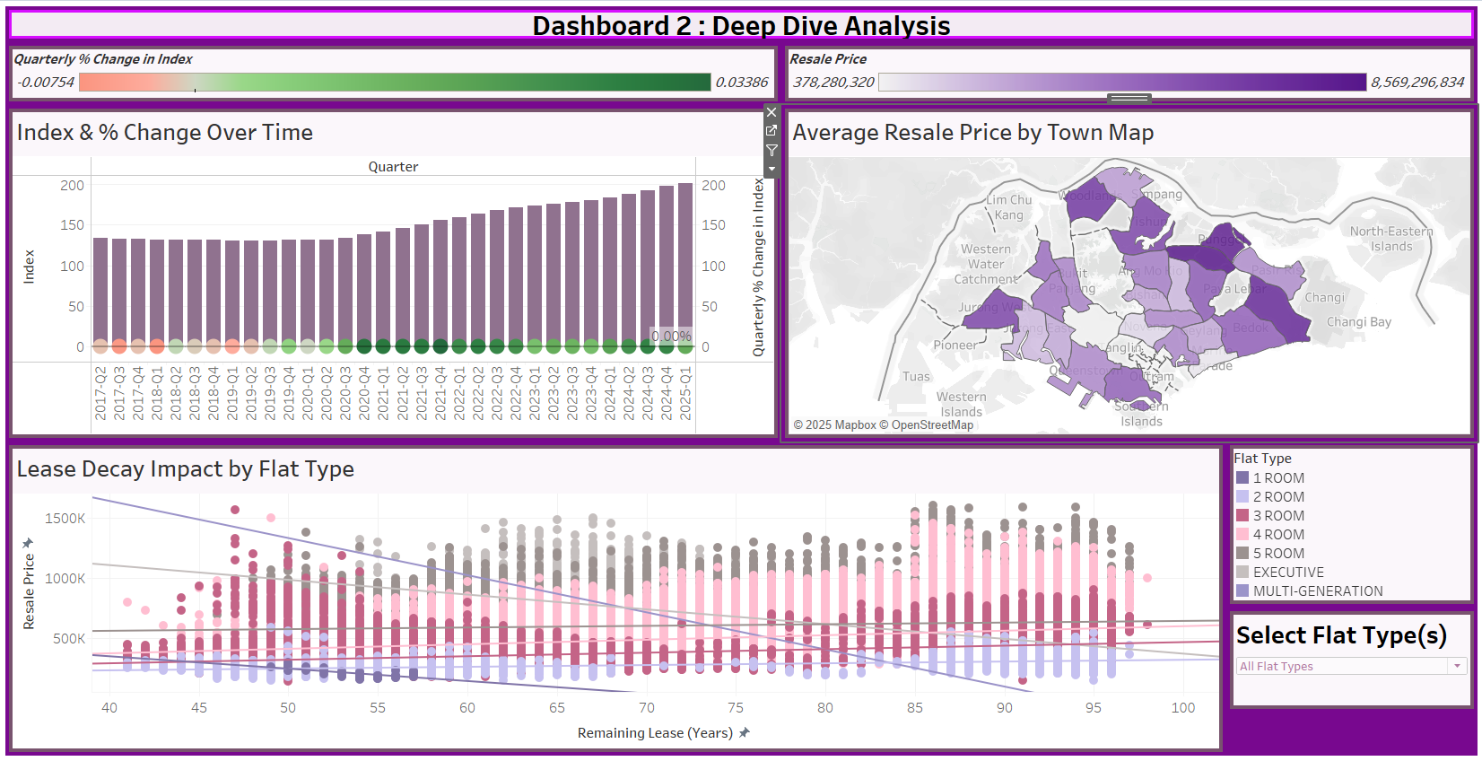
Dashboard 2: Deep Dive Analysis - Location, Momentum & Lease Decay
This dashboard moves beyond general trends to offer a deeper, more granular analysis of the factors influencing HDB resale values.
It allows for the exploration of geographical price variations across towns.
It examines the momentum of price changes through index analysis.
Critically, it quantifies the impact of remaining lease on property values across different flat types.
This dashboard also highlights interactivity to enable focused exploration by town, flat type, or quarter.
Notes:
Purpose: To visually present your second Tableau dashboard, which explores more specific drivers of the HDB resale market.

Slide 9
Key Insights: Uncovering Deeper Market Drivers
Dashboard 2 provides critical insights into the granular drivers of HDB resale prices and market momentum :
Geographical Price Premiums (Map Chart): The 'Average Resale Price by Town' map (Chart 4) clearly visualizes significant price disparities across Singapore. We observe distinct price premiums in certain towns (e.g., mature estates or those with strong amenities), reflecting location-based demand and value.
Market Momentum & Rate of Change (Dual-Axis Chart): The 'Index & % Change Over Time' chart (Chart 5) goes beyond absolute prices to show market momentum. Analyzing the quarterly percentage change reveals periods of accelerated growth or deceleration, offering a nuanced understanding of market sentiment and how quickly prices are changing, not just their value.
Quantifying Lease Decay's Impact (Scatter Plot): The 'Lease Decay Impact by Flat Type' chart (Chart 6) definitively illustrates the negative correlation between a flat's remaining lease and its resale price. Crucially, the distinct trend lines for each flat type demonstrate that the rate of price depreciation due to lease decay varies significantly, with larger flat types potentially experiencing a steeper decline as their leases shorten.
Interactive Exploration: This dashboard features interactive capabilities, such as the 'Select Flat Type(s)' parameter for the Lease Decay chart, and the ability to use the Quarterly % Change chart as a filter, allowing for focused exploration of market dynamics by specific flat types or time periods.
Notes:
Purpose: To elaborate on the key findings and observations from your "Dashboard 2: Deep Dive Analysis," making sure to highlight the value of the interactive elements.

Slide 10
Conclusion & Key Recommendation
My comprehensive analysis of the HDB resale market from 2017 onwards has yielded several critical insights into its dynamics :
Market Resilience and Segmentation: The HDB resale market has experienced consistent price appreciation, with distinct trends influenced by both geographical location and flat type. Certain mature estates and larger units consistently command premium values, highlighting significant market segmentation.
Quantified Lease Decay Impact: A fundamental insight is the measurable and varied impact of remaining lease on resale prices. As leases shorten, prices generally decline, with the rate of depreciation notably differing across flat types. This represents a crucial, quantifiable long-term valuation factor.
Dynamic Momentum: Beyond absolute prices, the analysis of quarterly percentage changes reveals the market's dynamic momentum, showing periods of accelerated or decelerated growth.
My Key Recommendation :
Prioritize Data-Driven Valuation and Strategic Timing : Based on these insights, I strongly recommend that all stakeholder, especially buyers and seller, integrate comprehensive data analytics into their decision-making process. Focus on understanding the quantified impact of lease decay specific to flat types, leverage up-to-date geographical price benchmarks, and analyze market momentum to make more accurate valuations and optimize transaction timings. This ensures decisions are strategically aligned with objective market realities for maximized value and minimized risk.
Notes:
Purpose: To concisely summarize the most critical insights gained from your analysis and propose one clear, impactful recommendation that stems directly from these findings.

Slide 11
The End
Data Sources :
HDB Resale Flat Prices (2017-2025): > Housing & Development Board. (Accessed May 2025). HDB Resale Flat Prices. Retrieved from https://data.gov.sg/dataset/hdb-resale-flat-prices
HDB Resale Price Index: > Housing & Development Board. (Accessed May 2025). HDB Resale Price Index. Retrieved from https://data.gov.sg/dataset/hdb-resale-price-index
Thank You!!! :D
Notes:
Purpose: To provide citations for your data sources and open the floor for questions.

