Slide 1
DELE CA1 Part B : RNN
Tan Eu Zin
DAAA/FT/2B/22
P2415927

Slide 2
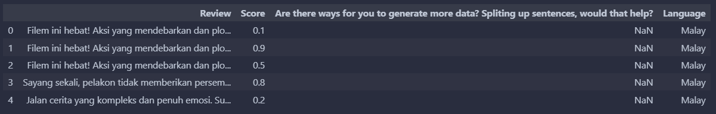
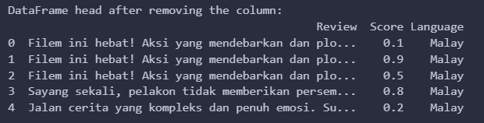
Objective : train an rnn model to predict which rating (class) the review belongs to by predicting on reviews.
Firstly, import data and view the head.
We drop the 3rd column as it is all NaN values, and does not serve a purpose.

Slide 3
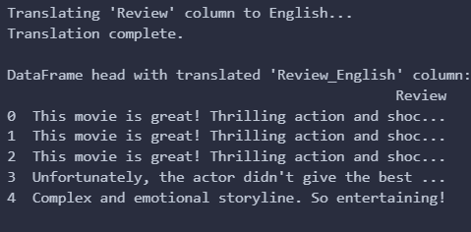

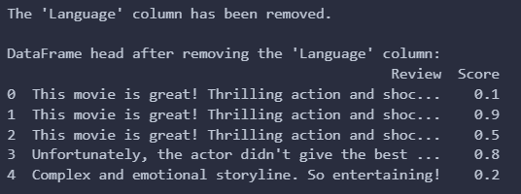
And we see that the reviews are all not in English, we standardize and translate everything to English and then remove the language column

Slide 4
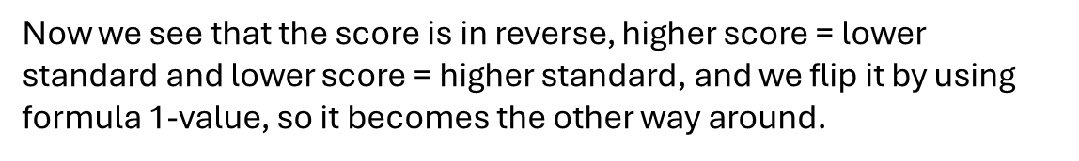
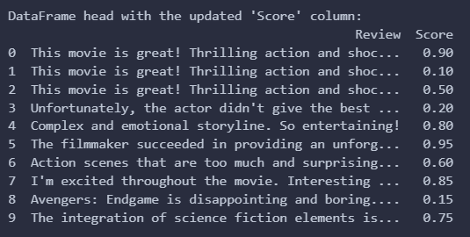

Slide 5
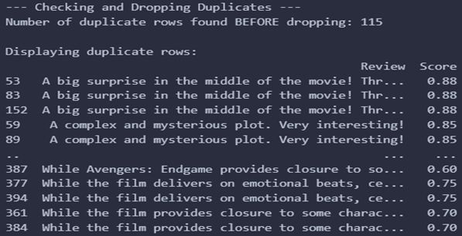
Now we check for duplicate rows, and we drop it as duplicate data can affect our models

Slide 6
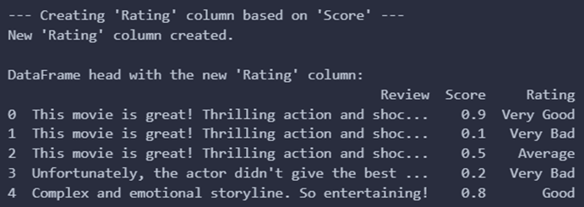
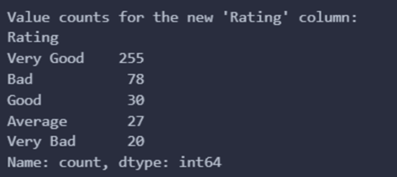
Now we split the ratings into 5 with a 0.2 score range, and label each row with the respective class

Slide 7
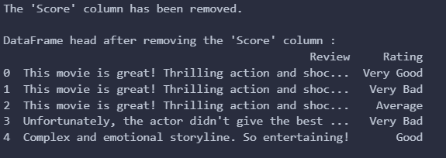
Now we remove the score column because it is useless now since the data is already labelled

Slide 8
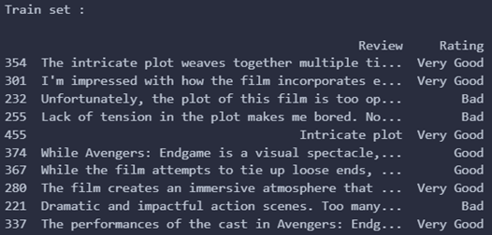
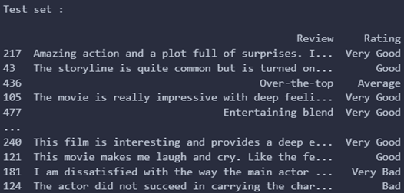

Now we split the data into train and test data in the 7 : 3 ratio

Slide 9
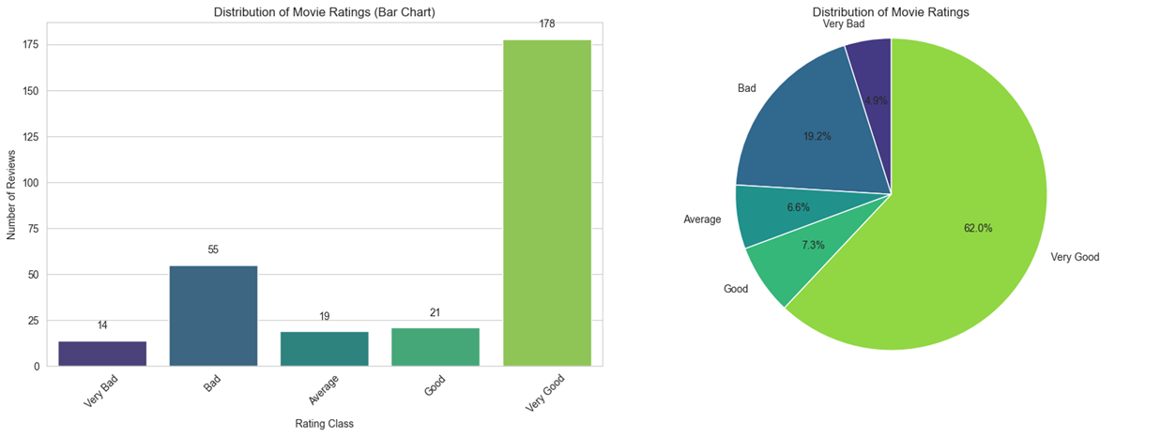
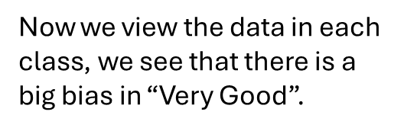

Slide 10
Now we augment the data, we first create more data by doing full stop separation -> if got two sentences, separate it by the fullstop, into 3 new data, one original, one with first sentence, and one with second sentence, this is the shape we get

Slide 11
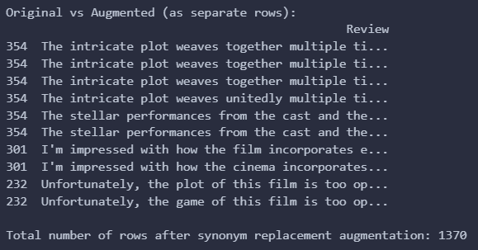
Now we do synonym augmentation by replacing words with the same meaning

Slide 12
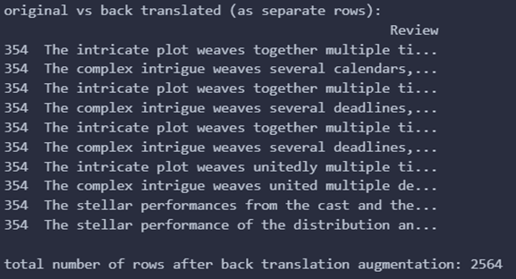
Now we do back translation, translate it into a mediocre difficulty language, and translate it back, and it will change the way the sentence is structured, which gives more data.

Slide 13
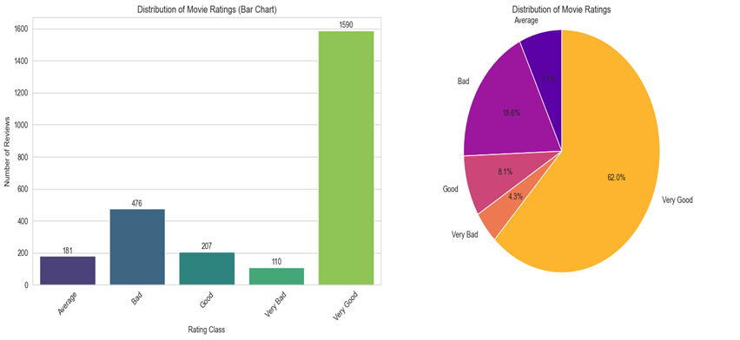
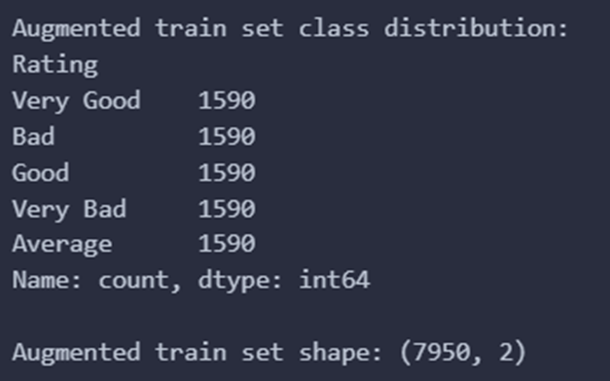
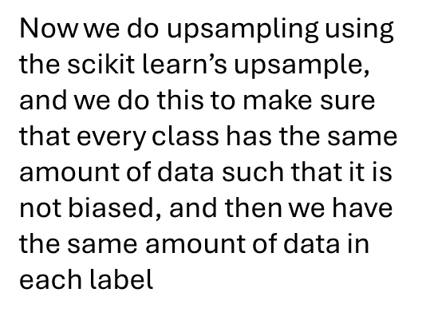

Before

Slide 14
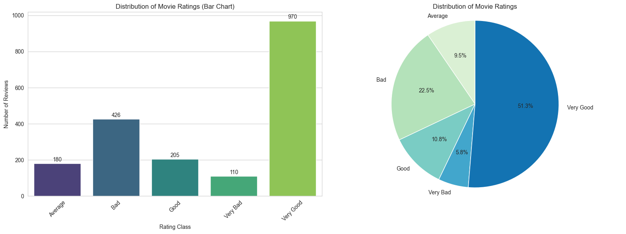
Now we remove the duplicates and we see that the data is still biased, but we can see that the data did in fact decrease in biasness and more data was created after upsampling. We will try to train our models now.

Slide 15
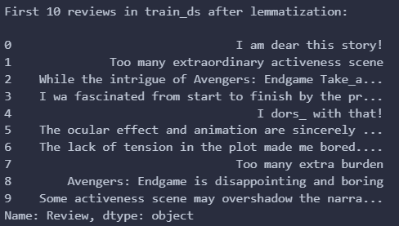
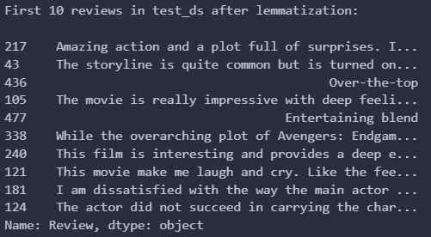
Now we carry out lemmatization, to convert the words into its simplest form, which standardizes words

Slide 16
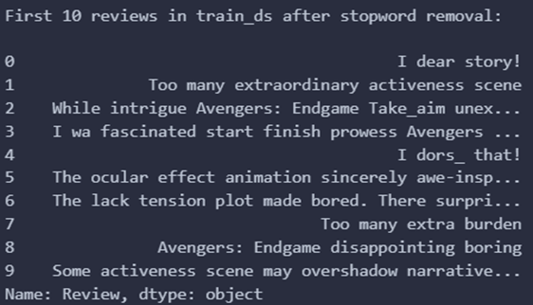
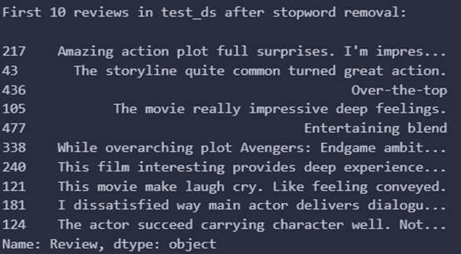
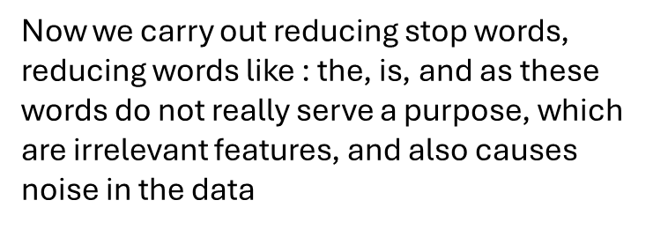

Slide 17
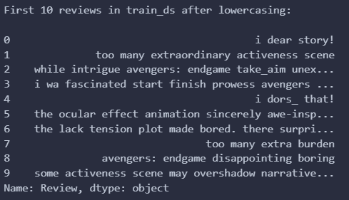
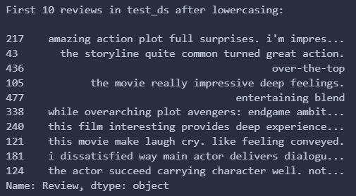
Lowercasing to make all the words in lower case, which ensures uniformity and reduce vocab size. This prevents model from seeing same words with upper and lower caps as different

Slide 18
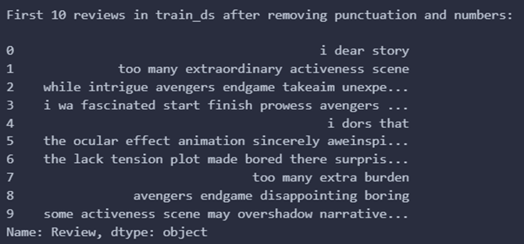
Now we remove punctuations and number which eliminates irrelevant characters, this reduces noise in the data

Slide 19
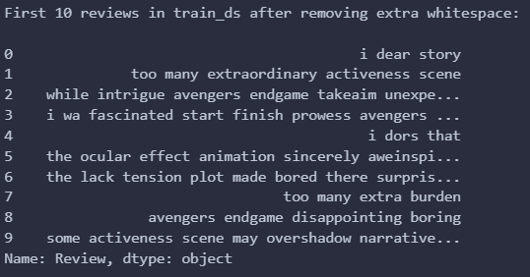
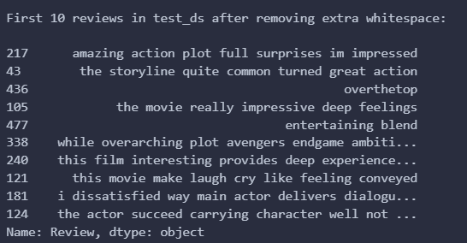
Now we remove extra whitespace, Removing extra whitespace strips leading/trailing spaces and replaces multiple spaces with a single space. It helps prevent issues during tokenization and improves model accuracy

Slide 20
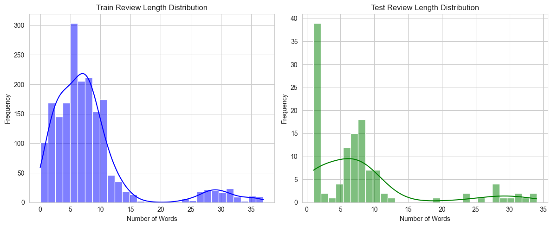
Now we visualize the length of the reviews, and they generally are not that long, suggesting the data is not very complex, hence the model can be quite simple too.

Slide 21
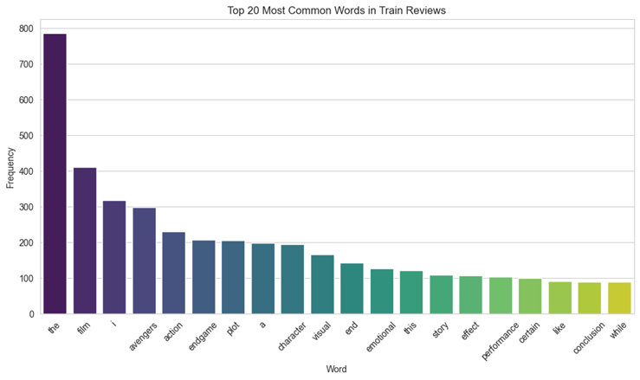
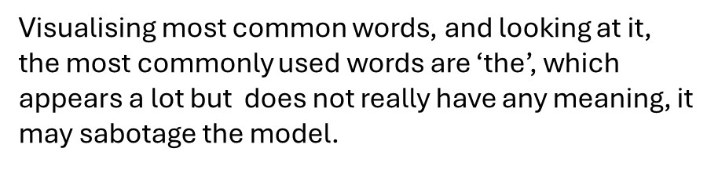

Slide 22
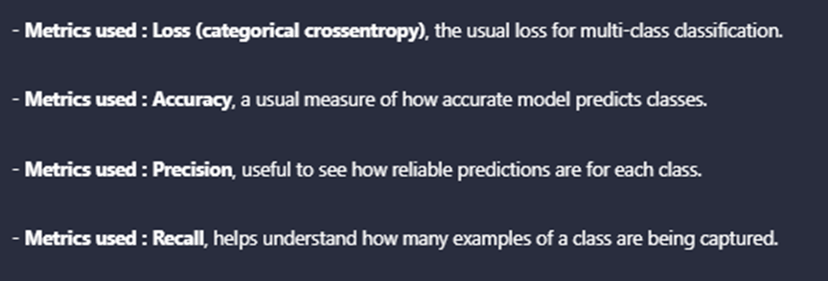
These are all the metrics I used, I will mainly focus on precision, because we are more focused on the true positives predicted

Slide 23
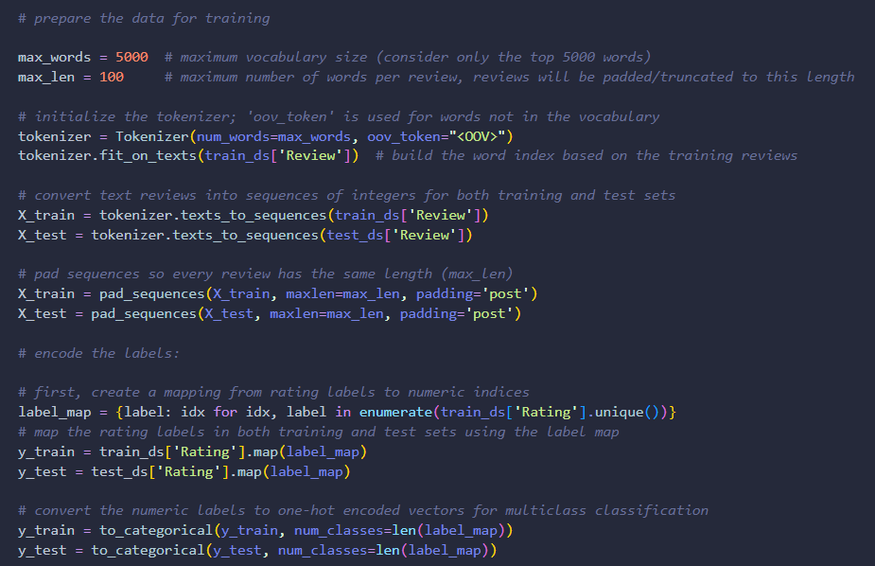
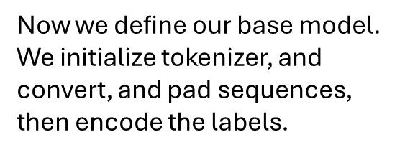

Slide 24
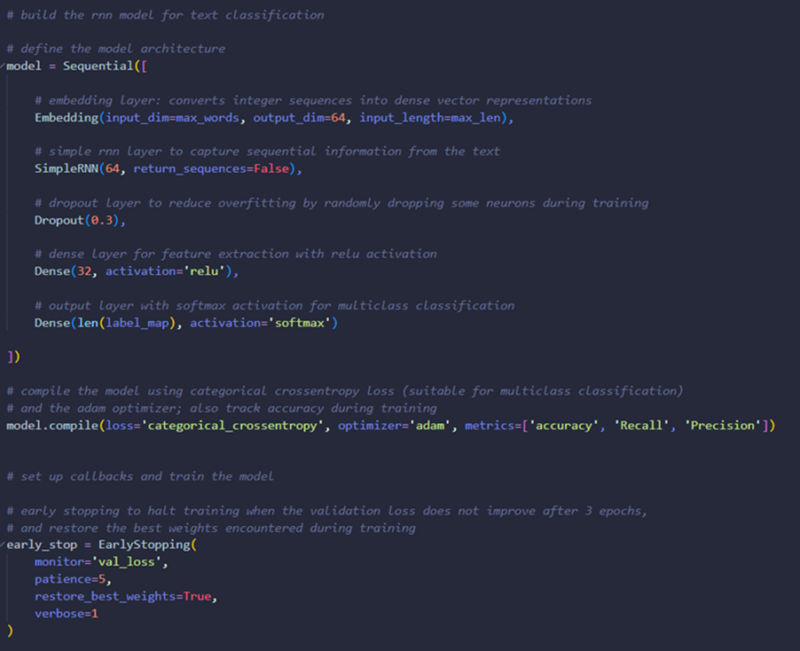
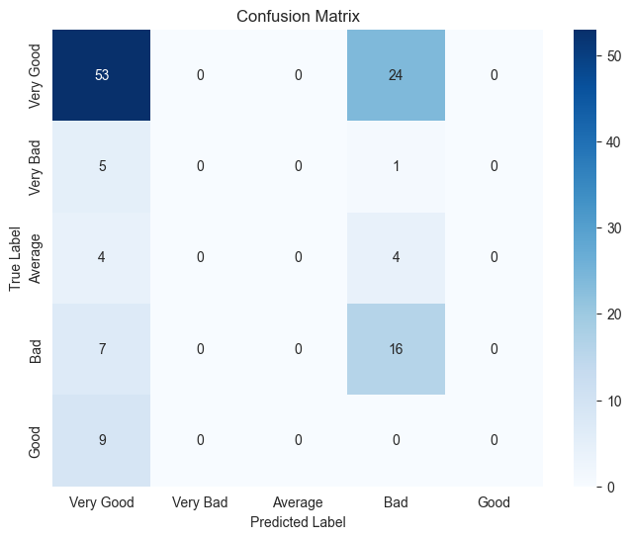
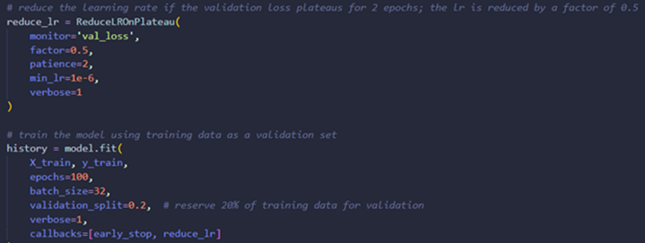
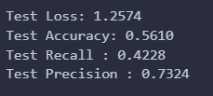
Here’s the results of our first base model.
We see that the model is only good at predicting “Very Good” and abit of “Bad”, so we use class weights to try to make the model better at predicting classes by penalizing it for predicting other classes wrongly to try and fix this issue.

Slide 25
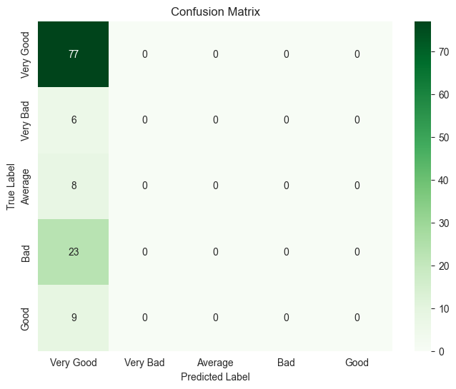

Applied class weights
After class weighting, we tried to fix the model again but this time, it has 0 precision, 0 recall and a high loss with moderate accuracy. This led to the model predicting very good. Maybe the model was not complex enough to capture the patterns of other classes, so we tune it to be able to do so.

Slide 26

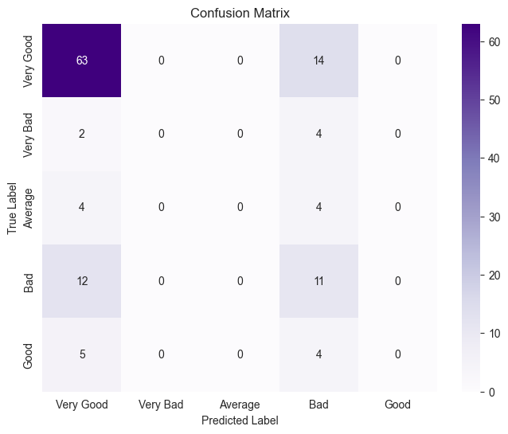
After tuning, and after class weighting, we see that the model performed even worse, with higher test loss, lower accuracy, but slightly better recall and precision because now it’s able to capture “Bad”.
Seeing this, the problem may not be in our model, but in the still constant data imbalance, let’s try to reduce it further through the undersampling method.

Slide 27
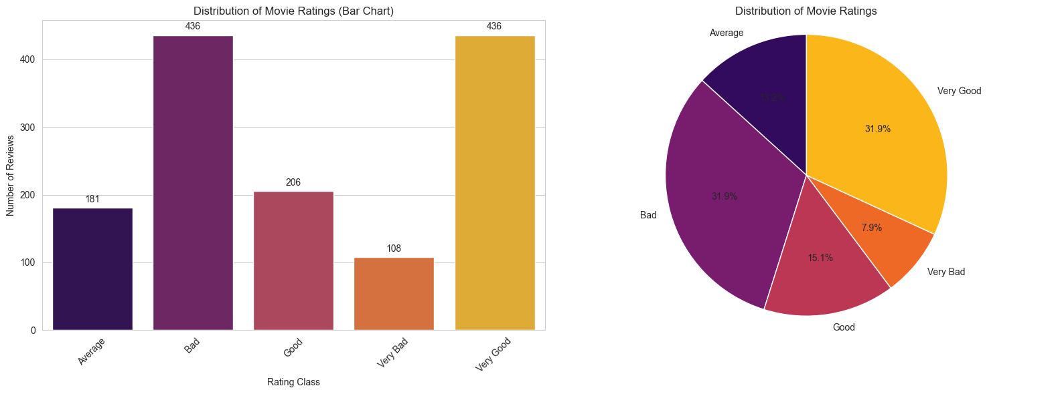
We use undersampling to reduce the data in the one dominating class with the most data “Very Good”, which makes the data more balanced now, let’s try one last time to see if our efforts work out.
Before undersampling
after undersampling

Slide 28
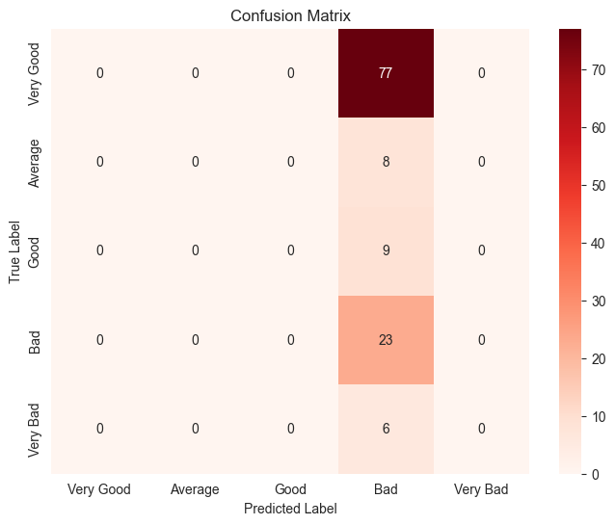

Now we see that after downsampling and tuning, the model still does not capture other classes, but captures only “Bad”.

Slide 29
Conclusion :
Since the efforts to improve the model once and once again were proved to have no effect / no improvement, the model most likely isn’t to blame for the outcome.
This was likely due to the dataset having too little data, and when we augment data, there’s only so much we can do. The data started out with 500 rows in total and was augmented upwards to about 1.9k, almost a 4x difference in terms of data, and the data created artificially through augmenting means might’ve been data that was contradicting, provided wrong info and insights to the model, or had anomalies.
Furthermore, to begin with, the data was too biased, by too big of a margin, that’s why before undersampling, all models tend to predict better on “Very Good”, as the amount of “Very Good” data was too much, both in the train and test, which still provided a decent accuracy.

Slide 30
Conclusion :
It is important that the dataset used for training RNN models be prepared correctly, non-biased and sufficient for the model to be trained properly.
In this case, the data was not, that’s why efforts to improve both the model and the data all failed.
Also, as visualized earlier, much of the data contained very little words and words with no meaning appeared a lot, like “the” being the most commonly used word, which showed that the dataset did’nt contain much information, which may have been another reason for these improvisation efforts to be a failure.

