Slide 1
CAN THE DATA FIND YOU A DREAM HOME?
An EDA case study: turning one client's wish list into King County's best-matched house
Zina Beek | Puget Sound Home Advisors
Notes:
Hi everyone, my name is Zina Beek. I work at Puget Sound Home Advisors, and today I want to walk you through a normal day in our job — the process we follow when a client hands us a wish list and asks us to find their dream house."
"Let me tell you about one case that came across my desk: a client I'll call Jennifer Montgomery. Jennifer came to us with seven wishes...

Slide 2
Meet Jennifer Montgomery
A rich, decisive buyer with seven very specific priorities
Her Wish List
JM
High budget
money's not the limit
Wants to show off
main-character energy
Timing within a month
she won't wait
Jennifer Montgomery
Waterfront
non-negotiable
VIP BUYER
Renovated
move-in perfect
Rich, decisive, and impatient — Jennifer doesn't wait around, and she wants a home that makes a statement.
High grades
only the best-built
“Find it fast. Make it unforgettable.”
Resell within 1 year
an investment too
About the Client
Jennifer Montgomery Buyer Profile
Notes:
The day Ms. Montgomery walked in, I knew this one would be memorable. A rich woman, high budget, no interest in waiting — she wanted a house within a month. It had to be renovated, on the waterfront, and top-graded construction. And she already had her exit plan: she was going to resell it within a year. Seven wishes, one client, and every one of them was about to shape how I searched.

Slide 3
Before I Searched, Three Things to Check
Real-estate wisdom makes some assumptions — worth testing before I trust them
1
2
3
Prestige clusters geographically
Premium features cost more
A quick resale usually pays off
Nice homes shouldn't be scattered evenly across the county.
Waterfront, high grade, and renovation should each add real value.
Buy and sell within a year, and you should come out ahead.
Let's see if the data agrees.
Our Assumptions
Jennifer Montgomery Buyer Profile
Notes:
Now, before I tell you how I actually searched for Jennifer's house, let me pause for a second and tell you what I was assuming going in. Real-estate wisdom makes a few claims: that the nicest homes cluster in a handful of neighborhoods instead of spreading evenly across the county; that waterfront, high grade, and renovation should each add real value on their own; and that a quick resale — buying and selling within about a year — should usually pay off. I didn't want to just take those on faith. So let's see if the data actually agrees.

Slide 4
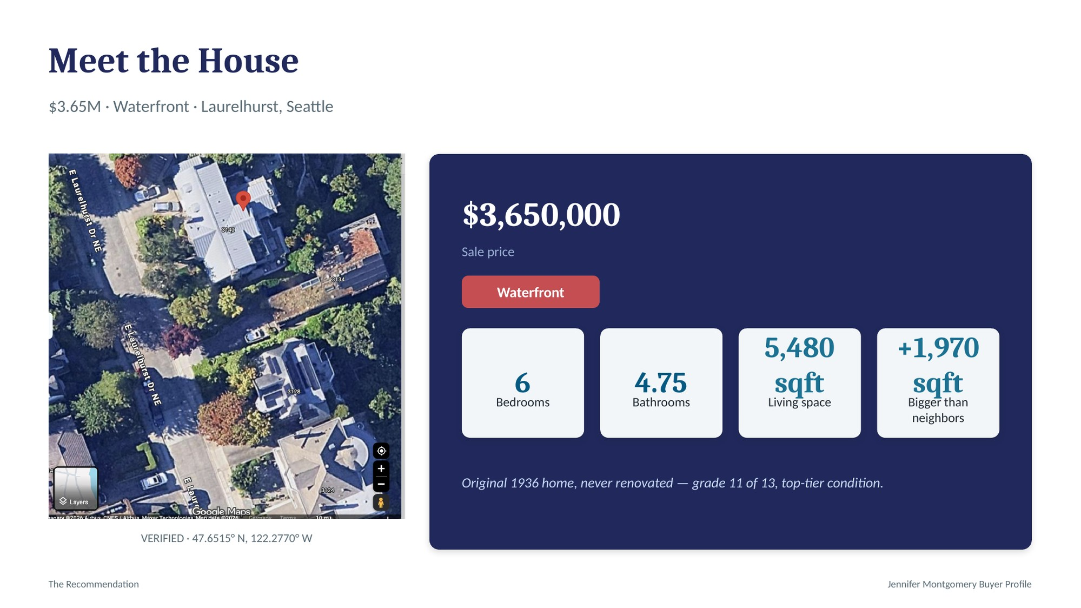
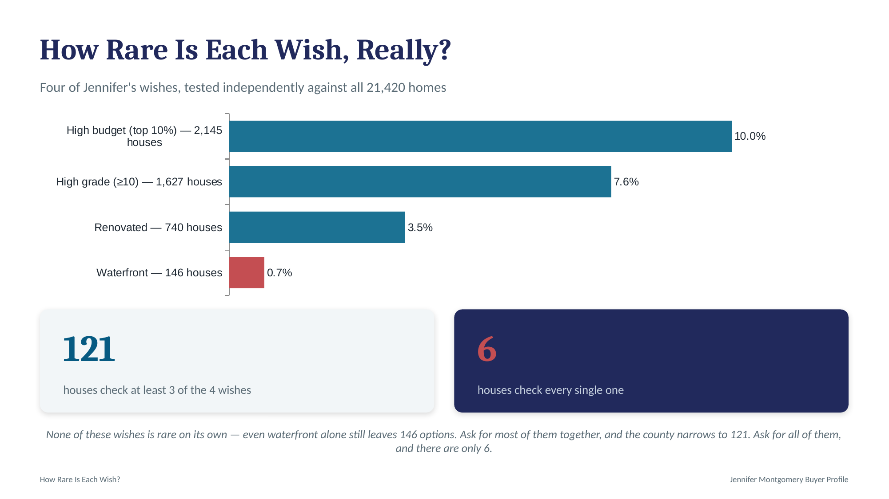
Meet the House
4217402115 • Zip 98105, Seattle
6
4.75
5,480 sqft
19,401 sqft
$3,650,000
Bedrooms
Bathrooms
Living space
Lot size
Sale price
4 / 4
+1,970 sqft
1936
98105
View score
Bigger than neighbors
Year built
Zip code
Waterfront
This house was identified by intersecting Jennifer's two must-haves — waterfront and grade ≥ 10 — with the county's most prestigious zip codes.
Top-tier condition (5/5) • Grade 11 of 13
Never renovated — an original, well-preserved 1936 home
The Recommendation
Jennifer Montgomery Buyer Profile
Notes:
Before I even started the real search, I wanted to know how realistic Jennifer's wish list actually was. So I checked each wish on its own, against every house in the county. Waterfront turned out to be the real bottleneck — just 146 homes out of 21,420. High budget and high grade weren't nearly as rare by themselves. But Jennifer didn't want just one wish — she wanted most of them at once. Ask for at least three of the four together, and the county narrows to 121. Ask for all four, and there are only six houses left.

Slide 5
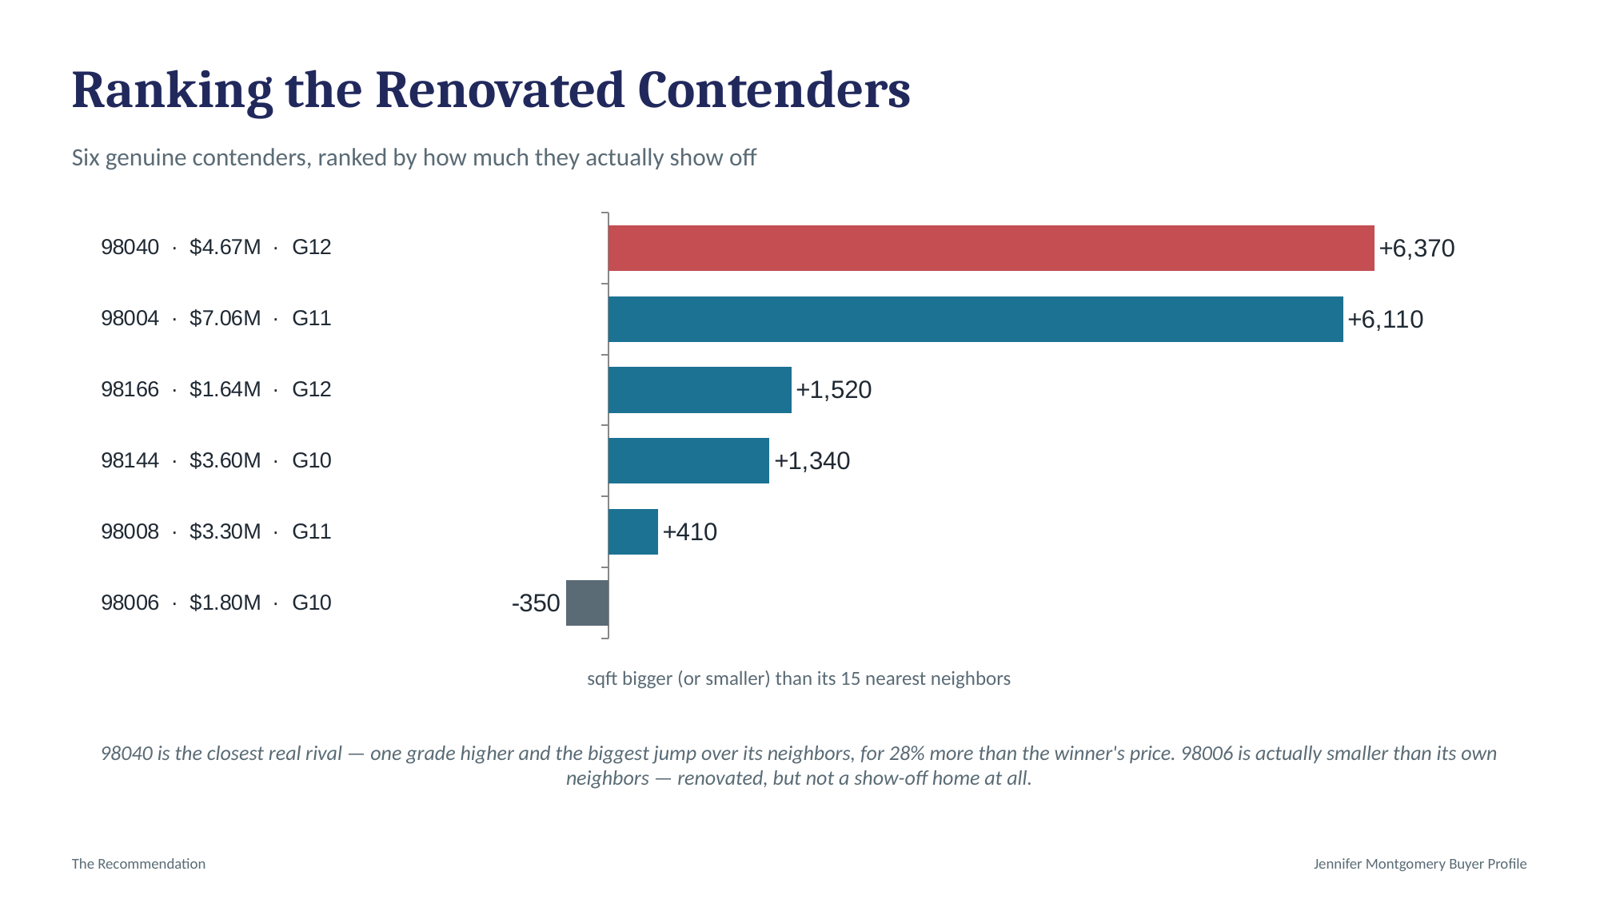
From 21,420 Houses to a Verified Shortlist
Applying Jennifer's non-negotiables narrowed the entire county to a handful of real candidates
→
→
Applying Jennifer's non-negotiables:
21,420
1
Waterfront
46
All King County
home sales
2
Grade ≥ 10
Verified candidates
on Jennifer's shortlist
3
Complete data on view & renovation status
Every house on this shortlist was individually checked against Jennifer's remaining wishes before one was chosen as the top recommendation.
Narrowing the Field
Jennifer Montgomery Buyer Profile
Notes:
"Since each of these six houses is identified by its zip code on this chart — alongside its price and grade, so nothing is hidden behind a number — I'll refer to them the same way as we go through this.
At the top of this ranking is 98040 — the highest grade here at 12, and by far the biggest gap over its neighbors, at 6,370 square feet. It's also the second most expensive of the six, at $4.67 million. Right behind it, 98004 is even pricier at $7.06 million and just as oversized relative to its neighbors, but its grade is one point lower, at 11. Together, these two are clearly the most impressive of the six — everything below them on this list is noticeably smaller and far less dramatic by comparison."

Slide 6
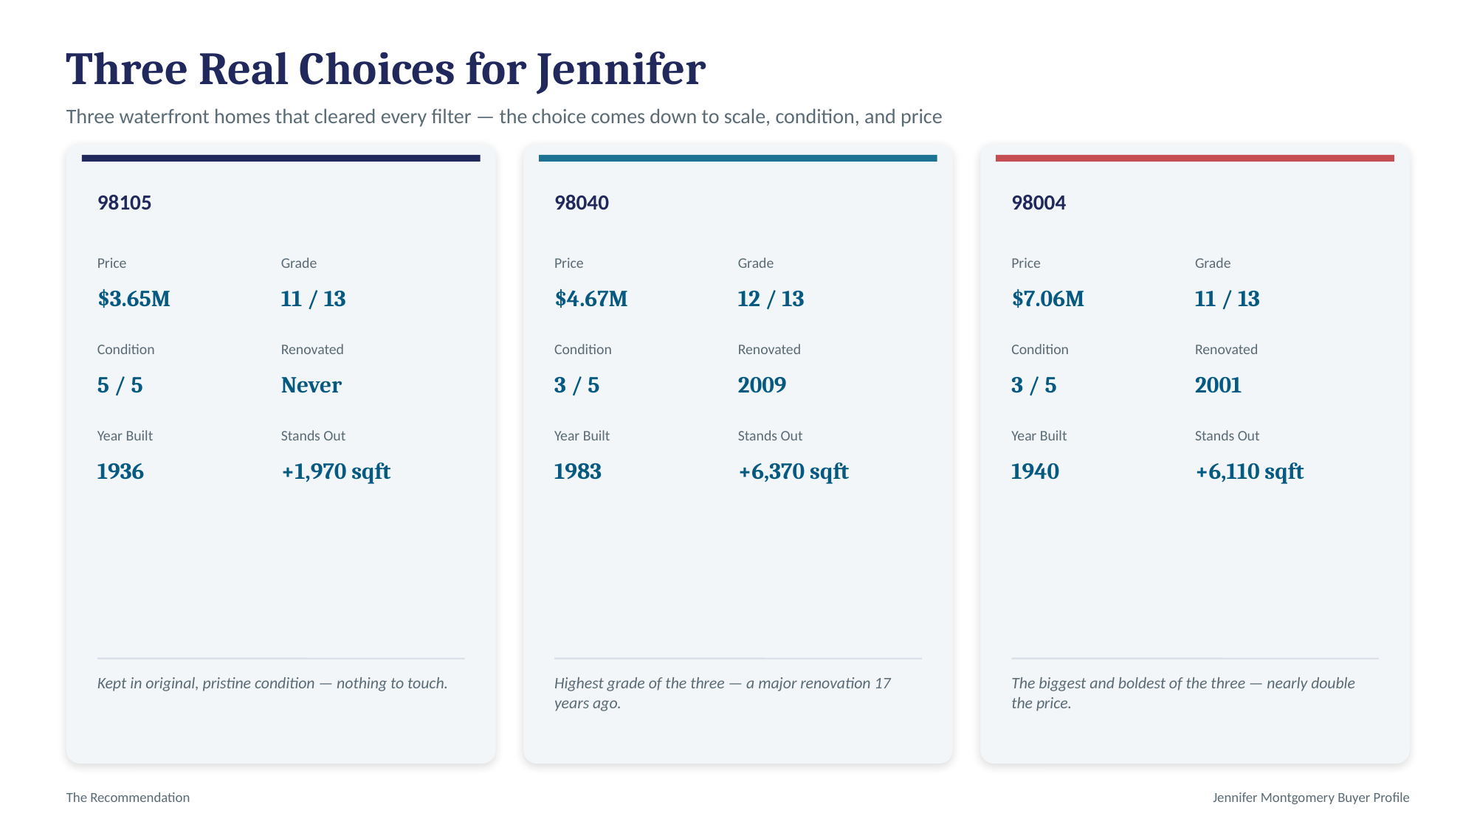
From Wishes to Evidence
Six wishes had an obvious signal — one took real detective work
High budget
Price percentile vs. the whole county
THE TRICKY ONE
Timing within a month
Historical sale-frequency pattern
Wants to Show Off
No column says “impressive.” I measured it two ways:
Waterfront
Waterfront flag (must-have filter)
76%
46%
Renovated
Renovation year & condition score
bigger than their 15 nearest neighbors
sit in a county-wide “Prestige Location” zip
High grades
Construction grade ≥ 10 (must-have filter)
Floors ≠ Grandeur — size and location do the work, not height.
Resell within 1 year
Comparable repeat-sale homes
From Wishes to Evidence
Jennifer Montgomery Buyer Profile
Notes:
Three Real Choices for Jennifer
"After every filter, three real houses were left standing — all three on the water, and each one telling a different story.
98105 comes in at $3.65 million, with a grade of 11 out of 13 and a condition score of 5 out of 5 — the highest of the three. It's never been renovated, and at 1,936 built, it hasn't needed to be; it still stands nearly 2,000 square feet bigger than the homes around it.
98040 is priced at $4.67 million and carries the highest grade of the group, a 12 out of 13. Its condition sits at 3 out of 5, which tracks with its history — it was renovated in 2009, on a house originally built in 1983. It's also the biggest standout against its neighbors, at 6,370 square feet over.
98004 is the largest investment at $7.06 million — nearly double the first house. It matches an 11 out of 13 grade, was renovated back in 2001, and was originally built in 1940. Like 98040, it towers over its neighbors, coming in 6,110 square feet bigger.
Three houses, three different paths to the same result: one that never needed touching, one that earned a higher grade through renovation, and one that goes bigger and bolder than either. Jennifer has three genuinely strong options to choose from."

Slide 7
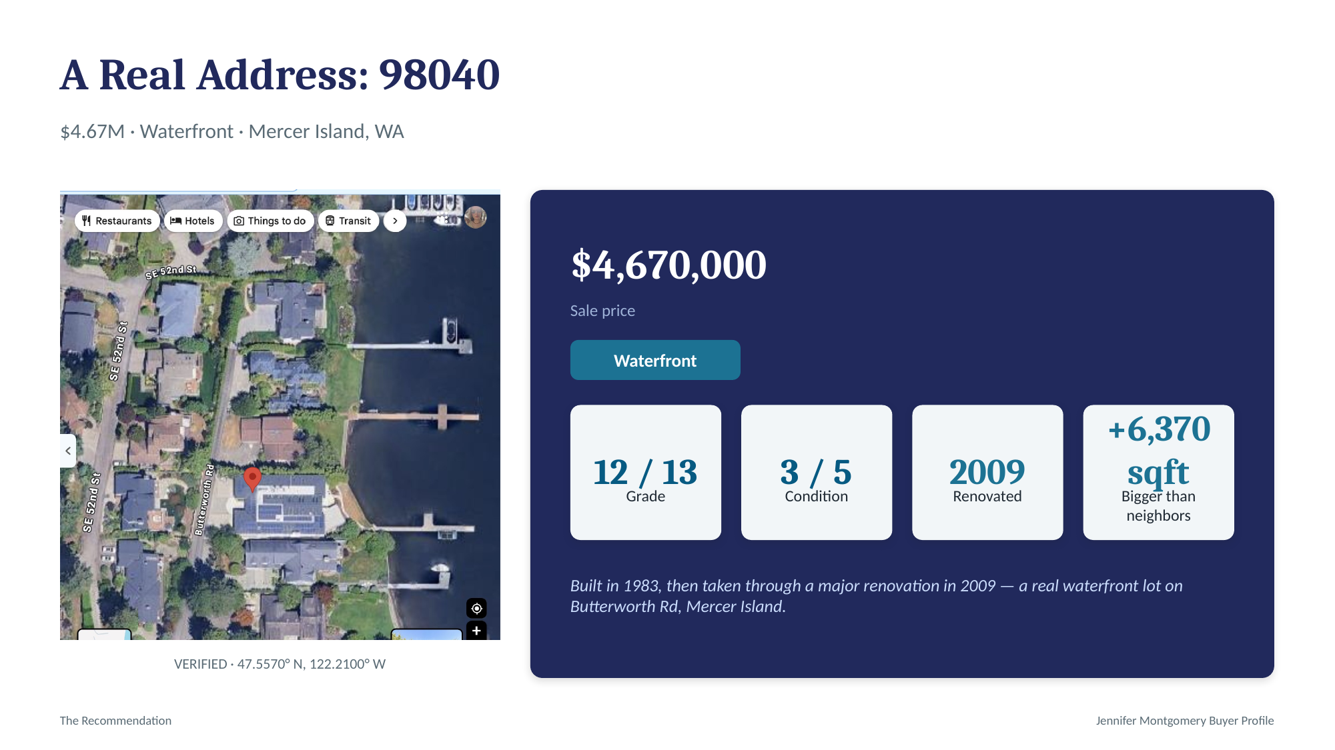
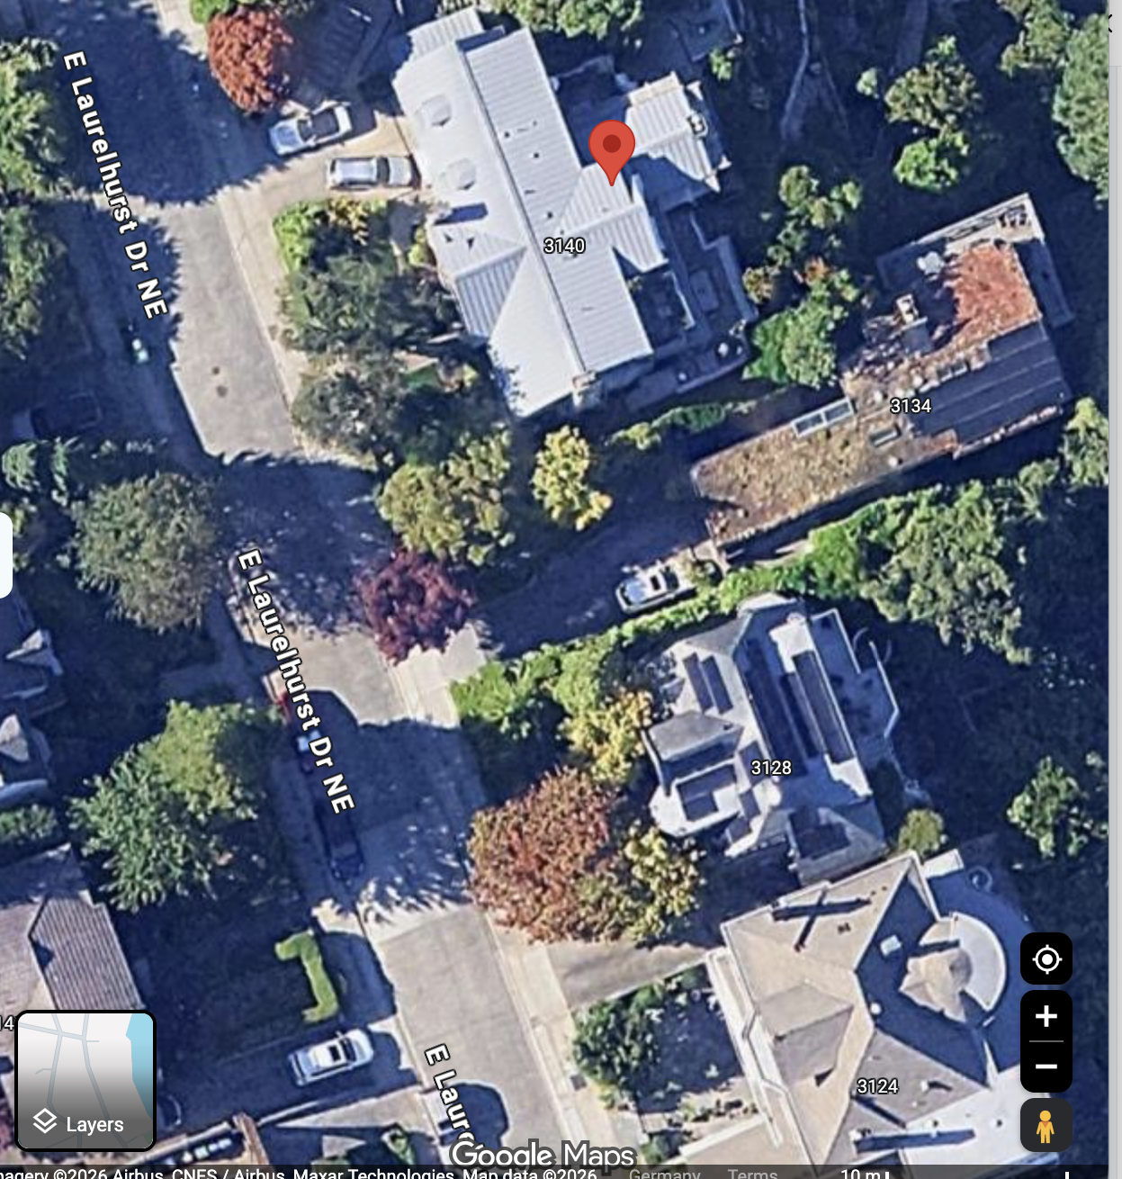
See It for Yourself
The dataset's coordinates, mapped in the real world
VERIFIED
Laurelhurst, Seattle
47.6515° N, 122.2770° W
The dataset's recorded latitude and longitude place this house exactly here — an established, tree-lined street in Seattle's Laurelhurst neighborhood, minutes from Lake Washington and the University of Washington.
This isn't just a row in a spreadsheet — it's a real, findable address.
The Recommendation
Jennifer Montgomery Buyer Profile
Notes:
"98040, verified on the map — a real waterfront lot on Butterworth Rd, Mercer Island, on Lake Washington. $4.67 million, grade 12 of 13, the highest of the three — thanks to a 2009 renovation on a 1983 build. Not just a spreadsheet row; a real address."

Slide 8
Did the Data Confirm
Our Assumptions?
Revisiting the three hypotheses from earlier — now with real candidates in hand
Notes:
Now that we have real candidates — not just criteria on paper — let's go back and see if those three assumptions actually held up.

Slide 9
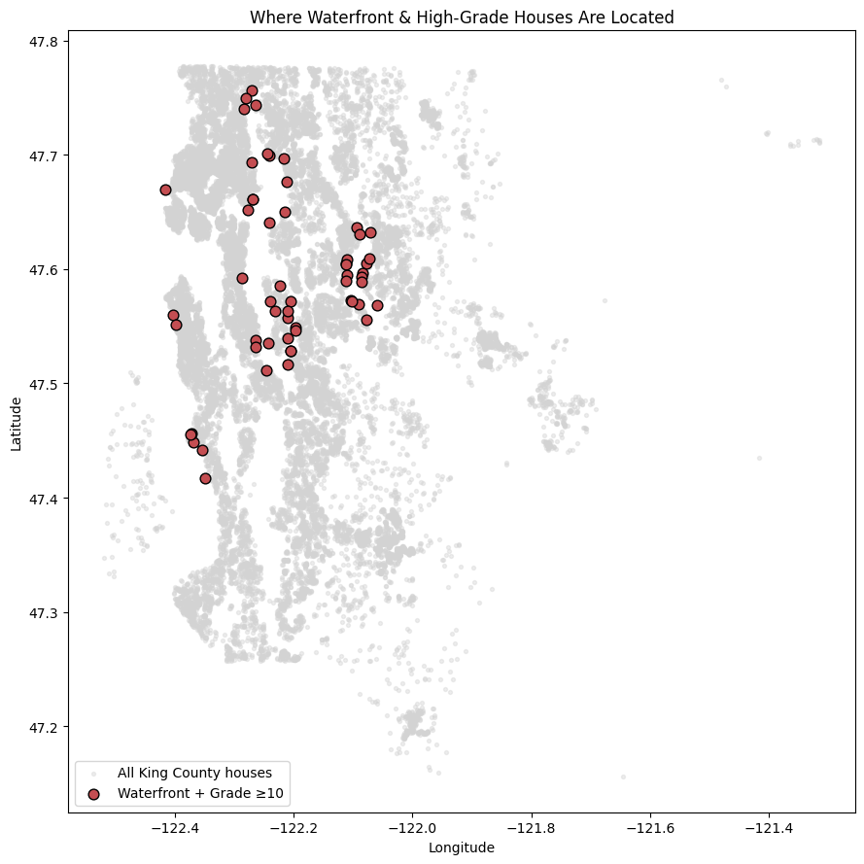
Insight 1: Prestige Clusters Geographically
CONFIRMED
47%
Waterfront, high-grade homes concentrate in a handful of high-end pockets — not spread across the county.
Did the Data Confirm Our Assumptions?
Jennifer Montgomery Buyer Profile
Notes:
Geographic Clustering: Confirmed: 47% of all waterfront, high-grade homes sit in just 5 of King County's 70 zip codes — Mercer Island, Bellevue, Sammamish, and north Seattle. Jennifer's search was never really county-wide; it's a search of a handful of neighborhoods.

Slide 10
Insight 2: Premium Features Cost More
CONFIRMED
Waterfront + high-grade homes sell for far more — and renovation adds another 36–39%, independent of condition.
Did the Data Confirm Our Assumptions?
Jennifer Montgomery Buyer Profile
Notes:
Premium Pricing: Confirmed: waterfront plus high grade sells for over 4x the county median. And renovation adds its own separate boost — 36–39% — even comparing homes at the exact same condition level.

Slide 11
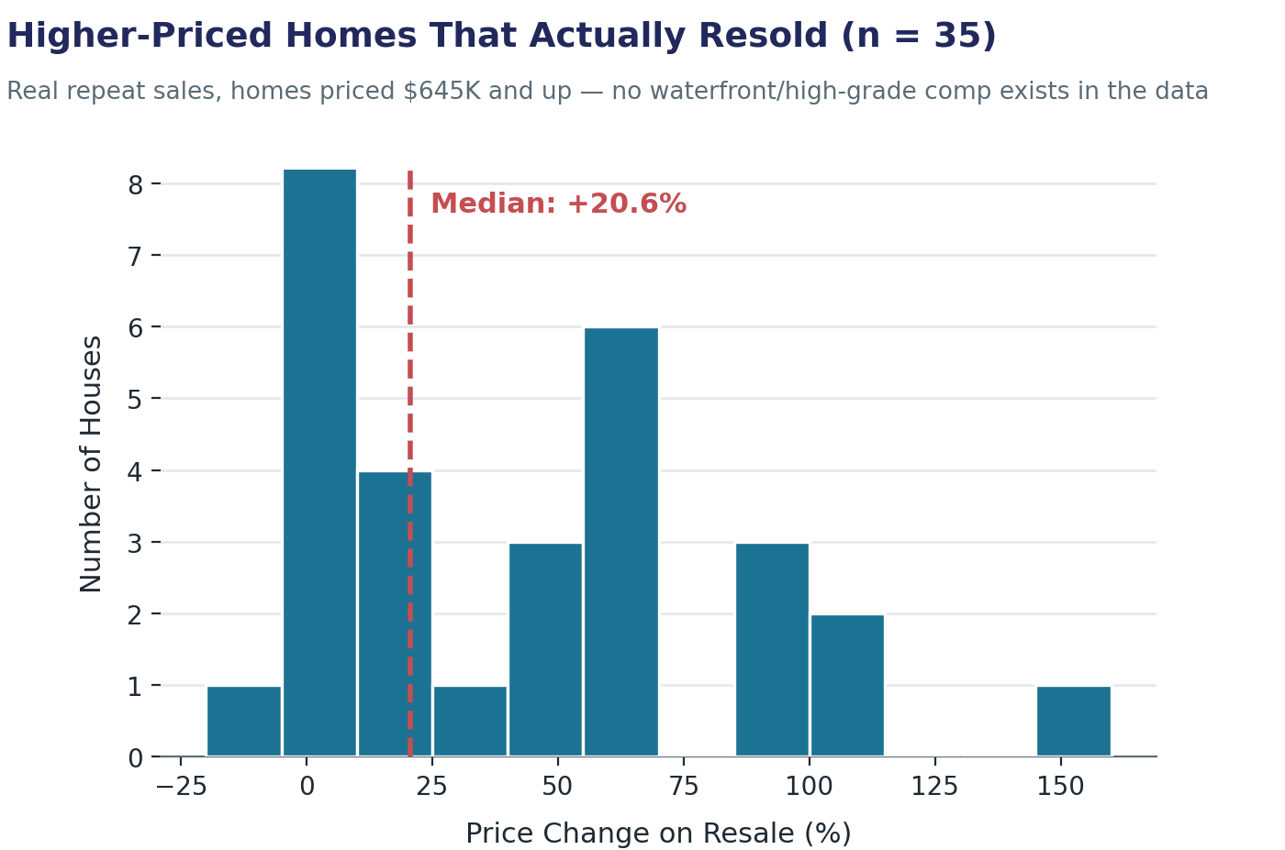
Insight 3: Resale Gains Vary by Home Type
CONFIRMED*
95%
of homes resold within ≈ 1 year gained value
*Confirmed in general — but no repeat sale of a home like Jennifer's exists in the data, so the realistic figure comes from the closest real comparison, not a direct precedent.
Did the Data Confirm Our Assumptions?
Jennifer Montgomery Buyer Profile
Notes:
"Resale Reality: Confirmed, with a catch — 95% of homes resold within about a year gained value. But the eye-catching 57% average is inflated by cheap fixer-upper flips. There's no repeat sale of a home like Jennifer's — waterfront, high-grade — anywhere in the data, so the closest real evidence we have is the 35 higher-priced homes that actually resold: a median gain of +20.6%. That's the realistic number for her plan — not a guarantee, but the best honest estimate the data supports."

Slide 12
Recommendations for Jennifer
1
2
3
Search the prestige clusters first
Move on the home in zip 98040
Set a realistic resale target
The best homes cluster in a handful of zip codes — not spread across the county.
Highest grade of the three candidates, and the biggest standout from its neighbors.
Budget a moderate ~20% gain — not the inflated 57% headline.
Assumption: Assumes these historical patterns continue to hold for homes coming to market now.
Assumption: Assumes the property's condition and features are unchanged since its last recorded sale.
Assumption: No repeat-sold comparable in the dataset was confirmed waterfront, so this benchmark carries extra uncertainty.
Recommendations
Jennifer Montgomery Buyer Profile
Notes:
"Three recommendations, and each one comes with an assumption I want to be upfront about. First — search the prestige clusters. The best homes concentrate in a handful of zip codes, not spread evenly across the county. Second — move on the home in zip 98040. Of the three candidates we compared, it has the highest grade — a 12 out of 13 — and it stands out the most from its neighbors, a result of its 2009 renovation. That assumes its condition and features are unchanged since its last recorded sale. Third — set a realistic resale target. Budget for a moderate ~20% gain if reselling within a year, not the inflated 57% county-wide headline — but nothing directly comparable to this home has ever actually resold in the data, so this is the closest real estimate we have, not a guarantee."

Slide 13
Limitations & Honest Caveats
What this analysis can't fully answer
1
No listing-date or days-on-market data — timing was estimated, not observed.
2
No repeat-sold home was confirmed waterfront — the resale benchmark is an approximation.
3
Renovation's price boost is a correlation, not proven causation.
4
Some fields (waterfront, view, renovation year) needed cleaning assumptions.
5
Data reflects 2014–15 sales — not today's market.
Limitations
Jennifer Montgomery Buyer Profile
Notes:
A few honest caveats: we don't have real listing or days-on-market data, no repeat-sold house in the data was confirmed waterfront, the renovation premium is a correlation not proof of causation, some fields needed cleaning assumptions, and this is 2014–15 data, not today's market.

Slide 14
Thank You
Questions & Discussion
Zina | King County Housing Analysis for Jennifer Montgomery
Notes:
Thank you — happy to take questions.

