Slide 1
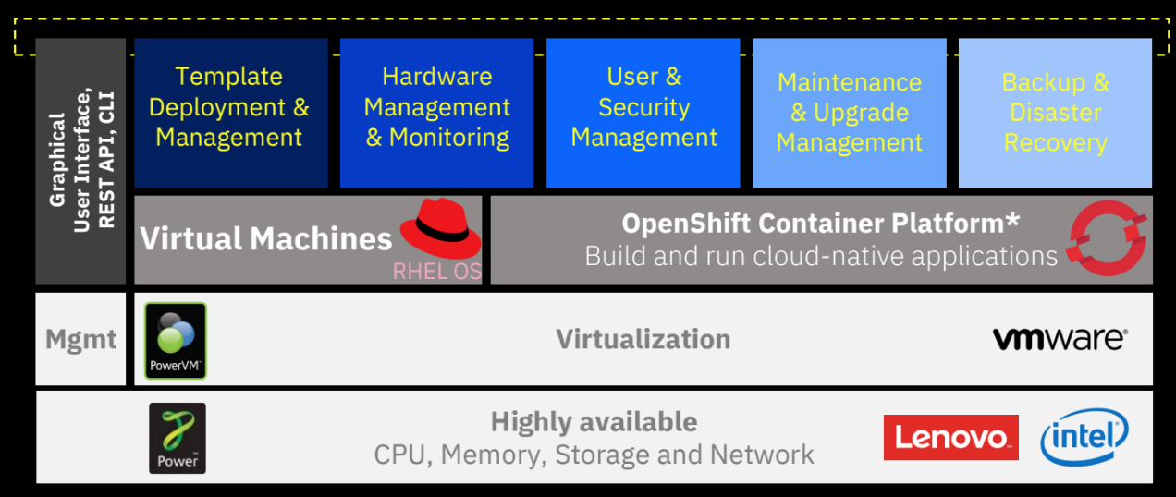
?

Slide 2
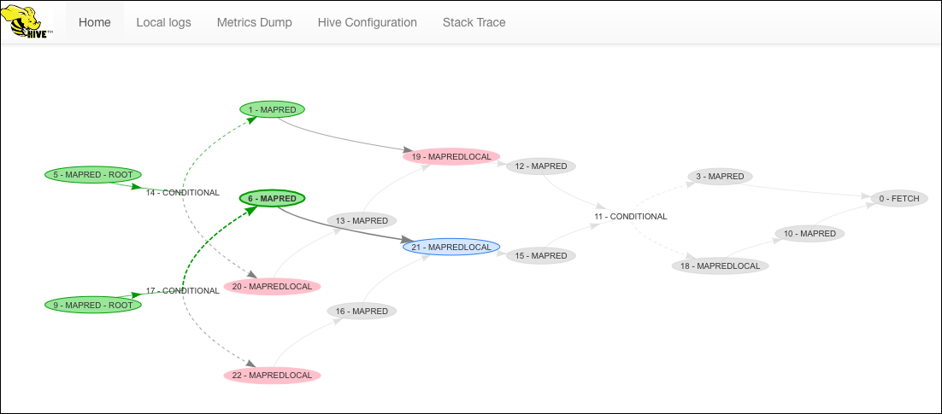
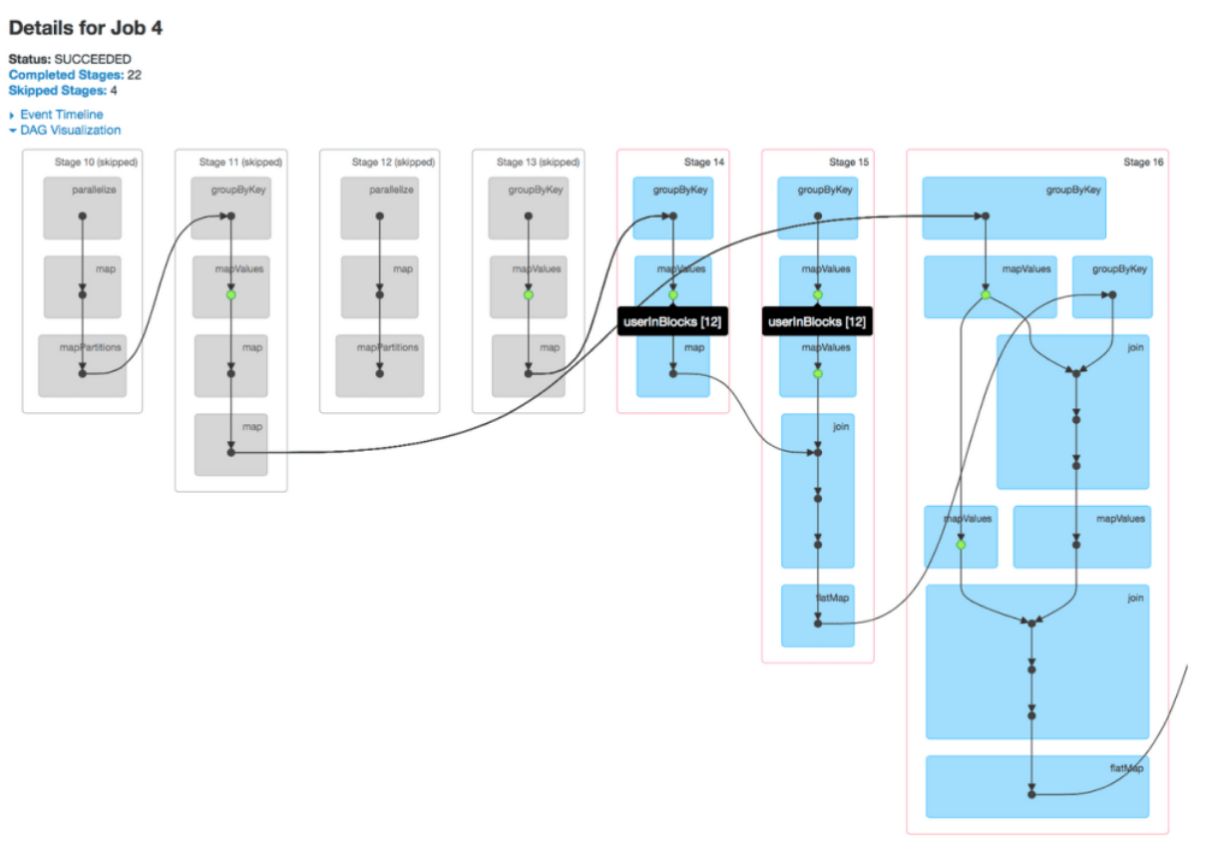

Slide 3
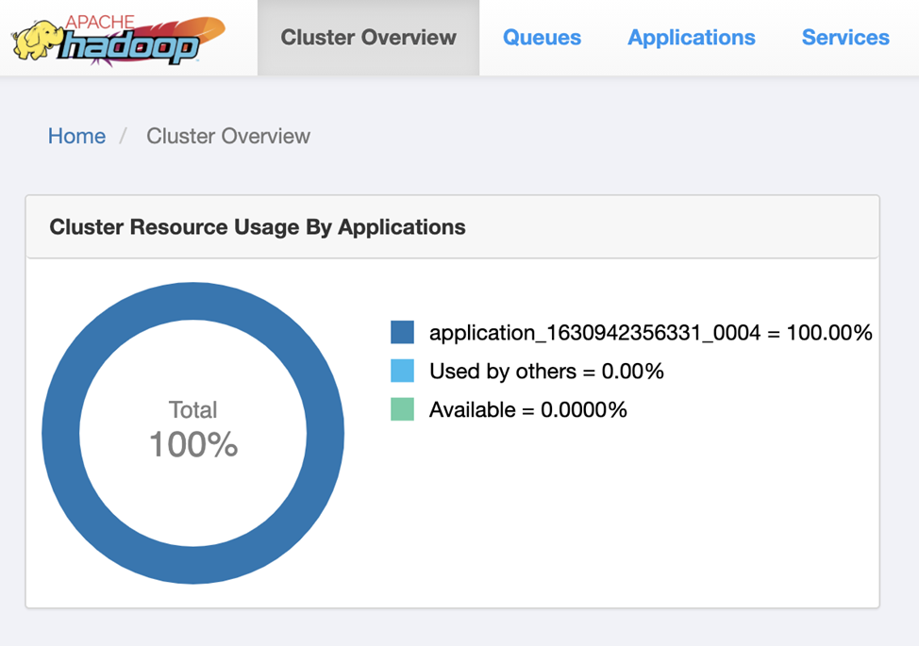
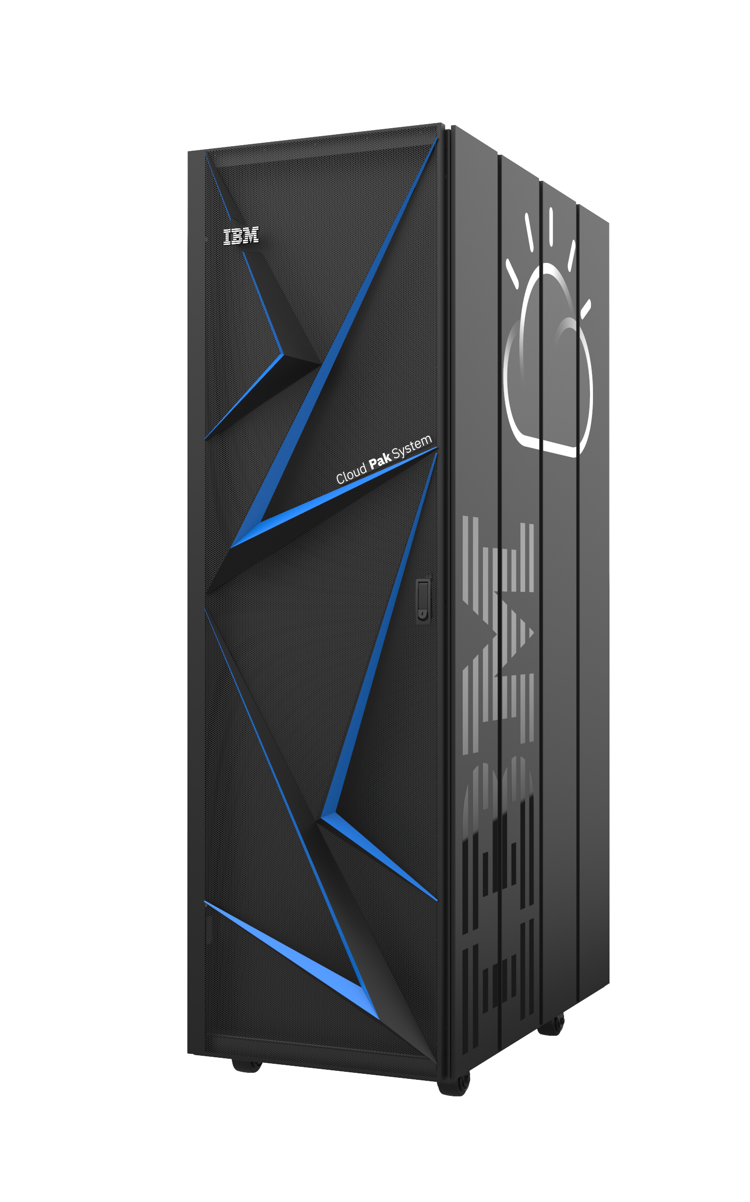
Cloudera Manager
Repositories
Yarn,
Tez,
Spark,
...
Yarn,
Tez,
Spark,
...
Yarn,
Tez,
Spark,
...
Yarn,
Tez,
Spark,
...
Yarn,
Tez,
Spark,
...
Spectrum Scale
Spectrum Scale
Spectrum Scale
Spectrum Scale
Spectrum Scale
META1
DATA1
DATA2
DATA3
DATA4

Slide 4
