Slide 1
Basic Fire Fighting
Ugee Chemicals Limited
Ibadan Plant

Slide 2
TRAINING CONETNT
Components of fire.
Classes of fire.
Fire Fighting Methods
Fire fighting equipment.
How to use a fire Extinguisher.
Qualification

Slide 3


Components of Fire
Fire Triangle
OXYGEN
CHEMICAL REACTION
HEAT
FUEL
(ignition source)
Without any of the components, there can’t be fire. Eliminating one, extinguishes fire.

Slide 4
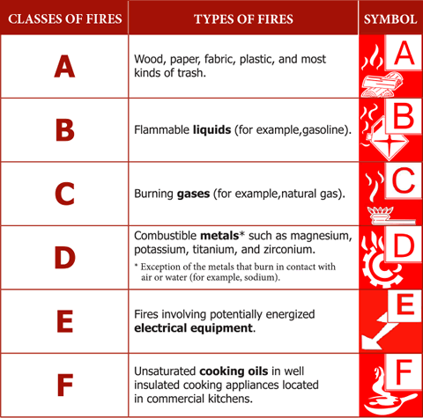
Classes of Fire
(ignition source)

Slide 5
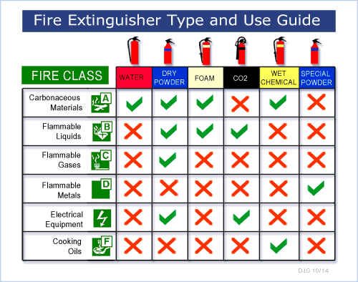
Fire Fighting Methods
(ignition source)
Dry Powder or Dry Chemical Powder is a Universal Fire Extinguisher

Slide 6
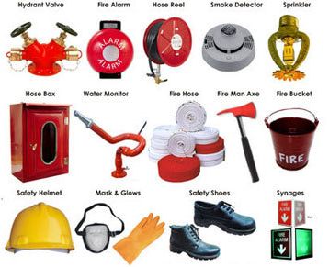
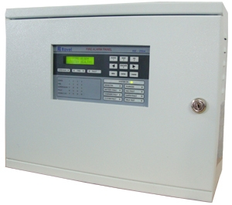
Fire Fighting Equipment
Fire Alarm Panel
(ignition source)

Slide 7
How to Use a Fire Extinguisher
P – Pull the pin
A – Aim at the base of the fire
S – Squeeze the lever
S – Swing the nozzle right to left and back while applying content
(ignition source)

Slide 8
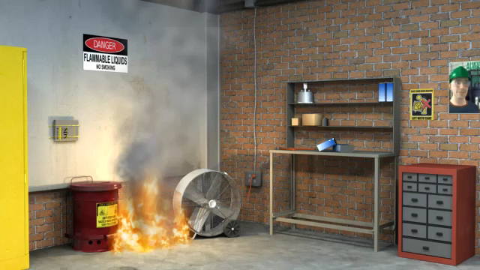
How to Use a Fire Extinguisher
Use the right class of fire extinguishers only for Incipient Fires
(ignition source)

Slide 9
THE END

