Slide 1
BEHAVIOUR & CULTURE

Slide 2
Behavior & Culture
Introduction
Importance of B&C
Understanding behavior measurement
Understanding feedback
Difference and link between OFS & FFS.

Slide 3
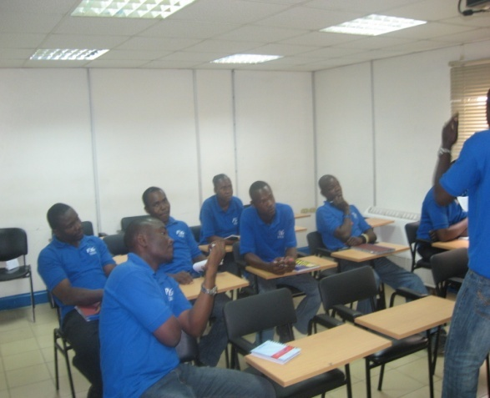
Behavior & Culture
Introduction
WE WANT EVERY PERSON TO:
Make a habit of giving feedback on HS&E related behaviors as part of your daily routine
For Unsafe behavior give
feedback following the four A’s :
For Safe Behavior :
Anybody
Any time
Any unsafe behavior
Anywhere
Give positive feedback on safe behavior 1x per day.
(Note this may be reduced in low risk low population situations)

Slide 4
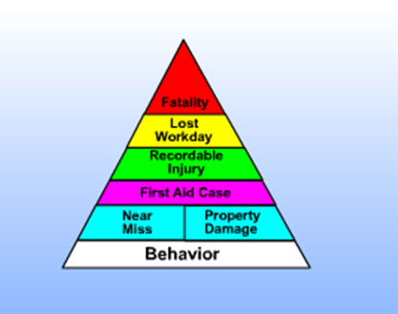
Behavior & Culture
Lesson 1: Understanding the Importance of Safe Behavior
Since Behavior Constitutes to most consequences of injuries >85%, its very important to work
On behavior, most importantly critical behaviors with higher potential to cause fatal injury.

Slide 5
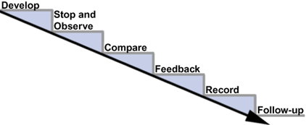
Behavior & Culture
Lesson 2: Understanding Behavior Measurement
Preparing to conduct a BOS (continued)
Observation consists of six steps:
 | Develop Tour Route
 | Stop and Observe
 | Compare Behaviors
 | Provide Feedback
 | Record Observations
 | Provide Follow-Up

Slide 6
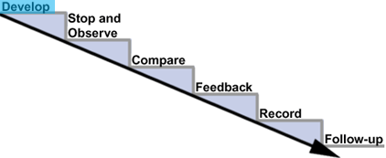
Behavior & Culture
Lesson 2: Understanding Behavior Measurement
Conducting a BOS
Develop
The first step in the behavior observation process is to develop a Tour Route.

Slide 7
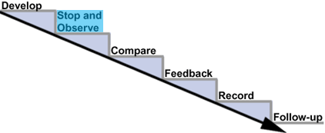

Behavior & Culture
Lesson 2: Understanding Behavior Measurement
Conducting a BOS
Stop and Observe
The next step is to stop and make observations according to your plan:
 | Walk to each predetermined point on your route
 | Stop at your spots.
 | Begin observing immediately, allowing from 10 to 30 seconds for each observation.
Take a good look

Slide 8

Behavior & Culture
Lesson 2: Understanding Behavior Measurement
Conducting a BOS
Stop and Observe (continued)
There are some important things to remember when observing:
 | Begin observing immediately in order to see the behavior that is occurring right now.
 | Observe only for the predetermined critical safe behaviors - don't check everything.
 | Concentrate on observing the people in the area.

Slide 9
Behavior & Culture
Lesson 2: Understanding Behavior Measurement
Conducting a BOS
Stop and Observe (continued)
There are some important things to remember when observing:
 | Watch for "vanishing unsafe acts". These are sudden changes in behaviors that occur because people notice that they are being observed.
Vanishing unsafe acts indicate that people know the safe behavior expected of them. In this situation lack of knowledge is not the issue and therefore training is not an appropriate corrective measure.

Slide 10
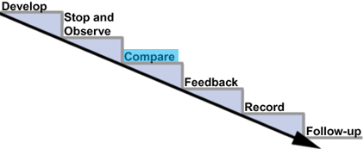
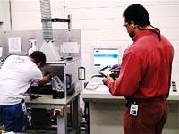
Behavior & Culture
Lesson 2: Understanding Behavior Measurement
Conducting a BOS
Compare
The next step is to compare the
observed behaviors to the
acceptable behaviors and then
decide if they meet the expectations.
Use CBAs and safe operating
procedures as a reference
You should:
 | Consider how the observed behavior compares to the acceptable behavior.
 | Decide if the observed behavior is safe or unsafe.

Slide 11
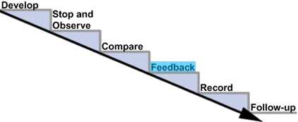
Behavior & Culture
Lesson 2: Understanding Behavior Measurement
Conducting a BOS
Feedback
After you compare each behavior with the safe behavior requirements, ask yourself:
 | "Does the observed behavior meet the safe behavior requirements?"
 | Depending upon your answer, you need to provide specific feedback to the individual.

Slide 12

Behavior & Culture
Lesson 2: Understanding Behavior Measurement
Conducting a BOS
Feedback (continued)
To give effective behavior feedback, use the following steps:
Describe the observed behavior to individual (tell what you saw). The observed unsafe behavior should be described to the individual without being judgmental.
Describe effects of behavior. Describe to the person the possible effects of that behavior, such as the good or bad consequences.
Problem solve. Problem-solve to reinforce safe behaviors, or correct unsafe behaviors. Ask the person: "How can we improve?"
 | Note: Site line management will provide additional feedback training.

Slide 13
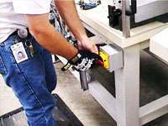
Behavior & Culture
Lesson 2: Understanding Behavior Measurement
Conducting a BOS
Feedback (continued)
If the behavior is correct, reinforce it.
"I am glad to see you are using the correct lockout procedures. Good Job! Do you have any suggestions how we can get others to remember to use the correct lockout procedures as well?"
If the behavior is not correct, help the individual change it.
"I see you are not using the correct lockout procedures. Is there a reason?"

Slide 14
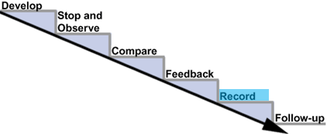
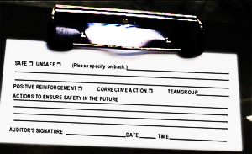
Behavior & Culture
Lesson 2: Understanding Behavior Measurement
Conducting a BOS
Record
Once you have provided immediate feedback to the observed individuals, you are ready to complete the BOS Form.
On this form you record the number of safe and unsafe observations for each behavior.
This information helps determine if your work place is becoming safer, and what more can be done to increase safe behaviors.

Slide 15
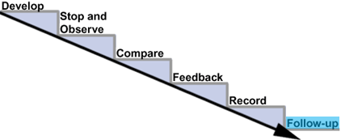
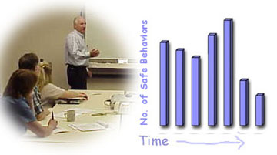
Behavior & Culture
Lesson 2: Understanding Behavior Measurement
Conducting a BOS
Follow-Up
After completing the observation tracking form, the last step in the observation process is the follow-up.
Here are two activities to consider in the follow-up step:
 | Discuss trends and on-going problems within the team.
 | Share problem-solving ideas on improving safety. Consider all new ideas.

Slide 16
Behavior & Culture
Lesson 3: Understanding Feedback
What Exactly is FFS ? (Focused Feedback System)
In FFS you ask a person if you can watch them work for 5 minutes. At the end of the time, you tell them what you saw - both safe and unsafe behaviors.
 | Is done by everybody
 | You can pick people to observe at random,
 | Includes all behaviors, not just critical ones
 | Has no checklist

Slide 17

Behavior & Culture
Lesson 3: Understanding Feedback
In Summary
Behavior Measurement (BOS & SSS) and Feedback (OFS & FSS) are distinct but complementary tools used to support an overall program. See the comparisons below.
In Measurement
 | We focus on continuous improvement of specific listed critical behaviors done on a set frequency.
 | We measure
 |  | Percentage Participation
 |  | Number of observations
 |  | Percent safe behavior
In Feedback
 | We provide feedback for all unsafe behaviors – Anybody, anytime, any where, any unsafe behavior!
 | We provide feedback on safe be- haviors on a set frequency – typically one person per day.
 | There is no checklist for Feedback.
 | If % of safe behavior is at target we assume effective feedback is occurring. We do not measure feed back of frequency directly.
 | We collect a sample of the feedback (typically 10%).

Slide 18
THE END

