Slide 1
Emergency Action Plan
Ibadan Plant

Slide 2
TRAINING CONETNT
EAP explained
Definition of an Emergency
Types of Emergency
What do to when there is an emergency
Members of the Emergency Response Team
Emergency Exits
Qualification

Slide 3
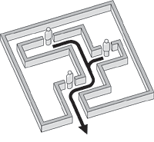
EAP
EAP stands for Emergency Action Plan. It explains step by step, what employees and contractors working in an area should do, usually to exit a building safely or respond to medical conditions, when there is an emergency situation.

Slide 4

Emergency
An Emergency is a situation that poses an immediate risk to health, life, property or environment. Most emergencies require urgent intervention to prevent the situation from becoming worse.

Slide 5
TYPES OF EMERGENCY
There are various categories of emergencies:
Fire Emergency
Medical Emergency
Chemical Spill Emergency
Confined Space Emergency
Explosion
Work at Height Emergency
Civil Disturbance
Bomb Threat
Flooding
Food Contamination

Slide 6
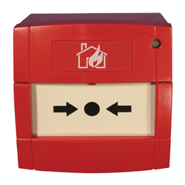
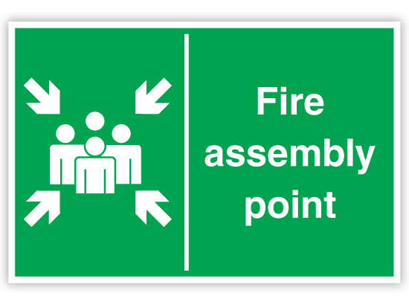
WHAT TO DO WHEN THERE IS AN EMERGENCY
CASE I
This is when you witness the outbreak of an emergency at its incipiency.
WHAT TO DO
Dial 07043319020 and state the following:
Location of the emergency
Type of emergency
2. Calmly & briskly walk to a call point and press it. (This is not required if you have dialed the emergency number)
2. Then walk calmly to the Assembly point.

Slide 7
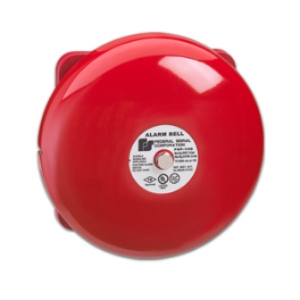
WHAT TO DO WHEN THERE IS AN EMERGENCY
CASE II
This is when you hear an alarm.
WHAT TO DO
1. Stop what you are doing when you hear a continuous alarm for more that 5 minutes.
2. Then walk calmly & briskly to the Assembly point.

Slide 8






Members of the Emergency Response Team (ERT)?
TRAINED FIRE FIGHTER
TRAINED FIRST AIDER
TRAINED PLANT NURSE
TRAINED SECURITY
TRAINED & QUALIFIED ELECTRICAL SAFETY OWNER
TRAINED & QUALIFIED CONFINED SPACE RESCUER

Slide 9

EMERGENCY EXIT
An Emergency Exit is a door that is only ever used when there is an emergency.
You must never obstruct an emergency door
Emergency doors must be designed such that they can only be opened from the inside
Emergency Exits must have easy-to-use push bars
Emergency Exits must be marked with a sign that reads “Emergency Exit.”

Slide 10
EAP QUALIFICATION
UGEE – Ibadan Plant
TRAINEE: DATE: PASS SCORE: 80%
Answer all the questions.
1. What is an EAP?
2. Define an Emergency.
3. List 5 types of Emergencies.
4. What is an Emergency Exit?
5. List 5 members of the ERT

Slide 11
THE END

