Slide 1
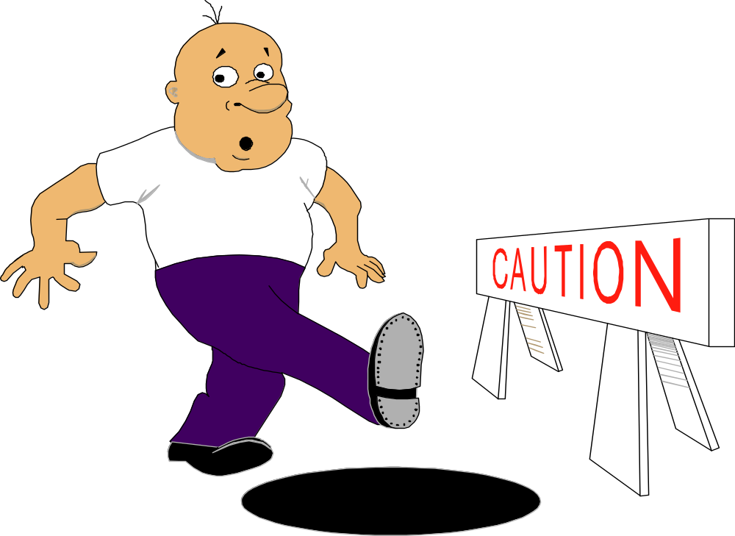
Ibadan Site
HAZARD Audits/survey Techniques

Slide 2

HAZARD AUDITS
WHAT IS A HAZARD AUDIT?
A hazard audit is simply an audit performed by trained individuals who are looking for unsafe conditions in the work place that potentially could cause an injury.
A hazard audit is designed to correct unsafe conditions, where the BOS is designed to correct unsafe behaviors.

Slide 3

HAZARD AUDITS
THE AUDIT PROGRAM CONSISTS OF 5 PARTS...
1. A published schedule showing who is to audit what area and when.
2. An audit form that is outlined to show the scope of what to look for
3. A survey team that is trained to look for specific hazards
4. Action steps and owners must be identified for accountability
5. Results must be communicated to the Site

Slide 4

HAZARD AUDITS
SITE AUDIT SCHEDULE
Audits are to be completed quarterly within the first 14 days of the first month.
The Module representative is responsible for assigning TEI ownership
TEI owner is responsible for scheduling the audits
The schedule should show when the audit is to be completed, who is to perform the audit, and where the audit is to take place

Slide 5
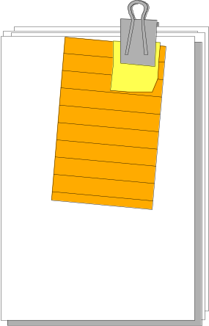
HAZARD AUDITS
2. THE AUDIT FORM
The audit form should be outlined to include the items or hazards that are potential problems
The form includes ...
  what to look for
  what was found
  what should be done to fix the problem
  who will fix the problem
  when will it be completed
The form should also include the distribution list, date and time of audit, area being audited, and the auditors names

Slide 6


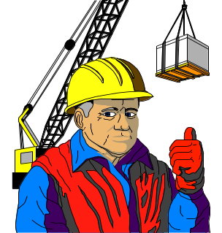
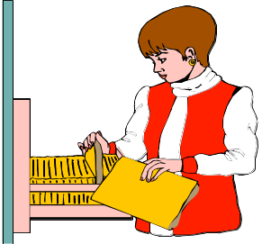
HAZARD AUDITS
3. SURVEY TEAM
The survey team is trained annually on how to conduct a hazard audit
Could include Managers, Technicians, or preferably both
Survey team should audit an area they do not work in. A fresh set of eyes can detect many things
The survey team could request a guide from the area being audited to be present for questions and to show them the area

Slide 7
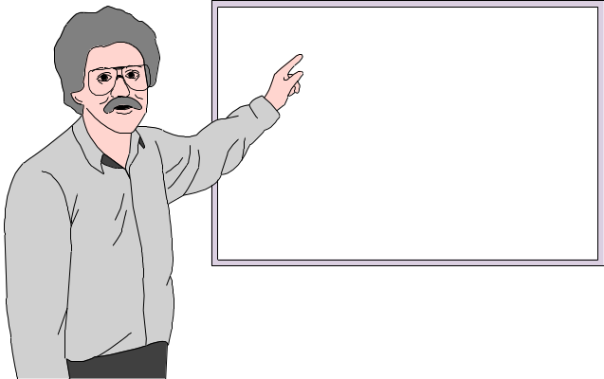
HAZARD AUDITS
4. ACTION STEPS AND OWNERS
There must be a person identified to fix each outage found on the audit
Sometimes the auditors can correct the problem during the audit, such as returning a leaning broom to its hanger, picking up a trip hazard, etc.
The dept./area TEI owner auditing is responsible for assigning people to fix the unsafe conditions
FOLLOW-UP IS THE MAIN KEY!

Slide 8
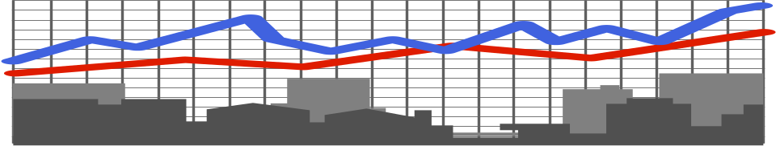
HAZARD AUDITS
5. COMMUNICATION OF RESULTS
The TEI owner is responsible for communicating the results of the audit back to the department with information like “found vs. fixed”
It is important that people know that the items that are found during the audit are fixed and not just ignored
When people know that hazards are being fixed after audits, they will feel comfortable knowing that day-to-day safety concerns they may report will also get fixed

Slide 9
HAZARD AUDITS
WHAT DO I LOOK FOR?
The following screens will take you through several examples of things that you want to look for during the audit.
They will be grouped into 16 different areas with examples under each one.
The audit form that you choose to use may have more, less, or different items on it. The important thing is to understand what you are looking for before you start the audit

Slide 10

TRIP HAZARDS

Slide 11
TRIP HAZARDS
CLUTTER/HOUSEKEEPING
  trash
  tools left out
  brooms, mops, shovels, etc.
PIPES
  loose pipes on floor
  piping from blowers at floor level
  conduit run at floor level
HOSES
  vacuum hoses
  water hoses
  any hoses that are in or near a walkway

Slide 12
TRIP HAZARDS
ELECTRICAL CORDS
  cords stretched across walkways without proper guards
  cords not picked up from maintenance
  cords hanging on a rack that have ends down on the ground
OTHER TRIP HAZARDS
  any items not covered above

Slide 13

SLIP HAZARDS

Slide 14
SLIP HAZARDS
LEAKS
  oil leaks around equipment
  water leaks around hydrants
  hydraulic leaks around fork trucks
SPILLS
  oil, water, etc. in a walkway or on floor
RAIN/ICE
  ice on walkway
  shaded areas where sun doesn’t shine
  concrete areas with a slick finish
LOOSE GRAVEL
  parking lots
  storage areas

Slide 15

BUMP HAZARDS

Slide 16
BUMP HAZARDS
PIPES
  pipes hanging low at head level
  overhead pipe-racks
CONDUITS
  conduits hanging low at head level
  overhead pipe-racks
LOOSE SIGNS
  signs that hang on chains, wire, or rope
  signs that stick out from a corner
OTHER BUMP HAZARDS
  any bump hazard not covered above

Slide 17
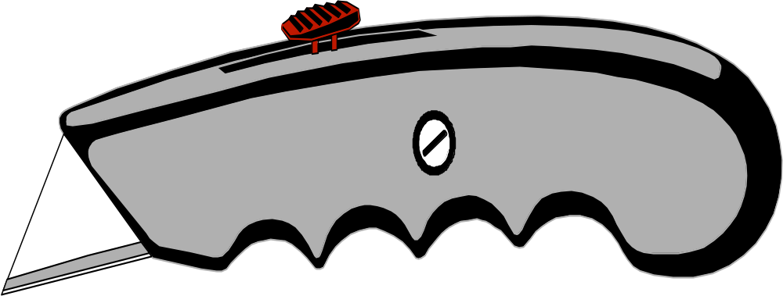
CUT HAZARDS

Slide 18
Cut hazards from sharp edges occur from one of the following situations:
Sliding Friction (High normal force) Sliding Friction “sharpens” one of the sliding surfaces - sliding doors
Slamming/Localized Impact Material fatigues to failure which causes bending or cracking - metal/Lexan
Removeable Guards/Covers/Parts Removable parts are improperly stored which creates a sharp edge - direct contact with concrete floor

Slide 19
Other cut hazards:
Metal banding from bulk materials
Metal insulation
Duct work

Slide 20

FALL HAZARDS

Slide 21
FALL HAZARDS
FLOOR OPENINGS
  Manholes or covers left open
  Sewers or Sumps
  Catwalks over vats, vessels, etc.
MEZZANINE EDGES
  Catwalks or walkways with no handrail
  Working on the edge of a platform without fall protection
FALL FROM ABOVE
  Working in pipe racks without fall protection
  Working on a ladder above the correct rung
  Running up and down stairways
OTHER FALL HAZARDS
  Any fall hazard not mentioned above

Slide 22
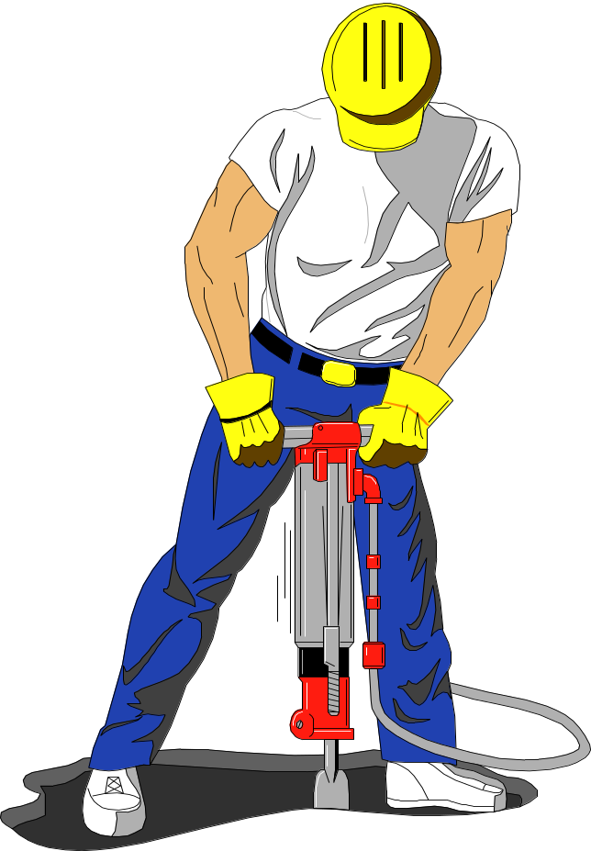
STRAIN HAZARDS

Slide 23
STRAIN HAZARDS
LIFTING HEIGHT
  Lifting items too high
  Getting heavy items off of high storage racks
WEIGHT LIFTED
  Lifting with back, not with legs
  Lifting too much weight for one person
  Putting body in awkward position while lifting
OTHER STRAIN HAZARDS
  Any strain hazard not metioned above

Slide 24
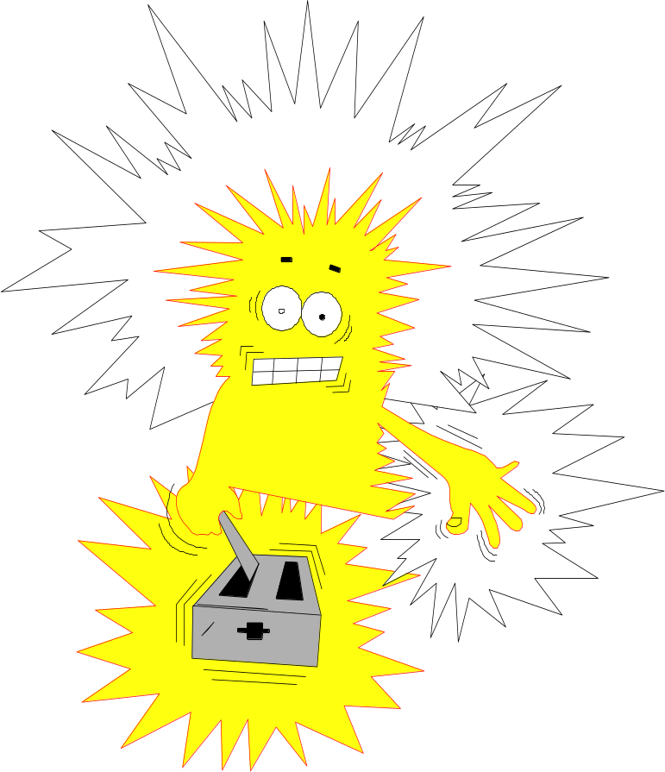
ELECTRICAL HAZARDS

Slide 25
ELECTRICAL HAZARDS
ELECTRICAL CORDS GROUNDED
  Cords with the ground prong broken off
  Cords not inspected and marked at least quarterly
PANELS & PULL BOXES COVERED
  Breakers missing without a blank or plug
  Panel doors left open
  Items blocking access to an electrical disconnect
OTHER ELECTRICAL HAZARDS
  Any electrical hazards not mentioned above

Slide 26

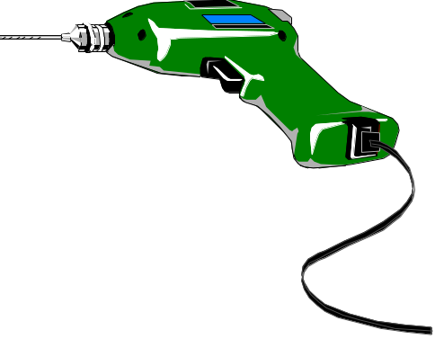
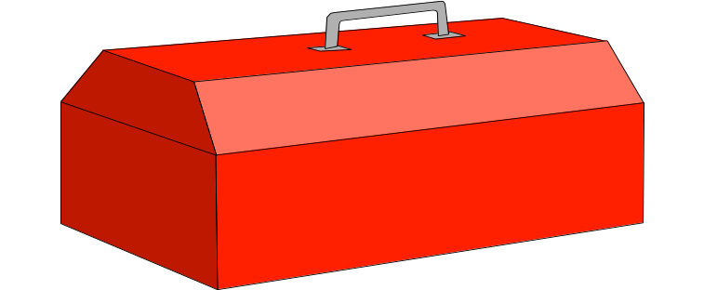
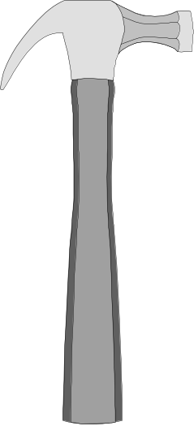
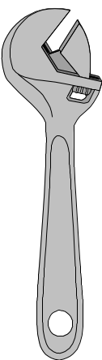
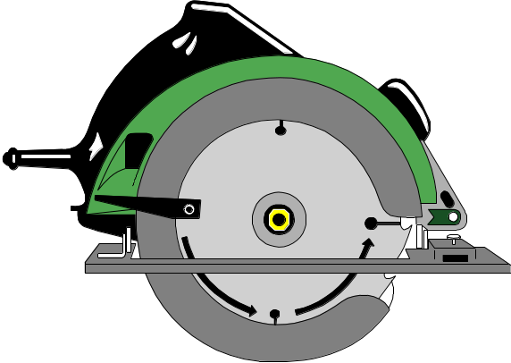
TOOL HAZARDS

Slide 27
TOOL HAZARDS
HOISTS/RIGGING/SLINGS
  Equipment not inspected as specified
  Slings broken, frayed, or splintered
SCREWDRIVER POINTS
  Standard screwdriver points chipped off or bent
  Phillips screwdriver points worn or rounded off
FILE HANDLES
  Using files with no handle
  File handles loose or broken
POWER TOOL CORDS
  Cords not inspected and marked
  Cords frayed, cracked, or have insulation missing
ALL TOOLS PROPERLY STORED
  Tools cluttering up work benches

Slide 28

ADEQUATE WORK AREA

Slide 29
ADEQUATE WORK AREA
3 FEET MINIMUM
  Less than 3 feet area to work in
  Proper footing for long periods of standing
LIGHTING
  Light bulbs burned out
  Not enough light fixtures in area
ACCESS ADEQUATE
  Enough room to leave work area in case of fire
OTHER ADEQUATE WORK ITEMS
  Any items not covered above

Slide 30
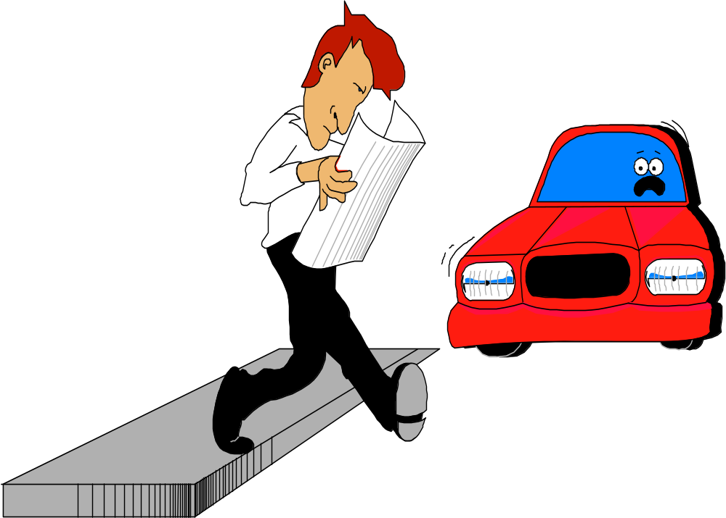
ADEQUATE SAFE
WALKWAYS

Slide 31
ADEQUATE SAFE
WALKWAYS
3 FEET MINIMUM
  At least 3 feet clearance for a walkway
LIGHTING
  Not enough lighting in walkways
CLUTTER
  Items left in walkway
  Trip hazards
MARKED
  Walkways marked for pedestrian traffic only
CLEAR PATH TO EWF
  Path must not be blocked to EWF
OTHER ADEQUATE WALKWAYS
  Any walkway not mentioned above

Slide 32
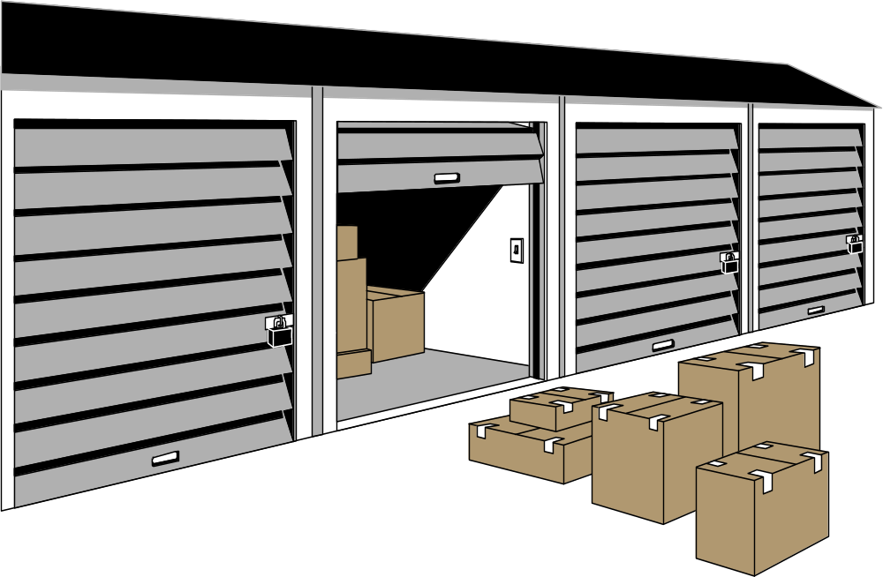
ADEQUATE STORAGE
AREAS

Slide 33
ADEQUATE STORAGE
AREAS
MARKED
  Storage area must be marked showing boundaries
  Walkways around these areas must also be marked
NO OVERHANGING ITEMS
  Items stacked should not be hanging over or leaning
  Double or triple stacking when prohibited
CYLINDERS CHAINED
  Gas cylinders must be chained to prevent moving
  Caps must be in place when not in use
  Flammable gases should not be stored near flames
OTHER ADEQUATE STORAGE ITEMS
  Any items not mentioned above

Slide 34

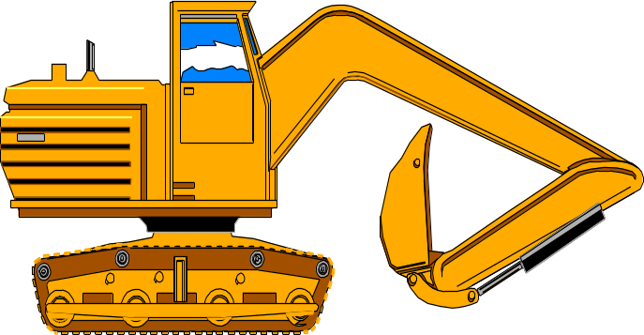
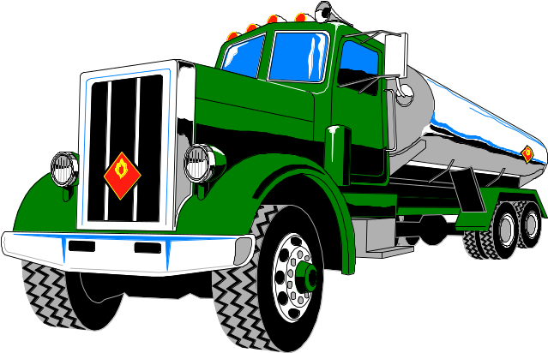
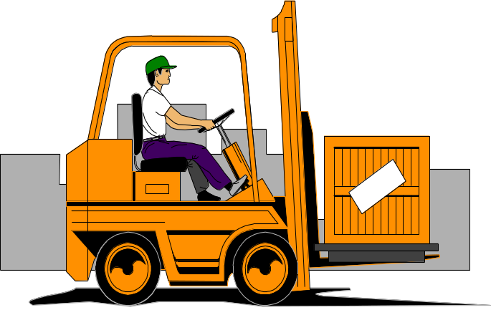
VEHICLES

Slide 35
VEHICLES
TRUCKS CHOCKED
  Trailers at a dock without a tractor should have chocks and nose stands if entering with forktruck
  Trailers should be chocked front and back
HYDRAULIC FLUID LEAKING
  Diesel, gasoline, hydraulic fluid, brake fluid, etc. leaking from a vehicle
  Slip hazards around parking places
SAFETY FEATURES WORKING
  Gates shut on boomlift
  Lights flashing on lift trucks
OTHER VEHICLE ITEMS
  Any item not mentioned above

Slide 36
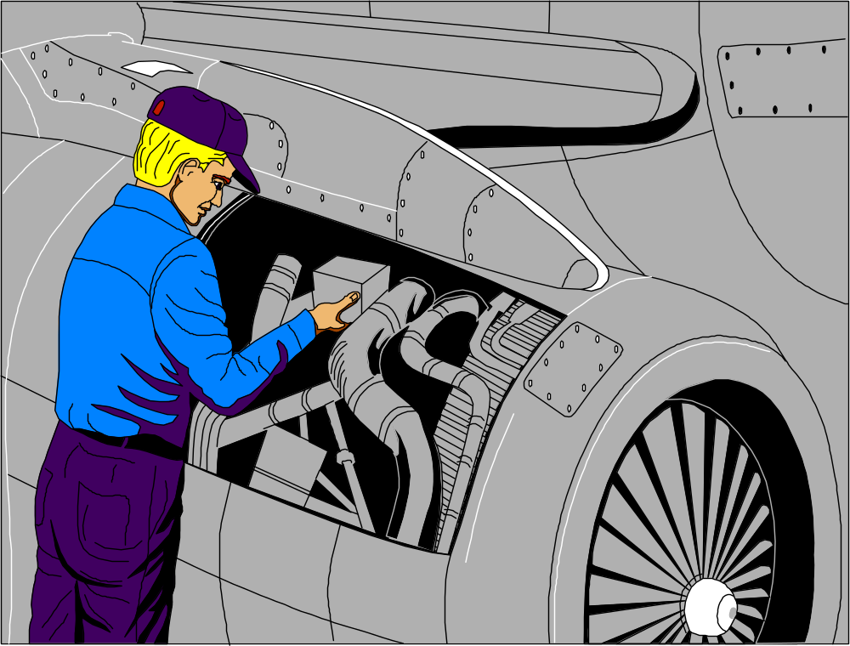
GUARDING

Slide 37
GUARDING
GUARDING IN PLACE
  No guards off while machine is running
  If guard is off, machine is locked out
GUARDING SECURE
  Guards are bolted down securely
  No bolts missing in guards
OTHER GUARDING ITEMS
  Any items not mentioned above

Slide 38
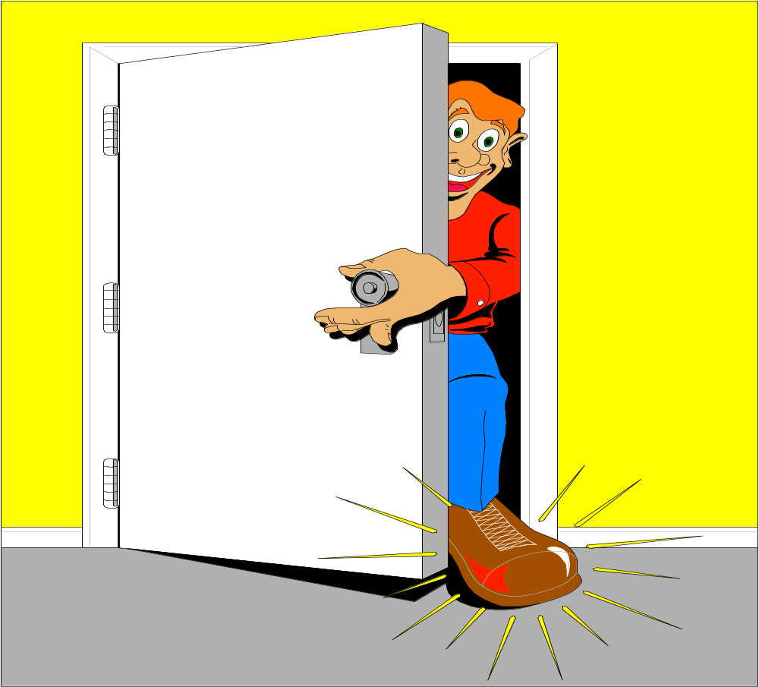
PINCH POINTS

Slide 39
PINCH POINTS
POTENTIAL FOR BEING CAUGHT IN OR BETWEEN
  Fork truck traffic backing into a walkway
  Machines with open guarding
  People wearing loose clothing, ties, jewelry, etc.
INRUNNING NIPS
  Hand railing that is close to a wall
  Small openings on machinery
OTHER PINCH POINT ITEMS
  Any item not mentioned above

Slide 40

BURN HAZARDS

Slide 41
BURN HAZARDS
STEAM LEAKS
  Leaking valves in steam lines
  Blowdown lines on steam headers
UNGUARDED HOT AREAS
  Steam tracing
  Dryers, Boilers, Drums, etc. with no insulation
OTHER BURN ITEMS
  Any burn item not mentioned above

Slide 42
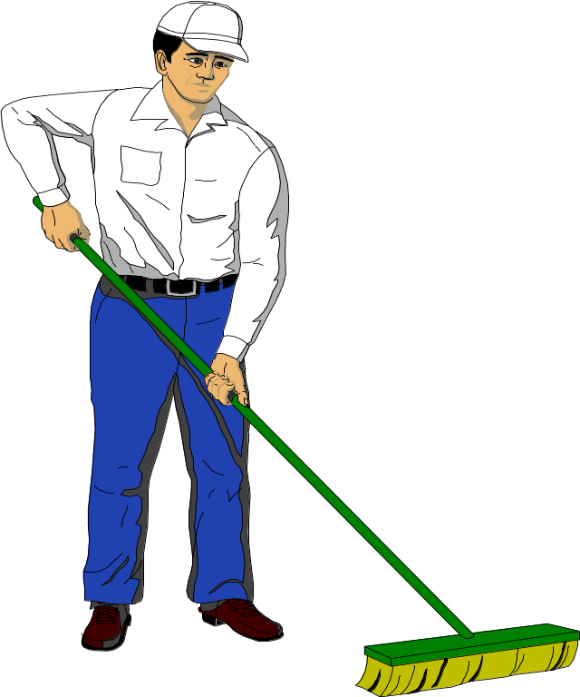
GENERAL HOUSEKEEPING
Most Common Cause for Unsafe Conditions!

Slide 43
GENERAL HOUSEKEEPING
OUT-OF-PLACE ITEMS
  Any item that is not in it’s place
  Brooms leaning against walls
  Clutter on the floors
  Trash cans running over
ANYTHING ELSE?

Slide 44
HAZARD AUDITS
SUMMARY
These audits are used to find unsafe conditions, not unsafe acts
The auditors should be trained at least annually on what to look for
MAKE SURE you communicate the results to the area being audited so they can correct the hazards
FOLLOW-UP IS THE KEY!!!!!!

Slide 45


