Slide 1
UGEE CHEMICALS
HSE AWARENESS TRAINING

Slide 2
Course Objectives
Upon completion of this course, you should be able to:
Explain the Company HS&E Expectations and Rationale
HS&E Vision
HS&E Program
- Model
- Safety Triangle
- Management
Describe the Company HS&E Key Elements Approach
Cite Typical HS&E Responsibilities for Each Employee
Notes:
This HS&E basics course is intended to help you comply with the law and avoid injuries by understanding and explaining the standards, policies, and procedures designed to protect you while in the workplace.
(Explain) To help you understand why this part of your job is important for UGEE and for YOU
(Describe) To help you understand how your HS&E results will affect the overall Site HS&E results
(Cite) To help you understand the basic HS&E work you will face
Note to instructor: For a knowledge check you will need to develop questions based on this presentation. If you need more information on how to do this please call Corporate Health Safety and Environment. Or have participants complete the test in Web Based Training.

Slide 3

Corporate Approach to HS&E Health, Safety and Environment Vision
Notes:
People: We protect the life and health of our employees and the communities in which we operate.
Public Trust: We obey all laws and regulations. We are viewed as responsible leaders worldwide and as role models by external organizations.
Profit: Through our HS&E mastery, we ensure business continuity in the supply chain and enable and accelerate innovation.

Slide 4
Corporate Approach to HS&E
Why Have an HS&E Program?
It Makes Good Business Sense:
A Safe Workplace protects our investment in you and your community.
Compliance with the Law is expected of Consumer Product Companies.
Protecting our Assets keeps the site running and avoids costly incidents
A recent study determined that the HS&E Program saves the Company at least $30 million per year!
Notes:
Some examples of where savings are derived from are reduced worker's compensation costs, avoiding business interruption (making products available on the store shelves) and civil action or lawsuits.
The study referenced was conducted in the year 2000.

Slide 5
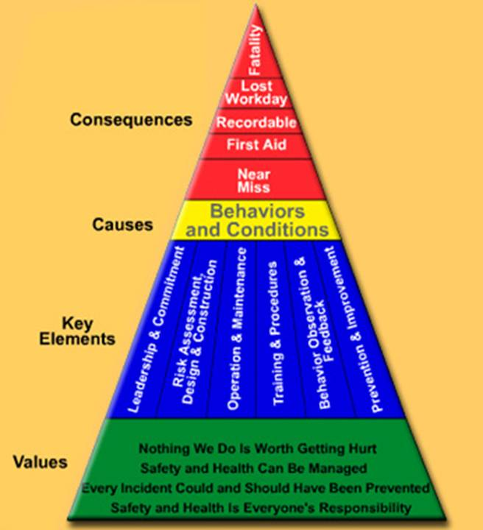
HSE Program Model Safety Triangle
Notes:
By preventing the causes of HSE incidents, we can avoid or minimize HS&E incidents. These can be prevented, by modifying Behaviors and Conditions – the next block in the Safety Triangle.

Slide 6
Safety Triangle Values
VALUES
Nothing We Do Is Worth Getting Hurt
Health Safety & Environment Can Be Managed
Every Incident Could and Should Have Been Prevented
Health Safety & Environment Is Everyone’s Responsibility
Notes:
The foundation of the Safety Triangle begins with VALUES.
Nothing we do is worth getting hurt. -No task is so important that you should risk injury or illness to yourself others. Never sacrifice safety for speed, cost, quality
Health Safety & Environment Can Be Managed -This training program is an example of how the Company puts systems in place to help manage HS&E. You are key to managing HS&E,, and this training will show you how.
Every Incident Could and Should Have Been Prevented - We examine every HS&E incident to learn how to prevent its recurrence. The role you play is to report all injuries or incidents promptly and to provide feedback to stop all unsafe behaviors.
Health Safety & Environment Is Everyone’s Responsibility - At UGEE, participating in HS&E activities is a condition of employment. Successfully completing this and other HS&E training, actively participating in safety meetings, completing Behavior Observation Surveys, providing feedback on safe and unsafe behavior of others are some examples of your HS&E responsibilities.

Slide 7
Key Elements - Controls
CONTROLS
Behavior Observation &
Feedback
Leadership & Commitment
Design & Construct
Operate & Maintain
Training & Procedures
Prevention & Improvement
How these elements apply to you will be covered later in this training program.
Notes:
The next major building block of the Safety Triangle is comprised of the six key elements. These are the systems used to promote safe behaviors, manage safe equipment and conditions needed to achieve the HS&E values.

Slide 8
Behaviors and Conditions - Causes
CAUSES
Behavior & Conditions
Notes:
By preventing the causes of HS&E incidents, we can avoid or minimize HS&E incidents. These incidents can be prevented, by modifying Behaviors and Conditions—the next block in the Safety Triangle.

Slide 9
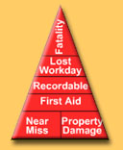
Consequences
Notes:
The top of the Safety Triangle includes the consequences of not properly managing HS&E. There are 3 categories of consequences: Injuries (and illnesses), Losses (property or business interruption) and
Legal/Fines (and compliance issues)
The severity of incidents is a matter of luck. For every 3-5 recordable injuries, we have one lost workday case that ultimately may result in a fatality.
Injuries can range from cuts, bruises, sprains and strains to life threatening incidents.
Losses can be damaged product or lost production
Legal/Fines could include the consequences of being out of compliance on evironmental permits.
Near Miss is an incident that could have resulted in injury or property damage.
Property Damage includes damage to equipment, structures, product or materials.
First Aid is immediate treatment for injuries that may or may not require addtional medical attention.
Recordable injuries require medical attention beyond first aid.
Lost Workday is defined as missing the next regular scheduled shift.
Incident resulting in the loss of life.
NOV = Notice of Violation

Slide 10
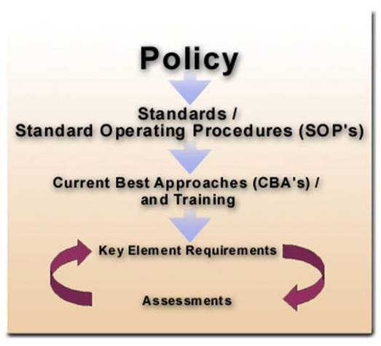
Corporate Approach to HS&E
Click here to go to the Policy
Notes:
There are two company wide Policies: The Safety & Health Policy and The Environmental Quality Policy
The six Standards are: You will note that these are the same as the six key elements.
Leadership & Commitment
Risk Assessment, Design & Construction
Operation & Maintenance
Training & Procedures
Behavior Observation & Feedback
Prevention & Improvement
SOP’s are how to meet the standards.
CBA’s provide guidance on effective methods to meet the SOP's.
The Standards and Standard Operating Procedure’s serve as the basis for the HS&E Key Element requirements. By regularly assessing and improving the performance against the Key Elements, we are able to effectively manage HS&E results. This reduces (or eliminates) HS&E incidents and costs.
Assessments are the method used to check the status of the key elements.

Slide 11
Summary
The HS&E Vision is to “Protect People, Public Trust and Profit”
The Safety Triangle is built upon:
A clear set of values: Nothing we do is worth getting hurt, HS&E can be managed, Every loss can and should be prevented, and HS&E is everyone’s responsibility
The six Key Elements
Causes of HS&E incidents: Behaviors and Conditions
Consequences of not properly managing HS&E—Injuries, Losses, and Legal/Fines
Program Management involves regularly assessing and improving performance against the Key Elements
Notes:
Key Elements: Leadership & Commitment, Risk Assessment, Design & Construction, Operation & Maintenance, Training & Procedures, Behavior Observation & Feedback, and Prevention & Improvement

