Slide 1
Incident Management
Ibadan Plant

Slide 2
TRAINING CONTENT
1. What is an Incident?
2. Distinction between a Near Miss, an Unsafe Condition and Unsafe Behaviors.
3. Classification of incidents
4. How to report near misses and incidents
5. Qualification

Slide 3

What is an incident?
An incident is an unplanned event that may result to injury, illness, or property damage or some combination of all three in varying degrees from minor to catastrophic.
(ignition source)

Slide 4

What is an incident?
Incidents are caused by Unsafe Behaviors and Unsafe Conditions that are not addressed or mitigated.
(ignition source)
Unsafe Behaviors – 85%
Unsafe Conditions – 15%

Slide 5
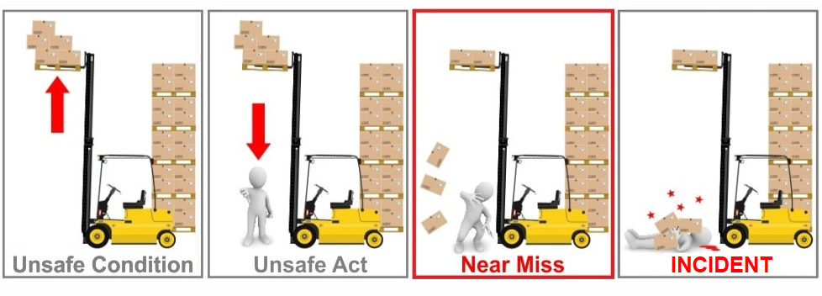
Distinction between a Near Miss, an Unsafe Condition (defect) and Unsafe Behaviors
(ignition source)
Safety defect can also be referred to as unsafe condition

Slide 6
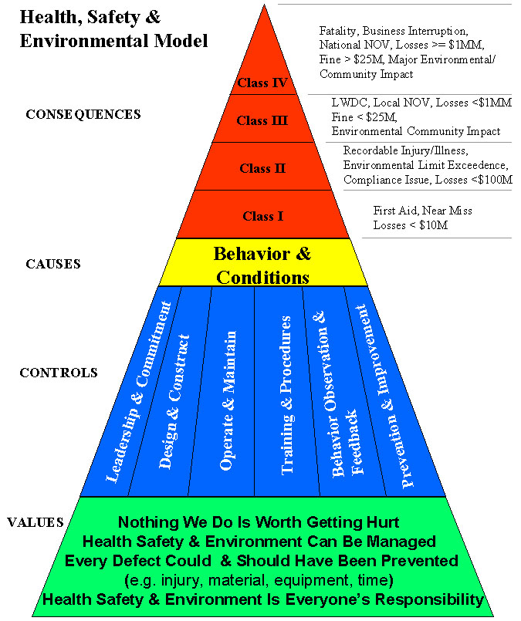
Classification of incidents

Slide 7
How to report near misses and incidents
Report all near misses and incidents immediately they occur on the portal
All Safety Defect Analysis (SDA) for near misses must be completed with 72hours.
All Safety Defect Analysis (SDA) for Incidents must be completed within 24hours.

Slide 8

Qualification

Slide 9
THE END

