Slide 1
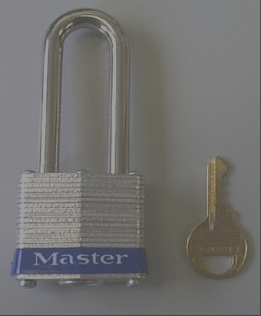
Isolation of hazardous energy

Slide 2

Contents of the course
What is Hazardous Energy?
What is isolation ?
How can I isolate Hazardous Energy?
Why should I do it ?
When should I do it?
Notes:
This is the summary of what we will talk about

Slide 3
Intent of energy lock out
Electrical energy
Mechanical energy (incl. gravity)
Pneumatic energy
Hydraulic energy
Notes:
What different kinds of energy do you know?

Slide 4

Intent of energy lock out
Energy may cause injuries
All different types of incident severities are possible from laceration to fatality
Therefore, we MUST isolate hazardous energy when cleaning, repairing and maintaining equipment
Notes:
What could happen caused by the energy?

Slide 5
Design Requirements
Electrical energy
Mechanical energy
Pneumatic /
Hydraulic energy
disconnect switch
put mechanical restraint mechanism in
place
push or pull the manual disconnect device to dump upstream pressure
Notes:
How can I isolate the different types of energy?

Slide 6

Design Requirements
Isolation devices for every energy source which is lockable
in the off / de-energized position ONLY !
Notes:
What do I need for every machine?
Why lockable?
Why in the off position only?

Slide 7
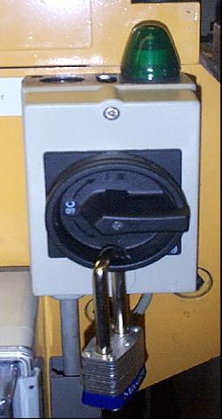
Design Requirements
Notes:
Lockable electrical disconnect

Slide 8
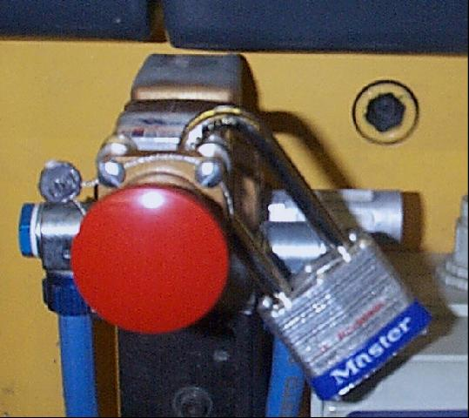
Design Requirements
Notes:
Lockable pneumatic disconnect

Slide 9
Lock out procedure: De-energize
Stop the machine
Switch off the electric disconnect
Dump the upstream pressure and isolate from pneumatic or hydraulic energy
Lock-out each power source with personal padlock
Inspect the work area if clear of persons
Call out “stand clear” or equivalent and push the start button
verify that all stored energy is relieved
Push the stop button
verify that contacts have dropped out and
machine is de-energized
Start work
Notes:
What are the necessary action steps to de-energize an electrically powered mechanical machine?

Slide 10
Lock out procedure: Re-energize
Check if all safeguards are back in place
Check if all padlocks have been removed
Call out “stand clear” or equivalent
Switch on all disconnects
Push the start button
Notes:
How do we re-power a machine?

Slide 11
Lock out procedure
IF disconnect is within arm reach and
in line of sight
For Jam Clearing apply Loto
But only if a single person is
performing the task.
I more than 1 person, then apply Lo/To
Notes:
Why do we have a special procedure for jam clearance?
When does this procedure apply?

Slide 12

Padlock removal
Each person has to remove
his own padlock
If the job will be continued
by somebody else,
that person must lock
out before you remove
your own lock
Notes:
Who is allowed to remove the personal padlock?
What will happen if the task which has to be performed will take more than one shift?

Slide 13
Padlock removal
If you can contact the lock-owner: confirm that it is safe to remove the padlock, fill out the padlock removal form and return the completed form to your IH&S leader
If you can´t contact the lock-owner:
request from a qualified person to decide if it is safe to remove the lock. He can authorize the removal form
Notes:
What will you do if somebody left his padlock in a machine and is on site?
Find him/her to remove the lock!!!
If he is off site apply to the following procedure?

Slide 14

Padlock removal
“I am qualified”
He/She is familiar with the safe
operations of the equipment,
the process, hazards and the
procedure for isolation!
Notes:
Who is an authorized person?

Slide 15
Lock devices
each lock must be identifiable (“who is the owner”)
each lock should have only one key
(if two are provided, keep one in a secure place, where an authorized person can access)
Notes:
What are the requirements for a lock?

Slide 16
Tag-out devices
Warning “Do not operate”
Name and signature
Reason for placing
Date
De - energized system
TAG
Notes:
How should a tag lock like?
How should it be fixed?
* Use a tie or strap which must be
cut off!

Slide 17
Tag-out devices
If someone has locked out a machine or device and
must leave the site while work on the machine continues, and
is not relieved during the next shift,then
Attach a tag to the
personal padlock
=Tag-out
Notes:
When do we have to place a tag?

Slide 18
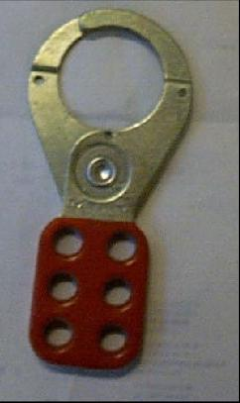
Group lockout or tag-out
Notes:
What will you do if more than one operator has to lockout an equipment?
Use a safety clip!

Slide 19
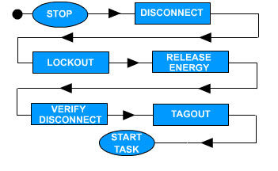
The IHE Procedure (LO/TO)
Notes:
Remember the Abbreviation AMEC.

Slide 20
WATCH OUT
99% OF INCIDENT DUE TO LOTO ARE ALWAYS FATAL
MINIMUM OF CLASS 3 WHEN LUCKY.
AMPUTATION IS THE MAJOR CASE.

Slide 21
WHAT NEXT
GO BACK TO YOUR DEPARTMENT AND RE-DEPLOY LOTO.
NOT THEORETICALLY BUT PRACTICALLY
CHECK IF EMPLOYEES VERIFIES AFTER LOCK OUT.

Slide 22
THANK YOU
ANY QUESTION?

