Slide 1

PPE

Slide 2
1. DEFINATION OF PPE 2. LEVELS OF PROTECTION
INDEX
EYE & FACE PROTECTION
FOOT & LEG PROTECTION
HEAD PROTECTION
BODY PROTECTION
HAND AND ARM PROTECTION

Slide 3
PPE STANDS FOR PERSONAL PROTECTIVE EQUIPMENT. They are various equipments used to protect different parts of the human body from hazardous conditions. Whenever possible, Controls are used to minimize risk and eliminate hazardous conditions. The Hierarchy of Controls lists control strategies from most to least preferable. Hierarchy of Controls : 1. Substitution or Design Out 2. Engineering 3. Administrative 4. PPE
DEFINATION OF PPE

Slide 4
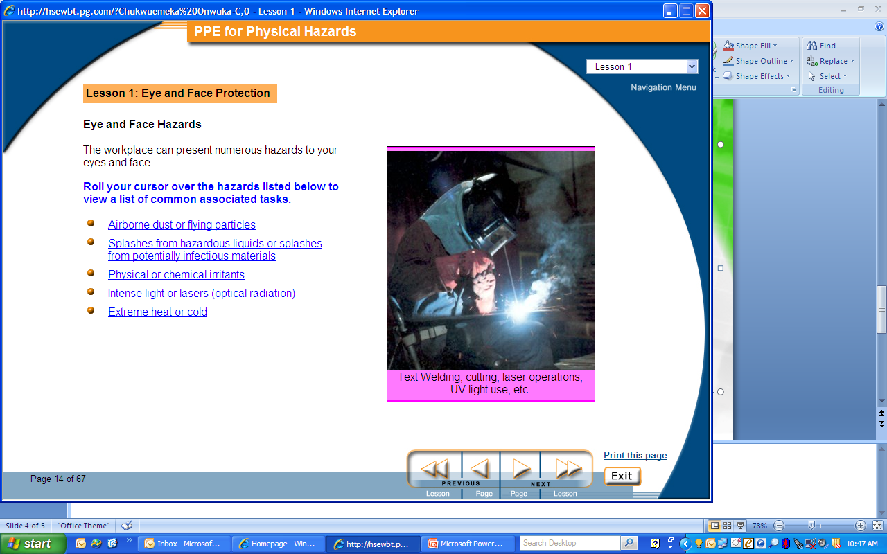
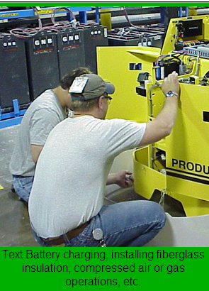
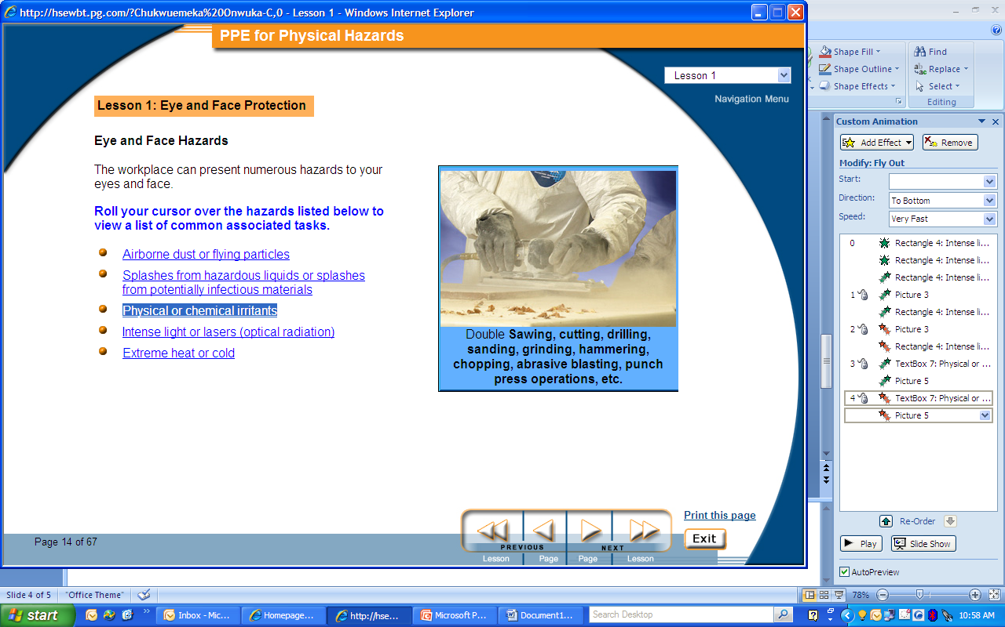
EYE AND FACE PROTECTION. Eye and Face Hazards The workplace can present numerous hazards to your eyes and face. Some of which are:
LEVELS OF CONTROL
Intense light or lasers (optical radiation)
Physical or chemical irritants
Airborne dust or flying particles

Slide 5
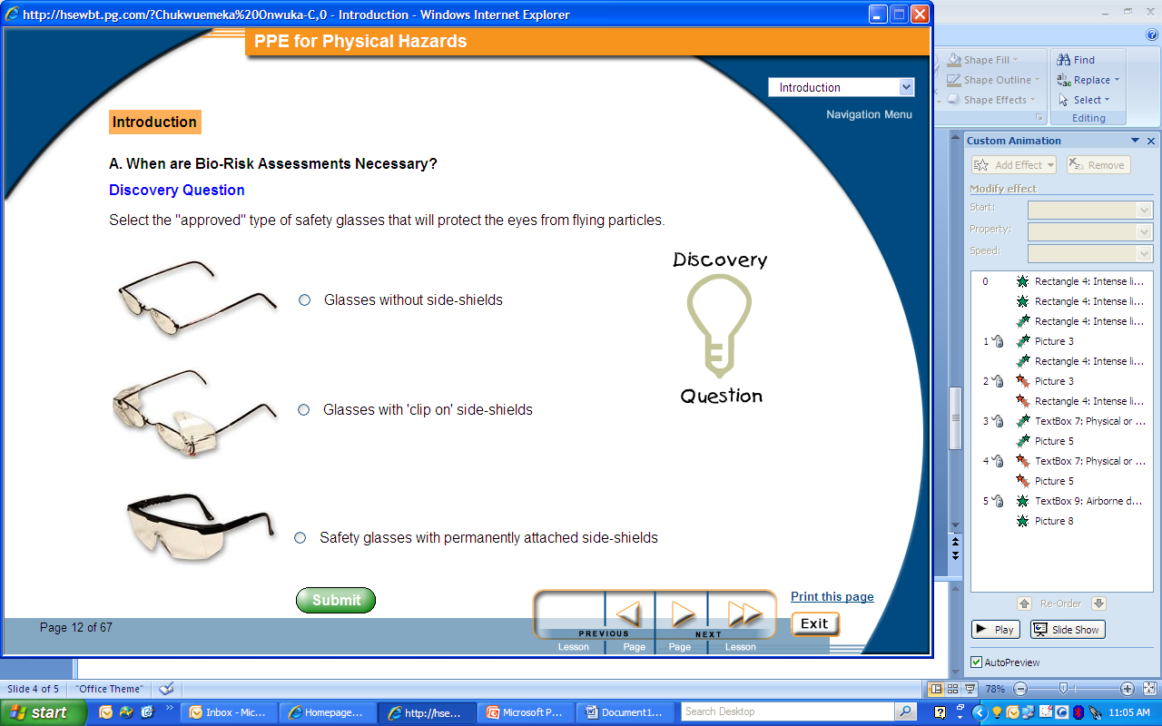
EYE AND FACE PROTECTION. Eye and Face Hazards Protection for the Hazards mentioned is SAFETY GLASSES
LEVELS OF CONTROL
It will protect against:
Flying fragments
Objects
Large chips
Particles (dust)
Dirt
Glare
Splashes from small quantities of low hazard chemicals
PRESCRIPTION GLASSES ARE NOT ALLOWED UNDER ANY CIRCUMSTANCE

Slide 6
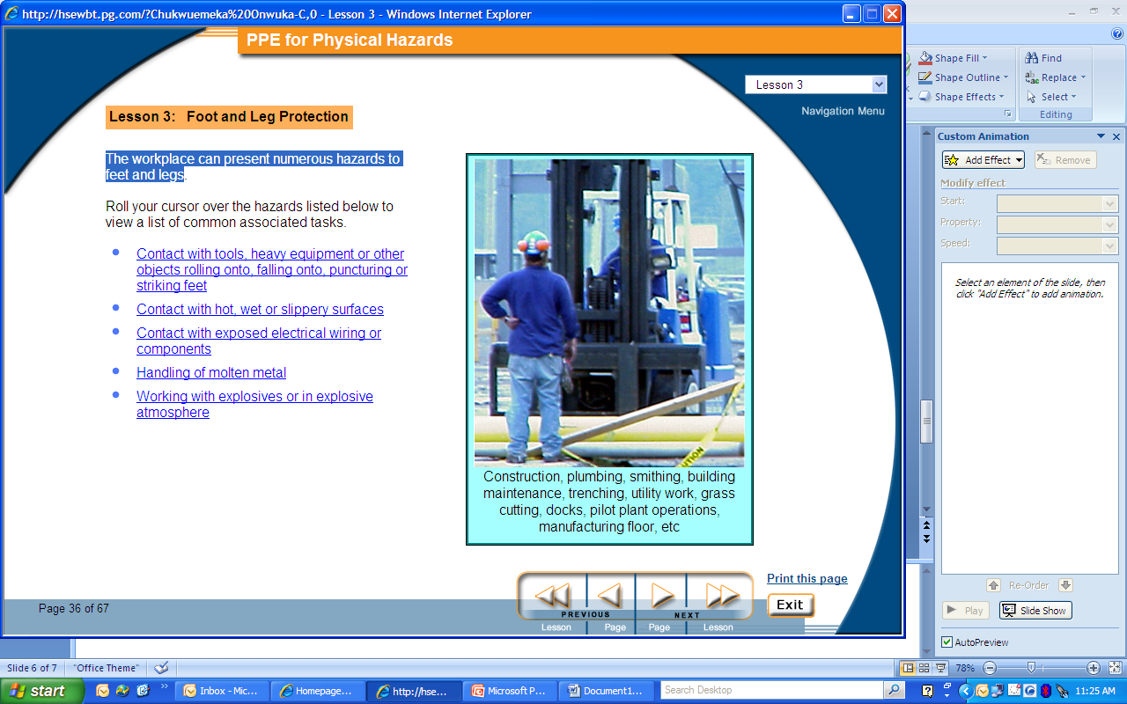
FOOT AND LEG PROTECTION. Foot and Leg Hazards The workplace can present numerous hazards to feet and legs. The hazard peculiar to the warehouse is as follows:
LEVELS OF CONTROL
Contact with tools, heavy equipment or other objects rolling onto, falling onto, puncturing or striking feet

Slide 7
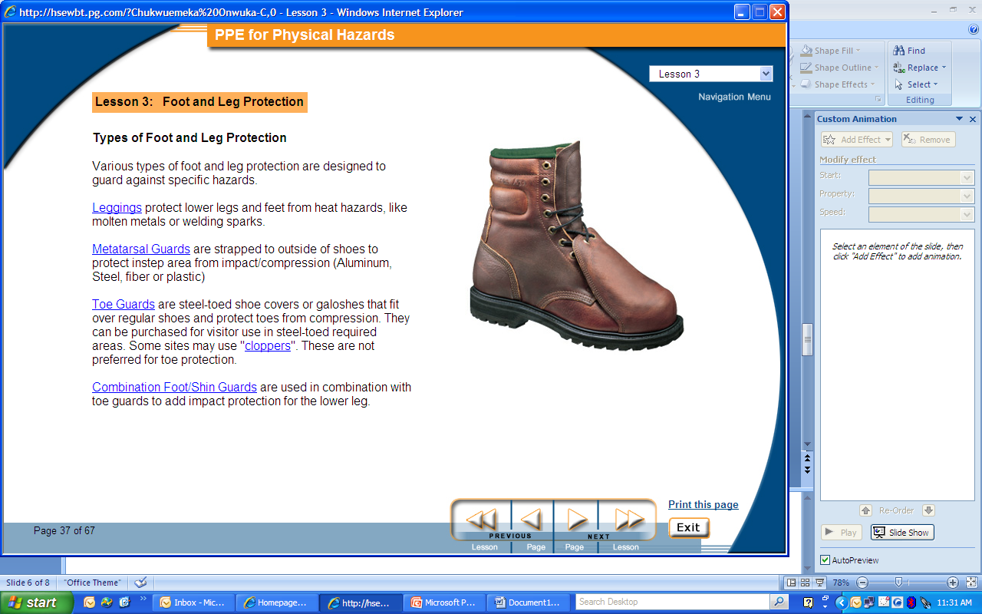
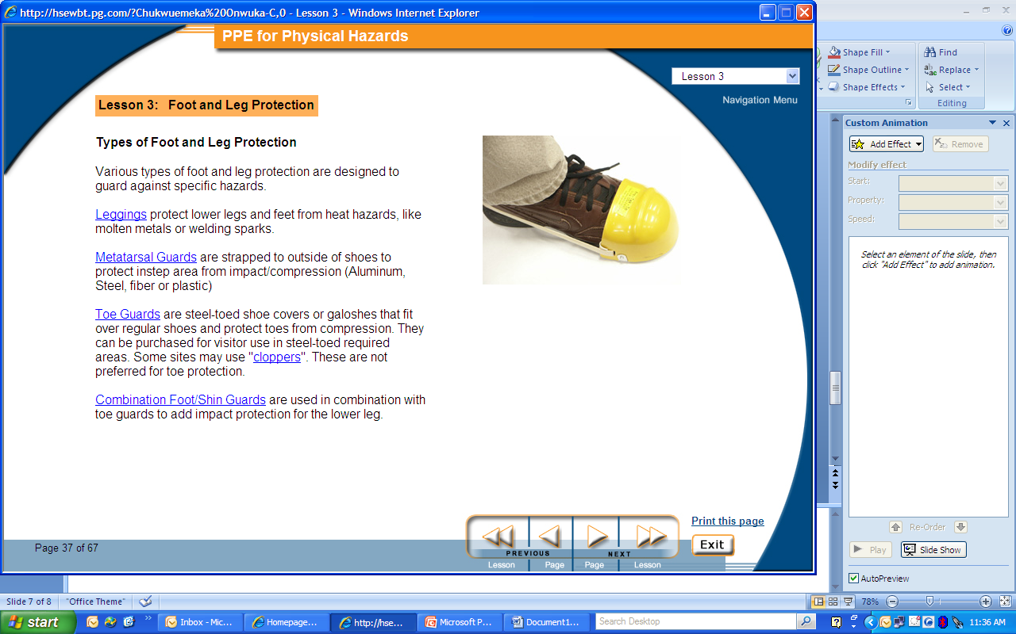
FOOT AND LEG PROTECTION. Foot and Leg Hazards Protection for the Hazards mentioned is SAFETY SHOES & TOE GUARDS/ CAPS
LEVELS OF CONTROL
It will protect against:
1. Stationary heavy objects
2. Heavy and semi- heavy duty machinery and equipments
SAFETY SHOES
TOE GUARDS OR CAPS DO NOT PROTECT THE WHOLE FOOT SO SHOULD NOT BE USED PERMANENTLY
TOE CAPS

Slide 8
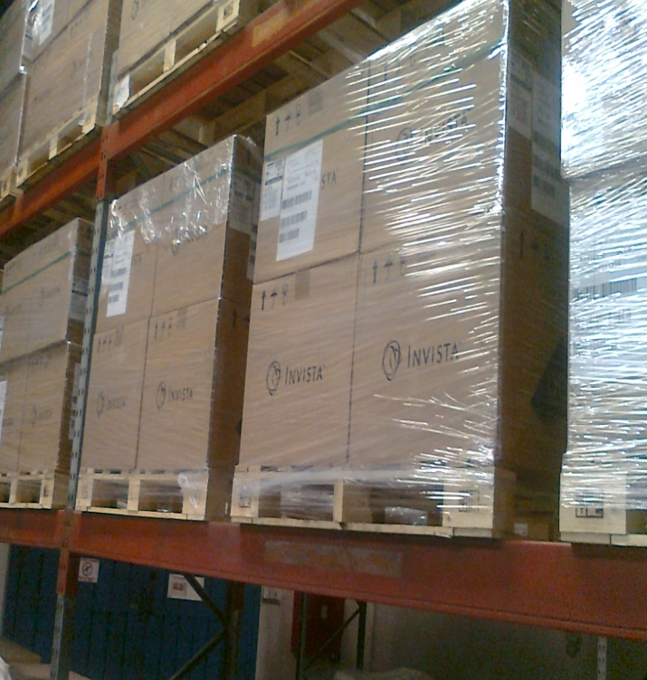
HEAD PROTECTION. Head Hazards The workplace can present numerous hazards to the head. The hazard peculiar to the warehouse is as follows:
LEVELS OF CONTROL
Stationary objects with potential energy falling from above during storage, construction or regular maintenance.

Slide 9

HEAD PROTECTION. Head Hazards Protection for the Hazards mentioned is SAFETY / HARD HATS
LEVELS OF CONTROL
It will protect against:
Stationary objects stored at a height.
Fall hazards during construction or maintenance tasks at a certain heights.
Low hanging cross beams or posts.

Slide 10
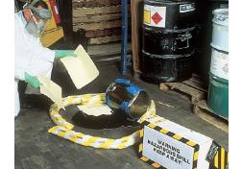
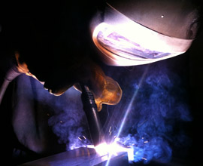
BODY PROTECTION. Body Hazards The workplace can present numerous hazards to the human body. The hazards peculiar to the warehouse are as follows:
LEVELS OF CONTROL
Exposure to chemicals after a spill or while cleaning a chemical spill
Sparks from welding works

Slide 11
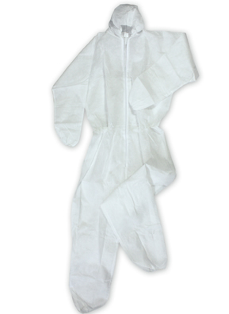
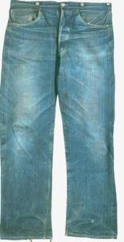
BODY PROTECTION. Body Hazards Protection for the Hazards mentioned is
LEVELS OF CONTROL
Paper suit
Protective clothing/ hard cloth
It will protect against:
Irritation from exposure to chemicals during or after a spill.
Sanitization to enzymes after exposure.
It will protect against:
Burn to exposed skin surfaces.
Burn to ordinary fabrics.
.

Slide 12

HAND PROTECTION. Hand Hazards The workplace can present numerous hazards to the head. The hazard peculiar to the warehouse is as follows:
LEVELS OF CONTROL
Bruised palms from pulling pallet truck and handing idle wooden pallets.

Slide 13

HAND PROTECTION. Hand Hazards Protection for the Hazards mentioned is HAND GLOVES
LEVELS OF CONTROL
It will protect against:
Injury to the palms.

Slide 14
THE END

