Slide 1

Tools and Techniques for Script Analysis

Slide 2
1. Named Entity Recognition (NER)
For: characters, locations
SpaCy
GLiNER
- Allows for incremental training, which helps mitigate catastrophic forgetting
- Can help maintain consistency in entity recognition throughout long-form narratives
- Tags: PERSON, ORG, GPE (geo-political entity), LOC, PRODUCT, EVENT, WORK_OF_ART, LAW, LANGUAGE, DATE, TIME, PERCENT, MONEY, QUANTITY, ORDINAL, CARDINAL + customizable entities
- Its approach of using both local and global information creates more robust representations that are less susceptible to catastrophic forgetting
- Tags: PERSON, LOCATION, ORGANIZATION, DATE, TIME, MONEY, PERCENT, FACILITY, PRODUCT, EVENT, WORK_OF_ART, LAW, LANGUAGE + custom entity types
Sources:
https://spacy.io/usage/linguistic-features#named-entities
https://github.com/urchade/GLiNER

Slide 3
NER Tools: flair/ner-english-fast and flair/ner-english-large
flair/ner-english-fast
flair/ner-english-large
- Small size (~10-50M params) and LSTM-CRF architecture mean lower memory footprint and faster inference on CPU or modest GPUs
- Better accuracy, but heavier and longer inference time
Sources:
https://huggingface.co/flair/ner-english-fast
- Tags: PER, LOC, ORG, MISC
https://huggingface.co/flair/ner-english-large

Slide 4
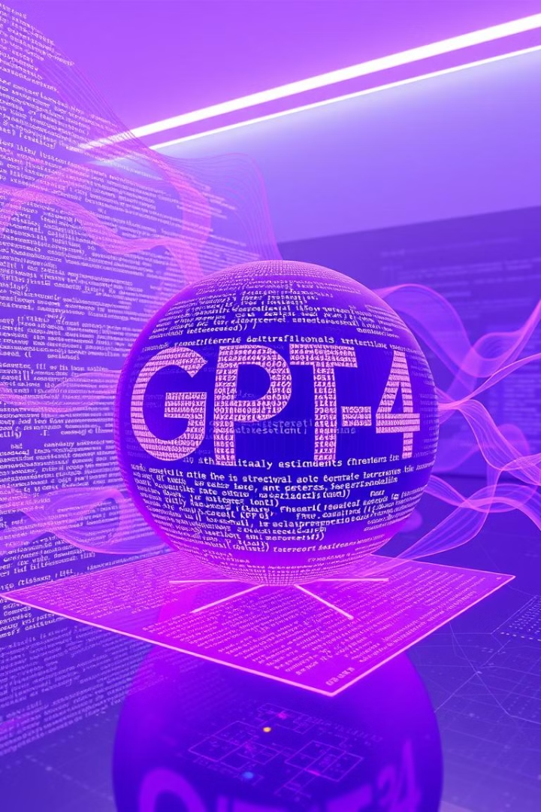
2. Large Language Models (LLMs)
For: context, relationships, and themes
1
GPT-4 with function calling
- For structured JSON outputs
Technical specs:
- Context window: 128K tokens (~300 pages)
- Fine-tunable with optimized JSON schemas
- Model size: ~1.8 trillion parameters (estimated)
- Addressing catastrophic forgetting: Parameter-efficient fine-tuning methods like LoRA (Low-Rank Adaptation) preserve most original model knowledge
- Pricing: $0.01/1K input tokens, $0.03/1K output tokens
Source:
OpenAI function calling documentation:
https://platform.openai.com/docs/guides/function-calling

Slide 5
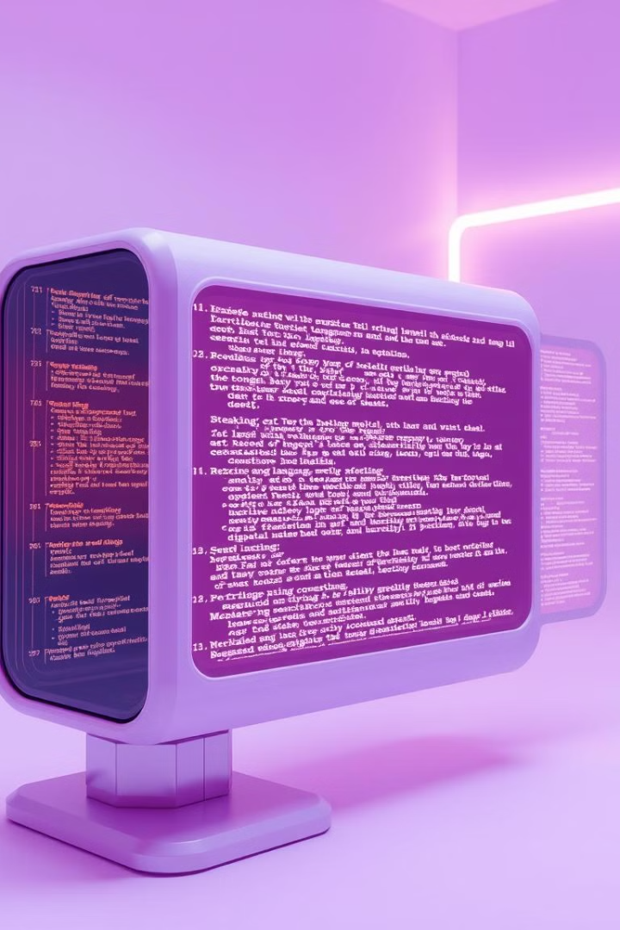
Gemini 2.0 Flash
1
Technical specs:
- Context window: 1,000,000 tokens (~2,500 pages)
- Fine-tunable with parameter-efficient methods like LoRA
- Model size: Likely in the trillion-parameter range (exact size not disclosed)
- Addressing catastrophic forgetting: Parameter-efficient fine-tuning methods like LoRA (Low-Rank Adaptation) preserve most original model knowledge
- Pricing: More cost-efficient than previous models, estimated ~$0.10–$0.15 per million tokens
Sources:
Gemini API prompting strategies for function calling:
https://ai.google.dev/gemini-API/docs/prompting-strategies#function-calling
Tune Gemini models by using supervised fine-tuning:
https://cloud.google.com/vertex-ai/generative-ai/docs/models/gemini-use-supervised-tuning

Slide 6
3. Retrieval-Augmented Generation (RAG)
LangChain Implementation
Addressing catastrophic forgetting
- Modular architecture for flexible retrieval pipelines
RAG inherently helps with catastrophic forgetting by retrieving information rather than relying solely on model parameters.
- Supports multiple embedding models (OpenAI, HuggingFace, etc.)
Source:
Retrieval-Augmented Generation for Knowledge-Intensive NLP Tasks (https://arxiv.org/abs/2005.11401)

Slide 7
4. Knowledge Graphs and 5. Proposed Architecture
Knowledge Graphs
Proposed Architecture
For relationships between characters, locations, and plot points in a structured, queryable format.
- Initial Processing: Use one of the NER models to identify characters and locations
Implementation options: Neo4j, NetworkX
- Structured Extraction: Fine-tuned LLM with function calling for consistent JSON outputs
- Storage: Knowledge graph to represent relationships
- Retrieval: Langchain to maintain consistency across long scripts

Slide 8
6. Coreference Resolution and 7. Fountain Format Script Parsing
Coreference Resolution: neuralcoref
Fountain Format Script Parsing
neuralcoref is a spaCy extension for coreference resolution, using neural networks to link text references (like pronouns) to entities. It's production-ready, includes a pre-trained English model, and offers visualization tools and an online demo.
Fountain is a simple plaintext format for movie and TV scripts. It's also used as an export and import format by multiple script-writing apps
fountain-tools is a set of libraries for parsing the Fountain script-writing language.
Source:
Sources:
https://github.com/huggingface/neuralcoref
https://wildwinter.medium.com/fountain-movie-script-parser-javascript-python-c-c-ca088d63d298
https://github.com/wildwinter/fountain-tools

