Slide 1
MassPass
Alex Lesman
Giuseppe Zingales
Adrian Miguel

Slide 2
The Idea
Input
Maximum entropy password
bCrypt
Master Password
Domain
Username
31 char b64 hash
Form Password

Slide 3
Key Features
No stored data
No Trusted 3rd parties
Phishing protection
184 bits of password

Slide 4
Implementation
Chrome Plugin
Client-Side JS
more…

Slide 5
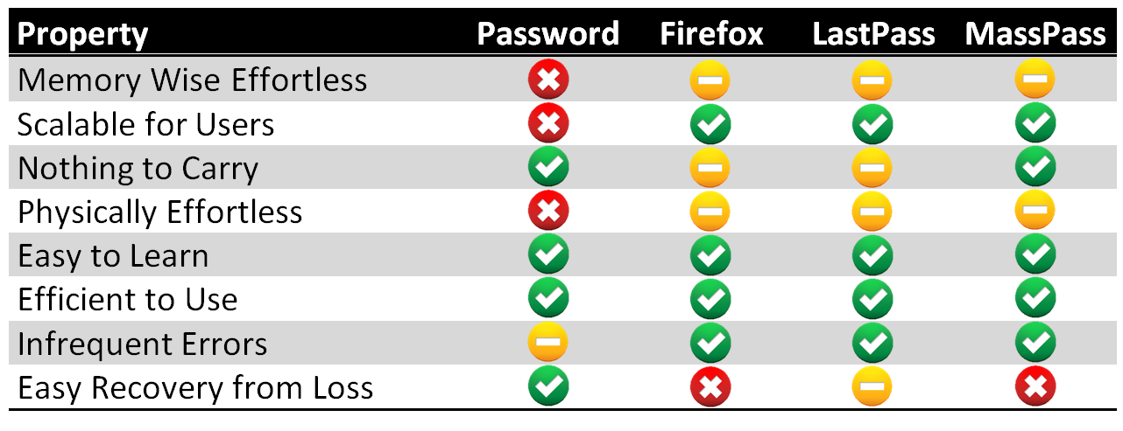
Usability

Slide 6
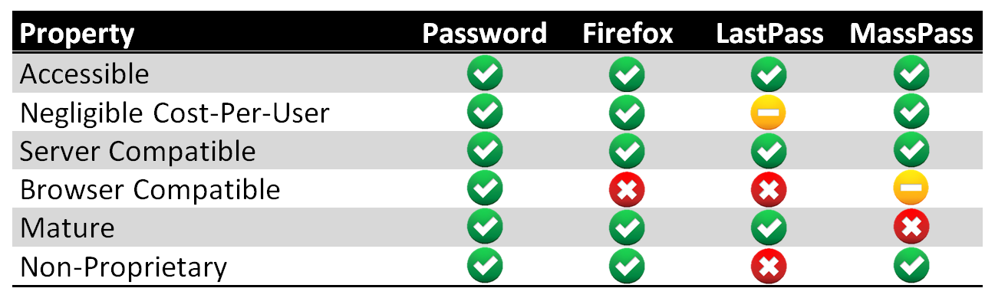
Deployability

Slide 7
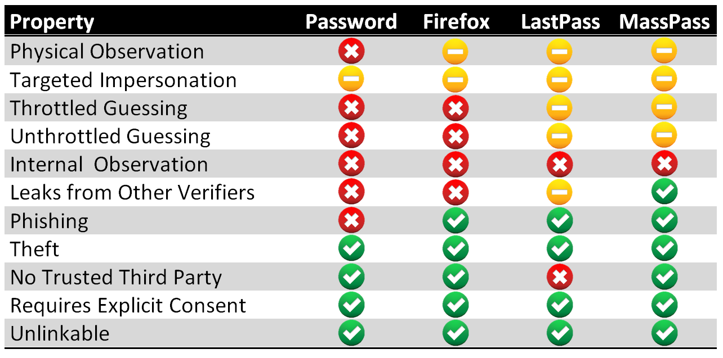
Security

Slide 8


