Slide 1
Operating System Principle Lab 8
May, 2021

Slide 2
System Configuration
lscpu
x86_64
getconf LONG_BIT
64bit
getconf PAGESIZE
page size

Slide 3
64bit 4-level paging (4KB page)
48
52
CPU
MMU
Memory

Slide 4
64bit 4-level paging (4KB page)
Virtual address:
48 | 39 | 30 | 21 | 12 | 0
ignored | page maplevel 4 | page directory pointer | page directory | page table | offset
9
9
9
9
12

Slide 5
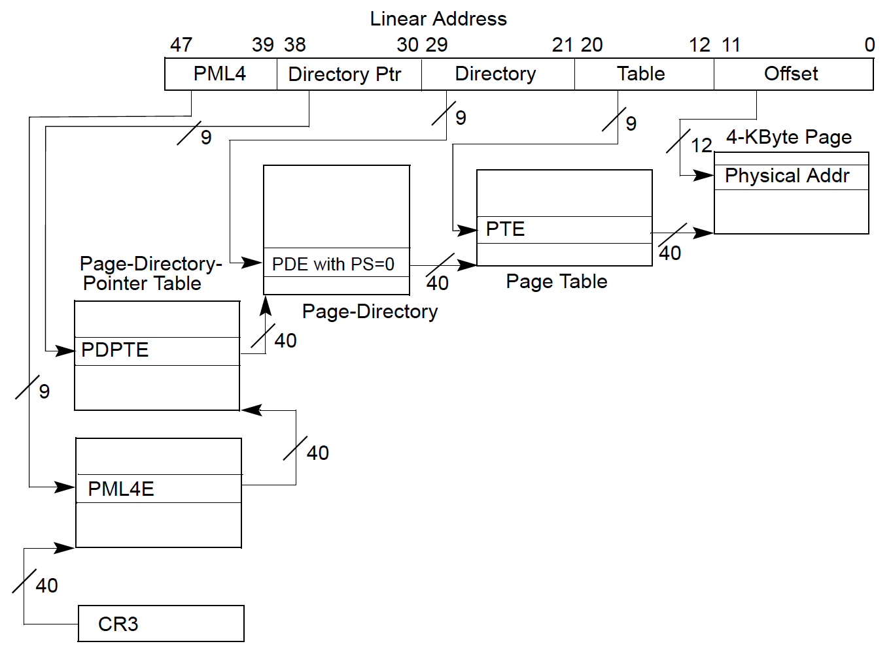
64bit 4-level paging
最外层页表的物理地址存在CR3寄存器中
(physical frame number)

Slide 6
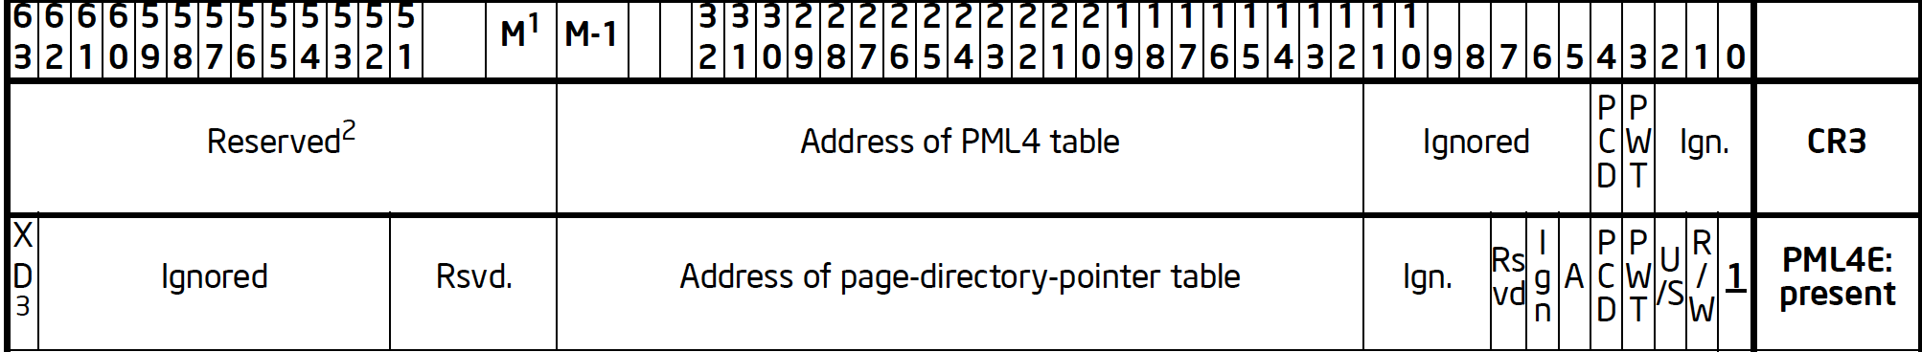
64bit 4-level paging
CR3 register
最外层页表项
次外层页表项
物理页框号
(40bit)
次内层页表项
最内层页表项
Notes:
M: maximal supported physical memory, maximal 52
Virtual address: 48bit (256TB)

Slide 7
Virtual address
48 | 39 | 30 | 21 | 12 | 0
ignored | page maplevel 4 | page directory pointer | page directory | page table | offset
viradd: hexadecimal
offset: viradd & 0xFFF;
page mapleve 4?
page directory pointer?
page directory?
page table?

Slide 8
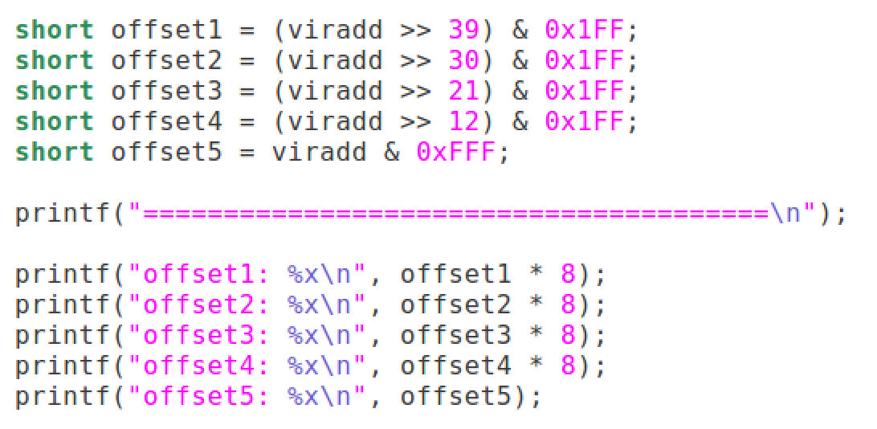
Virtual address
48 | 39 | 30 | 21 | 12 | 0
ignored | page maplevel 4 | page directory pointer | page directory | page table | offset
Offset in page table: page table entry is 8Byte

Slide 9
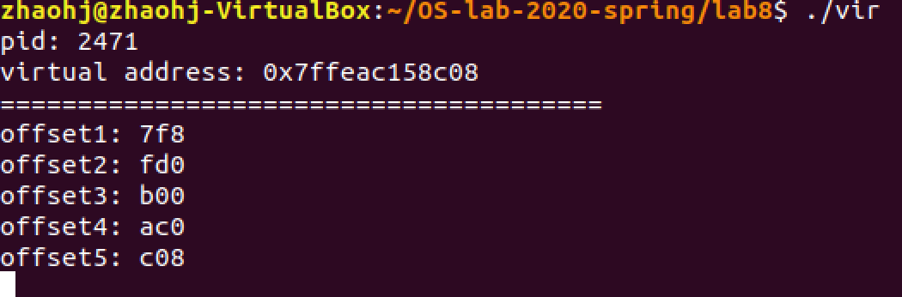
Virtual address

Slide 10
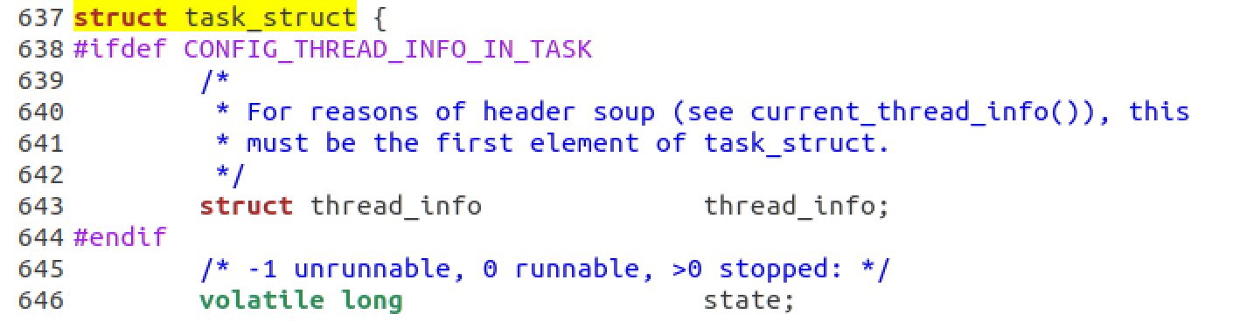
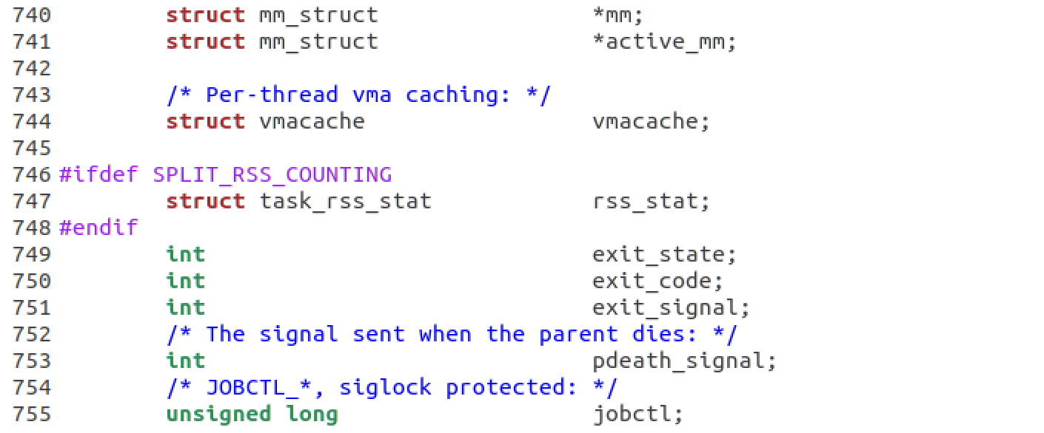
Page table: level 1
Memory management information
Notes:
/usr/src/linux-headers-5.3.0-40/include/linux/sched.h

Slide 11
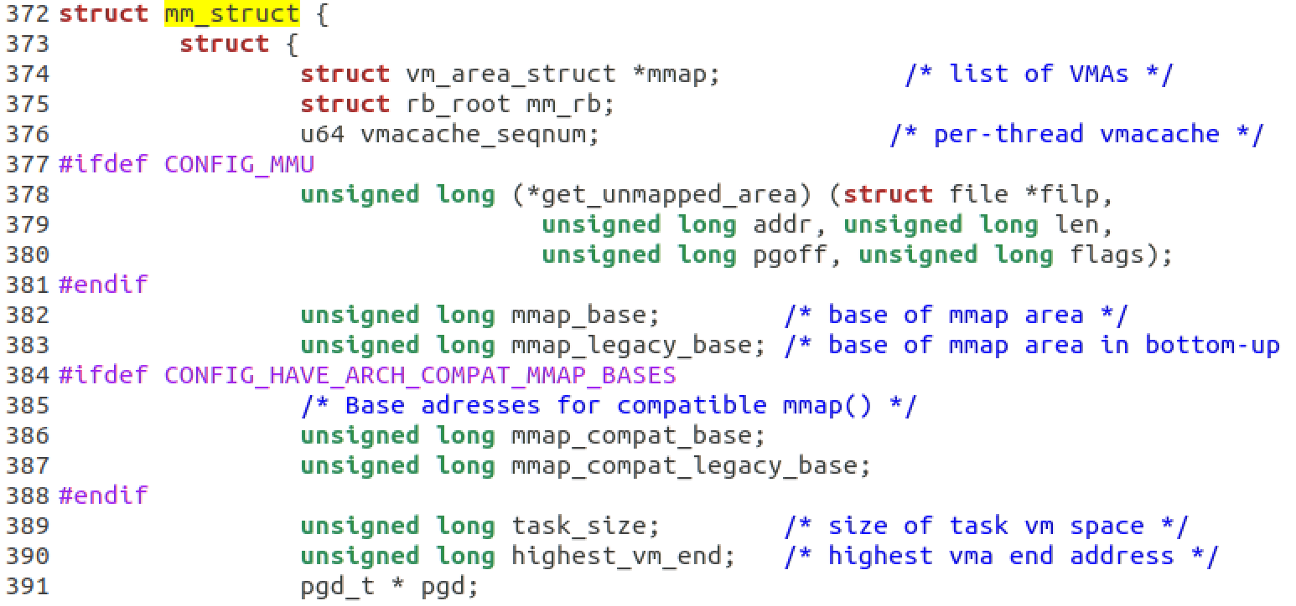
Page table: level 1
The virtual address of level-1 page table: unsigned long *
Notes:
/usr/src/linux-headers-5.3.0-40/include/linux/mm_types.h

Slide 12
CR3

Slide 13
Read physical memory
48 | 39 | 30 | 21 | 12 | 0
 | page maplevel 4 | page directory pointer | page directory | page table | offset

Slide 14
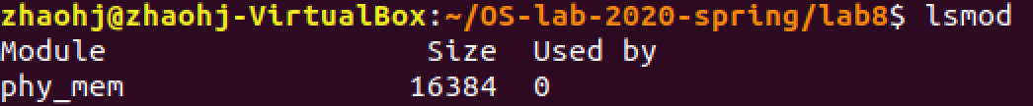
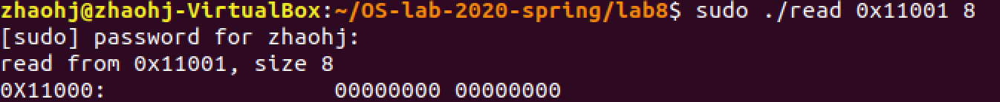
Read physical memory
Compile and load the phy_mem module
Compile and run the read_physical.c

Slide 15
64bit 4-level paging
最外层页表的物理地址存在CR3寄存器中
(physical frame number)

Slide 16
64bit 4-level paging
CR3 register
最外层页表项
次外层页表项
物理页框号
(40bit)
次内层页表项
最内层页表项
Notes:
M: maximal supported physical memory 52bit
Virtual address: 48bit (256TB)

Slide 17
Read the Outmost Page Table
sudo ./read [cr3]+offset1 8

Slide 18
The End

Slide 19

Page table: level 1
The virtual address of level-1 page table: unsigned long *
Notes:
/usr/src/linux-headers-5.3.0-40/include/linux/mm_types.h

