Slide 1
Confounder-Robust Flood Detection from Street-Level Imagery
via Phase-1 Hard Negative Mining
When Rivers Look Like Floods — and Why Standard Metrics Miss It
Aanya Singh
Advised by Dr. Dixon
University of South Florida
April 18, 2026

Slide 2
PROBLEM
The problem: floods are hard to detect because visual confounders mimic flood imagery
Rivers, pools, and wet roads share water texture, color, and reflections with real flood scenes
Why real-time screening matters
What makes classification hard
58 million people/year
exposed to floods globally, 2000–2018 (Tellman 2021)
River scenes
Share water texture, reflections, murky color — the #1 confounder
Hours to days
satellite revisit cycles — too slow for dispatch
Swimming pools
Clear water with similar edge patterns; small N limits analysis
Citizen photos arrive first
smartphone images precede official reports
Wet / rain roads
Surface reflections and standing water resembling shallow floods
Recall-first design
missing a flood = delayed response; a false alarm = wasted call
Parks after rain
Waterlogged grass and paths trigger flood classifiers
No prior work reports per-category false positive rates with confidence intervals across confounder types.

Slide 3
PROBLEM
Standard metrics hide recall failures — accuracy rewards non-flood correctness, not flood detection
The accuracy paradox: ResNet50 scores higher accuracy than EfficientNetB0 while missing 9× more floods
Accuracy paradox
ROC-AUC is misleading here
PR-AUC is the right metric
ResNet50 accuracy: 98.5%
Receiver Operating Characteristic
Precision-Recall AUC (PR-AUC)
EfficientNetB0 accuracy: 98.3%
AUC (ROC-AUC) treats all non-flood
focuses on the flood (minority) class.
→ ResNet appears better
images equally.
PR-AUC gap: 0.9976 vs. 0.9614
But ResNet misses 63/322 floods.
ROC gap: 0.9985 vs. 0.9728
= 3.6 points — reveals collapse
EfficientNet misses only 7/322.
= only 2.6 points — 'nearly as good'
Penalizes precision drop at
Non-flood images (497) outnumber floods (322).
Large non-flood class inflates
high recall — exactly what matters
Getting non-floods right inflates accuracy.
the true-negative rate artificially.
for a recall-first screener.

Slide 4
RESEARCH QUESTIONS
Four research questions guide this work
RQ1
Metric validity
Does PR-AUC reveal recall failures that accuracy and ROC-AUC conceal for imbalanced flood/non-flood data?
Motivates metric choice before all else.
RQ2
Architecture comparison
Which architecture — EfficientNetB0 (5.3M params) or ResNet50 (25.6M params) — better supports recall-first flood screening?
Drives model selection for subsequent mining experiments.
RQ3
Confounder profiling
Which specific non-flood categories produce false positives, and at what rate with 95% confidence intervals?
Identifies where hard negative mining should be targeted.
RQ4
Mining strategy
Does Phase-1 Hard Negative Mining (P1-HNM) outperform extended training and random confounder injection?
Tests whether difficulty ranking adds value beyond compute or data quantity alone.

Slide 5
SOLUTION
Solution: EfficientNetB0 with Phase-1 Hard Negative Mining achieves 98.78% accuracy with measured confounder robustness
Two-phase fine-tuning + difficulty-ranked mining on Phase-1 checkpoint outperforms all ablations
RQ1 answered
RQ2 answered
PR-AUC = 0.9976 vs. 0.9614
EfficientNetB0 is the right architecture
3.6-pt gap exposes ResNet's recall collapse — invisible in accuracy (98.5% vs. 98.3%) and ROC-AUC (2.6-pt gap).
7 missed floods vs. ResNet's 63. Errors are symmetric boundary cases, not systematic miscalibration.
RQ3 answered
RQ4 answered
River is the only significant confounder
P1-HNM strictly outperforms all ablations
9.2% FP rate (7/76, CI [3.8%–17.7%]). All 7 other categories: 0% FP. Pools: 0% but underpowered.
Accuracy: 98.78% > Extended 98.66% > Random 98.41% > Baseline 98.29%. River FP unchanged — power-limited.

Slide 6
METHOD
Dataset: 4,099 street-level images from two labeled sources, deduplicated by SHA-256
USF FloodingDataset (flood severity + non-flood categories) + RIWA river images (Wagner et al. 2023)
USF FloodingDataset
RIWA River Dataset (Wagner et al. 2023)
Flood images (severity labeled):
River scene images — water confounder
Major — 796 images
399 river images added
Moderate — 301 images
European river monitoring source
Minor — 516 images
Enriches the hardest confounder category
Total flood: 1,613
Label: Non-flood / River
Non-flood (7 categories):
Street, Animal, Building, Vehicle
Combined non-flood total: 2,486
Plant, Park/Walkway, Swimming Pool
Total non-flood: 2,087
4,099 unique images
80/20 stratified split · seed 42
39.3% flood prevalence
55 duplicates removed (SHA-256 hash)
3,280 train | 819 validation
Same ratio maintained in both splits

Slide 7
METHOD
Method: two-phase progressive fine-tuning preserves ImageNet representations
Phase 1 → checkpoint M1 (hard negative mining source) · Phase 2 → checkpoint M2 (final model)
EfficientNetB0
ResNet50
5.3M parameters — primary model
25.6M parameters — comparison baseline
Phase 1 → Checkpoint M1
Phase 2 → Checkpoint M2
• Last 30 layers trainable
• First 50 layers frozen
• Learning rate: 1e-4
→
• Learning rate: 1e-5
• ≤ 15 epochs
• ≤ 20 epochs
• Residual uncertainty on confounders
• Early ImageNet features preserved
• → mining signal lives here
• → final deployed model
Classification head:
Global Average Pooling (GAP) → Dropout(0.2) → Dense(256, ReLU) → BatchNorm → Dropout(0.3) → Dense(1, sigmoid)
Loss functions evaluated: Binary Cross-Entropy (BCE) · Focal loss (γ=2, α=0.25)

Slide 8
METHOD
Phase-1 Hard Negative Mining (P1-HNM): mine confounders before the signal disappears
Phase-2 converged model gives near-zero probability to all non-flood images — no mining gradient remains
Key insight: use the Phase-1 checkpoint M1 (partially trained, early layers still frozen) while residual uncertainty on rivers and pools still exists — that uncertainty is the mining signal. By Phase 2 the model has overfit its boundary; hard negatives can no longer be identified.
1
Identify
2
Rank & Select
3
Augment
4
Retrain
Use Phase-1 model M1
Sort flagged images by
5× augmentation on
Start from checkpoint M2
Flag categories with FP > 5%
predicted flood probability
selected hard negatives
Train with enriched set
→ River: 9.2% qualifies
→
Take top 10% (hardest)
→
Adds difficulty-weighted data
→
→ P1-HNM final model
Why difficulty ranking matters: random injection ignores which images the model is confused by — ranked selection targets the decision boundary directly.

Slide 9
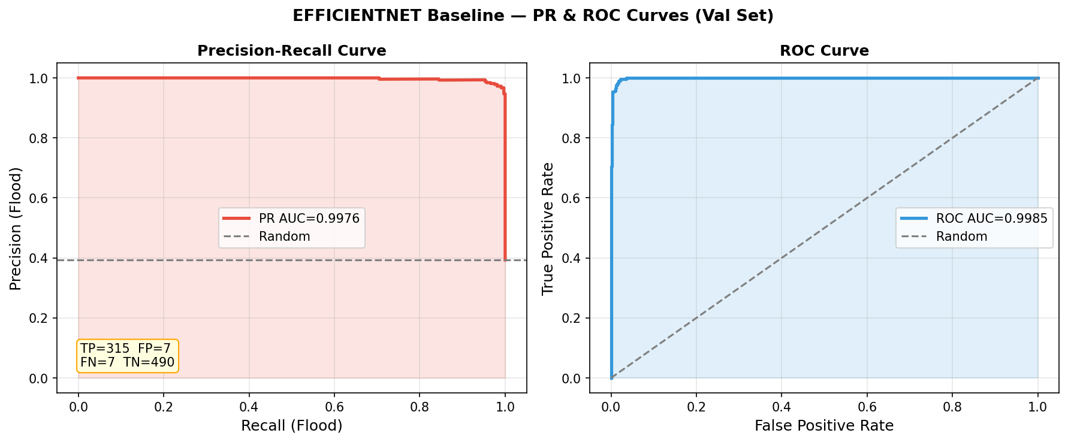
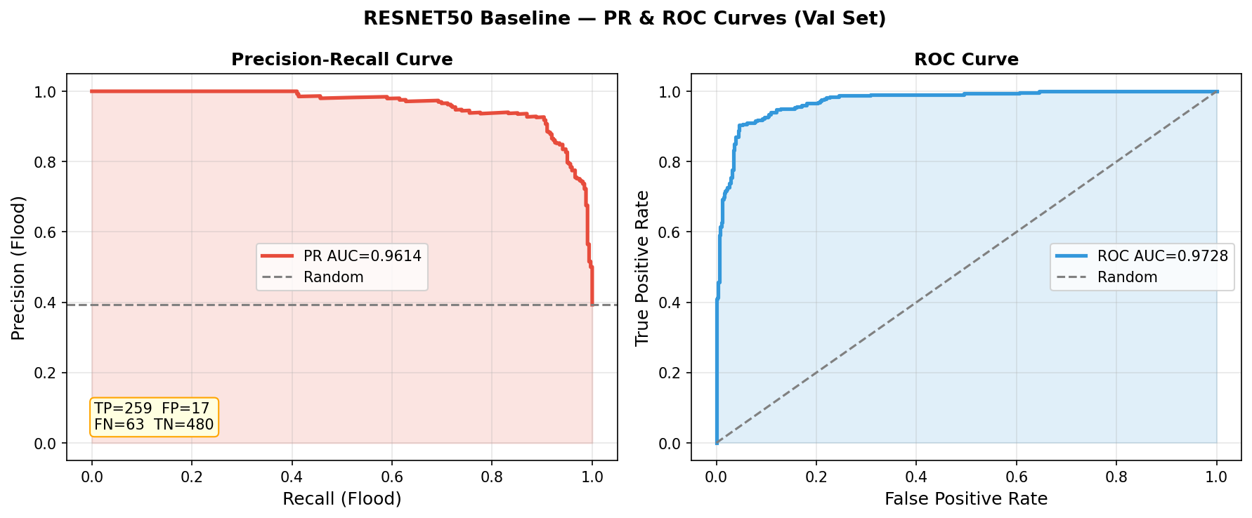
RESULTS
EfficientNetB0 misses 9× fewer floods than ResNet50 — visible in PR-AUC, hidden in ROC-AUC
PR-AUC gap 3.6 pts vs. ROC-AUC gap 2.6 pts · 63 vs. 7 missed floods hidden by the accuracy paradox
EfficientNetB0 + BCE
ResNet50 + BCE
Metric
EfficientNetB0
ResNet50
Gap
PR-AUC
0.9976
0.9614
−3.6 pts
ROC-AUC
0.9985
0.9728
−2.6 pts
Missed floods (FN)
7/322 (2.2%)
63/322 (19.6%)
9× more
Accuracy
98.3%
98.5%
paradox ↑

Slide 10
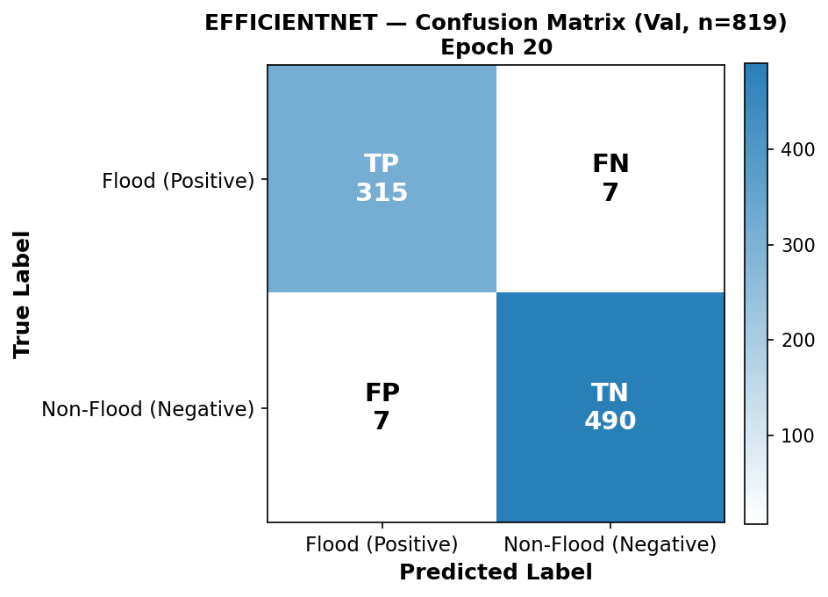
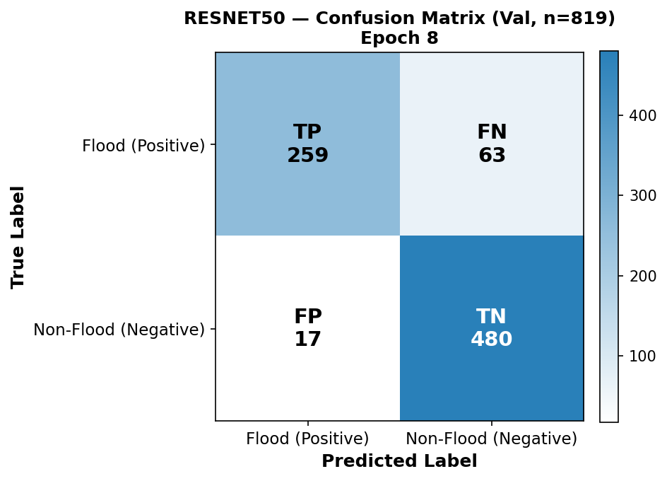
RESULTS
EfficientNetB0 makes symmetric boundary errors; ResNet50 collapses systematically
Symmetric 7/7 FN/FP vs. asymmetric 63/17 — tells us which model to target with HNM
EfficientNetB0 — 7 FN + 7 FP (boundary errors)
ResNet50 — 63 FN + 17 FP (systematic miscalibration)
EfficientNet's symmetric errors are genuine ambiguous cases. ResNet's 63 false negatives include prototypical clear flood scenes — the decision boundary is miscalibrated. → EfficientNet is the right model to target with HNM.

Slide 11
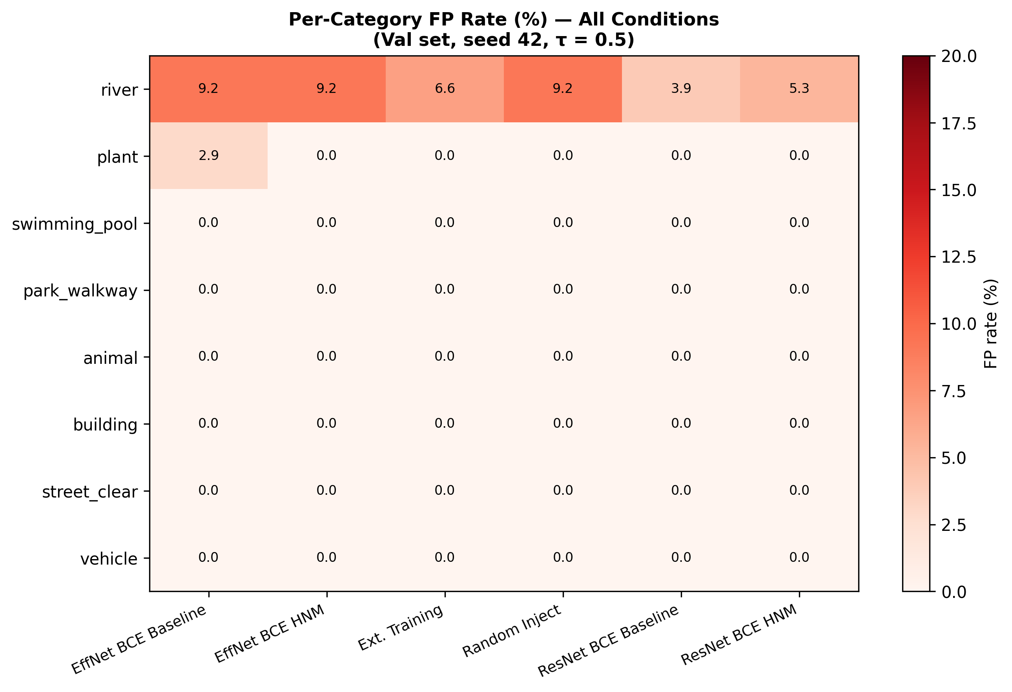
RESULTS
River scenes cause a 9.2% false positive rate — every other confounder category is 0%
EfficientNetB0 BCE · 95% confidence intervals · N per category shown
EfficientNetB0 + BCE
• River: 9.2% (7/76, CI [3.8%, 17.7%])
• Plant: 2.9% (1/34, CI [0.1%, 15.3%])
• All 6 other categories: 0%
ResNet50 + BCE
• River: 3.9% (3/76, CI [0.8%, 11.0%])
• All 7 other categories: 0%
Swimming pool (N=28)
• 0% FP — but upper CI = 12.3%
• Insufficient sample: 0% ≠ 'robust'
Fig: Confounder FP rate heatmap by category and model
• ~150+ images needed for tight bound
Takeaway: river is the only statistically significant confounder. This justifies targeting rivers specifically in HNM.

Slide 12
RESULTS
Difficulty-ranked Phase-1 mining strictly outperforms extended training and random augmentation
Accuracy ordering: P1-HNM 98.78% > Extended 98.66% > Random 98.41% > Baseline 98.29% · EfficientNetB0 BCE
Gains vs. Baseline
Val. Accuracy
+0.49 pp P1-HNM
+0.37 pp Extended
Baseline
+0.12 pp Random
River FP after HNM:
7/76 = 9.2%
(unchanged)
McNemar test:
p > 0.05 all pairs
Bonferroni corrected
Baseline
98.29%
Random inject
98.41%
Extended train
98.66%
P1-HNM
98.78%
RESULT (mirrors goal): 1 in 46 EfficientNet floods missed at baseline (7/322, 2.2%). P1-HNM achieves same recall with +0.49 pp accuracy — difficulty ranking strictly beats both alternatives.

Slide 13
CONCLUSION
Conclusion
✓
PR-AUC is the right metric for recall-first flood screening.
3.6-pt gap (0.9976 vs. 0.9614) is concealed by accuracy (98.3% vs. 98.5%) and nearly hidden in ROC-AUC (2.6 pts).
✓
EfficientNetB0 is the right screener — symmetric boundary errors, not systematic collapse.
7 FN vs. ResNet's 63 FN; errors are genuinely ambiguous cases, not miscalibration.
✓
River is the only category with a statistically significant false positive rate.
9.2% FP (7/76, CI [3.8%, 17.7%]). All 7 other confounder categories: 0% FP.
✓
Phase-1 Hard Negative Mining (P1-HNM) strictly outperforms all ablations.
P1-HNM 98.78% > Extended 98.66% > Random 98.41% > Baseline 98.29%.
✓
No significant river FP reduction yet — a statistical power problem, not a null result.
76 river validation images gives insufficient power; ~300 images needed to detect a 3–4 pp reduction.

Slide 14
FUTURE WORK
Future directions: statistical power, geographic generalization, and operational deployment
Five concrete next steps from the paper's limitations
1
Expand river validation set
~300 river images needed for 80% power to detect a 3–4 pp FP reduction. Current 76-image set is underpowered.
2
Multi-seed robustness validation
Re-run all experiments across seeds 42, 123, 256, 512, 1024 with bootstrap CIs to verify seed-independence.
3
Severity-stratified miss rate analysis
Major vs. Minor flood miss rates differ operationally. Report separately — missing a Major flood costs far more.
4
Geographic generalization
Dataset is US-centric. Test on South/Southeast Asian and European urban flood imagery to assess transfer.
5
Threshold calibration for deployment
τ=0.5 is not optimal. Calibrate threshold against operational recall targets (e.g., ≥ 99%) using the PR curve.

Slide 15
ACKNOWLEDGMENTS
Acknowledgments
Lab & Advisor
Dr. Dixon and the research lab for guidance and support throughout this project.
USF FloodingDataset
Authors of the USF FloodingDataset for the labeled flood severity imagery and non-flood category annotations.
RIWA Dataset
Wagner et al. (2023) for the RIWA river scene dataset used to enrich the water confounder category.
Audience
Thank you for your time and attention today.

Slide 16
Questions?
Aanya Singh · University of South Florida
Advised by Dr. Dixon

