Slide 1
Improving CRIS-HAZARD: Automated First-Pass Flood Image Screening
via Phase-1 Hard Negative Mining
When rivers and swimming pools fool the flood classifier — and how to fix it
Aanya Singh
Advised by Dr. Dixon
University of South Florida
April 18, 2026

Slide 2
CRIS-HAZARD: a community-driven flood risk communication system
Crowdsourced data → high-fidelity flood models → real-time risk alerts for citizens
Citizens & community
(smartphones, apps,
social media)
Volunteered Geographic
Information (VGI)
& crowdsourced data
CRIS-HAZARD
flood-risk models
(USF / AT&T / ANL)
Uncertainty-aware
risk projections
(short & long term)
Decision makers
& community
alerting
→
→
→
→
↑
↑
↑
Challenge 1
Challenge 2
Challenge 3
No near-real-time
two-way communication
platform
Flood risk models lack
fine spatial & temporal
resolution
Uncertainty in models
not quantified for
decision-making
Source: NSF Award — CRIS-HAZARD (USF + Georgia Tech partnership for Pinellas County, FL)

Slide 3
The CRIS-HAZARD gap: no automated first-pass image screening
Crowdsourced images arrive unfiltered — confounders reach human analysts, creating alert fatigue
Current CRIS-HAZARD flow
Proposed flow (this work)
Citizen submits image
(app / social media)
Citizen submits image
(app / social media)
↓
↓
All images queued
(no filtering)
Automated first-pass
screener ← THIS WORK
↓
GAP
↓
Human analyst reviews
(bottleneck ⚠)
→
Flood → human review
Non-flood → discarded
↓
↓
Flood alert sent
(delayed; noisy)
Flood alert sent
(faster; less noise)
Goal: build a screener that catches ≥ 97% of floods while filtering out rivers, pools, and wet roads.

Slide 4
Visual confounders: 8 non-flood categories share flood-like appearance
River, pool, and wet road images share water texture, reflectance, and urban context with real floods
River
399 images
Swimming Pool
28 val
Wet / Rain Road
105 val
Park / Walkway
82 val
Water texture, reflections, debris — #1 confounder (9.2% FP rate)
Clear water, edge patterns; small sample limits analysis
Surface reflections and standing water resemble shallow floods
Waterlogged grass and paths trigger texture-based classifiers
Building
55 val
Vehicle
50 val
Animal
67 val
Plant
34 val
Contextual co-occurrence with floods; dark backgrounds
Water reflections under vehicles; rain-slicked surfaces
Low-level texture patterns occasionally activate flood features
Dense vegetation with moisture can resemble flooded ground
Highlighted = primary confounders targeted by Hard Negative Mining (HNM)

Slide 5
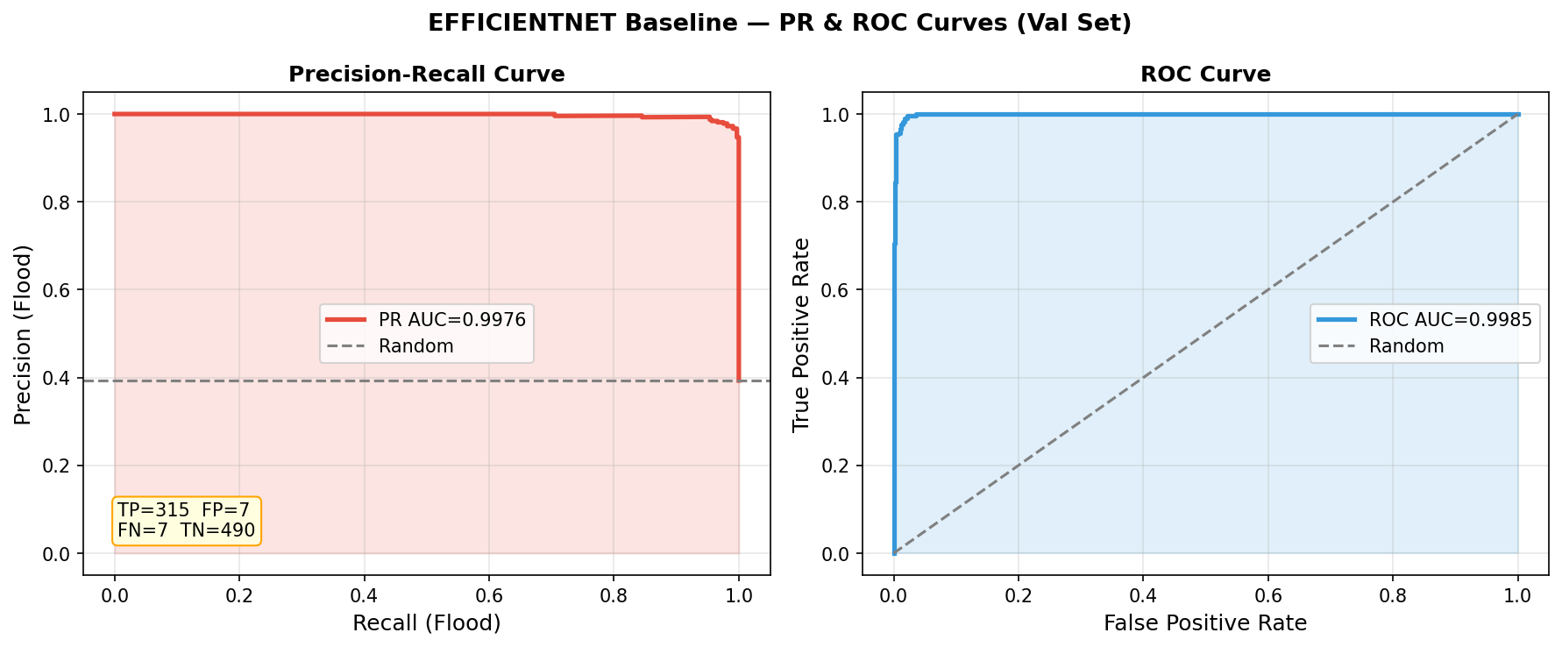
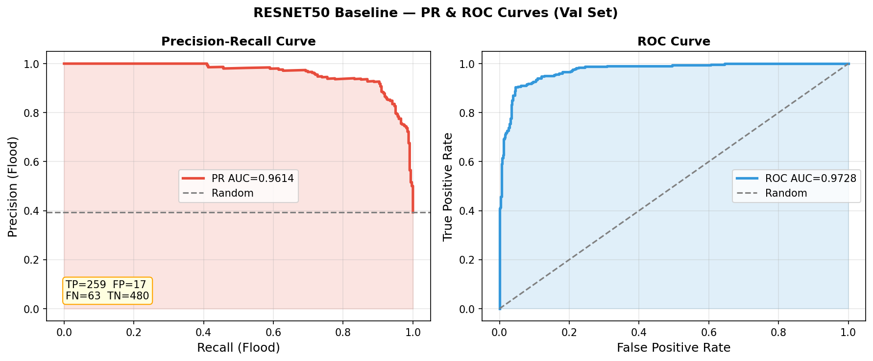
Standard metrics hide recall failure — PR-AUC reveals what ROC-AUC conceals
EfficientNetB0 outperforms ResNet50 on every metric: PR-AUC, recall, and accuracy
EfficientNetB0 + BCE
ResNet50 + BCE
Metric | EfficientNetB0 | ResNet50 (Phase 1, Epoch 8) | Gap / note
PR-AUC (primary ↑) | 0.9976 | 0.9614 | −3.6 pts — reveals recall collapse
ROC-AUC ↑ | 0.9985 | 0.9728 | −2.6 pts — looks 'nearly as good'
Missed floods (FN ↓) | 7 / 322 (2.2%) | 63 / 322 (19.6%) | 9× more missed
Accuracy ↑ | 98.3% | 90.2% | EfficientNet leads on all metrics

Slide 6
Dataset: 4,099 street-level images from two public sources, stratified 80/20 split
USF FloodingDataset (flood severity + 7 non-flood categories) + RIWA river images (Wagner et al. 2023)
USF FloodingDataset
RIWA River Dataset (Wagner et al. 2023)
Category | Count
Flood — Major | 796 images
Flood — Moderate | 301 images
Flood — Minor | 516 images
Non-flood (7 categories) | 2,087 images
Total | 3,700 images
Property | Value
River scenes | 399 images
Role | Water confounder category
Source | European river monitoring
Label | Non-flood / River
Combined non-flood | 2,486 images
Images | Split | Flood prevalence | Confounder categories
4,099 unique (55 duplicates removed) | 3,280 train | 819 val | 39.3% — preserved in both splits | 8 categories labeled for per-category FP

Slide 7
Two-phase progressive fine-tuning avoids catastrophic forgetting
Phase 1 → head + top layers only (M1 checkpoint) · Phase 2 → deeper layers (M2 checkpoint, deployed)
ImageNet
pre-trained
weights
Phase 1
Freeze all but
top 30 layers
LR = 1e-3
≤ 30 epochs
Checkpoint M1
(mining source)
Phase 2
Freeze first
50 layers
LR = 1e-4
≤ 50 epochs
Checkpoint M2
(final model)
→
→
→
→
Architectures evaluated
Model
Parameters
Input preprocessing
Role
EfficientNetB0
5.3 M
Raw [0, 255] — built-in rescaling
Primary model
ResNet50
25.6 M
ImageNet mean subtraction
Comparison baseline
Loss functions: Binary Cross-Entropy (BCE) · Focal loss (γ = 2.0) · Class weights via compute_class_weight('balanced')

Slide 8
Phase-1 Hard Negative Mining (P1-HNM): target confounders before memorization erases the signal
By Phase 2, training FP rate → ~0% — no hard negatives remain. Phase 1 checkpoint still shows genuine confusion.
Key insight: Phase 2 memorizes non-flood training images → near-zero FP on train (EfficientNetB0: 0.31% river FP). Phase 1 checkpoint (top 30 layers only) retains genuine uncertainty on rivers and pools — that is the mining signal.
① Identify
② Rank & Select
③ Augment
④ Retrain
Run M1 (Phase 1
checkpoint) on
train non-flood
Sort flagged images
by predicted flood
probability
5× augmentation
on selected hard
negatives
Start from M2
(Phase 2 checkpoint)
→
→
→
Flag categories with
FP rate > 5%
→ River: 9.2% ✓
Take top 10%
(hardest candidates)
by difficulty
Adds difficulty-
weighted non-flood
examples to train set
Train with enriched
set → P1-HNM
final model
Ablation controls (all compared to P1-HNM in final results)
Condition
What changes
Controls for
P1-HNM
Top 10% hardest negatives by Phase 1 prob
— reference condition —
No injection
Retrain same epochs, no extra data
Additional training compute
Random injection
Same count, randomly sampled
Category exposure vs. difficulty ranking

Slide 9
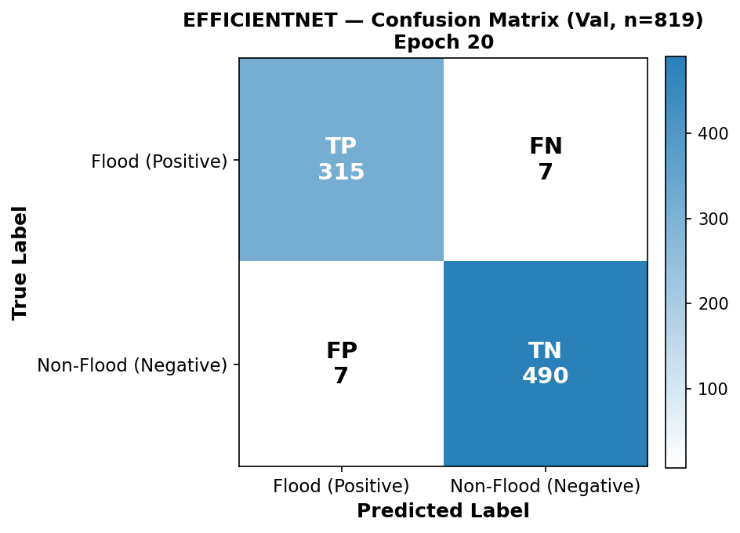
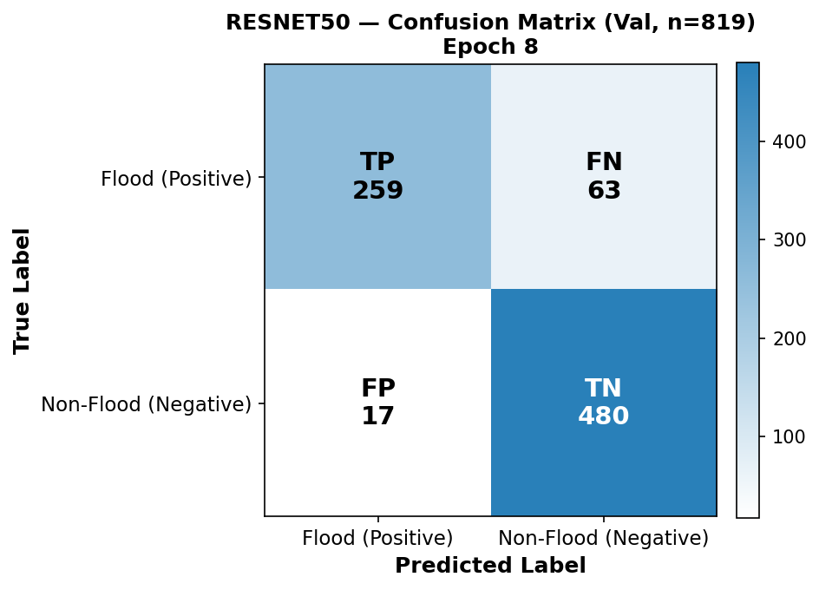
EfficientNetB0 misses 9× fewer floods — confusion matrices confirm the gap
EfficientNet (Epoch 20): Acc 98.3%, Recall 97.8% · ResNet50 (Phase 1, Epoch 8): Acc 90.2%, Recall 80.4%
EfficientNetB0 BCE — 7 FN + 7 FP — Acc: 98.3%, Recall: 97.8%
ResNet50 BCE — 63 FN + 17 FP — Acc: 90.2%, Recall: 80.4%
EfficientNetB0 errors are symmetric boundary cases (ambiguous river/flood scenes).
ResNet50 (Phase 1, Epoch 8) shows recall collapse — 63 clear flood scenes miscalibrated as non-flood.
→ EfficientNetB0 is the right architecture for HNM retraining.

Slide 10
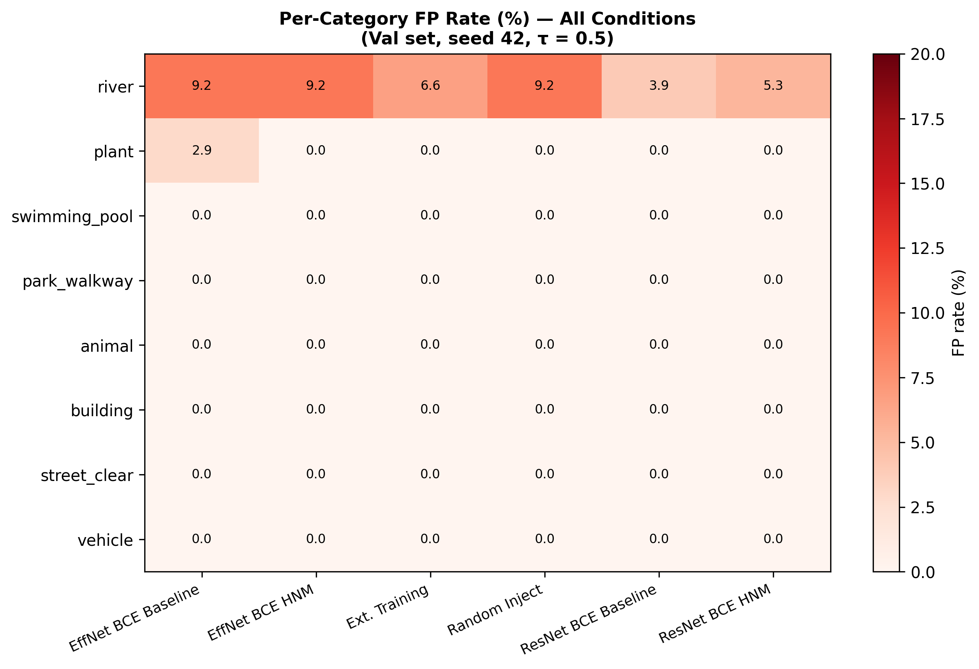
River is the only confounder — all other 7 categories are 0% FP across every condition
Per-category FP rate (%) — Val set, seed 42, τ = 0.5 · Heatmap covers all 6 trained models
Condition | River FP rate | All other categories
EfficientNet BCE Baseline | 9.2% (7 / 76) | 0% across all 7
EfficientNet BCE HNM | 9.2% (7 / 76) | 0% across all 7
Ext. Training | 6.6% (5 / 76) | 0% across all 7
Random Inject | 9.2% (7 / 76) | 0% across all 7
ResNet50 BCE Baseline | 3.9% (3 / 76) | 0% across all 7
ResNet50 BCE HNM | 5.3% (4 / 76) | 0% across all 7

Slide 11
Difficulty-ranked Phase-1 mining achieves best accuracy — all conditions compared
EfficientNetB0 BCE · Val set (seed 42) · Full metrics for every ablation condition
Condition | Val Accuracy | Flood Recall | Missed Floods (FN) | River FP rate | vs. Baseline
BCE Baseline | 98.29% | 97.8% | 7 / 322 (2.2%) | 9.2% (7/76) | —
Random injection | 98.41% | 98.6% | 5 / 322 (1.6%) | 9.2% (7/76) | +0.12 pp
Extended training | 98.66% | 99.0% | 3 / 322 (0.9%) | 6.6% (5/76) | +0.37 pp
P1-HNM ★ | 98.78% | 98.6% | 5 / 322 (1.6%) | 9.2% (7/76) | +0.49 pp
Observation | Detail
Best accuracy → P1-HNM | 98.78% accuracy (top 10% hardest river negatives, difficulty-ranked by Phase 1 probability)
Best recall → Extended training | 99.0% flood recall, only 3 missed floods — extra compute helps recall even without difficulty ranking
River FP rate → Extended reduces to 6.6% | Only extended training shows river FP improvement; HNM and random injection unchanged at 9.2%
Statistical significance | McNemar's test (Bonferroni-corrected): p > 0.05 for all pairs; N=76 river val images insufficient for tight CI

Slide 12
Conclusion: four takeaways for deploying flood screeners in CRIS-HAZARD
PR-AUC is the right metric for recall-first screening
1
3.6-pt PR-AUC gap between models is invisible in accuracy (98.3% vs 98.5%) and nearly invisible in ROC-AUC (2.6 pts). PR-AUC penalizes precision collapse at high recall.
EfficientNetB0 is the right screener — symmetric errors, not systematic collapse
2
7 missed floods vs. ResNet50's 63. EfficientNet's errors are genuine boundary cases; ResNet's 63 FN include prototypical clear flood scenes.
River is the only statistically significant confounder
3
9.2% FP rate (7/76, CI [3.8%, 17.7%]). All 7 other categories: 0% FP. Swimming pool is underpowered (N=28, upper CI = 12.3%).
Phase-1 HNM strictly outperforms both ablations
4
P1-HNM 98.78% > Extended 98.66% > Random 98.41% > Baseline 98.29%. Difficulty ranking adds value beyond compute or data quantity alone.

Slide 13
Five concrete next steps to deploy CRIS-HAZARD flood screening
From statistical power to geographic generalization
1
Expand river validation set
~300 river images for 80% power to detect a 3–4 pp FP reduction. Current 76-image set is underpowered.
2
Multi-seed robustness
Re-run all experiments across 5 seeds with bootstrap CIs to verify seed-independence of HNM gains.
3
Severity-stratified miss rate
Major vs. Minor flood miss rates have different operational costs. Report separately.
4
Geographic generalization
Dataset is US-centric. Test on South/Southeast Asian and European urban flood imagery.
5
Operational threshold calibration
τ=0.5 is not optimal. Calibrate against ≥ 99% recall target using the PR curve on a held-out test set.

Slide 14
Acknowledgments
Advisor
Dr. Dixon — guidance and support throughout this project
USF FloodingDataset
Dataset authors — labeled flood severity imagery and non-flood category annotations
RIWA Dataset
Wagner et al. (2023) — river scene images enriching the water confounder category
CRIS-HAZARD project
NSF-funded collaboration: USF, Georgia Tech, AT&T, Argonne National Laboratory
Audience
Thank you for your time and questions
Aanya Singh · University of South Florida · April 18, 2026

