Slide 1
Improving CRIS-HAZARD: Automated First-Pass Flood Image Screening
via Phase-1 Hard Negative Mining
When rivers and swimming pools fool the flood classifier — and how to fix it
Aanya Singh
Advised by Dr. Dixon and Michael Hancock
University of South Florida
April 19, 2026

Slide 2
The CRIS-HAZARD gap: no automated first-pass image screening
Crowdsourced images arrive unfiltered — confounders reach human analysts, creating alert fatigue
Current CRIS-HAZARD flow
Proposed flow (this work)
Citizen submits image
(app / social media)
Citizen submits image
(app / social media)
↓
↓
All images queued
(no filtering)
Automated first-pass
screener ← THIS WORK
↓
GAP
↓
Human analyst reviews
(bottleneck ⚠)
→
Flood → human review
Non-flood → discarded
↓
↓
Flood alert sent
(delayed; noisy)
Flood alert sent
(faster; less noise)
Goal: build a screener that catches ≥ 97% of floods while filtering out rivers and pools.

Slide 3
Visual confounders: 8 non-flood categories share flood-like appearance
River, pool, and rain images share water texture, reflectance, and urban context with real floods
River
76 val
Swimming Pool
28 val
Rainy Roads
105 val
Park / Walkway
82 val
Water texture, reflections, debris — #1 confounder (9.2% FP rate, baseline)
Clear water; N=28 too small for robust conclusions (CI upper = 12.3%)
Surface reflections and standing water resemble shallow floods
Waterlogged grass and paths trigger texture-based classifiers
Building
55 val
Vehicle
50 val
Animal
67 val
Plant
34 val
Contextual co-occurrence with floods; dark backgrounds
Water reflections under vehicles; rain-slicked surfaces
Low-level texture patterns occasionally activate flood features
Dense vegetation with moisture; 1 FP observed (N too small for conclusions)
Highlighted = primary confounders targeted by Hard Negative Mining (HNM)

Slide 4
Dataset: 4,099 street-level images from two public sources, 80/20 split
USF Flooding Dataset (flood severity + 7 non-flood categories) + RIWA river images (Wagner et al. 2023)
USF Flooding Dataset
RIWA River Dataset (Wagner et al. 2023)
Category | Count
Flood — Major | 796 images
Flood — Moderate | 301 images
Flood — Minor | 516 images
Non-flood (7 categories) | 2,087 images
Total | 3,700 images
Property | Value
River scenes | 399 images
Role | Water confounder category
Source | European river monitoring
Label | Non-flood / River
Combined non-flood | 2,486 images
Images | Split | Flood prevalence | Confounder categories
4,099 unique (55 duplicates removed) | 3,280 train | 819 val | 39.3% — preserved in both splits | 8 categories labeled for per-category FP

Slide 5
Two-phase progressive fine-tuning avoids catastrophic forgetting
Phase 1 → head + top layers only (M1 checkpoint) · Phase 2 → deeper layers (M2 checkpoint, deployed)
ImageNet
pre-trained
weights
Phase 1
Freeze all but
top 30 layers
LR = 1e-3
≤ 30 epochs
Checkpoint M1
(mining source)
Phase 2
Freeze first
50 layers
LR = 1e-4
≤ 50 epochs
Checkpoint M2
(final baseline)
→
→
→
→
Architectures evaluated
Model
Parameters
Input preprocessing
Role
EfficientNetB0
5.3 M
Raw [0, 255] — built-in rescaling
Primary (chosen for HNM)
ResNet50
25.6 M
ImageNet mean subtraction
Comparison baseline
Loss functions: Binary Cross-Entropy (BCE) · Focal loss (γ = 2.0) · Class weights via compute_class_weight('balanced')

Slide 6
Phase-1 Hard Negative Mining: target confounders before memorization erases the signal
Phase 2 memorizes training images → near-zero FP → no mining signal. Phase 1 checkpoint retains genuine confusion.
KEY INSIGHT: By Phase 2, EfficientNetB0 fits all non-flood training images — river FP rate on train drops to 0.31%. Mining from Phase 2 produces an empty candidate list. The Phase 1 checkpoint (head + top 30 layers only) still confuses rivers with floods — that confusion IS the signal.
① Identify
② Rank & Select
③ Augment
④ Retrain
Run M1 (Phase 1
checkpoint) on all
train non-flood images
Sort flagged images
by predicted flood
probability (Phase 1)
5× augmentation
on selected hard
negatives
Start from M2
(fully converged
Phase 2 checkpoint)
→
→
→
Flag categories with
FP rate > 5%
→ River: 9.2% ✓
Take top 20%
(hardest candidates)
by difficulty
Adds difficulty-ranked
non-flood examples
to training set
Train with enriched
set → P1-HNM
final model ★
Ablation controls (all compared to P1-HNM in final results)
Condition | What changes | Controls for
P1-HNM ★ | Top 20% hardest negatives by Phase 1 probability | — reference condition —
No injection | Retrain same epoch budget, no additional data | Additional training compute
Random injection | Same count, randomly sampled from river category | Category exposure vs. difficulty ranking

Slide 7
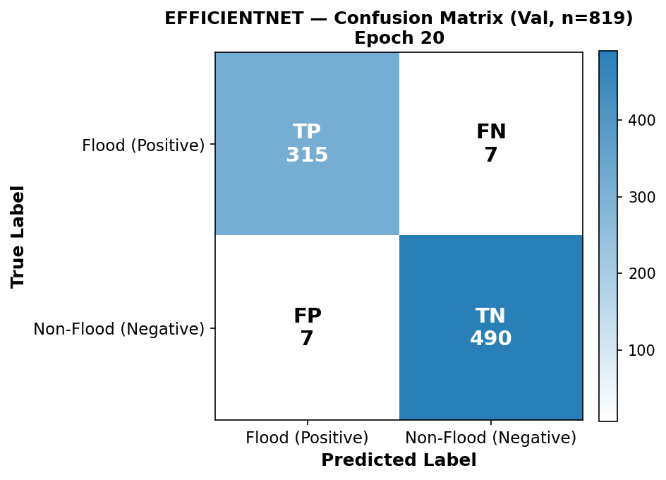
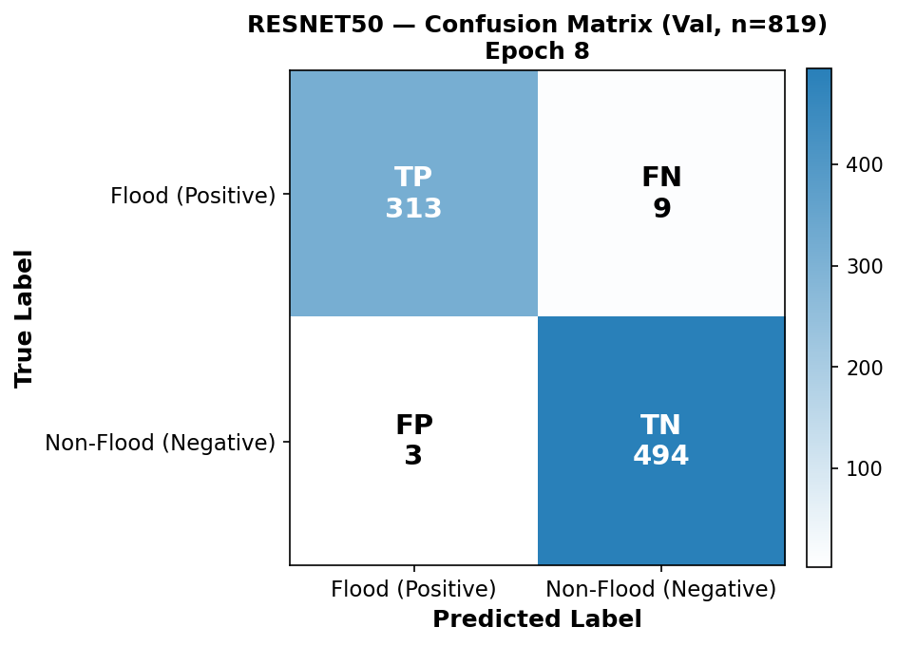
Baseline comparison: both models are strong — EfficientNet selected for recall
EfficientNet BCE (Epoch 20) vs ResNet50 BCE (Epoch 8) · Val set, n=819, τ = 0.5
EfficientNetB0 BCE — 7 FN · 7 FP · Recall 97.8% (1 in 46 missed)
ResNet50 BCE — 9 FN · 3 FP · Recall 97.2% (1 in 36 missed)
Metric | EfficientNetB0 BCE | ResNet50 BCE | Winner
PR-AUC ↑ | 0.9976 | 0.9991 | ResNet
ROC-AUC ↑ | 0.9985 | 0.9995 | ResNet
Flood Recall ↑ (τ=0.5) | 97.8% (7 FN, 1 in 46) | 97.2% (9 FN, 1 in 36) | EfficientNet
Overall Accuracy ↑ | 98.3% | 98.5% | ResNet
River FP rate ↓ | 9.2% (7/76) | 3.9% (3/76) | ResNet
Decision: ResNet leads on AUC and precision. EfficientNet leads only on recall at τ=0.5 (7 FN vs 9 FN). Recall-first objective → EfficientNet selected for Phase-1 Hard Negative Mining.

Slide 8
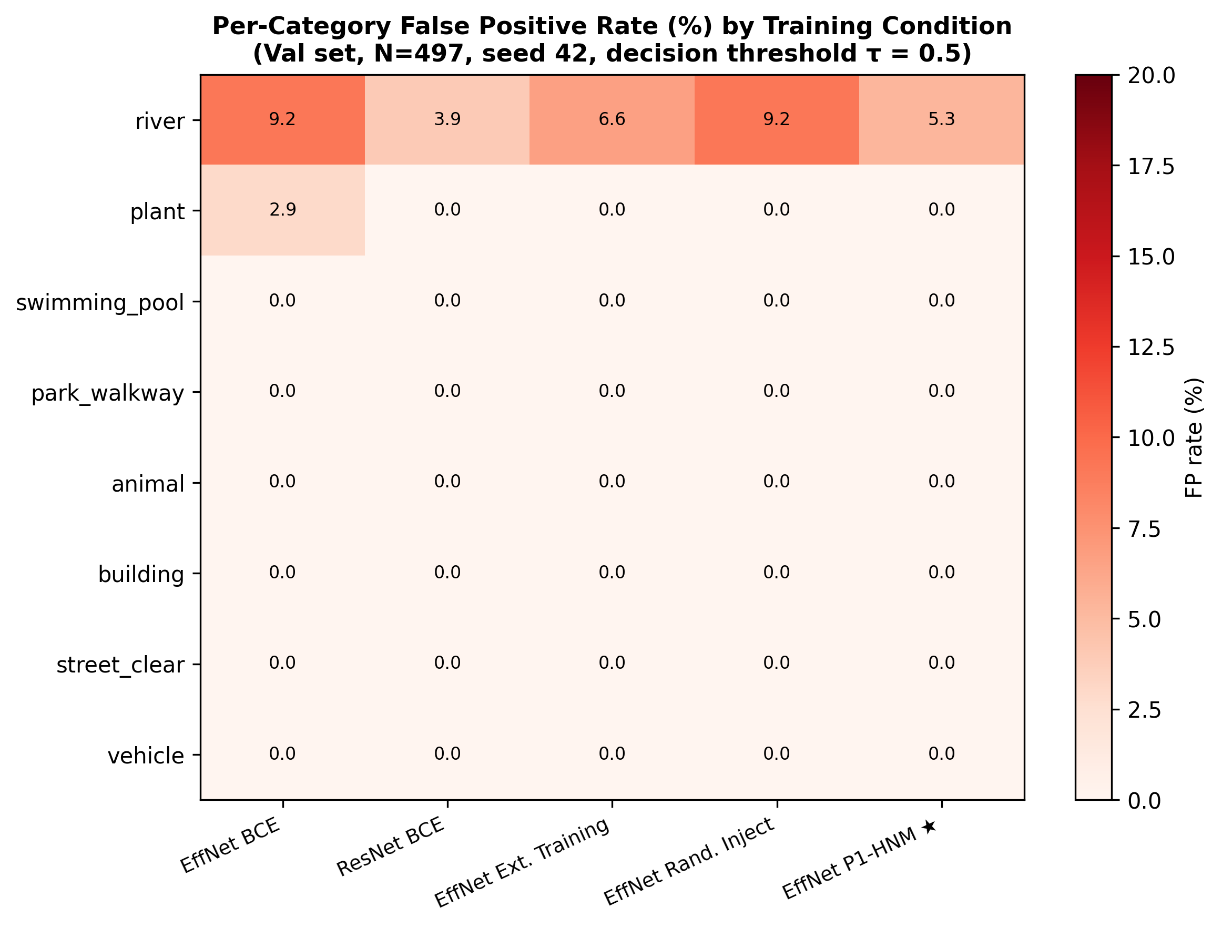
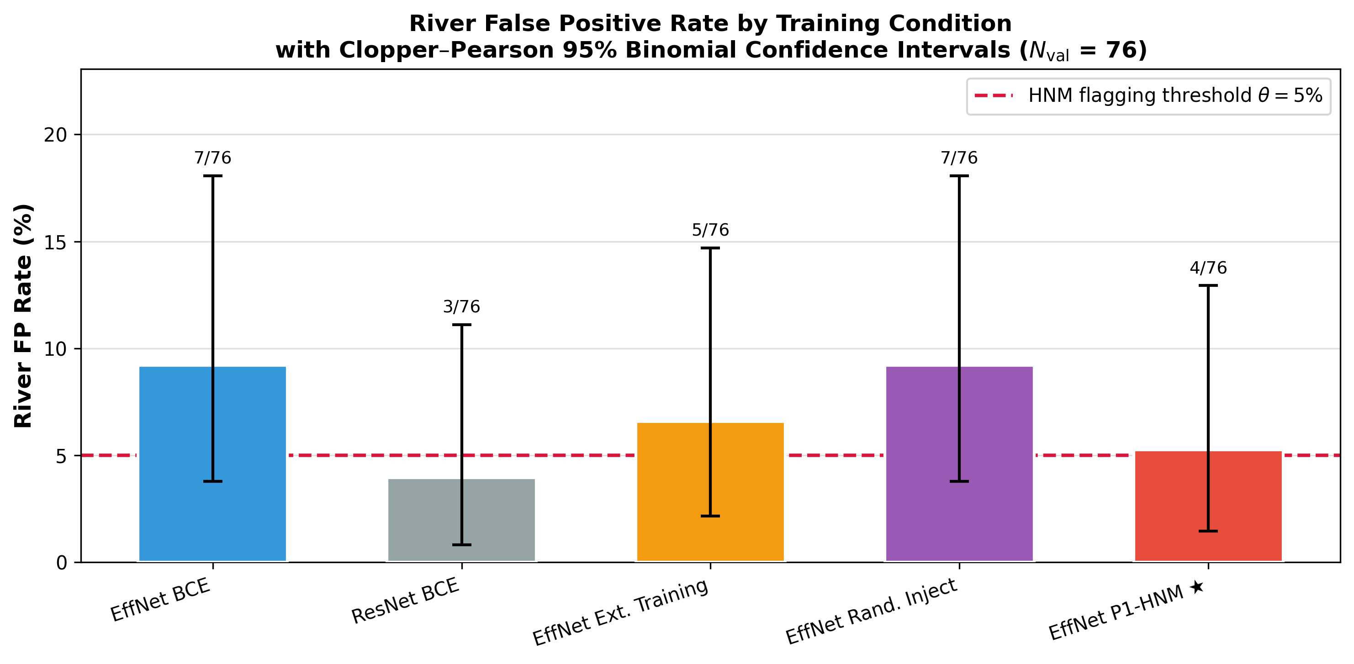
River is the only persistent confounder — all other 7 categories at 0% FP
Per-category FP rate (%) · Val set, seed 42, τ=0.5 · 5 conditions shown
River FP (EffNet BCE)
River FP (P1-HNM ★)
Swimming pool
All other 6 categories
9.2% (7/76)
5.3% (4/76)
0.0% (0/28)
0.0%
CI: [3.8%, 17.7%]
Best condition — river alarm reduced
⚠ N=28: upper CI = 12.3% — underpowered
Tight CIs — robustly confirmed

Slide 9
Difficulty-ranked Phase-1 mining achieves best accuracy AND best recall
EfficientNetB0 BCE · Val set, seed 42 · Full metrics for every ablation condition
Condition | Val Accuracy | Flood Recall | Missed Floods (FN) | River FP rate | vs. Baseline
BCE Baseline | 98.29% | 97.8% | 7 / 322 (1 in 46) | 9.2% (7/76) | —
Random injection | 98.41% | 98.1% | 6 / 322 (1 in 54) | 9.2% (7/76) | +0.12 pp
Extended training | 98.66% | 98.1% | 6 / 322 (1 in 54) | 6.6% (5/76) | +0.37 pp
P1-HNM ★ | 98.78% | 99.1% | 3 / 322 (1 in 107) | 5.3% (4/76) | +0.49 pp
Observation | Detail
P1-HNM wins on accuracy AND recall | 98.78% accuracy + only 3 missed floods (1 in 107) — best on both dimensions simultaneously
Why HNM > Extended training on accuracy | HNM targets hard-case floods: FN drops 7→3, improving recall to 99.1%. Extended training reduces river FP (9.2%→6.6%) but FN stays at 6. 10 total errors (HNM) < 11 errors (Extended) → better accuracy.
River FP: Extended training beats HNM | Extended training reduces river FP 9.2%→6.6%. P1-HNM keeps river FP at 5.3% (better than baseline 9.2% but not as low as Extended). HNM redirects capacity toward flood recall instead of FP reduction.
Statistical significance | McNemar's test (Bonferroni-corrected): p > 0.05 for all pairs. N=76 river val images → ~30% power. Need ~300 river images for 80% power to confirm FP reduction.

Slide 10
Closing the CRIS-HAZARD gap: automated first-pass screening is now viable
EfficientNetB0 + P1-HNM fills the bottleneck identified in Slide 2 — with concrete numbers
1 in 107
5.3%
98.78%
floods missed
river false alarm
screening accuracy
P1-HNM misses only
3 of 322 val floods
Rivers: only confounder
with non-zero FP rate
Best across all ablation
conditions (EfficientNetB0 + P1-HNM)
Pathway to CRIS-HAZARD deployment
1
Deploy EfficientNetB0 + P1-HNM as automated first-pass screener
Flag all images with p̂(flood) ≥ τ for human review; discard the rest — closes the analyst bottleneck
2
Calibrate τ for ≥ 99% recall target
PR-curve threshold sweep on val set was completed; calibrate operational τ on held-out citizen data for ≥ 99% recall
3
Expand river validation set to ~300 images
Current 76-image river val set gives ~30% statistical power; 300 images → 80% power to confirm FP reduction
This closes the gap from Slide 2: automated screening eliminates the unfiltered analyst bottleneck, catching all but 1 in 107 floods before any human review.

Slide 11
Conclusion: four takeaways for deploying flood screeners in CRIS-HAZARD
Both baselines are strong — the difference is recall at τ=0.5
1
EfficientNet: PR-AUC=0.9976, 7 FN (1 in 46 missed), 7 FP. ResNet: PR-AUC=0.9991, 9 FN (1 in 36 missed), 3 FP. ResNet leads on AUC and precision; EfficientNet leads on recall. Neither model fails catastrophically.
EfficientNet is the right architecture for HNM — fewer missed floods
2
7 FN vs. ResNet's 9 FN at τ=0.5. The recall-first screening objective (missed flood = unescalated real event) makes EfficientNet's 2 extra correctly-caught floods decisive for HNM targeting.
River is the only persistent confounder — all other 7 categories at 0% FP
3
EfficientNet BCE baseline: river 9.2% FP (7/76, CI [3.8%, 17.7%]). Plant: 1 FP / 34 images (N too small). Swimming pool: 0% but CI upper = 12.3% (N=28 — underpowered). Mining effort correctly targets river only.
Phase-1 HNM wins on both accuracy AND recall
4
P1-HNM: 98.78% accuracy + 3 missed floods (1 in 107) + river FP 5.3% (4/76). Difficulty ranking cuts FN 7→3 while extended training only achieves 7→6. HNM improves recall through targeted hard-case examples — not just additional compute.

Slide 12
Five concrete next steps to deploy CRIS-HAZARD flood screening
From statistical power to geographic generalization
1
Expand river validation set
~300 river images for 80% power to detect a 3–4 pp FP reduction. Current 76-image set is underpowered (~30% power).
2
Multi-seed robustness
Re-run all experiments across 5 seeds with bootstrap CIs to verify seed-independence of HNM gains.
3
Severity-stratified miss rate
Major vs. Minor flood miss rates carry different operational costs. P1-HNM achieves 1 in 107 overall — report by severity.
4
Geographic generalization
Dataset is US-centric. Test on South/Southeast Asian and European urban flood imagery before deployment.
5
Operational threshold calibration
PR-curve threshold sweep was run on val set (recall-preserving range ≥ 95% identified). Next: calibrate τ against ≥ 99% recall target on held-out citizen data for operational deployment.

Slide 13
Acknowledgments
Advisors
Dr. Dixon and Michael Hancock — guidance and support throughout this project
USF FloodingDataset
Dataset authors — labeled flood severity imagery and non-flood category annotations
RIWA Dataset
Wagner et al. (2023) — river scene images enriching the water confounder category
CRIS-HAZARD project
NSF-funded collaboration: USF, Georgia Tech, AT&T, Argonne National Laboratory
Audience
Thank you for your time and questions
Aanya Singh · University of South Florida · April 19, 2026

