Slide 1
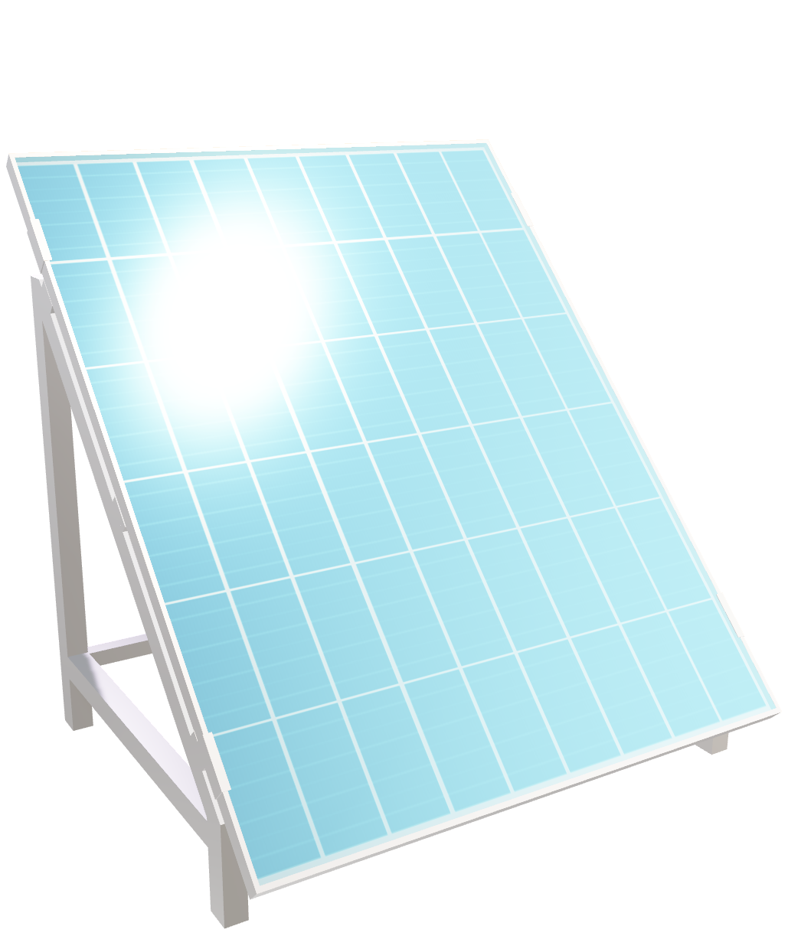
Renewable Energy Solutions product
PREPARED BY: VALORIA, FRANCIS JEY R.

Slide 2

Renewable Energy Solutions product
PREPARED BY: VALORIA, FRANCIS JEY R.

Slide 3
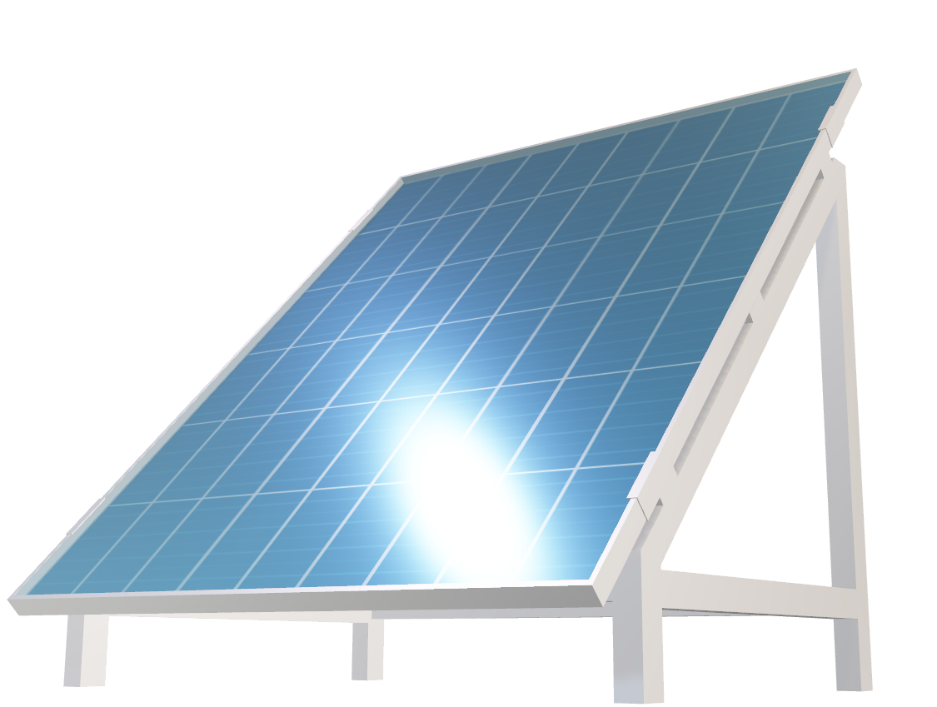

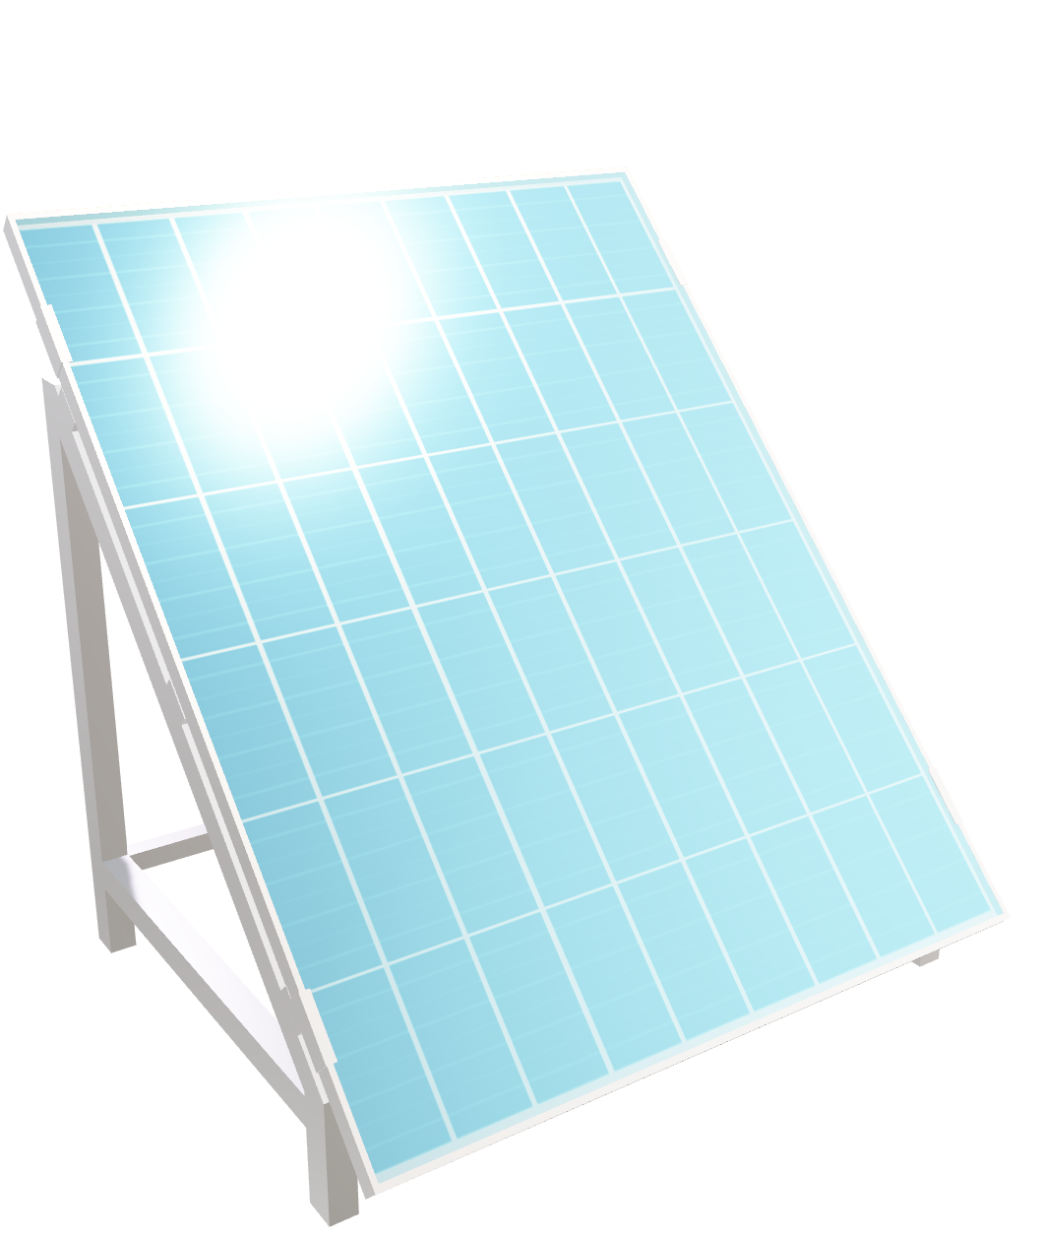
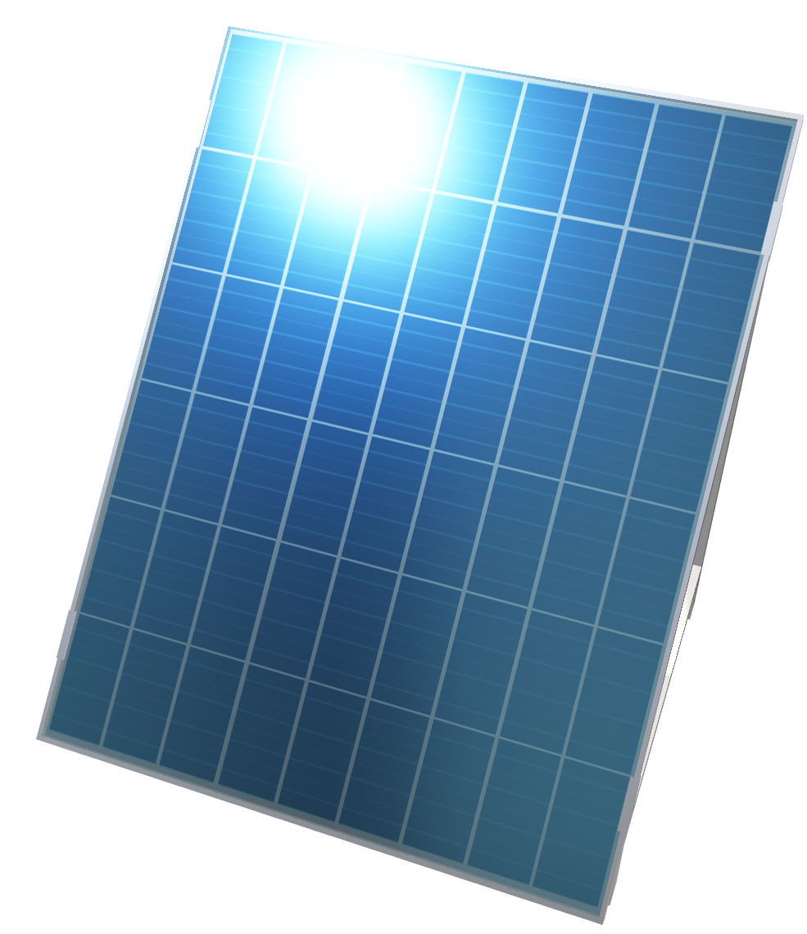
Solar panels
Renewable Energy Solutions product
Renewable Energy Solutions product
2

Slide 4
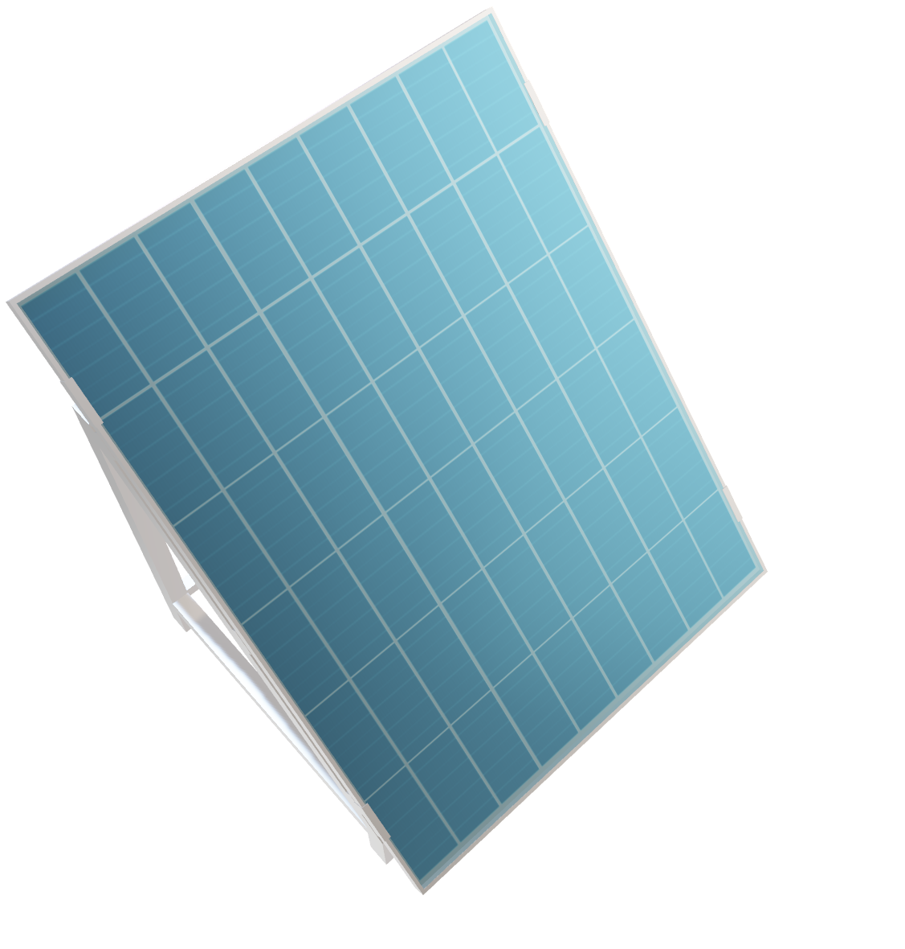
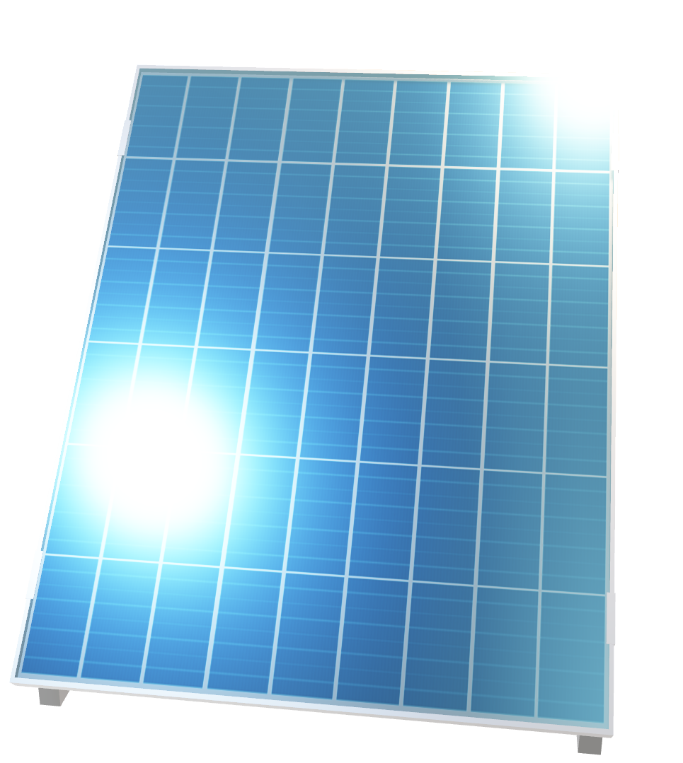
Solar panels
Introduction
Solar panels offer a dual solution: environmental sustainability and economic growth.
Environmental impact
Reduces greenhouse gas emissions, combating climate change.
Fosters a greener future and a resilient global ecosystem.
Economic benefits
Drives job creation and innovation in manufacturing, installation, and maintenance.
Stimulates economic activity and prosperity within communities
Choosing solar panels for the Philippines holds immense potential to boost the country's economy in several ways
Technological advancements
Promotes research and development in renewable energy.
Leads to more efficient and cost-effective solar solutions.
Global perspective
Enhances energy independence, reducing reliance on finite fossil fuels.
Mitigates risks associated with energy scarcity and geopolitical conflicts.
Conclusion
Choosing solar panels is an investment in a sustainable and robust global economy.
Illuminating a path towards economic growth, job creation, and technological advancement while safeguarding our planet.
Renewable Energy Solutions product
3

Slide 5
Choosing solar panels for the Philippines holds immense potential to boost the country's economy in several ways
Job creation
Energy Independence
The installation, maintenance, and manufacturing of solar panels would create job opportunities, addressing unemployment and contributing to economic stability.
Reducing reliance on imported fossil fuels and transitioning to solar energy enhances energy security, minimizing the impact of global oil price fluctuations on the Philippine economy.
Cost-Effective Energy
Environmental Sustainability
As technology advances and solar becomes more efficient, the cost of solar energy decreases. This shift to cost-effective renewable energy sources can lead to savings for businesses and consumers alike, stimulating economic activities.
The Philippines is susceptible to the impacts of climate change, including extreme weather events. Embracing solar energy helps reduce the nation's carbon footprint, contributing to a more sustainable and resilient environment.
Renewable Energy Solutions product

Slide 6
Francis jey r. valoria
BS INFO TECH 2-C
Renewable Energy Solutions product

