Slide 1
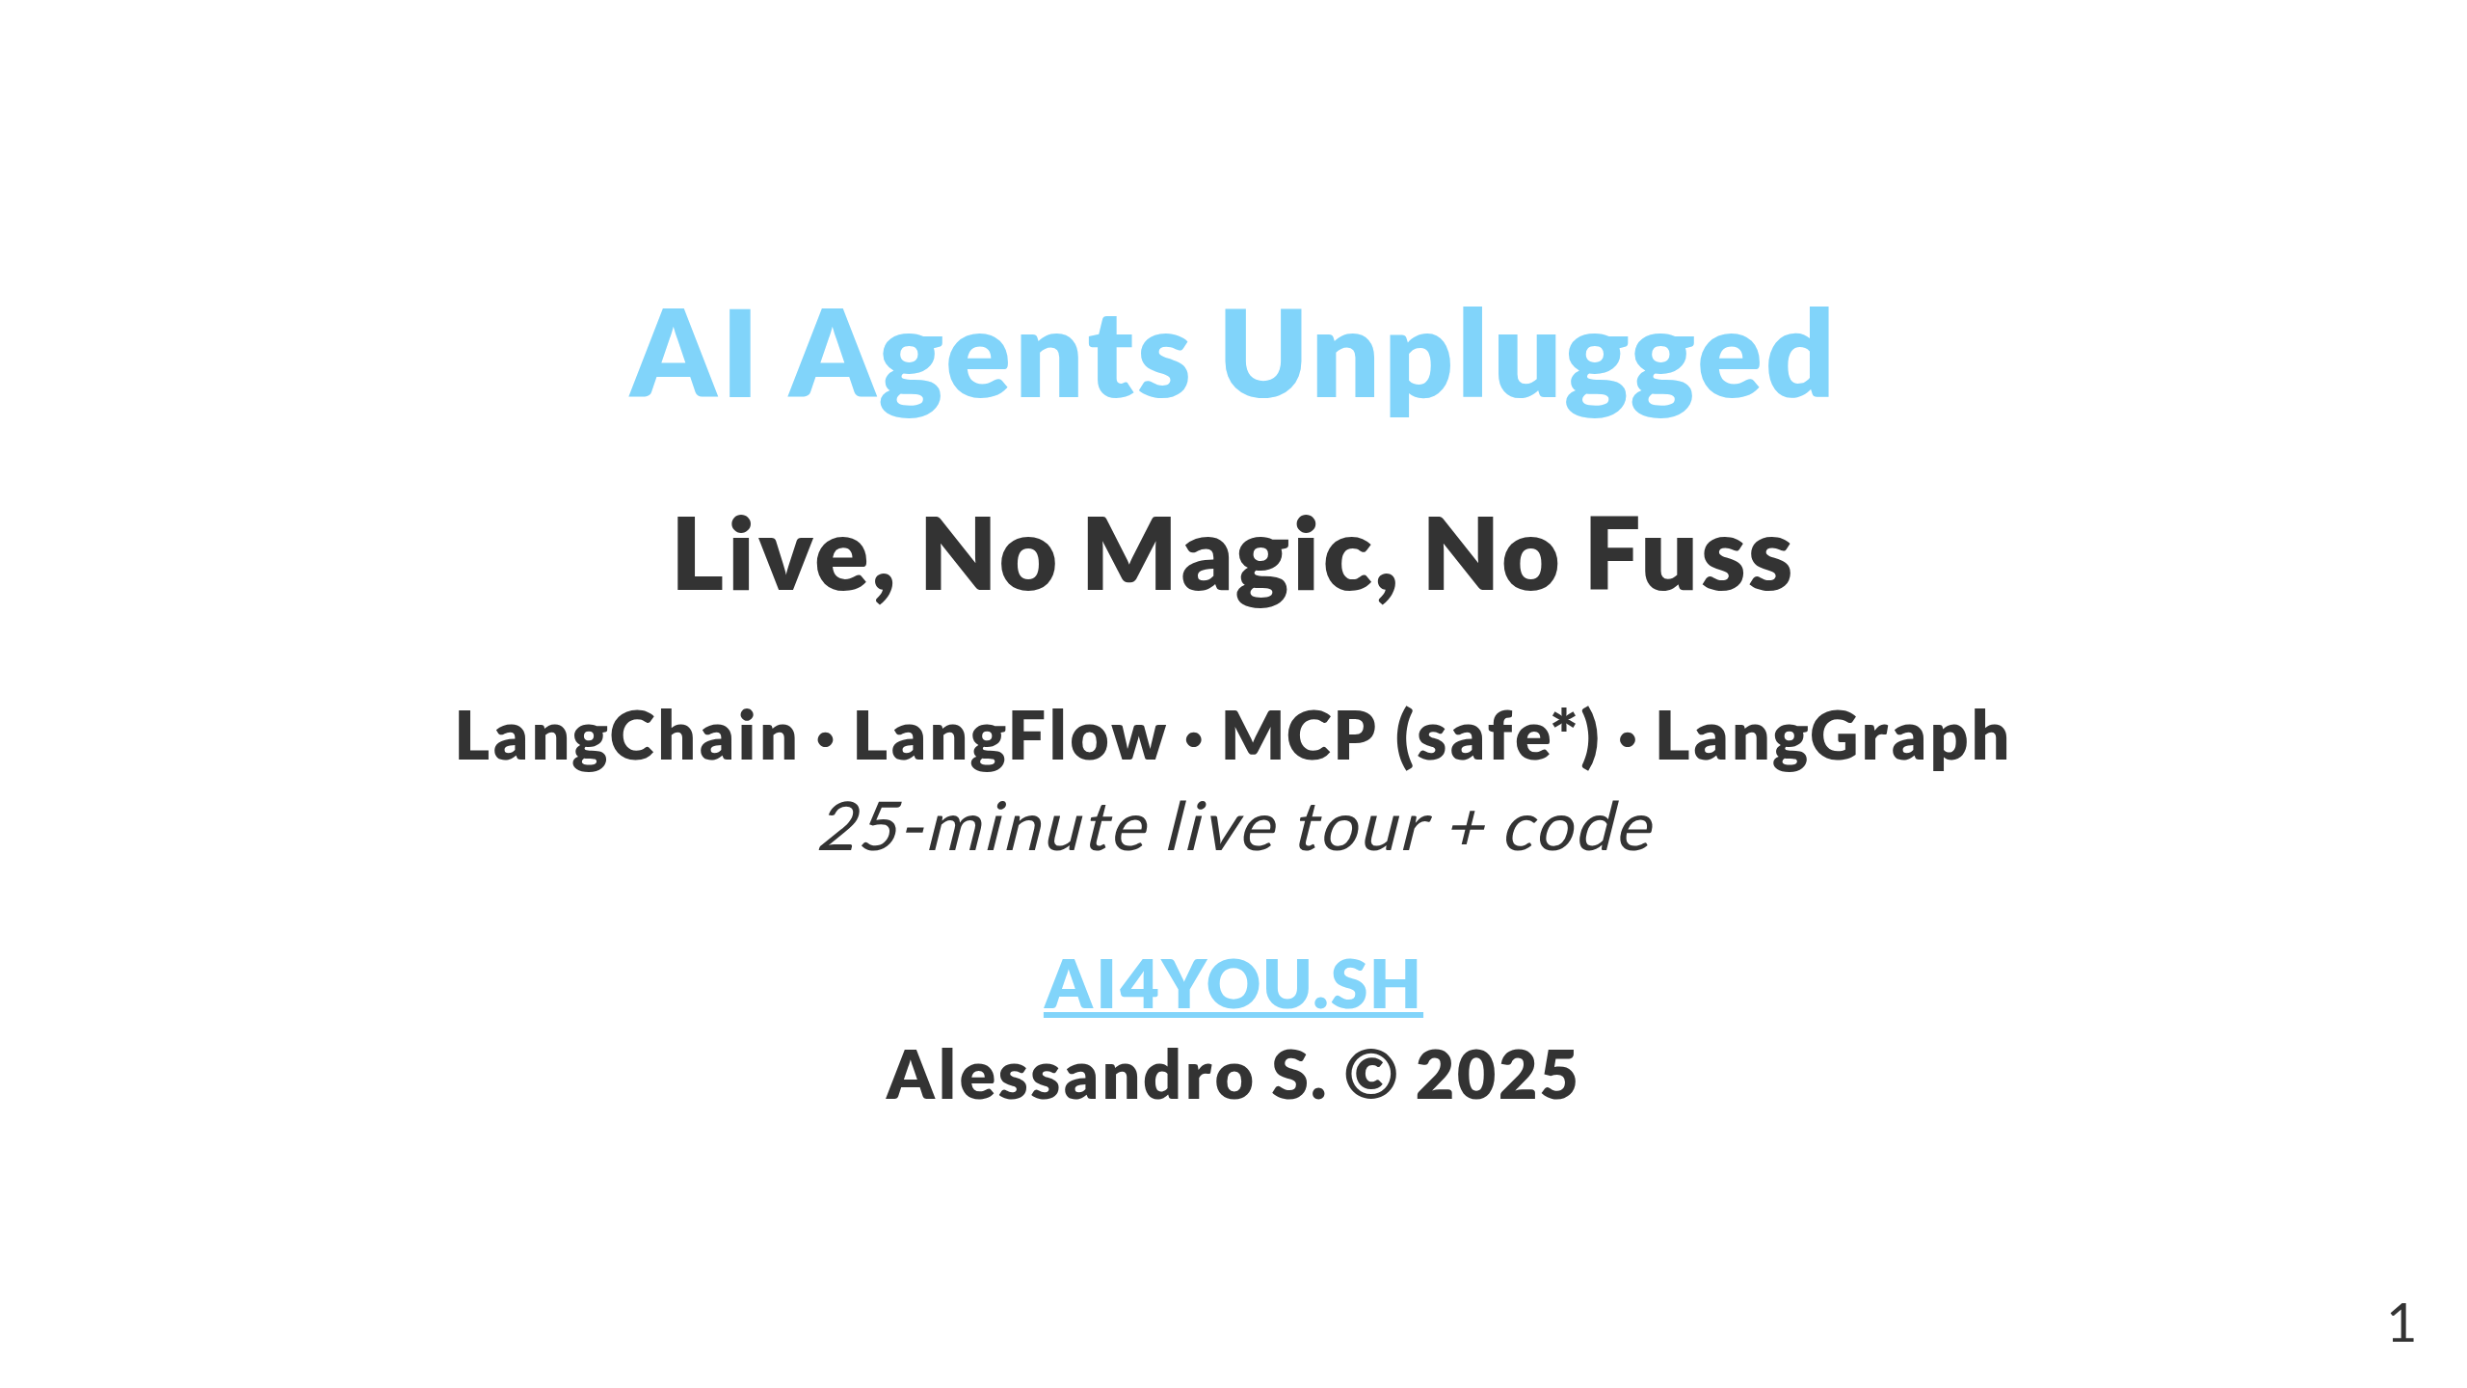

Slide 2
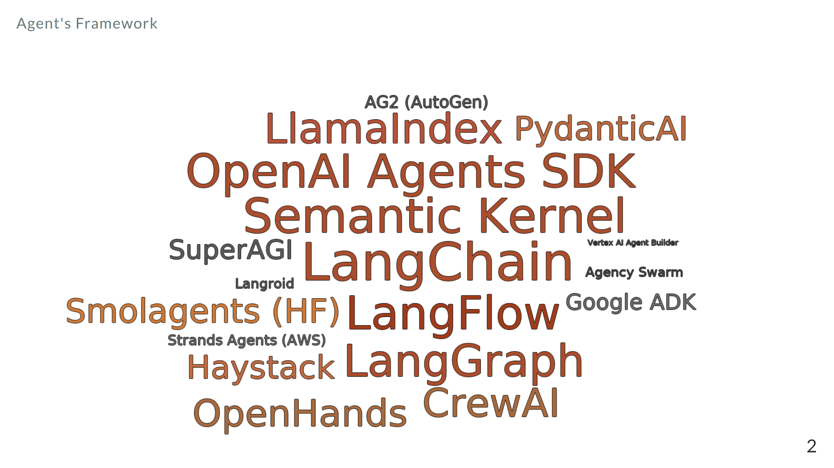

Slide 3
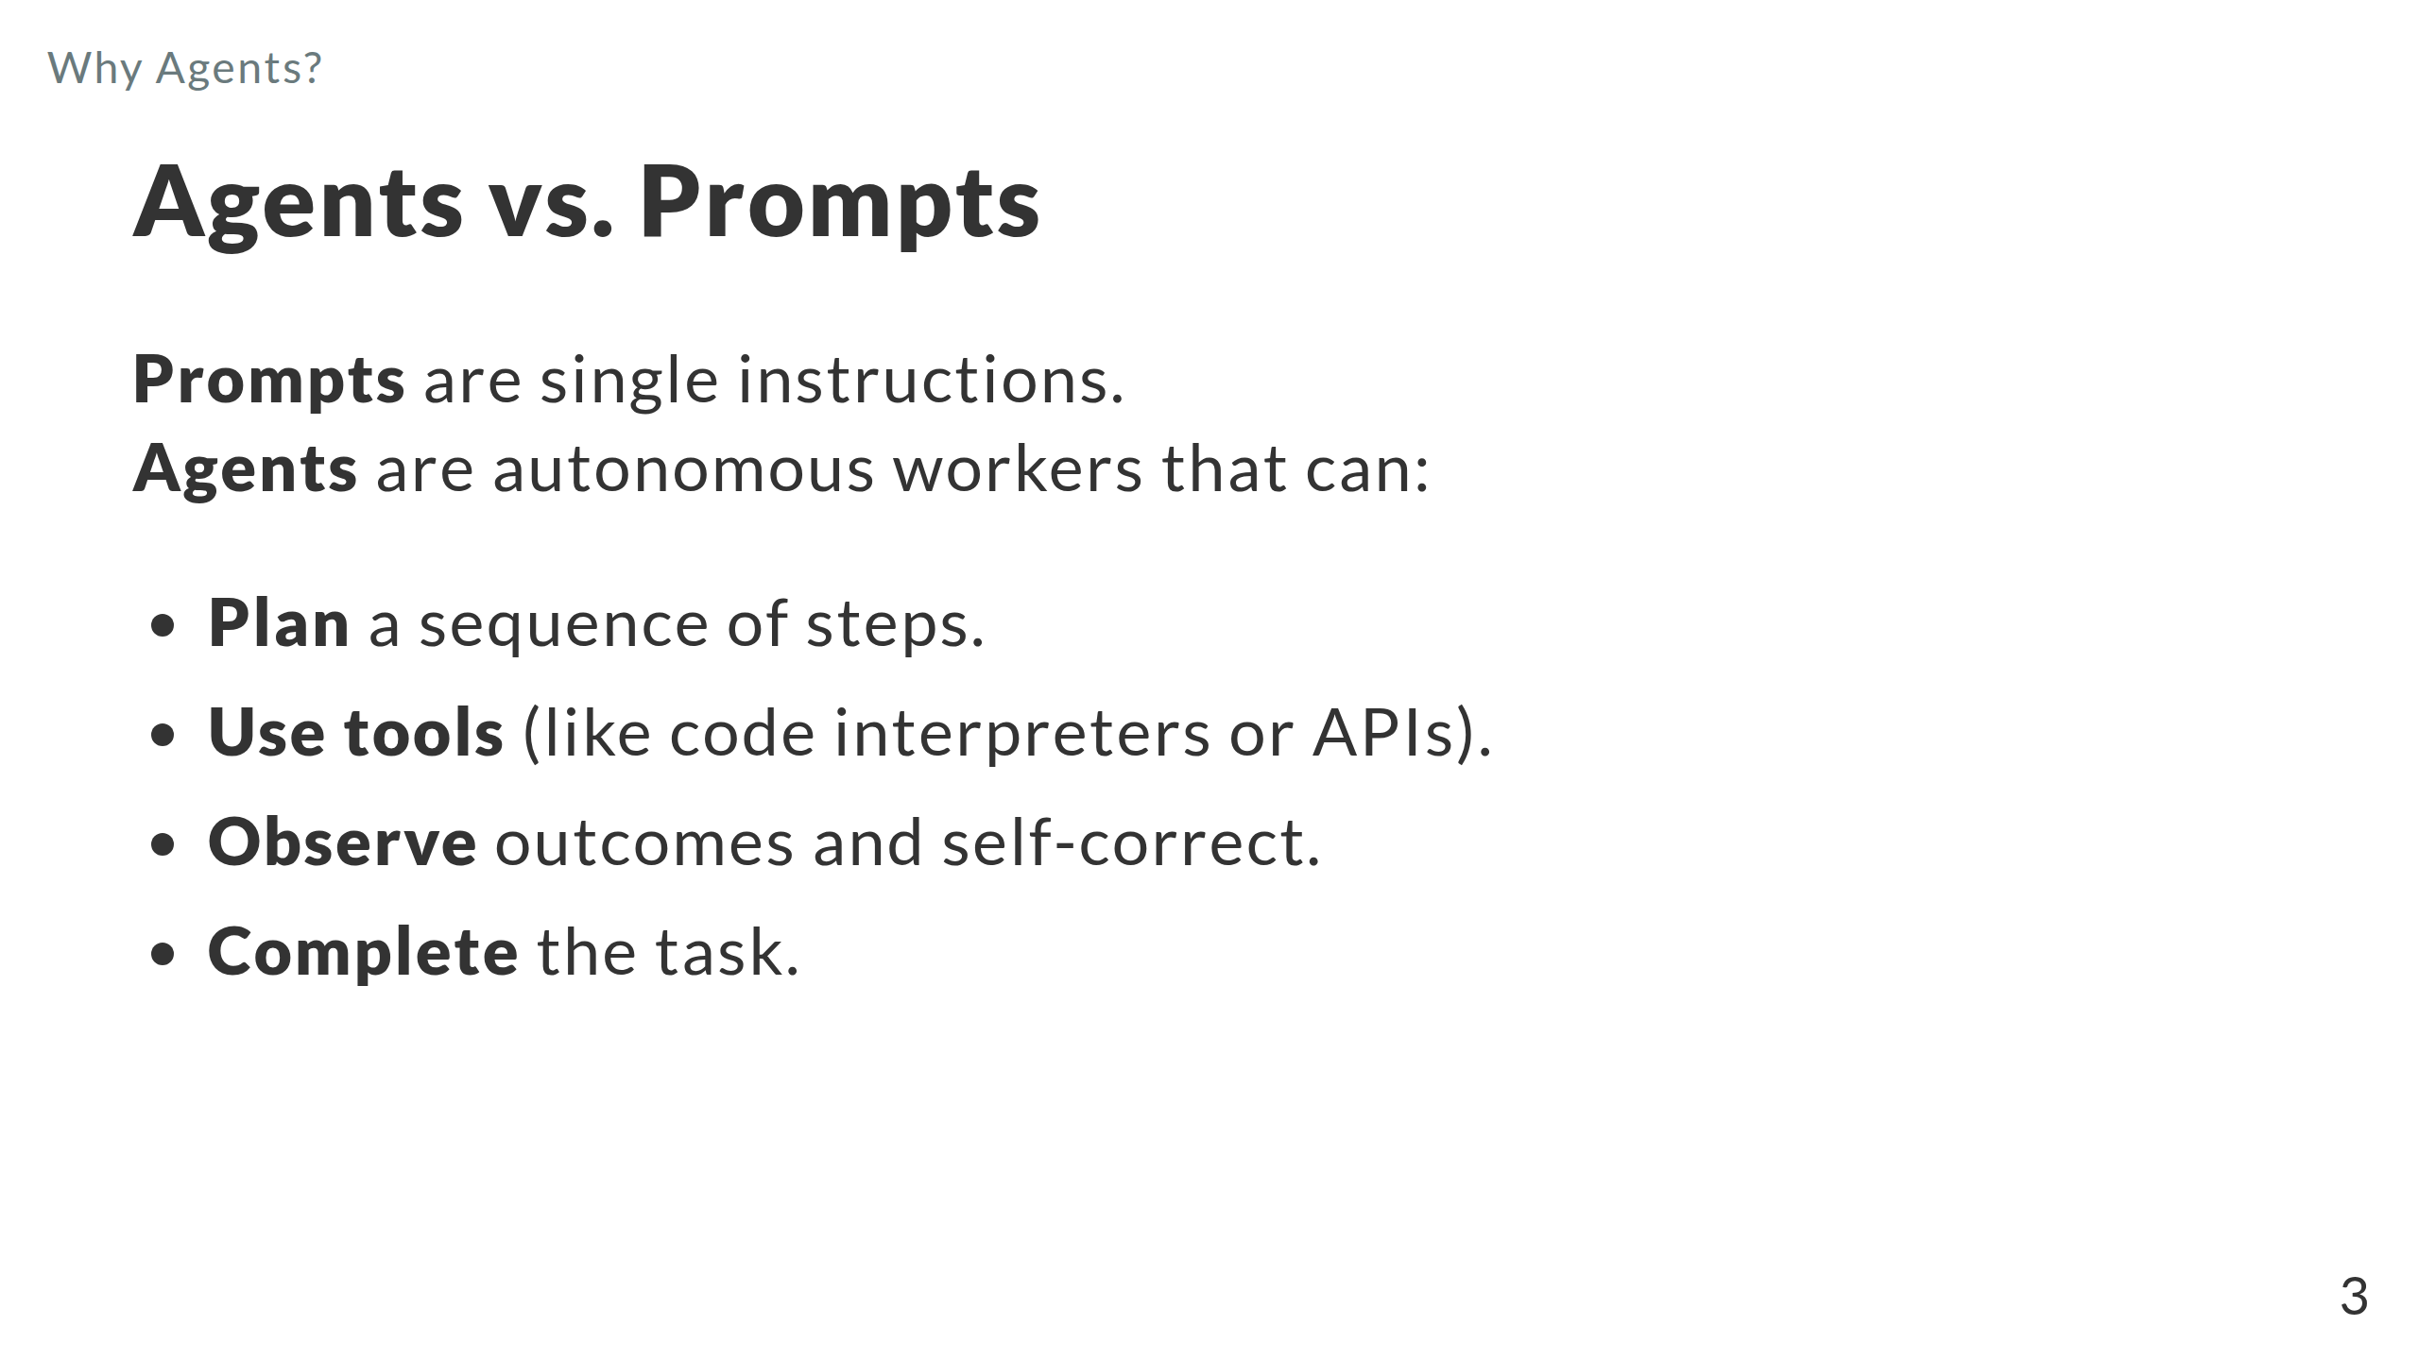

Slide 4
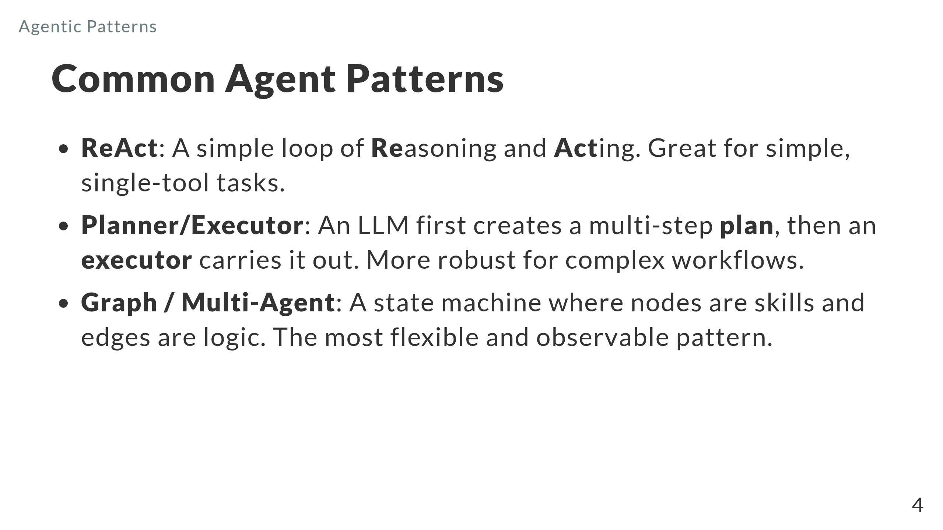
Notes:
Notes: - ReAct: Reason + Act → Observation loop; great for short tasks and few tools. Show a single tool call trace from the notebook. Mention guardrails: step limit and parsing errors. - Planner/Executor: LLM drafts a plan, executor runs steps, re-plans on failure; better global context but slower. Call out retries, timeouts, and cost tracking. - Graph / multi‑agent: Nodes = skills; edges = routing; shared state; easy to version, test, and add human‑review. Demo LangGraph g3: route (calc vs retrieve) → answer → human_review (interrupt) → accept/reject loop. - Trade‑offs: ReAct (simple, fast) vs Planner/Executor (structured, costlier) vs Graph (most control/observability). - Transition line: “We’ll start with ReAct, then add routing, then close with human‑in‑the‑loop and MCP tools.”

Slide 5
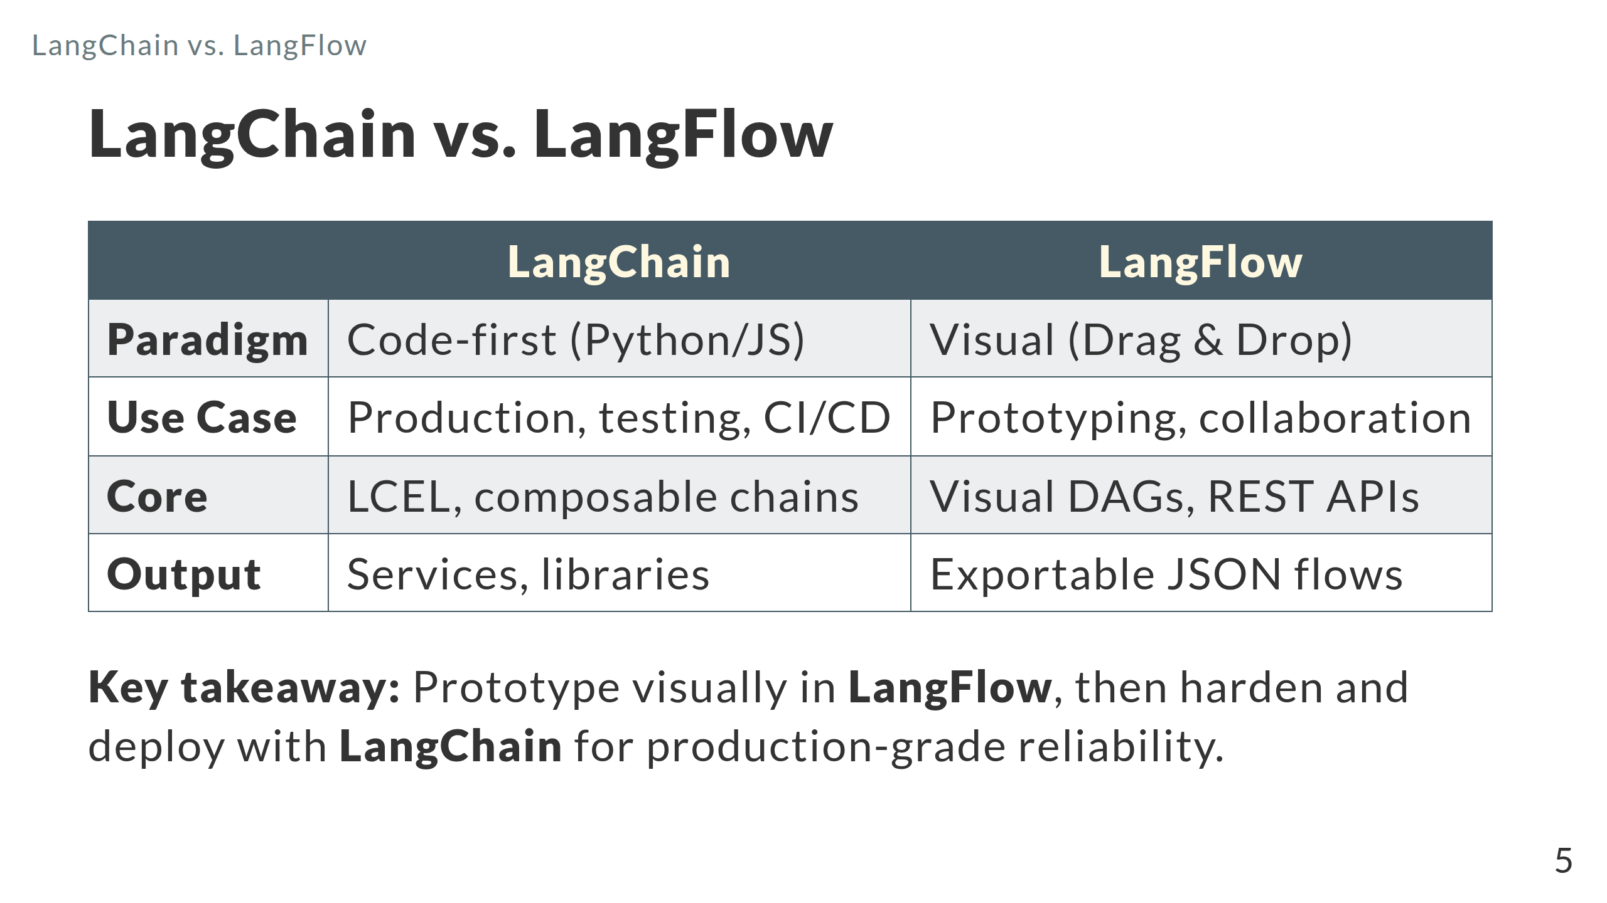
Notes:
Presenter notes — LangChain vs LangFlow Definitions - LangChain (code-first): Python-first framework. LCEL = LangChain Expression Language (composable chains, streaming, retries). - LangFlow (visual): Drag-and-drop DAG editor for LangChain objects. Export/import JSON. Run flows via REST; can expose endpoints/tools (incl. MCP). When to choose each - Use LangChain when you need: - Version control + PR review, unit tests, CI/CD, reproducible builds, fine-grained error handling. - Library interop (LangGraph, LangSmith), typed state, and custom tool/security wrappers. - Use LangFlow when you need: - Fast prototyping with non-dev collaborators, quick parameter tuning, and live demos. - Visual DAGs that you can export to JSON and call from services via REST. Deployment paths - LangChain: package as a service or notebook; containerize; add observability (LangSmith) and evaluations; store prompts and chains in repo. - LangFlow: self-host or local; secure REST with API keys; export JSON and keep it versioned alongside code; treat environment variables as secrets. Costs/latency and ops - Both call the same models/tools; cost is similar. Visual runtime may add a small network hop for REST. - Keep tool allow-lists, rate limits, and circuit breakers in both. Interop patterns - Prototype in LangFlow → export JSON → either invoke via REST or load the exported config into a LangChain service. - Surface the same tools directly in LangChain and (optionally) via an MCP server for controlled access by multiple agents/clients. Demo cue - Flow today: code-first agent → call a LangFlow flow via REST → show MCP tools and controlled access. Takeaway - Start visual to align on design, then move stable graphs into code for tests, CI, and hardened security.

Slide 6
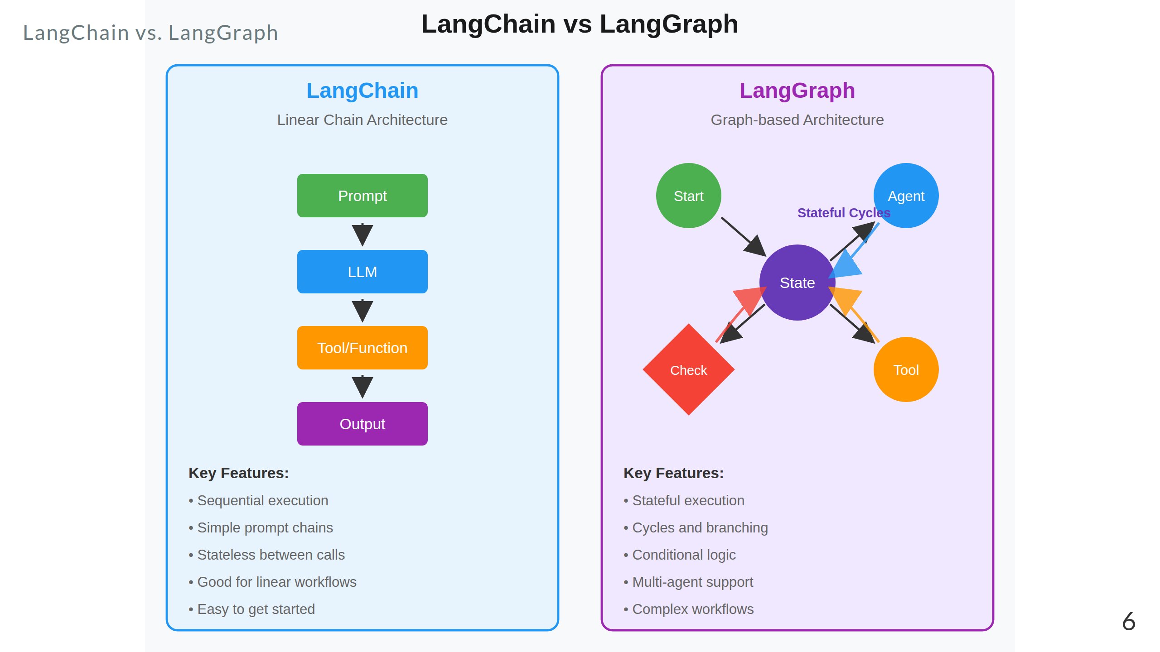

Slide 7
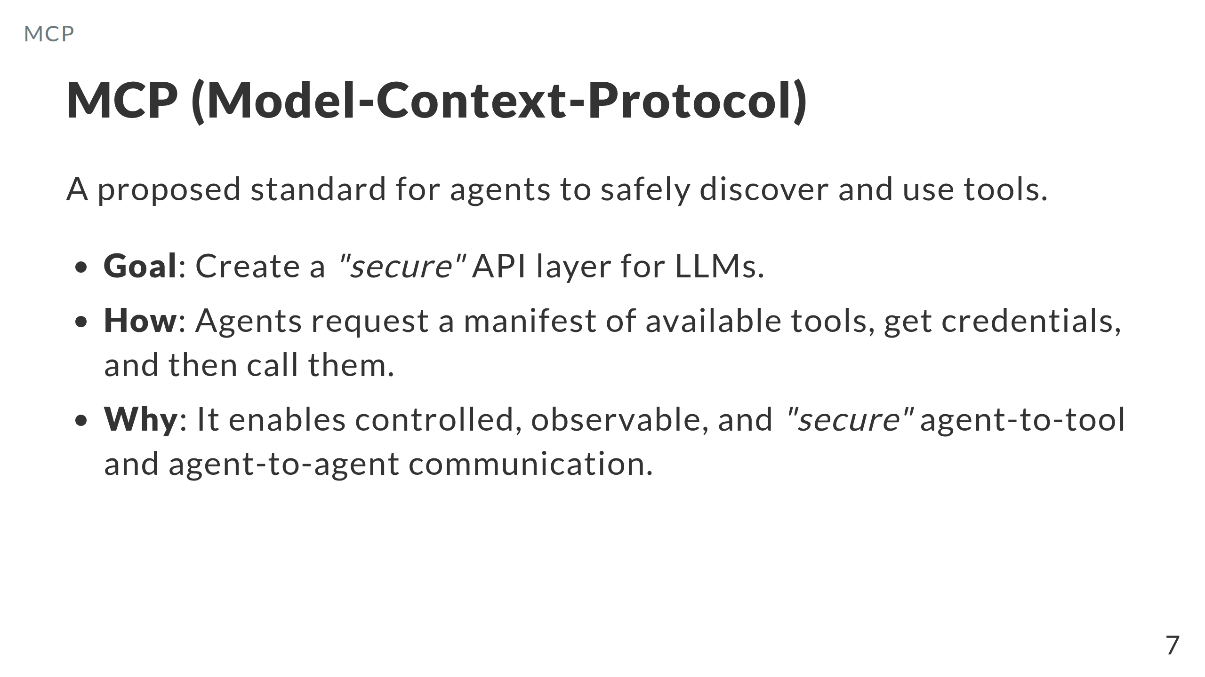

Slide 8
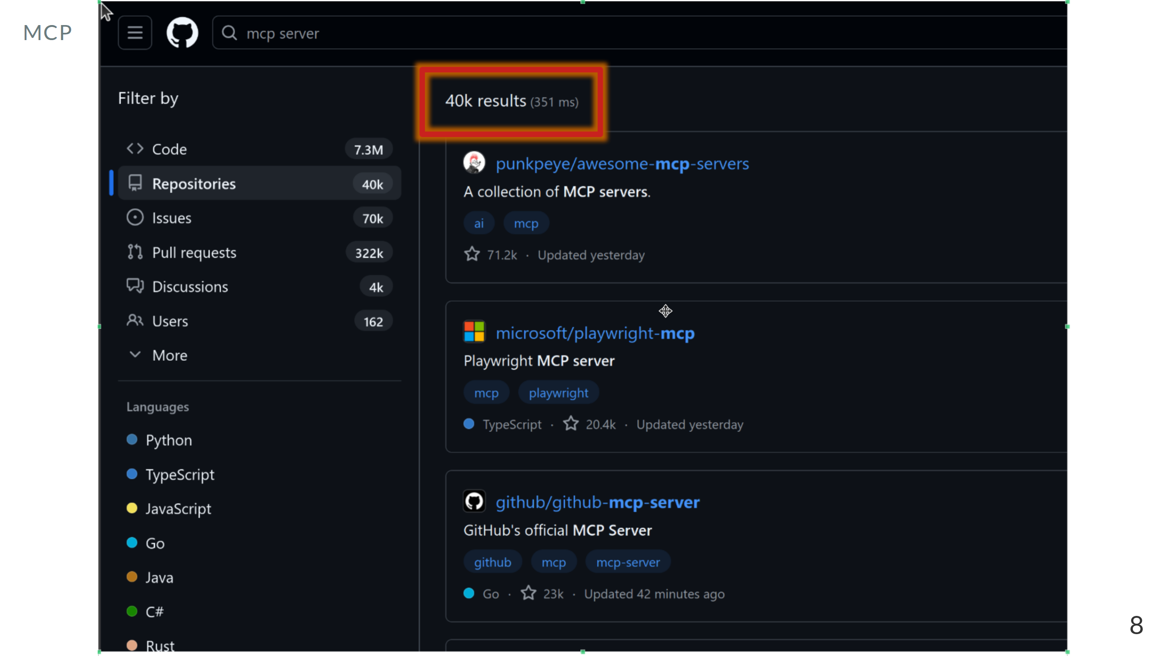

Slide 9
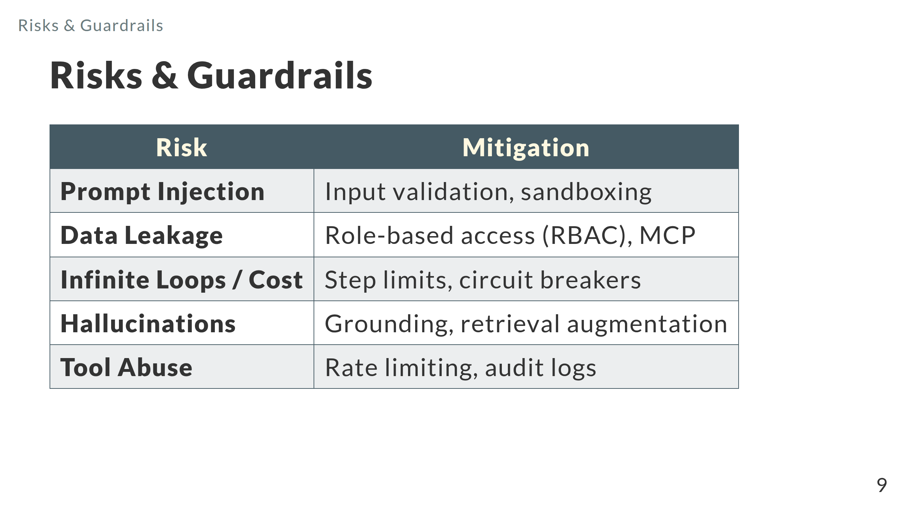

Slide 10
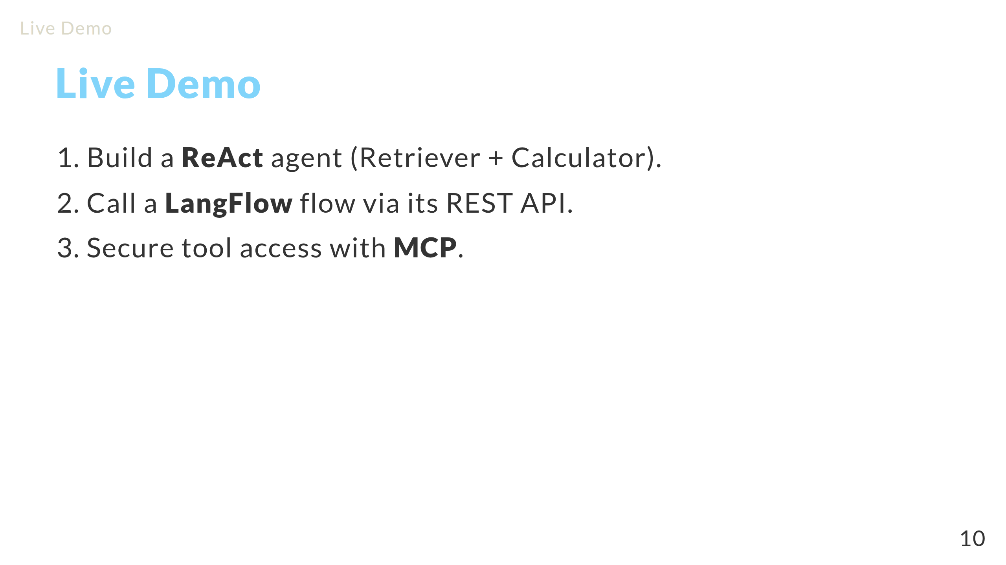

Slide 11
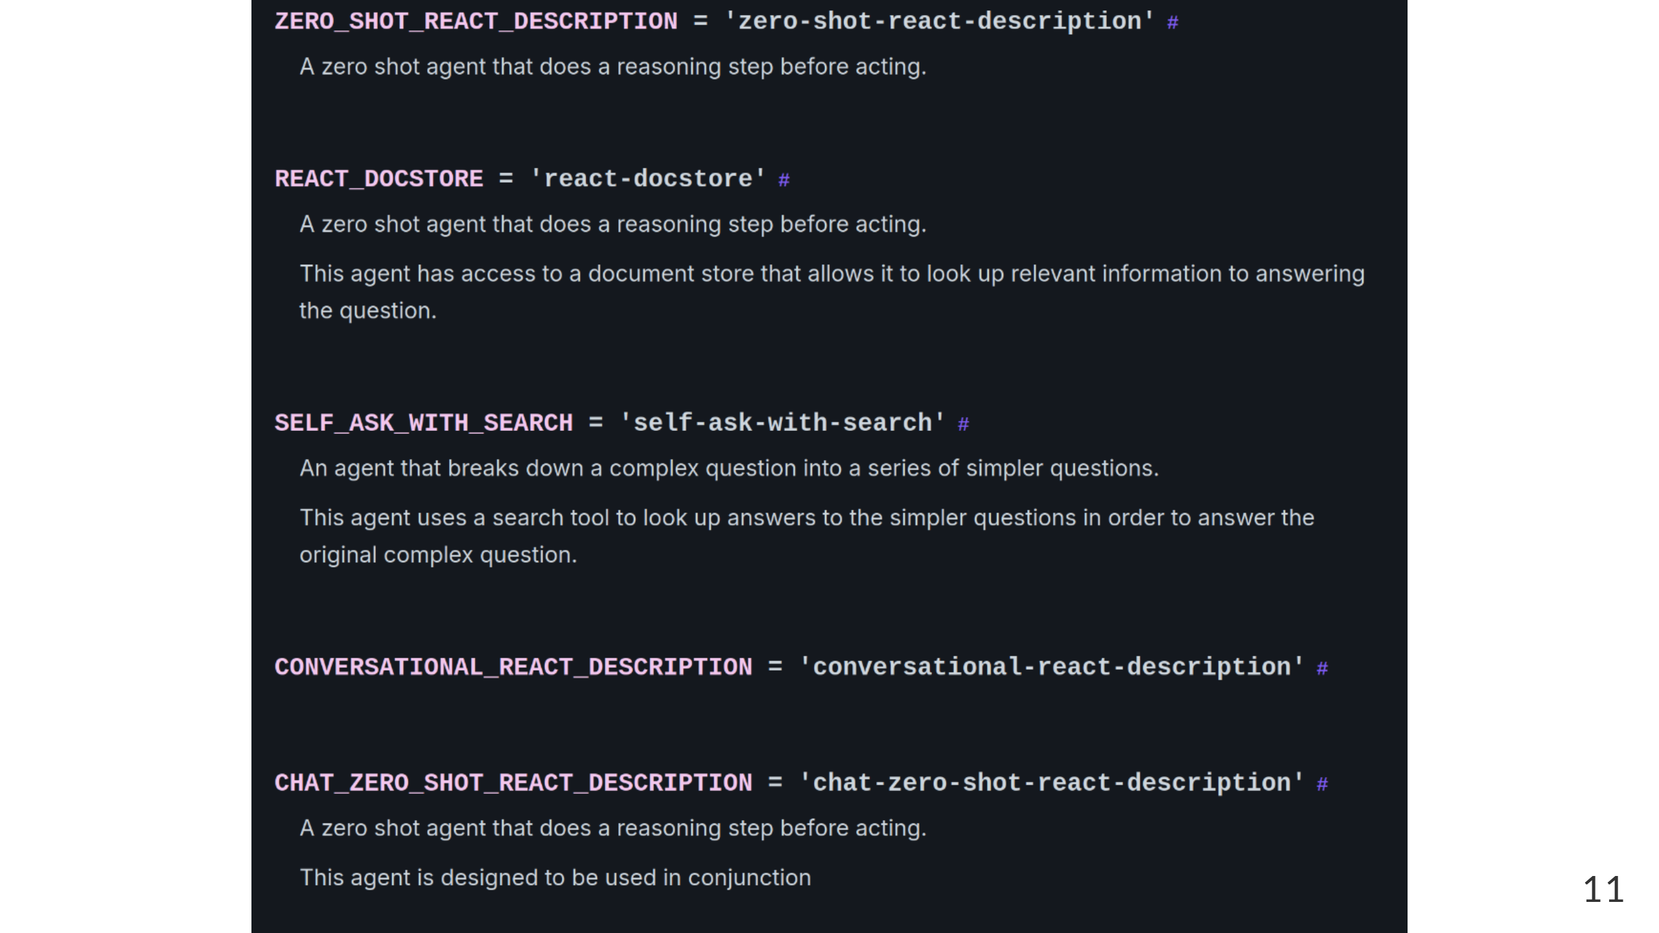

Slide 12
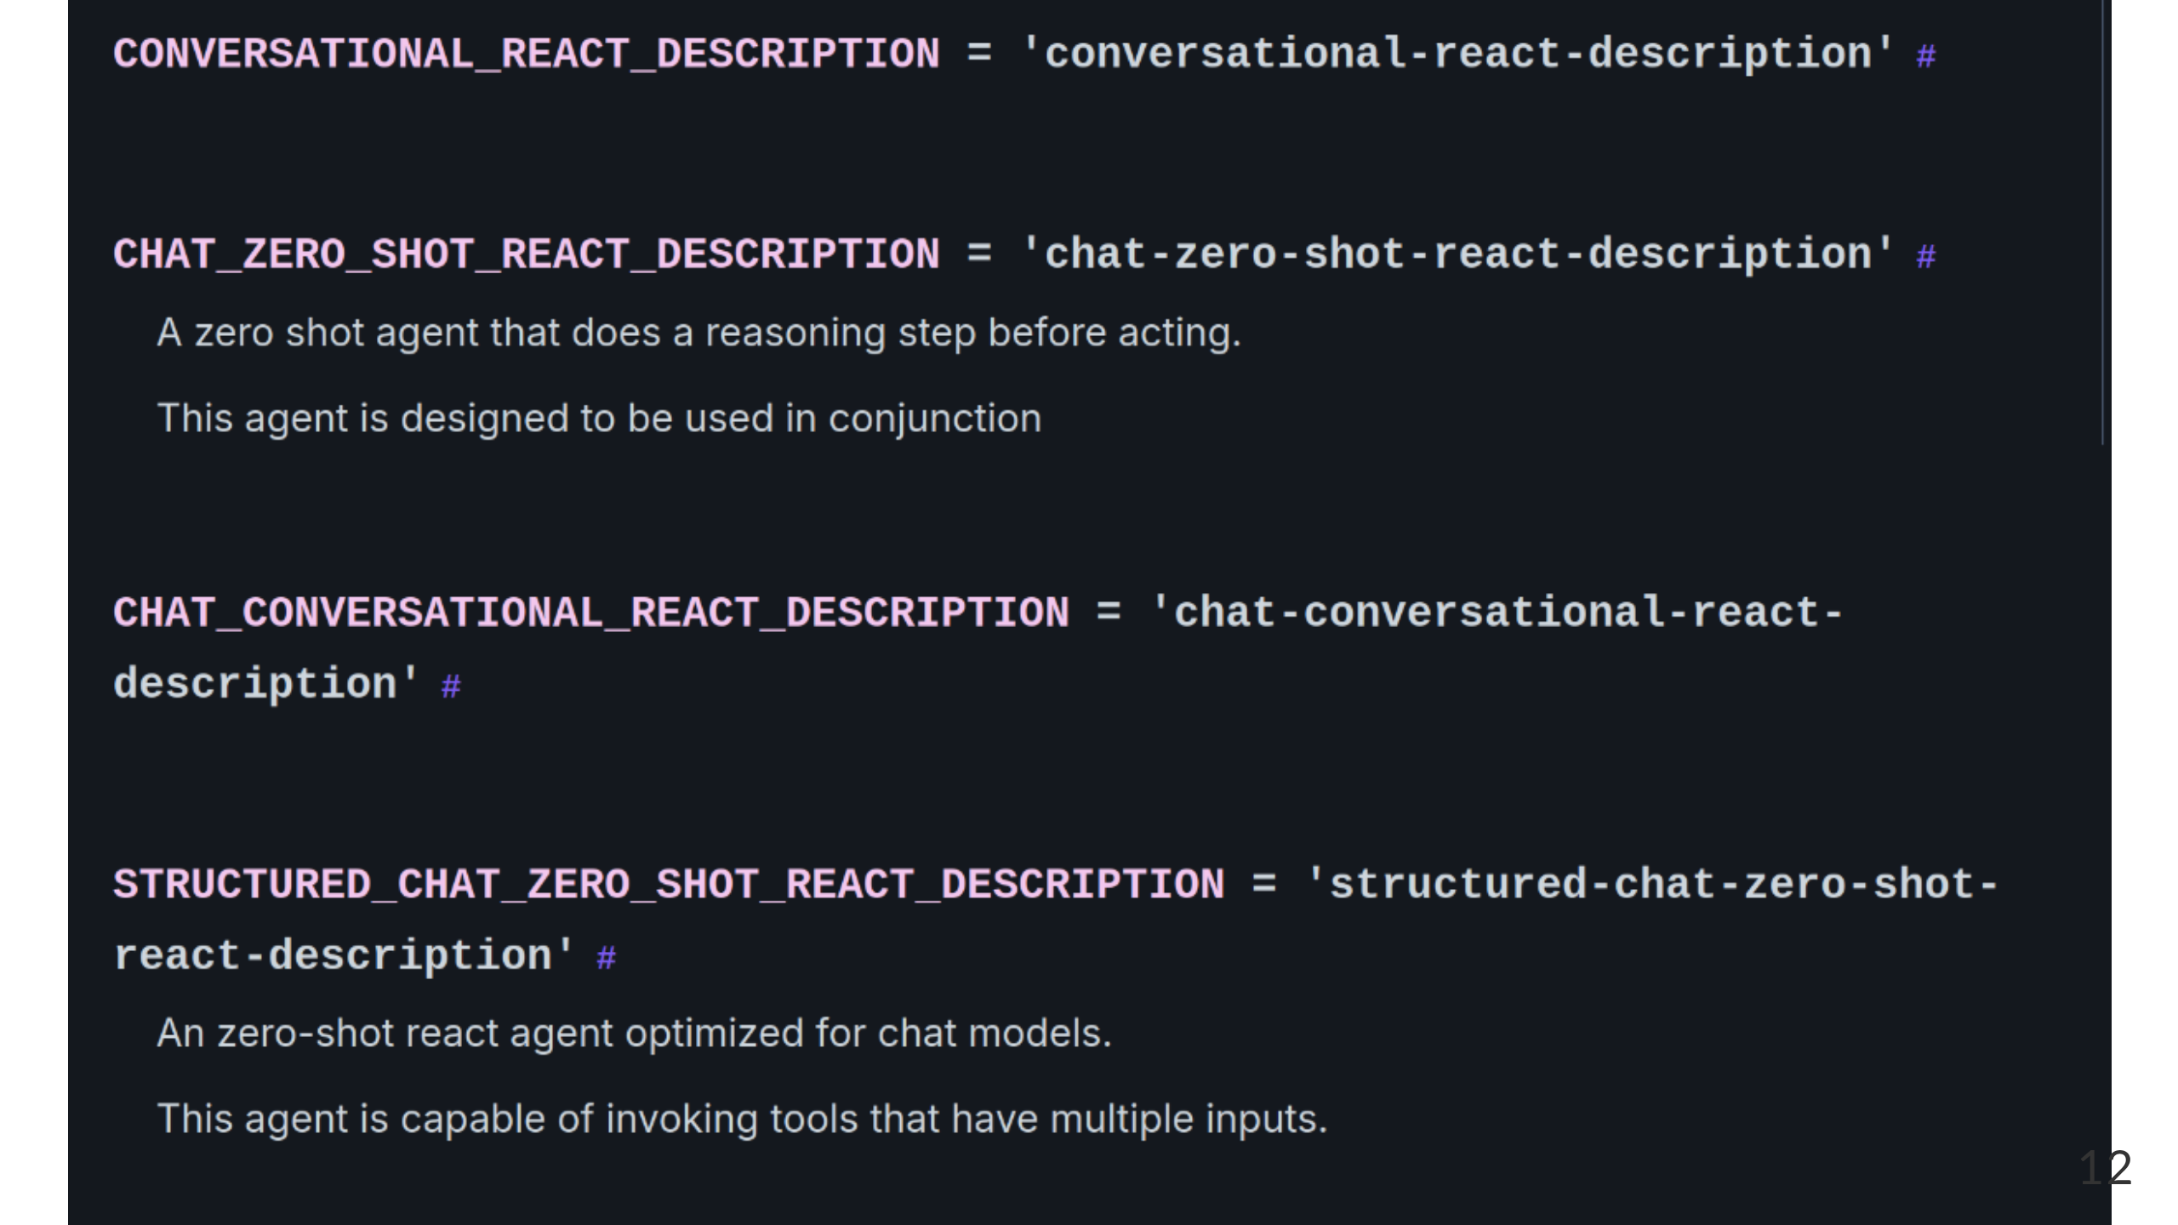

Slide 13
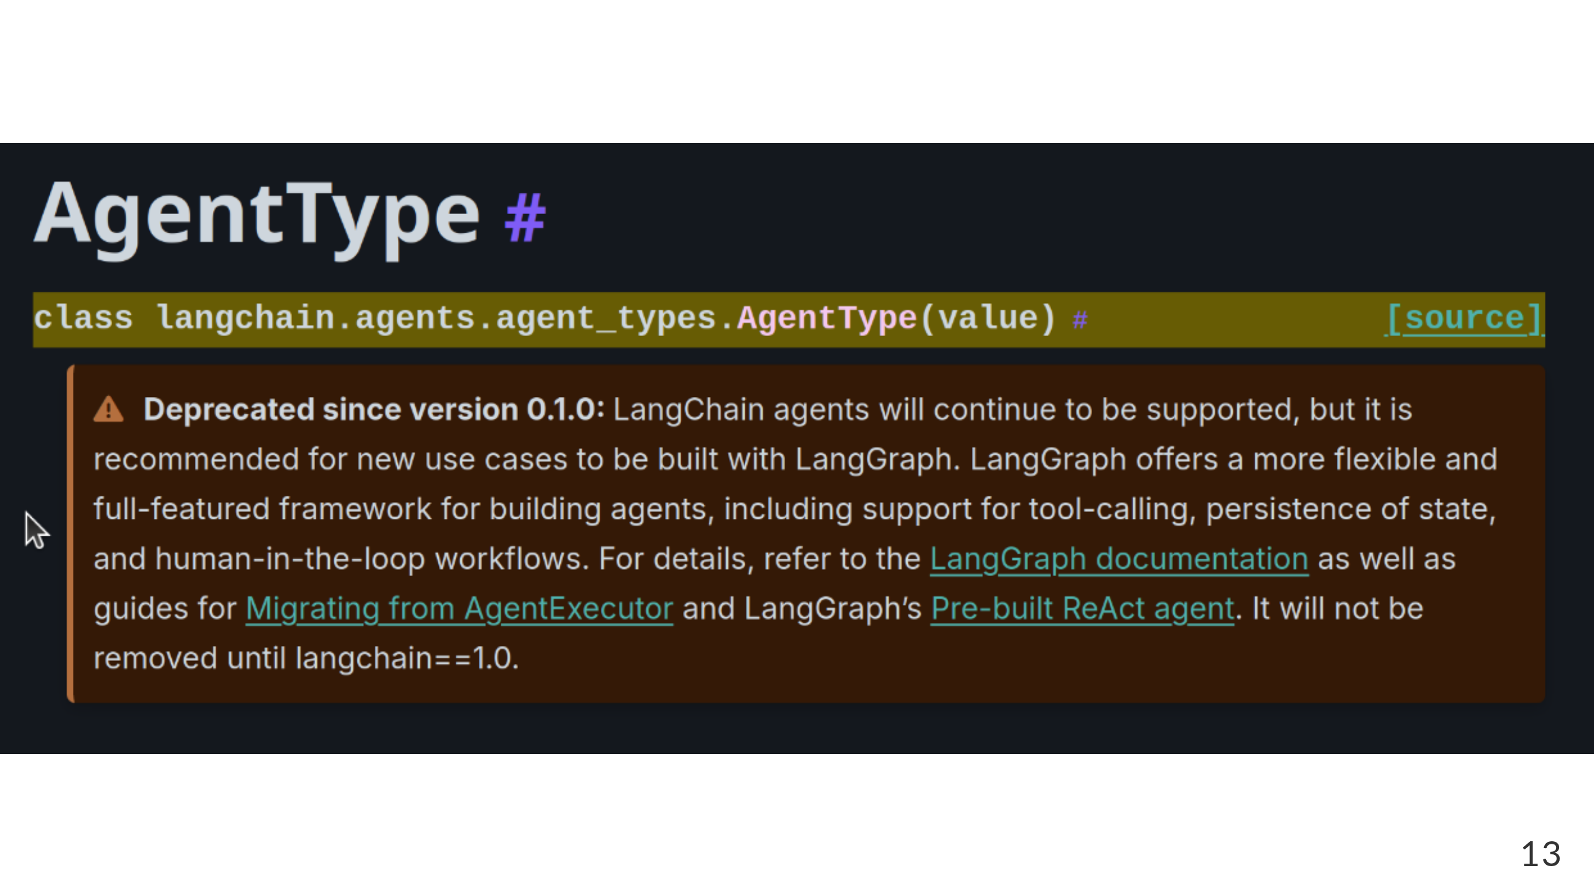

Slide 14
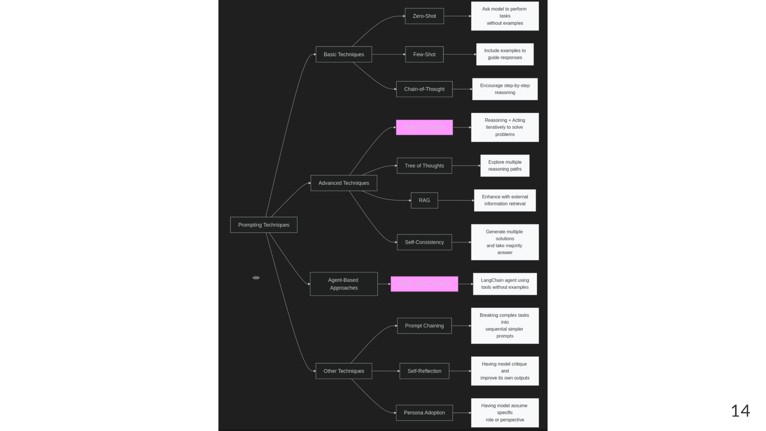

Slide 15
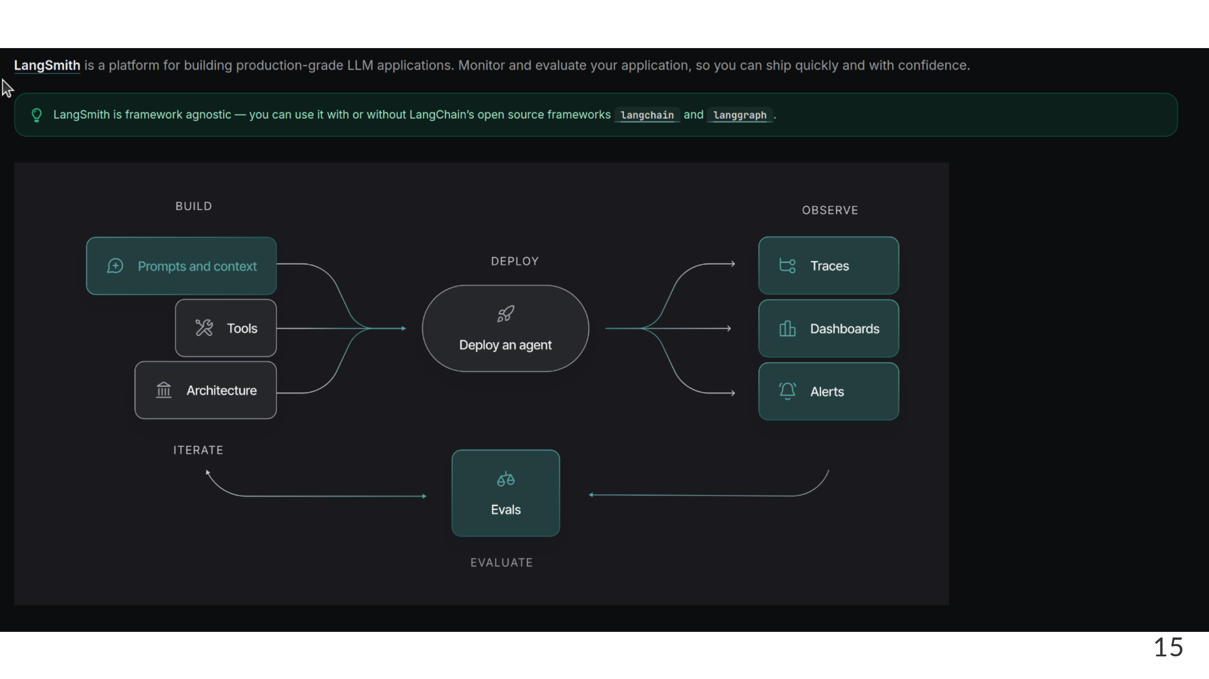

Slide 16
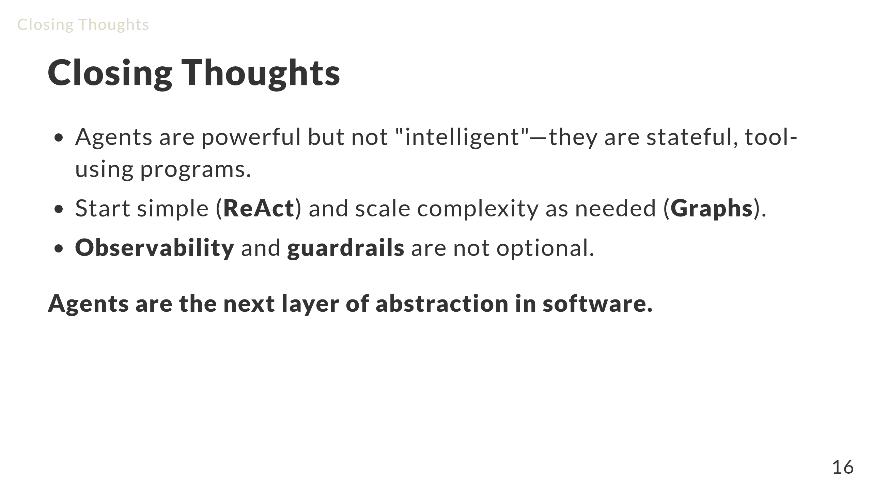

Slide 17
