Slide 1
Visual Artist Marketplace
Showcase of simple microservices app

Slide 2

Main requirements
Online art platform for trading
Using API, we need to be able to trade
At least application should be able to:
Place and order
Cancel an order
View open orders
View completed orders

Slide 3
Proposed solution
FastApi application with Postgresql as a database in the background
Using SQLAlchemy ORM to easly manipulate data
Using Postgresql to persist data in database
Providing notebook with running examples

Slide 4
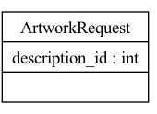
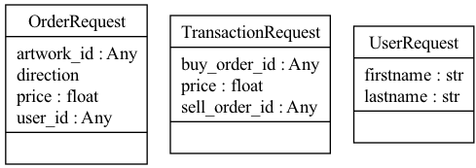
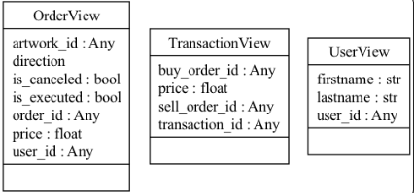
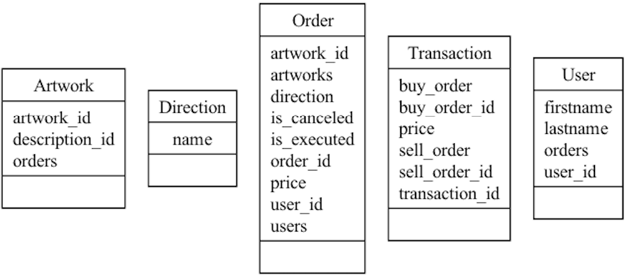
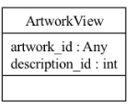
Application architecture
Requests:
DB Models:
Views:

Slide 5
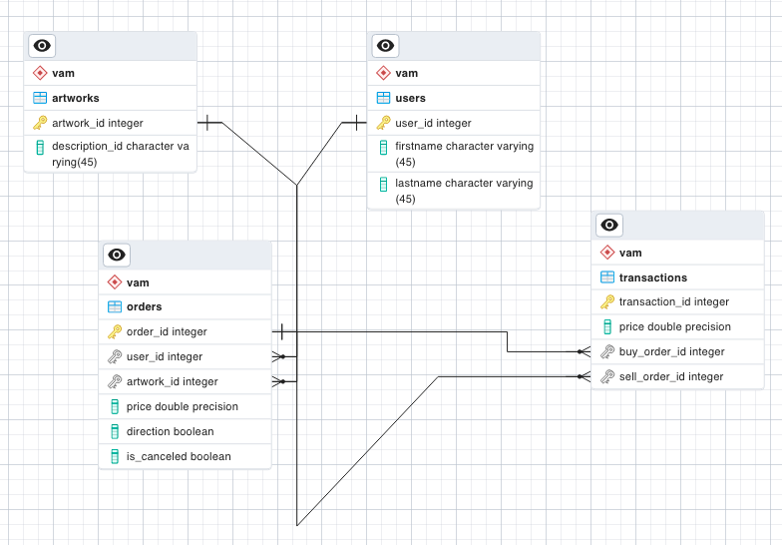
Database architecture

Slide 6
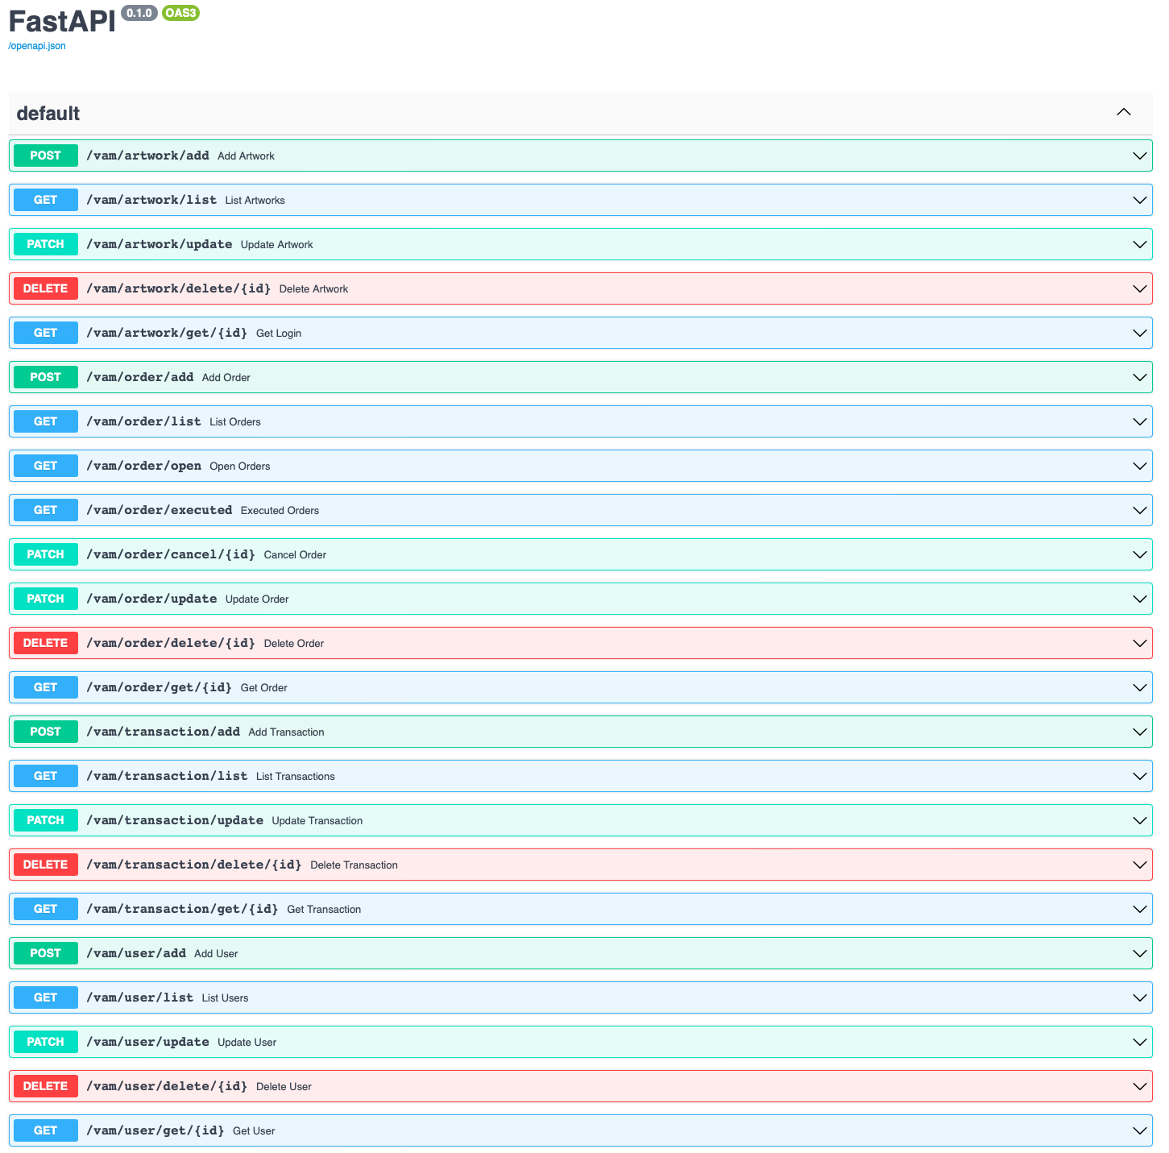
Endpoints and API

Slide 7
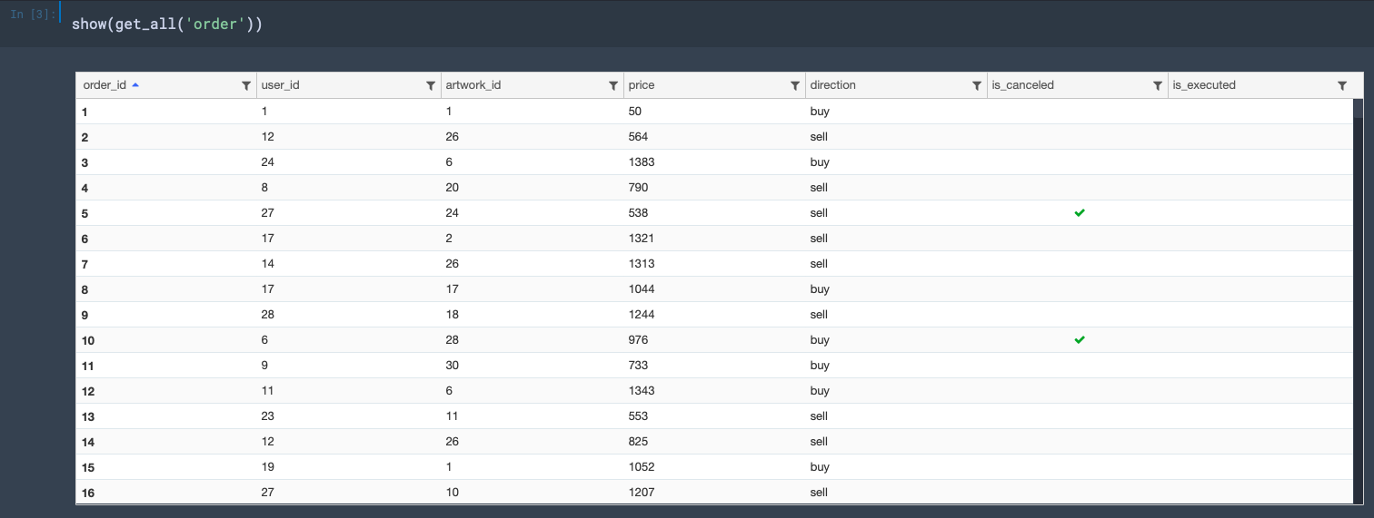
Use cases

Slide 8
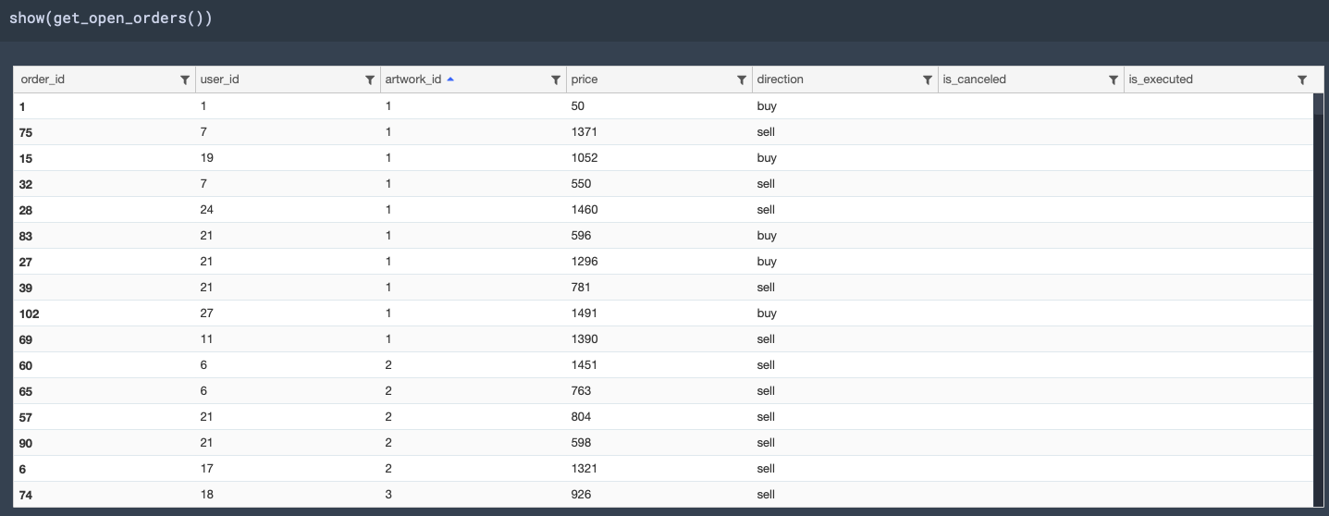
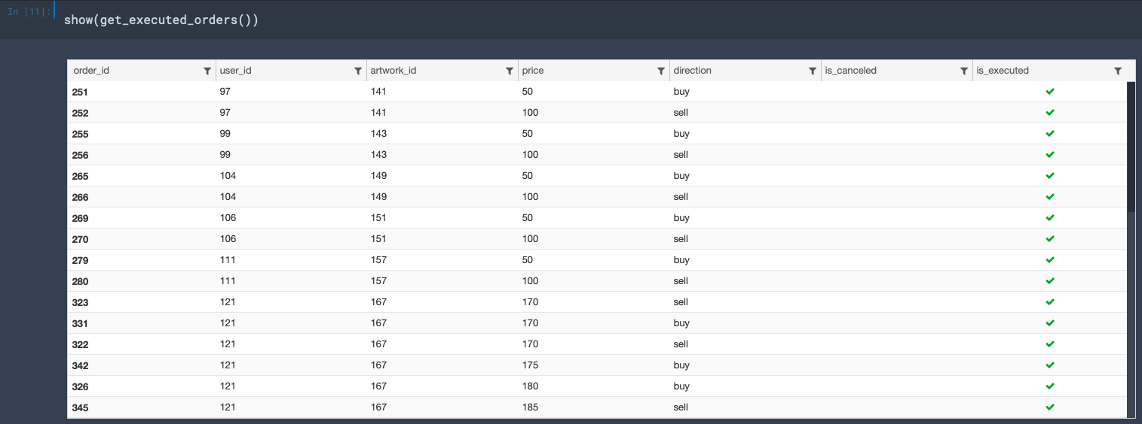
Use cases

Slide 9
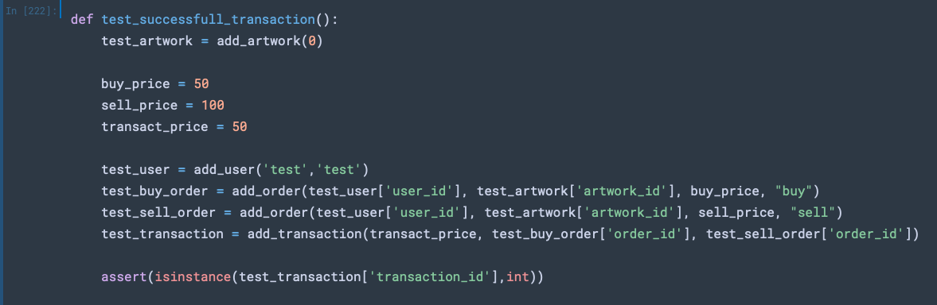
Use cases - tests

Slide 10
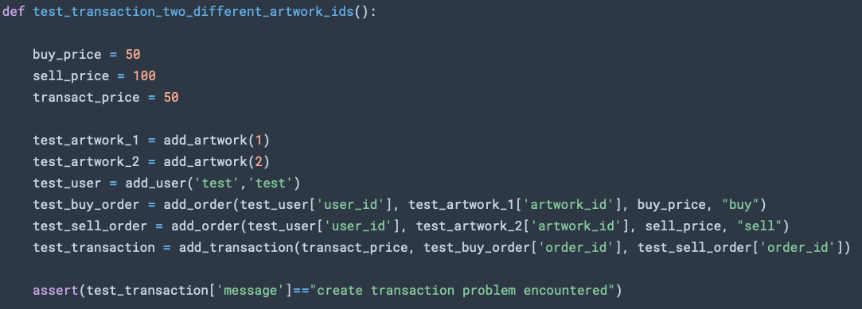
Use cases - tests

Slide 11
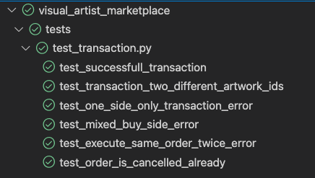
Tests

Slide 12
What needs to be corrected
Repository layer separated from DB
Tests operating on different database
IOC pattern, Injection of repository and applying to to tests as well
Correct HTTP responses
Advanced logging

Slide 13
Future expansion
Dockerization
User interface
Stress testing and optimalisation
Authentication

