Slide 1



Creation of an application for generating Wikidata triples for entities
Felipe Mateus Falcão Barreto
Najib Mounsif
Taha Ramdan

Slide 2
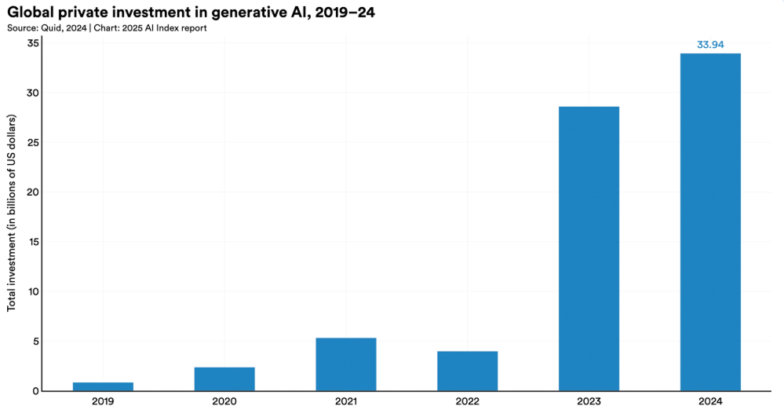
Context
Triple extraction is essential in NLP
Entity disambiguation depends on these relationships
Wikidata offers structured knowledge on a large scale
Lack of automated tool for triple extraction and ranking

Slide 3

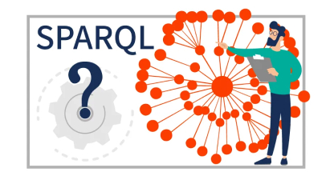
Pipeline
CSV file with named entities
Executes triples extraction with saved file
Query Wikidata, ranks results and generate graph
Store ids, labels and query data
3065 queries in dataset base (723kb of data)
Input: Title, entities ids, entities labels
Output: Triples and knowledge graph
Stack: Angular, Scikit-learn, FastAPI, SQLite and SPARQL

Slide 4
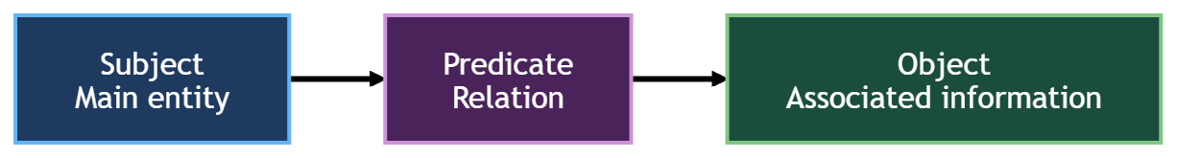

Knowledge Triplet Extraction
entities | queries | query_results
qid | id | triple
label | title | query_id
Reading the CSV file
Entity linking to obtain IDs
Querying triples via Wikidata SPARQL
Filtering only valid triples
Extracting unique IDs from triples and obtaning labels
Inserting entities, predicates, and triples into the database
top_n
subject_qid
score
Example :
Q2 — P31 — Q3504248.

Slide 5
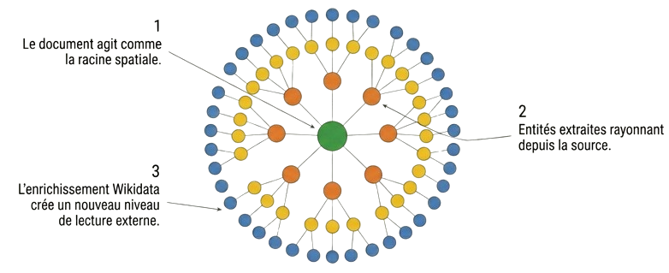
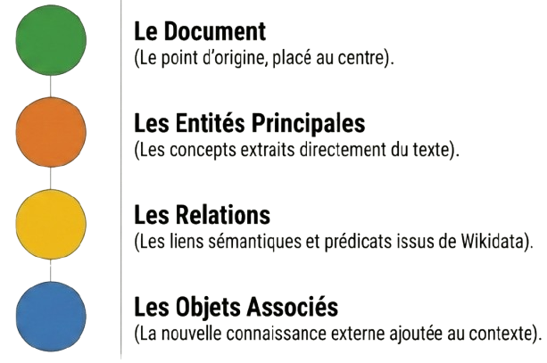
Construction of the knowledge graph
The document acts as the central root.
Extracted entities spread out from the source.
Wikidata enrichment adds external knowledge.
Document
Central point of the graph.
Main Entities
Concepts extracted from the text.
Relations
Links retrieved from Wikidata.
Associated Objects
Knowledge added to the context.

Slide 6
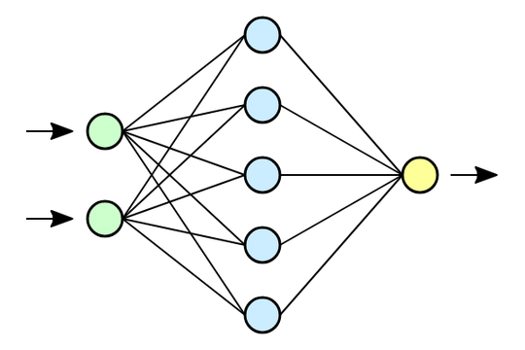
Ranking triplets
QIDs convertion to standard Wikidata format
Triples search in the database or Wikidata
Empty and invalid triples filter
Generates semantic embeddings with bi-encoder and predicate weight
Combination of multiple score
Triples ranking and graph generation

Slide 7
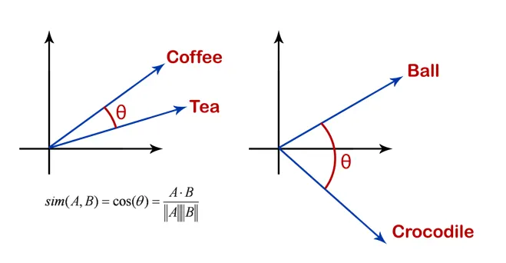
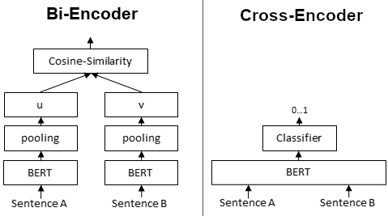
Models used
Cosine similarity: Similarity of embeddings between title and triplet using cosines
Cross-encoder: Analyzes the relationship between title and triplet using a shared encoder and transformers
Entity Score: Applies cosine similarity between title and entities
score = 0.45 * cosine_score + 0.35 * cross_scores + 0.20 * entity_scores

Slide 8

Conclusion
Results
Structuring knowledge through graphs and ranking triplets.
Hypotheses
Automating triples in Wikidata improves the extraction of structured knowledge.
Limitations
High dependence on the quality of external requests via SPARQL to Wikidata.
Perspectives
Optimization for large volumes of data with diverse models.
Personal improvement
Study of embedding techniques, transformers, and SPARQL requests.

