Slide 1
Ex0
XOR

Slide 2
Ex1
Adding, multiplication

Slide 3
Adding numbers
Input vs GT output vs NN output example:
X1: [0, 0, 0]
X2: [1, 0, 0]
Y: [0, 1, 0, 0]
Y_pred: ['0.00', '0.99', '0.00', '0.10']

Slide 4
Adding numbers
Dataset generation:
Traning dataset – all „m” bit number pairs generation
Test dataset – all „n” (n>m) without numbers in train ds.
Additional part „k” of test ds is moved to train ds. (network have to know what all inputs/outputs are doing)

Slide 5
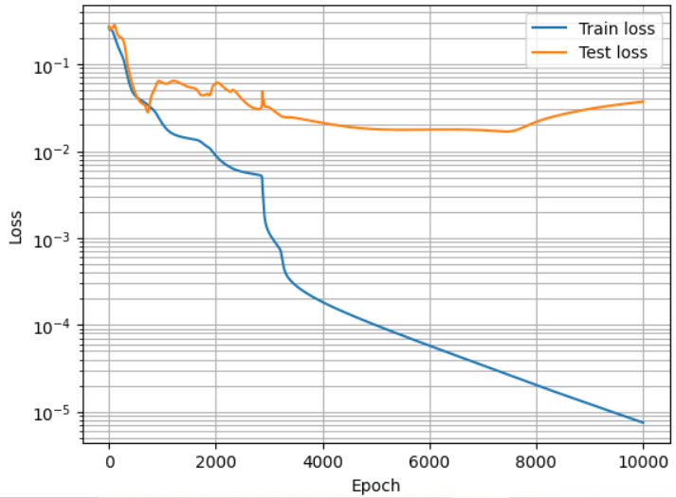
Adding numbers
n = 3
m = 2
k = 0.8
rozmiar ds train = 54
rozmiar ds test = 10

Slide 6
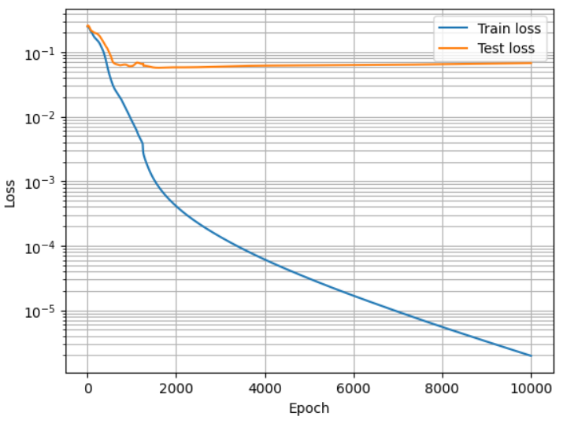
Adding numbers
n = 4
m = 2
k = 0.5
rozmiar ds train = 136
rozmiar ds test = 120

Slide 7
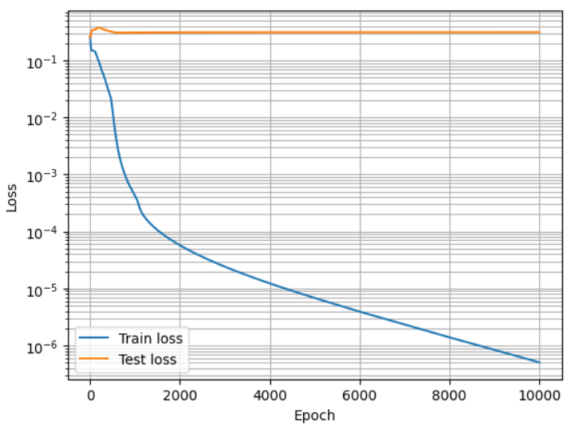
Adding numbers
n = 4
m = 2
k = 0.0
rozmiar ds train = 16
rozmiar ds test = 240
When loss ~0.3 NN misses 30% of bits, spits out wrong number most of the time

Slide 8
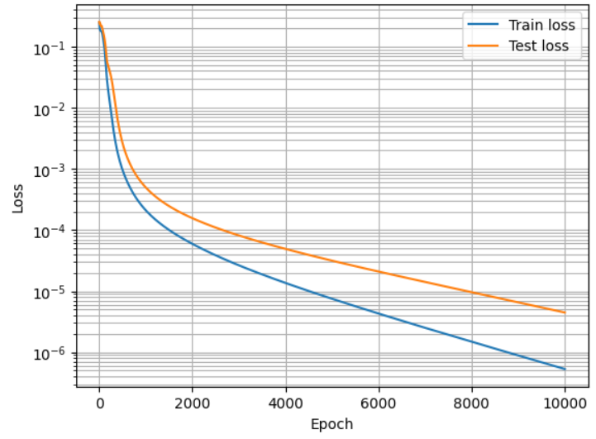
Multiplication by 2
n = 4
m = 2
k = 0.1
rozmiar ds train = 40
rozmiar ds test = 216
As this is just bitshift, NN easly generalizes when gets small sample of test ds

Slide 9
Ex2
Function approximation and expressivity

Slide 10
Parameter count
Shallow network params: (2w)+(w+1)
Deep network params: (2w)+(w+1)*w+(w+1)*w+w+1
w=4 -> Shallow params: 13, Deep params: 53
shallow_widths = [4, 8, 16, 32, 64, 128]
deep_widths = [1, 2, 4, 6, 9, 12]
shallow_params = [ 13 25 49 97 193 385]
deep_params =[ 8 19 53 103 208 349]

Slide 11
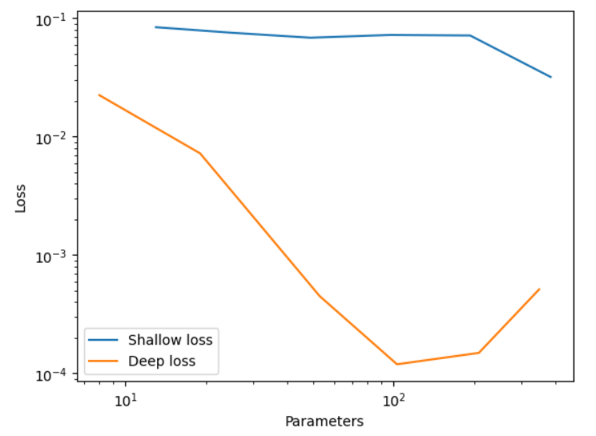
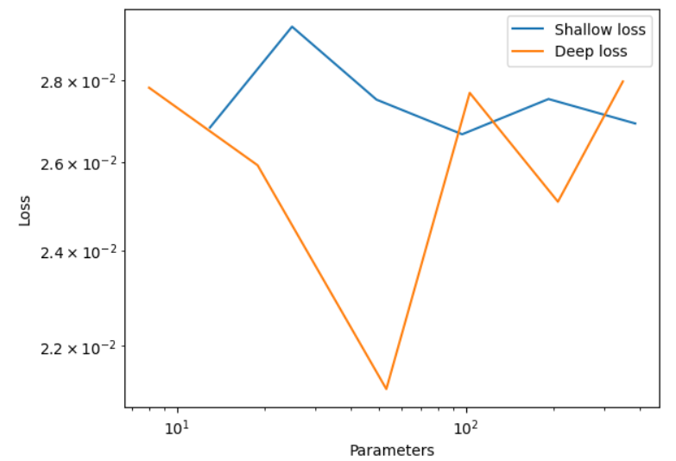
Results
50k epochs, SGD training with 0.5 lr
5k epochs, SGD training with 0.5 lr

