Slide 1
STEP Session 1
Epistemology, Learning Pedagogy, and Problem Solving
By Joseph Loy

Slide 2
The big picture
All knowledge is conjectural (an educated guess). The best theories (like the theory of evolution, theory of computation, quantum theory, etc) are constructed so that they make specific guesses/descriptions of something that can either be right or wrong (ie falsifiable) and are not easy to vary. The game of science is a never ending game in which we search for more accurate descriptions of the phenomena we can see around us.
An effective learning pedagogy (system of learning) involves creating blocks of time to focus on difficult problems and reviewing past concepts to maintain fluency with older topics.
Systematic approaches are easier to troubleshoot / error correct than unorganized appraoches. By dividing the problem solving process into multiple stages and emphasizing critical thinking about what is going on in each step, students can get an idea of how to proceed under uncertainty and how to ask specific questions to address misunderstandings with a problem.

Slide 3
Definitions
Epistemology: The theory of knowledge; the reasoning behind how we know something is true or false.
Pedagogy: A way of doing things
Systematic: An approach that follows a series of steps to a conclusion that is intended to work roughly the same way each time
Empiricism: Understanding things through experimentation and observation
Rationalism: Understanding things using reason and first principles thinking
Demarcation: The line that separates objects into one distinct group or another; a criteria used to classify objects into different groups
Induction: A form of reasoning that asserts that because things were observed a certain way in the past, they will continue to be observed the same way in the future.
Ad hoc: Something improvised in the moment for a specific purpose
Dogmatism: Sticking to a set of beliefs no matter what

Slide 4
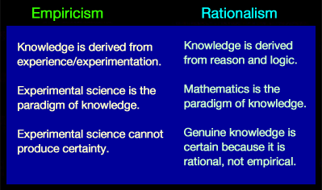
Epistemology
Empiricism + Rationalism = Science
Problems with empiricism
Induction – do things continue to work the same way because they always worked that way in the past?
Black Swans
Problems with rationalism
Spinning webs of confusion – ideas that make lots of sense ”in theory” may be flat out false in the real world
Descartes’ Demon

Slide 5
Epistemology
Why falsification?
Explanations that are falsifiable are easier to error correct.
Explanations that are falsifiable are harder to vary / change to fit the circumstances
Why verification?
Verifiable theories are interesting because they can be used to model things we care about
Falsification vs Verification
Falsification is more powerful than verification – one false observation invalidates a theory, no amount of verifications “confirms” a theory.
Einstein’s Theory of Relativity is a better explanation than Newton’s Laws of motions because it describes everything that Newton’s theory does AND describes how very fast and very large objects move (which Newton’s Theory does not).
Einstein’s Theory is a good explanation because it’s difficult for people to find counterexamples where it is wrong, and there is no theory that explains everything that Einstein’s does plus the things that Einstein’s theory cannot predict (like the behavior of extremely small objects).

Slide 6
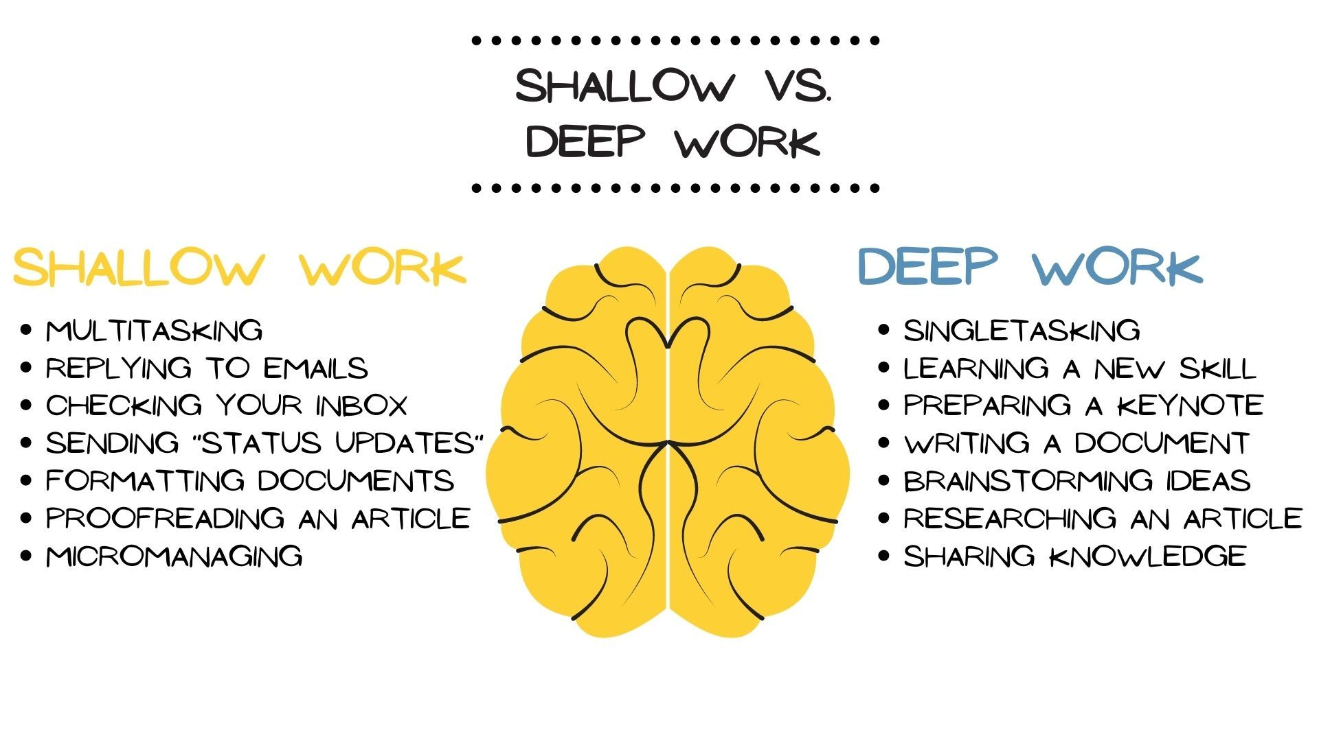
Learning Pedagogy – Deep Work
Your mind is not a multi-core CPU – focus on one thing at a time
Difficult problems require focused thinking and minimal distractions
Smaller tasks that can be started and stopped easily can be multi-tasked
Don’t beat your head against a wall – if you cant figure out a problem by the end of a work block, ask for help or come back to it later with a fresh mind

Slide 7
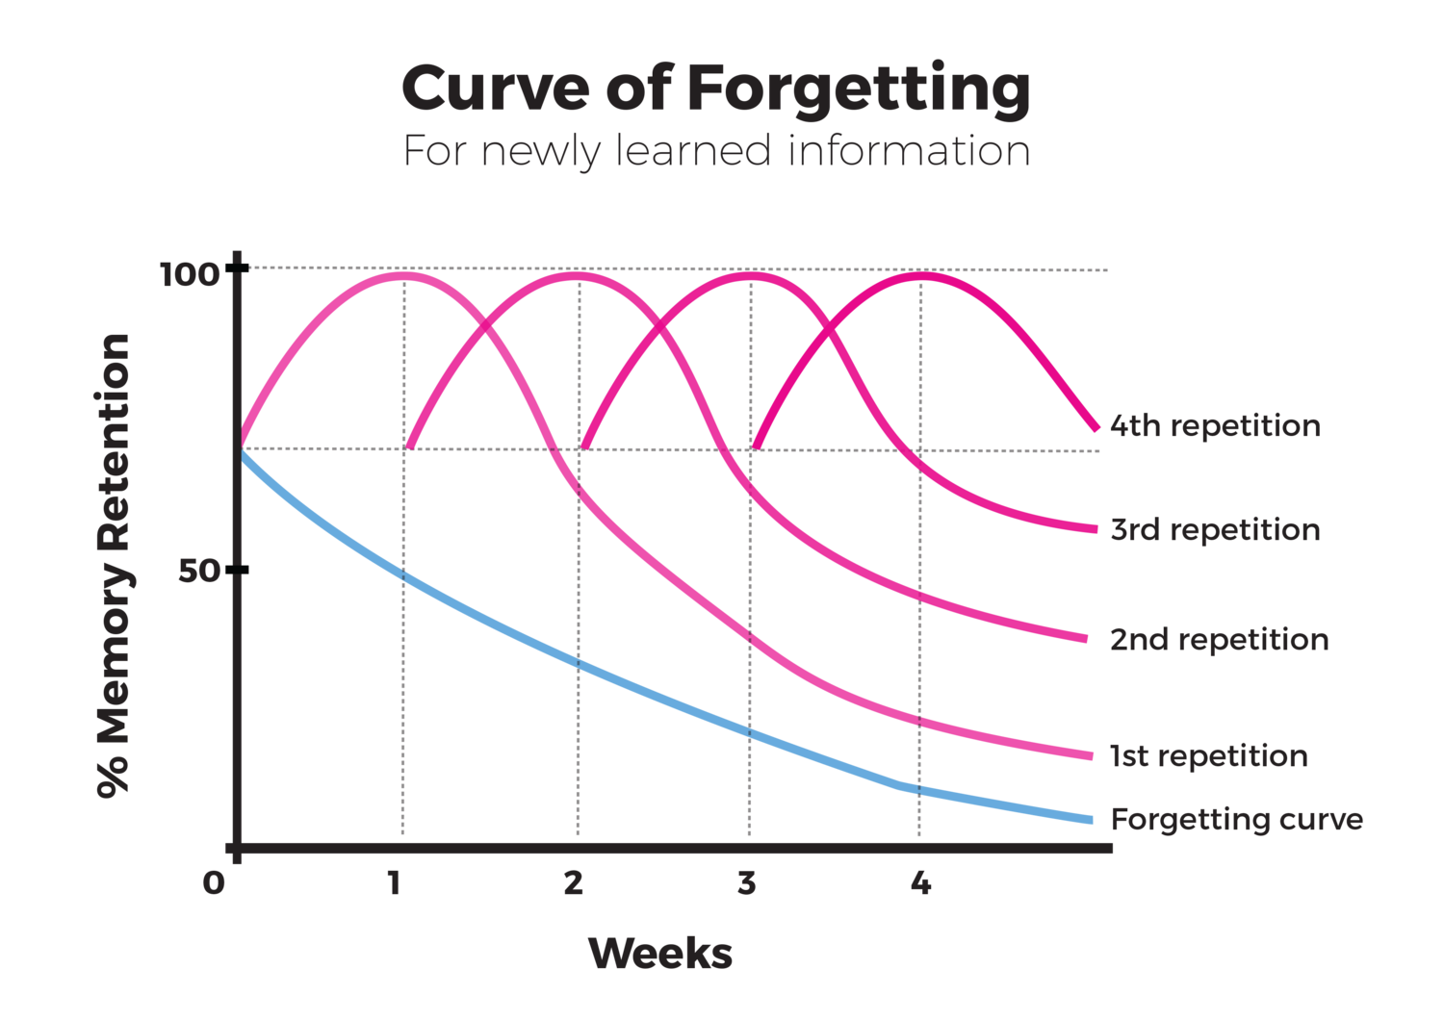
Learning Pedagogy – Spatial Repetition
Habitual practice solidifies ability
Allocate most of your time learning new things, but allocate some time to review old topics (particularly fundamentals that are needed for more advanced concepts)
Focus/prioritize review on concepts that you struggle the most with
Learning is iterative – it’s okay if you don’t get it at first. Keep practicing and over time it will make more sense.

Slide 8
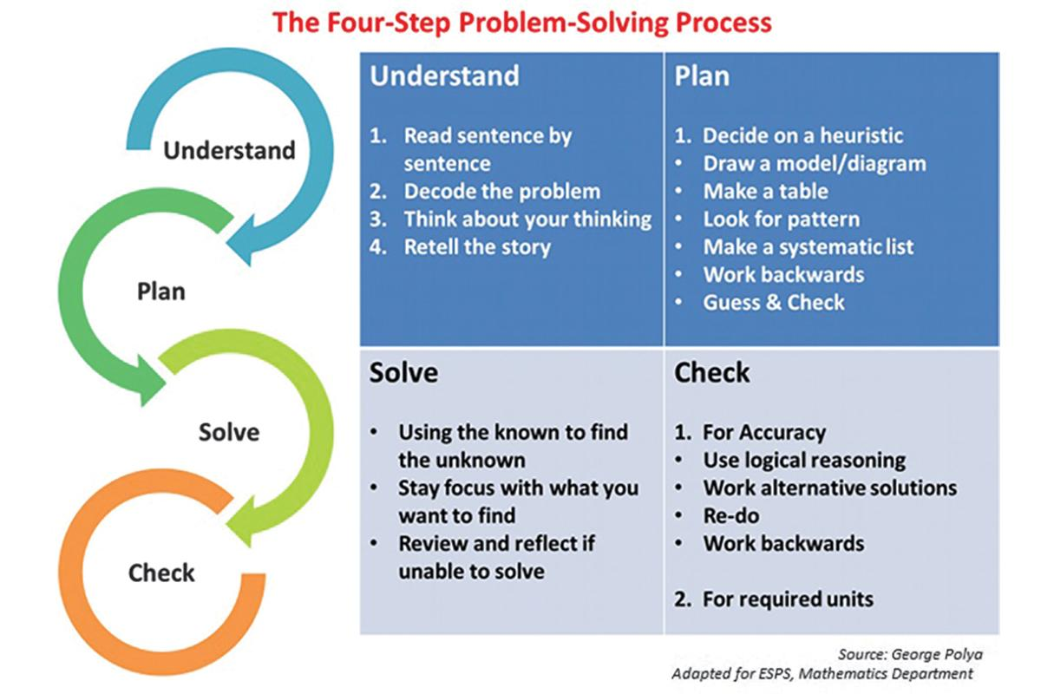
Problem Solving
There is no algorithm to solve ALL difficult problems – at the end of the day, you have to create your own style
Systematic approaches help both you and your teacher understand what part of a problem you are struggling with and how to address that specific problem
The key to getting meaningful help is to ask specific problems. The more you critically think about a problem and identify with maximal specificity what you are struggling with, the easier it is for a teacher to provide help
Systematic approaches are easier to remember and encourage an “organized understanding” as opposed to a “bag of tricks / muscle memory” approach.

