Slide 1
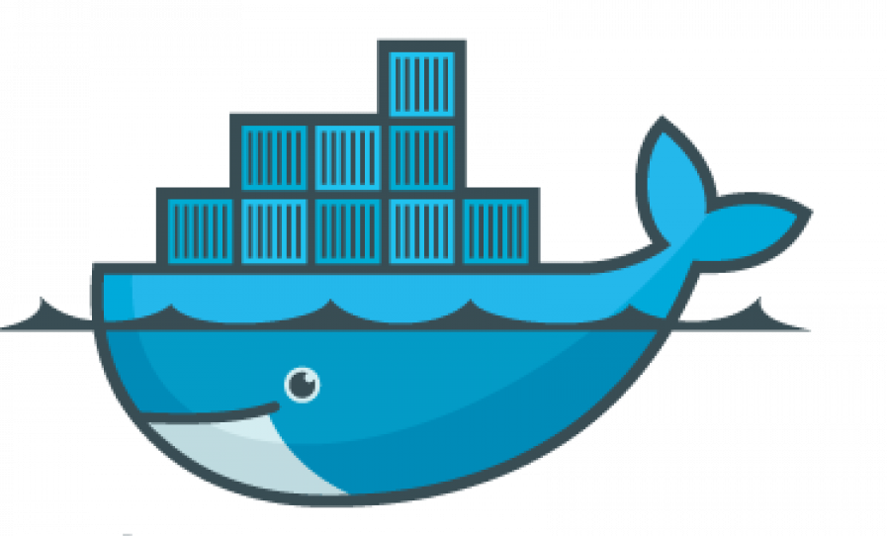
Docker Web Application Deployment
Joanne Yong, Zion Castillo

Slide 2
What is Docker?
Docker is an open platform that allows users to develop, ship/deploy, and test software without concern for infrastructure.
Docker utilizes containers that enable developers to create images of their software applications that can run on any platform.
Docker is particularly useful for CI/CD workflows, in which developers can make changes to their local software source code and then share it with their team.
The code can then be deployed to a test environment for testing.
  If bugs are discovered, the developer can simply update their local source code and re-push.
  When the test environment is ready to go, simply push the updated docker image to the production environment.

Slide 3
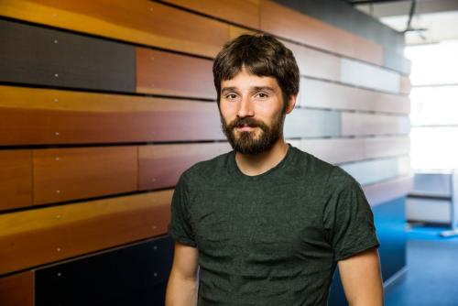


History of Docker
Docker was initially released on March 20, 2013.
Docker Inc., the company that runs Docker, was founded in 2010 by Kamel Founadi, Solomon Hykes, and Sebastien Pahl and launched in 2011.
    Hykes was the original creator of the Docker project as an internal project within dotCloud, a PAAS company (Platform as a service).
Hykes
Founadi
Pahl

Slide 4







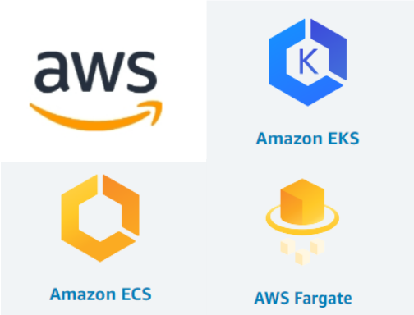

What Is It Used For?
Companies Using Docker
Microservice architecture, multiple containers running separate process
CI/CD pipelines, code deployment, testing and development
Simplifying Configurations For collaborative work
Creating scalable systems with container orchestration software like Kubernetes.

Slide 5
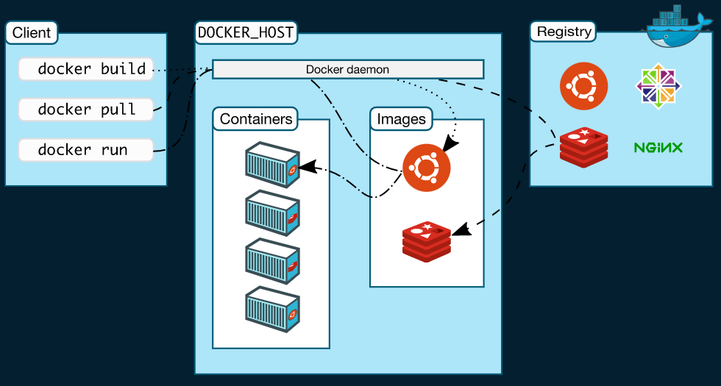
How Does Docker Work?
Client server
Docker CLI
Docker Daemon
Docker Registry
Docker Image
Docker Container

Slide 6
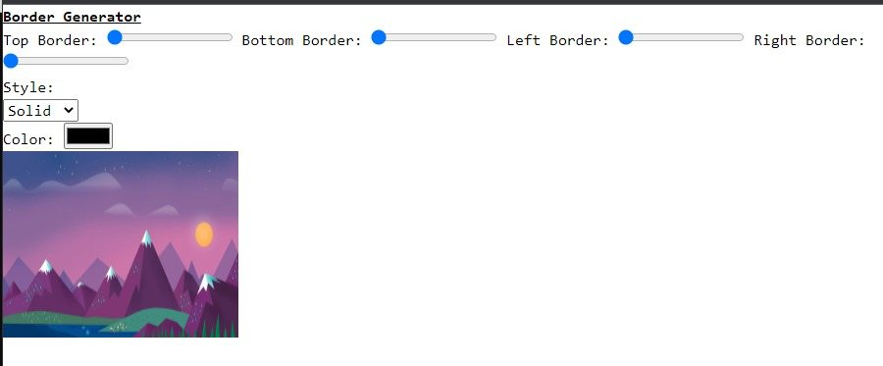



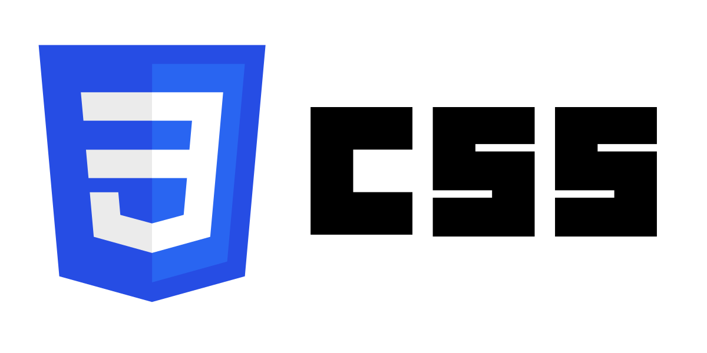

Our Web App and its Docker Usage
HTML: Frontend
CSS: Styling
GO: Server Connection
MAVO: Functionality & Interactivity
DOCKER: Deploy Web Application

Slide 7
APP DEMO

Slide 8
Conclusion
Joanne’s Challenges & Learning Outcomes
Zion’s Challenges & Learning Outcomes
Challenges:
  Deciding which programming language to create the web app in (which language would be the easiest to adapt to Docker).
  Attempt of learning Docker using the Desktop application before learning it in the terminal/CLI.
Learning Outcomes
  Realization of the variety of PLs that Docker accommodates for.
Challenges:
  Complications with running some of the Docker scripts (some gave unknown errors, some gave DB based errors)
  Attempt of learning Docker using the Desktop application and also in the terminal/CLI.
Learning Outcomes
  Realization of the usefulness of documentation.
  Learnt how to run work with Docker on multiplatforms. (Windows, Linux)

Slide 9
References
Docker. (n.d.). Developer use cases. Retrieved November 28, 2022, from https://www.docker.com/use-cases.
Docker Documentation. (2021, November 19). Docker Overview. Retrieved November 28, 2022, from https://docs.docker.com/get-started/overview/.
IBM Cloud Education. (n.d.). What is Docker? Retrieved November 28, 2022, from https://www.ibm.com/cloud/learn/docker.
Person. (2021, November 19). Who's using Docker? Contino: Global transformation consultancy. Retrieved November 28, 2022, from https://www.contino.io/insights/whos-using-docker.

