Slide 1
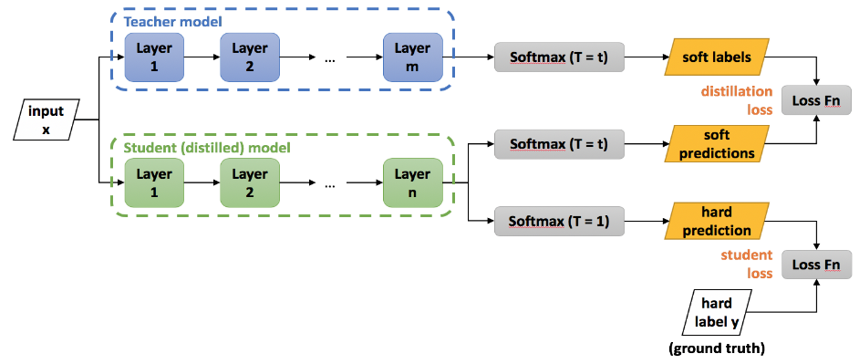
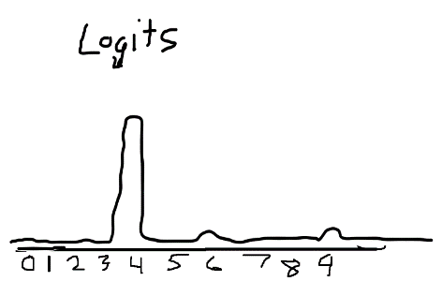
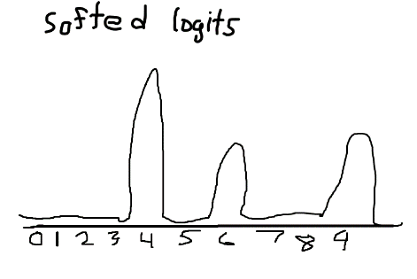
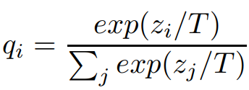
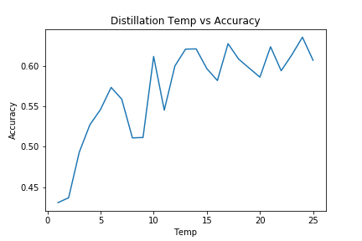
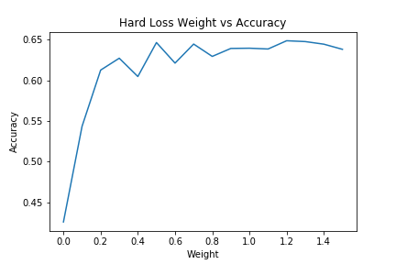
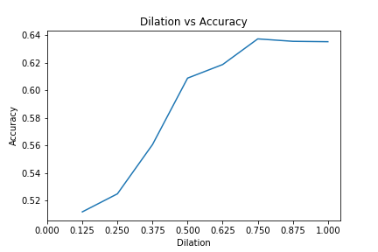
Increasing Neural Network Efficiency via Knowledge Distillation
Zion Steiner
Abstract
Methodology
Research on state-of-the-art neural network techniques continues to yield advances in accuracy and other performance metrics. As these models reach higher levels of performance, the room for further improvement decreases. Due to this trend and the nature of decreasing returns to scale, exponential increases in the costs of developing these networks are accompanied by marginal increases in performance. To account for this trend, the machine learning research community needs to place higher priority on advances in neural network efficiency. This research explores the hyperparameters of a technique that has shown some success in improving the time and space complexity of neural networks: knowledge distillation. Knowledge distillation is the training of a small neural network to match the probability distributions produced by the inference of large neural network, which can be used to increase the accuracy of the smaller network compared to the same model’s accuracy from a normal training schedule.
Train larger teacher CNN on CIFAR10 image dataset
Remove softmax from teacher
Collect outputs of penultimate dense layer (logits)
Train smaller student CNN using loss function combining logit cross-entropy and label cross-entropy
Conclusion
Future Work
Repea
[1]
Fig 1. Distillation is the process of transferring knowledge from one model to another.
References
[1] Schwartz, Roy, Jesse, Smith, Noah, Etzioni, Oren, and Dodge, “Green AI,” arXiv.org, 13-Aug-2019. [Online]. Available: https://arxiv.org/abs/1907.10597. [Accessed: 01-Dec-2019].
[2] https://nervanasystems.github.io/distiller/knowledge_distillation.html. (2019). [image].
Fig 2. The effect of temperature on the inference probability distribution on the MNIST dataset.
Results
Fig 3. Student accuracy vs. distillation temp with a fixed hard loss weight of 0.15
Fig 4. Student accuracy vs. distillation hard loss weight with a fixed temperature of 10
Fig 5. Student accuracy vs. student dilation factor (compared to teacher)

