Slide 1


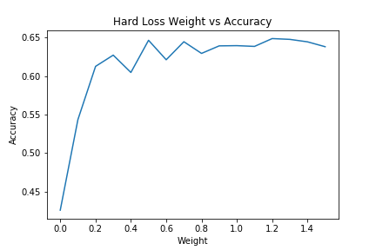
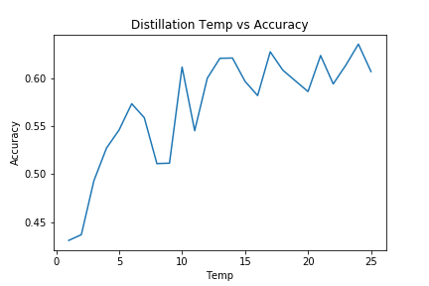
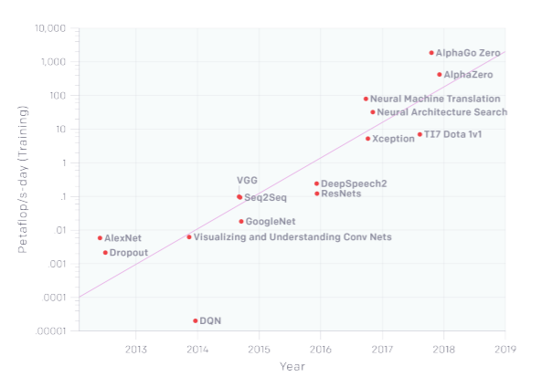
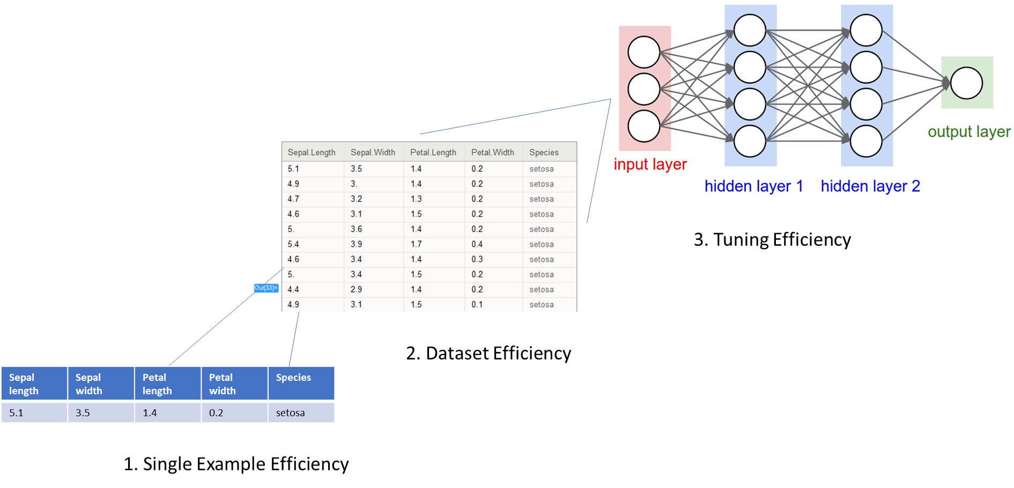
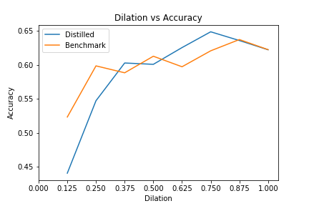
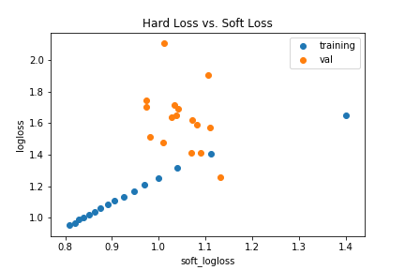
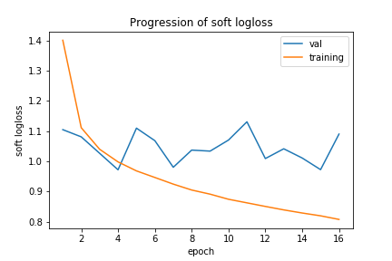
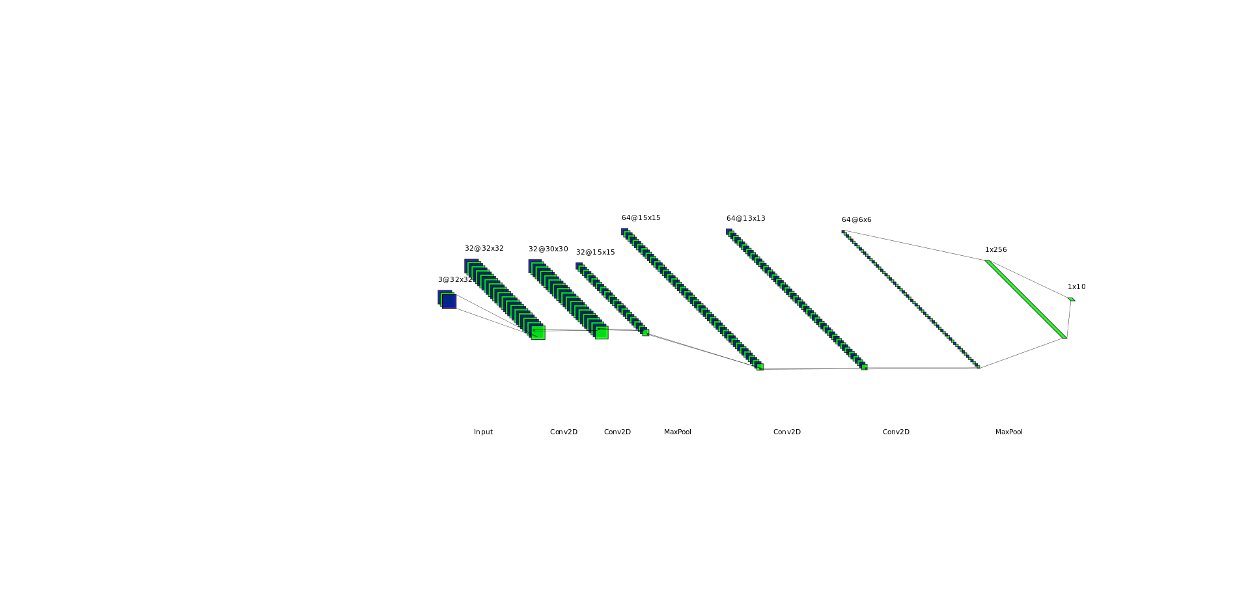
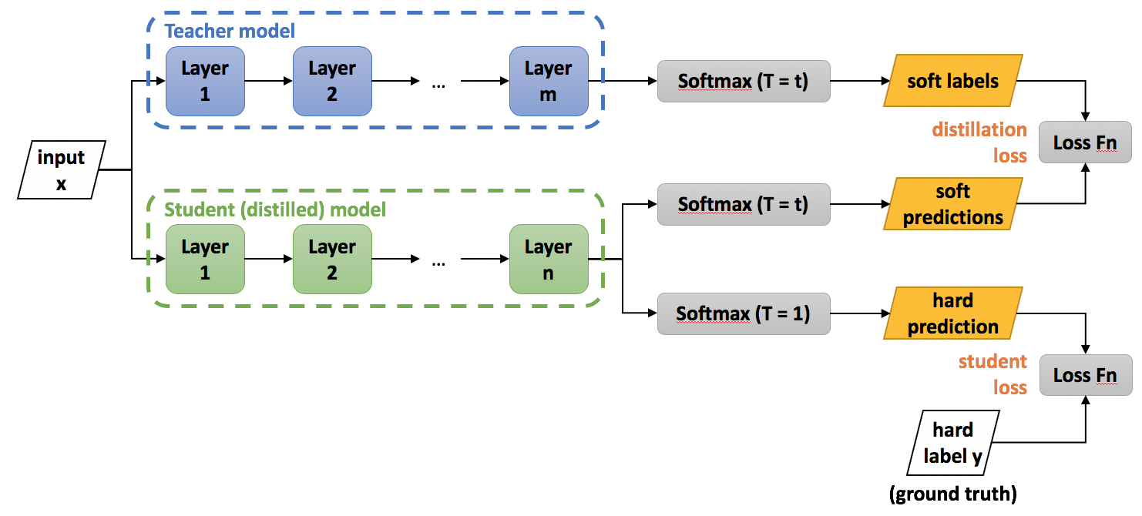
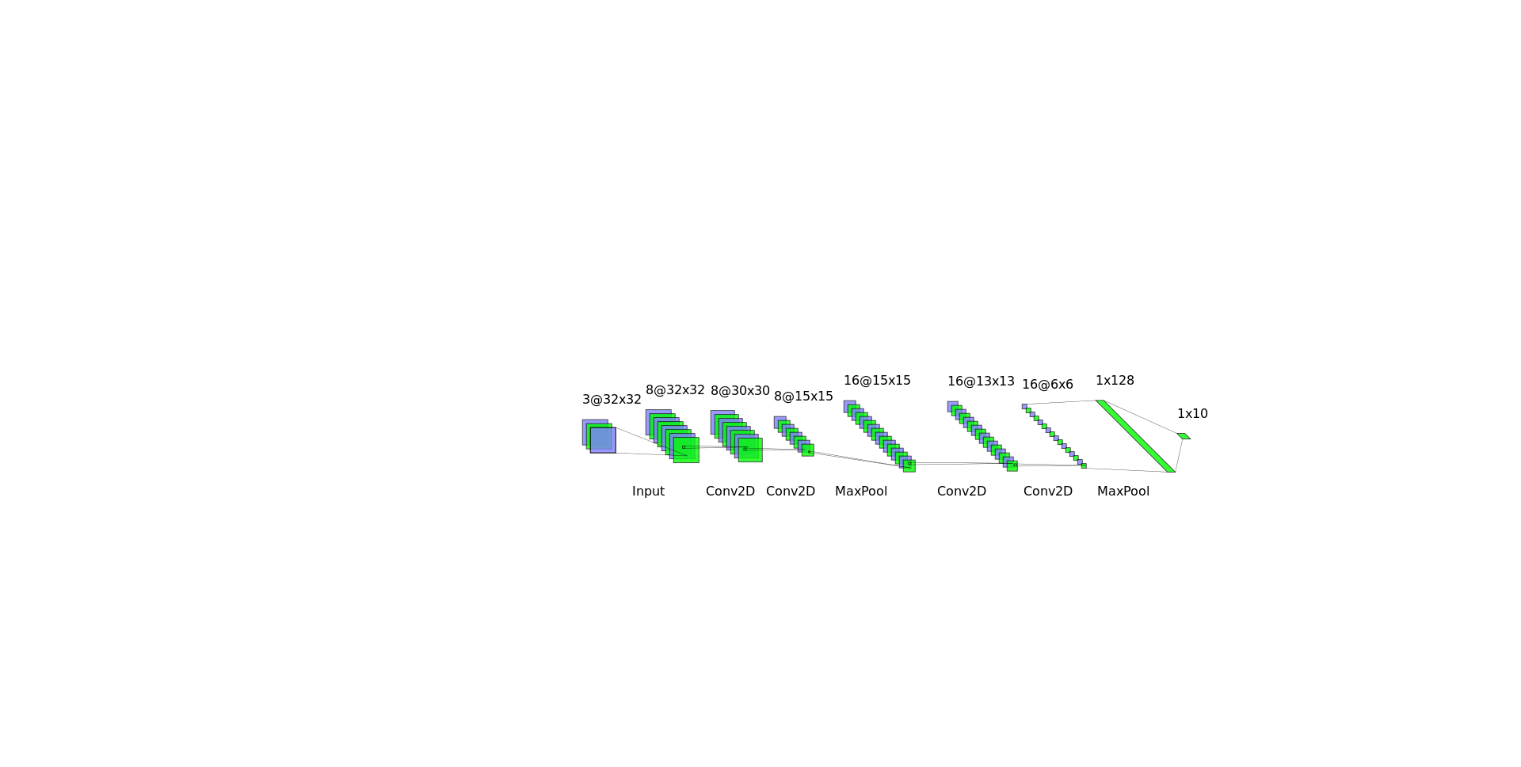
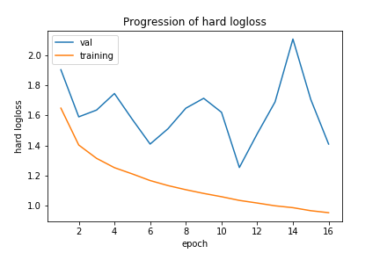
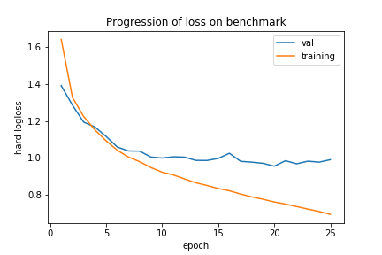
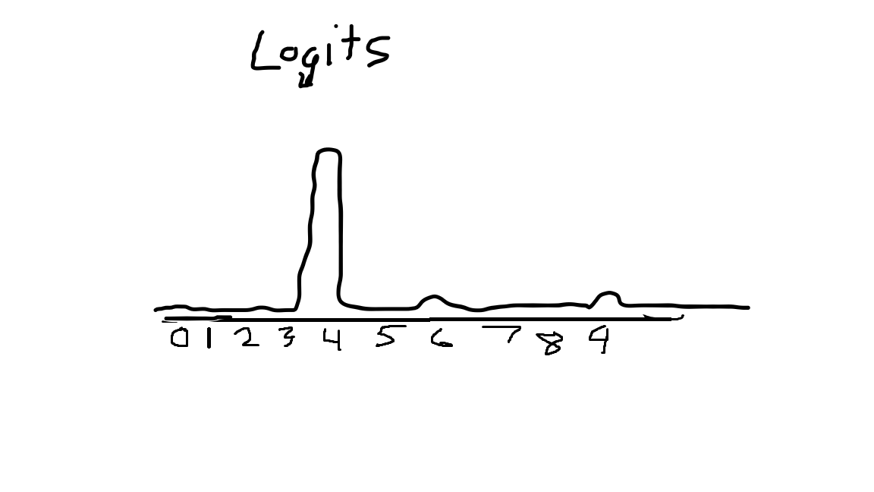
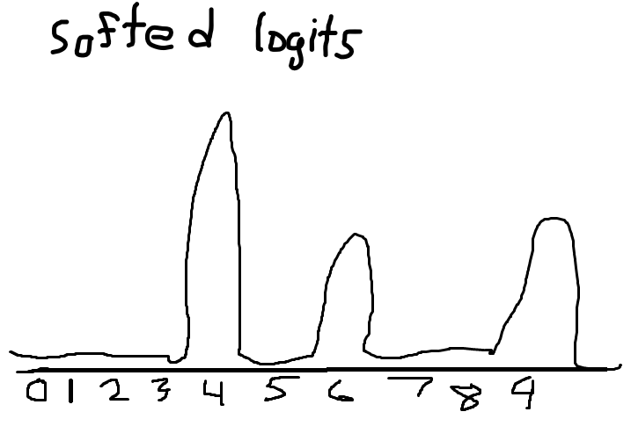
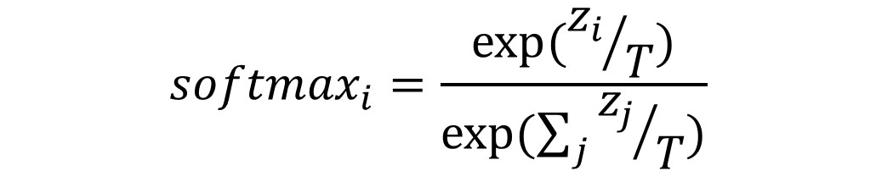
Increasing the efficiency of neural network inference via distillation
Zion Steiner
Machine Intelligence in Clean Energy ----- Fall 2019
Abstract
Results
Summary
Knowledge distillation is the process of transferring the knowledge learned by a large teacher neural network into a smaller student network. This process has been shown to increase the accuracy of the student network as compared to a student architecture not trained using distillation. This project explores the effects of three distillation hyperparameters on inference accuracy: temperature, hard loss weight, and student dilation.
The graphs below show how accuracy is affected by different levels of temperature and hard loss weight applied during the distillation process.
Although distillation works in principle, it was not found to be a reliable method of model compression in this research. Additionally, one would expect the accuracy versus temperature curve to contain a peak, not a plateau. This indicates that training the student on logits hindered training more than aiding it. This is contrary to the findings in [3].
Conclusion
Problem Description
It makes intuitive sense why knowledge distillation should work. However, the distillation process is very dependent upon the correct hyperparameter configuration and teacher/student architecture. For distillation to be a practical method of model compression, a deeper understanding of the relationship between optimal distillation hyperparameters and teacher/student architecture is required.
In recent years, state-of-the-art neural networks have grown to consume large amounts of electricity for training and inference. Electricity production is costly and often carries a large carbon footprint, which creates an incentive to increase the efficiency of developing and operating these networks. This project focuses on improving the efficiency of inference on a single sample by exploring a model compression technique.
Fig 5. Accuracy begins to plateau with higher weights on hard loss. Distillation is more like regular class label training at high hard loss weights.
Fig 6. Accuracy begins to plateau as temperature increases.
Computational Study
Dataset: CIFAR10 (10 32x32 color image categories)
Independent Variables
Temperature: parameter that controls the degree of logit distribution smoothing
Hard loss weight: controls relative contribution of class label loss compared with logit cross-entropy
Dilation: controls the width of the student architecture (number of CNN filters, dense nodes) compared to the teacher architecture
Dependent Variables
Accuracy: overall student inference accuracy on a validation dataset
Soft log loss: categorical cross-entropy from student inference on teacher logits
Hard loss loss: categorical cross-entropy from student inference on class labels
Controls
Student architecture
Training configuration
Dataset
Fig 1. The number of computations required to train state-of-the-art models has grown by ~300,000x in 6 years [1].
Fig 2. The three general areas for improvements in efficiency
Fig 7. A distilled student has the potential to have higher accuracy than a normally trained model, but this is not guaranteed.
Fig 8. Hard and softloss decrease proportionally in training, but no such relationship is found in validation data.
Method
Distillation
Train teacher network
Collect logits from inference
Smooth logit distribution with temperature
Train student on dual-loss function
$$loss=logloss\left(logits\right) + α∗logloss\left(predictions\right)$$
Fig 3. Distillation is done by training a student to approximate the inference probability distribution of a teacher [2].
Temperature
Fig 10. Teacher model CNN architecture
Smoothing the logit distribution accentuates generalizations learned by the teacher. Assuming handwritten 4s sometimes look like 9s, the figure below shows how smoothing affects inference probability distributions.
Fig 11. Student model CNN architecture
$${softmax}_{i}=\frac{exp⁡({z_{i}}/T)}{exp⁡(\sum_{j}{{z_{j}}/T)}}$$
References
[1] Schwartz, Roy, Jesse, Smith, Noah, Etzioni, Oren, and Dodge, “Green AI,” arXiv.org, 13-Aug-2019. [Online]. Available: https://arxiv.org/abs/1907.10597. [Accessed: 04-Dec-2019].
[2] Process of knowledge distillation. [Online]. Available: https://nervanasystems.github.io/distiller/index.html. [Accessed: 04- Dec-2019]
[3] Hinton, Geoffrey, Dean, Jeff, and Oriol, “Distilling the Knowledge in a Neural Network,” arXiv.org, 09-Mar-2015. [Online]. Available: https://arxiv.org/abs/1503.02531. [Accessed: 05-Dec-2019].
Fig 9. There is high variance among validation hard and soft loss values compared to training data. The bottom graph shows the progression of loss on a regularly trained student.
Fig 4. Example effect of temperature on logit distribution from inference on MNIST

